Slide 1



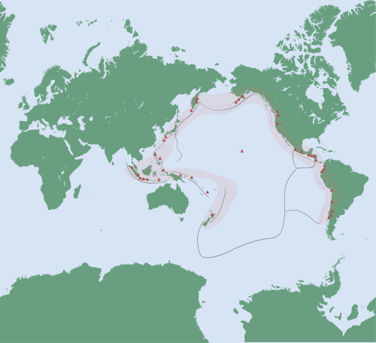


Investigating CO2 Emissions
Ethan Turner
December 6, 2024

Slide 2
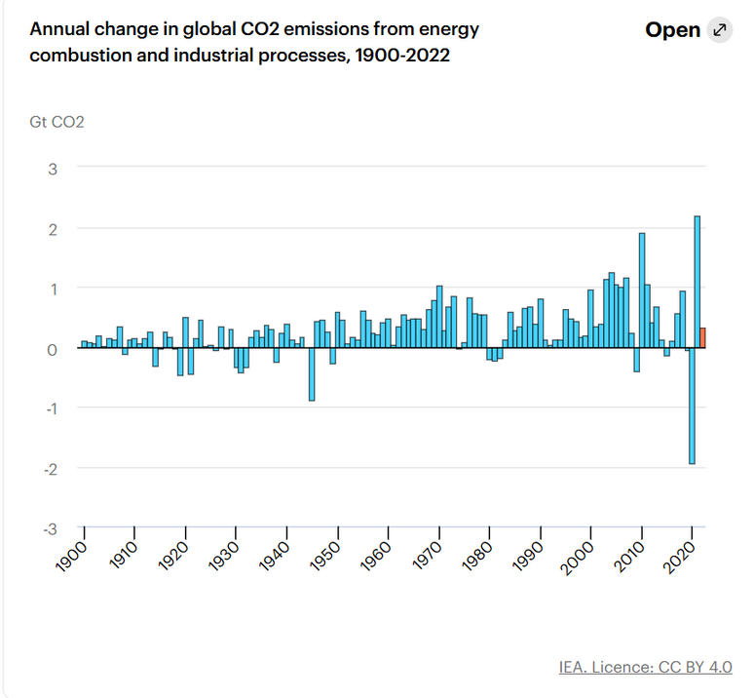
Introduction
  Why is CO2 important?
    Most prominent greenhouse gas
    Global warming and ocean acidification
  Atmospheric levels increasing exponentially
IEA, 2023

Slide 3


Current Status
  Climate records being broken
  Focus on stabilization rather than reversing damage
    Many nations have set net-zero goals
    Innovative technologies such as carbon capture
WXXI, 2023

Slide 4


Disagreements
  Devolution of international efforts into finger-pointing
    USA-China rivalry
    False equivalences?
  Difficulty in establishing reasonable national targets
NOWTHIS, 2024

Slide 5
QUESTION:
CAN WE ADOPT A MORE NUANCED PROCESS TO EVALUATE NATIONAL CO2 EMISSION PERFORMANCE?

Slide 6
Variable 1: edgar_co2gdp
  Response Variable
  Measured in tons per $1000
  Emissions Database of Global Atmospheric Research

Slide 7
Variable 2: cckp_temp
  Average annual temperature
  Measured in Celsius
  Provided by The World Bank Group
  Controls for several interesting factors
    Region
    Prevalence of global warming

Slide 8
Variable 3: emdat_naffect
  Raw number of people affected by national disasters (per nation)
  Provided by Center for Research on the Epidemiology of Disasters
  Factors controlled for:
    Population/nation size
    Prevalence of natural disasters made more common by climate change

Slide 9
Variable 4: fao_luagr
  Agricultural land as a percentage of land area
  Provided by United Nations
  Factors controlled for:
    Information about a nation’s economy
    A country’s terrain

Slide 10
Variable 5: ross_gas_prod
  A country’s gas production in millions of barrels
  Provided by Harvard University
  Factors controlled for:
    Economy size
    Reliance on gas within the economy

Slide 11
Variable 6: oecd_cctr_gdp
  Climate change tax revenue as percentage of GDP
  Provided by Organization for Economic Cooperation and Development
  Indicates whether a government is actively encouraging green energy

Slide 12




Empirical Model
    Basic Multiple Linear Regression
    Logarithmic Transformation of Response
Rounded Final Equation:
    log(edgar_co2_gdp) = -.039(cckp_temp) + 7.17*10^-5(ross_gas_prod) + 0.003(fao_luagr) + 6.04*10^-9(emdat_naffect) - 4.32*10^-4(oecd_cctr_gdp)

Slide 13
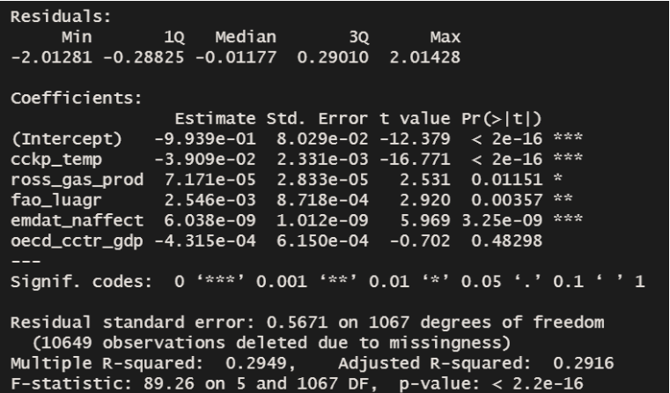
MODEL SUMMARY

Slide 14
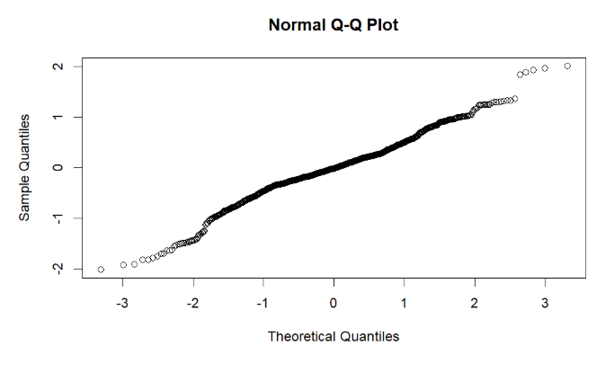
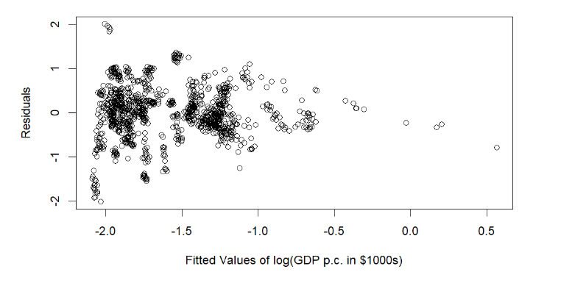
RESIDUAL ANALYSIS

Slide 15



Positives
    Easy Interpretation
    Established relationships between our response and all but one of our predictors
    Assumptions of linear model close to being met

Slide 16
Negatives
    Imperfect residual Normality and possible heteroskedasticity
    R-squared of ~0.29
    Data issues
    Mixture of Per-Capita, Percentage and Raw Total

Slide 17


Data
University of Gothenburg Environmental Indicators Dataset:
  amalgamation of dozens of datasets
  >10,000 points
    Majority of nations, timespan of 1960-2020 (panel data)
  Lots of missing entries
LinkedIn, 2024

Slide 18
Data We Used
  1073 points
  Timespan: 1994-2014
    More modern timespan preferable for application
  United States features 21 times, most countries do not
  Uneven panel data, in a sense
LinkedIn, 2024

Slide 19
Conclusions
We can evaluate national performance (relative to model):
  Underperformers: Trinidad and Tobago, South Africa
  Overperformers: Mali
Interestingly, United States “outperform” China.

Slide 20
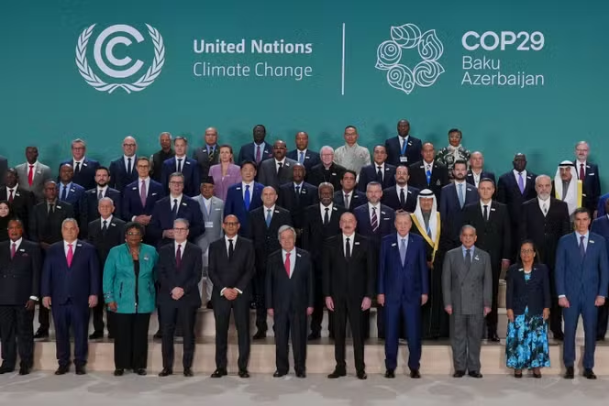

Future
  More comprehensive data:
    Wider breadth of variables
    More up-to-date data
  Ideally, impose harsher targets on worst-performing countries or at least focus on them
  Use more per-capita data for easier interpretation
Le Monde, 2024

Slide 21
References
CO2 emissions in 2022 – analysis. IEA. (2023, March). https://www.iea.org/reports/co2-emissions-in-2022
Liu, Z., Deng, Z., Davis, S., & Ciais, P. (2023, March 13). Monitoring Global Carbon Emissions in 2022. Nature Reviews. https://www.nature.com/articles/s43017-023-00406-z
Povitkina, M., Alvarado Pachon, N., & Mert Dalli, C. (2021). Environmental indicators dataset. University of Gothenburg. https://www.gu.se/en/quality-government/qog-data/data-downloads/environmental-indicators-dataset
Ritchie, H. (2023, December 28). Global inequalities in CO2 emissions. Our World in Data. https://ourworldindata.org/inequality-co2

