Slide 1
Factors Influencing Mortality and Recovery Rates
Jake Sheeler
ECO 5720-101
12/06/2024

Slide 2
What factors influence mortality and recovery rates across global health data?
Dependent Variables:
Mortality Rate %
Recovery Rate %
Independent Variables:
Healthcare Access %
Doctors per 1000
Hospital beds per 1000
Average Treatment Cost (USD)
DALYs
Improvement in 5 Years %
Per Capita Income (USD)
Education Index
Urbanization Rate %

Slide 3
Why is it important?
Understanding these factors can help identify gaps in healthcare systems and drive evidence-based interventions.

Slide 4
Data Overview
Dataset:
Global health dataset obtained via Kaggle
Author’s Username: MalaiarasuGRaj
Link: https://www.kaggle.com/datasets/malaiarasugraj/global-health-statistics?resource=download
Includes mortality and recovery rates, healthcare access, medical resources, and a variety of other socioeconomic factors.
Data Quality:
Cleaned the dataset with zero missing values in key variables
Generated summary statistics and correlation model.

Slide 5
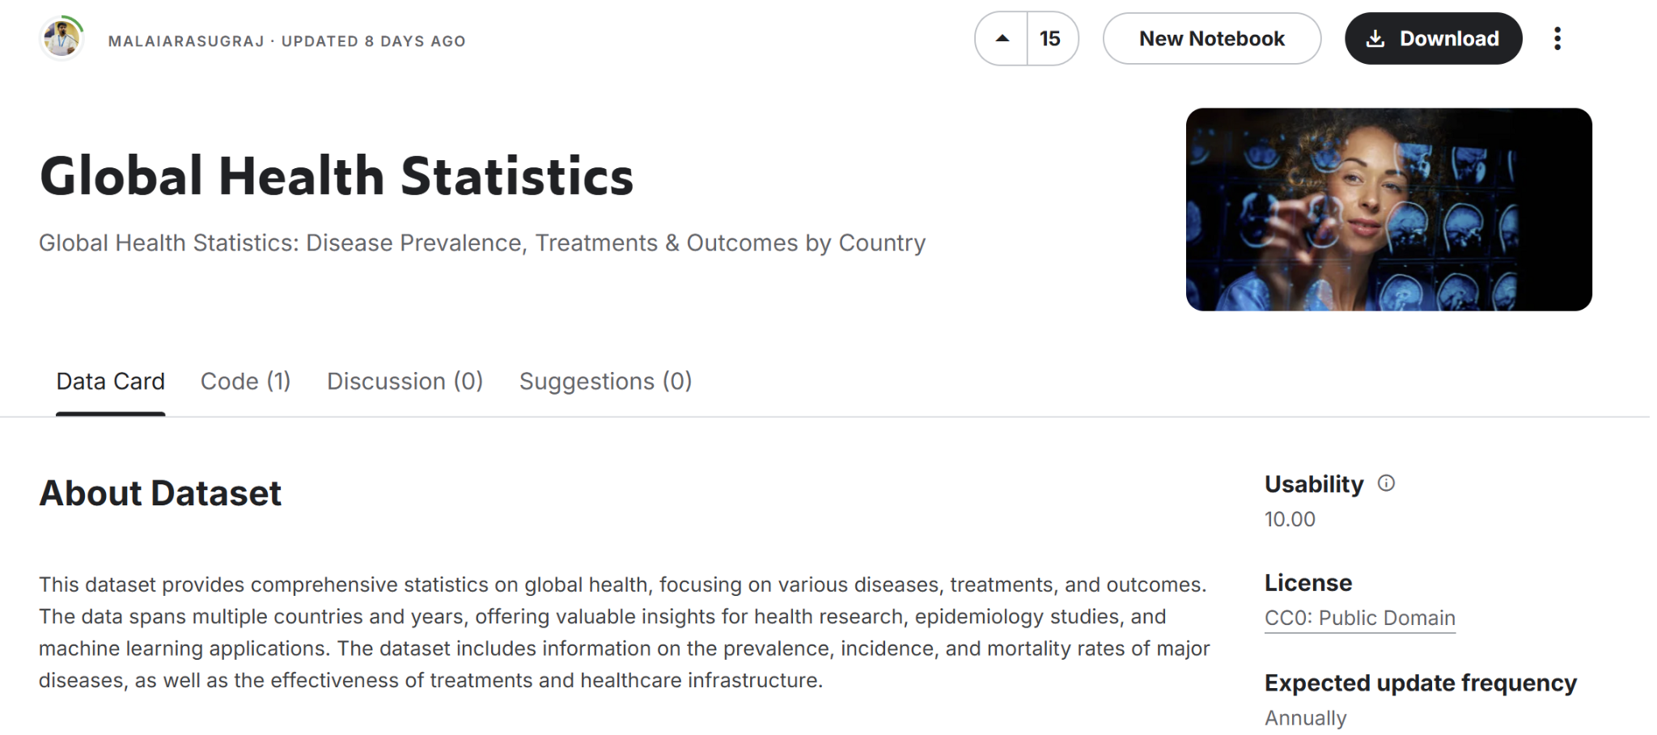

Slide 6
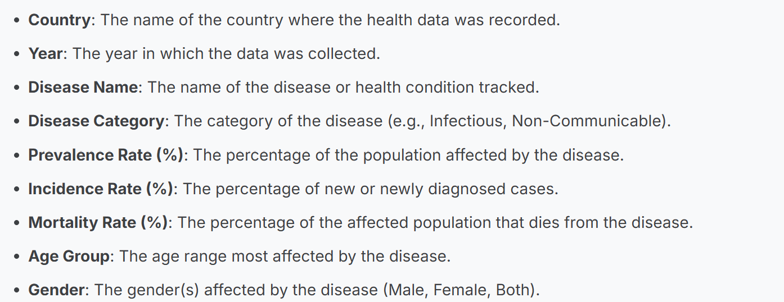
Variable Descriptions

Slide 7
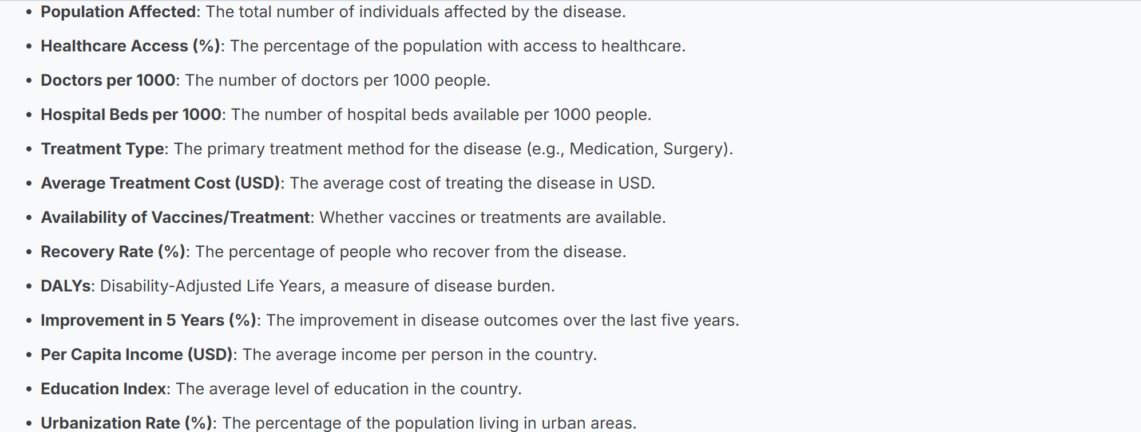
Variable Descriptions Continued

Slide 8
Estimation Strategy
Approach:
Linear Regression models conducted in R-studio were used to estimate the relationship between the independent and dependent variables.
Reasoning:
Clear interpretation
Ability to consider a variety of variables
Reporting statistical significance

Slide 9
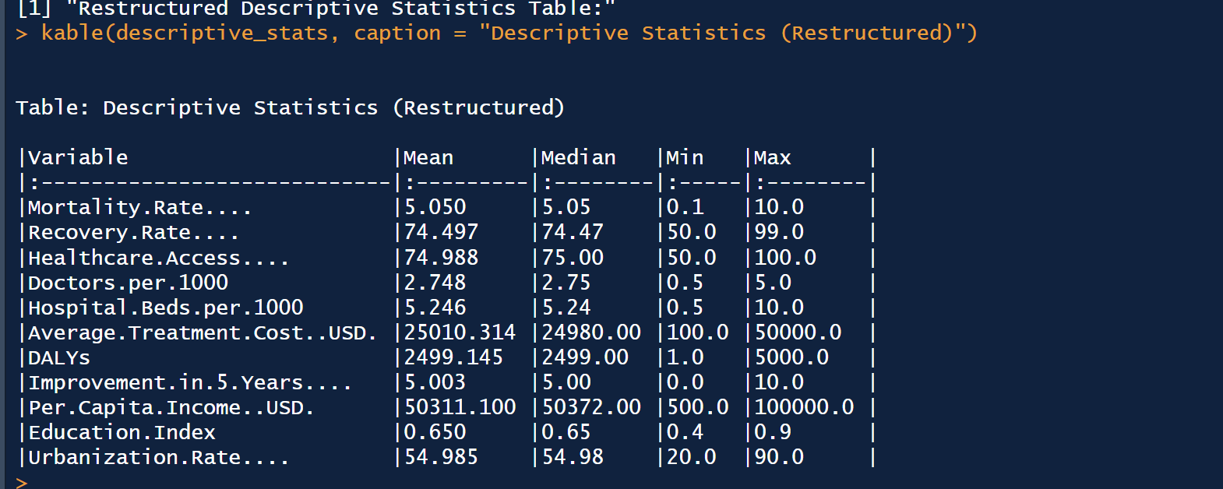
Descriptive Statistics

Slide 10
Correlation Analysis
Minimal linear relationships between healthcare resources and key outcomes like mortality and recovery rates.
Slight positive effects on recovery rates in regards to health and education access, but overall negligible impact.
Weak correlations suggest the need to investigate non-linear relationships or other variables.

Slide 11
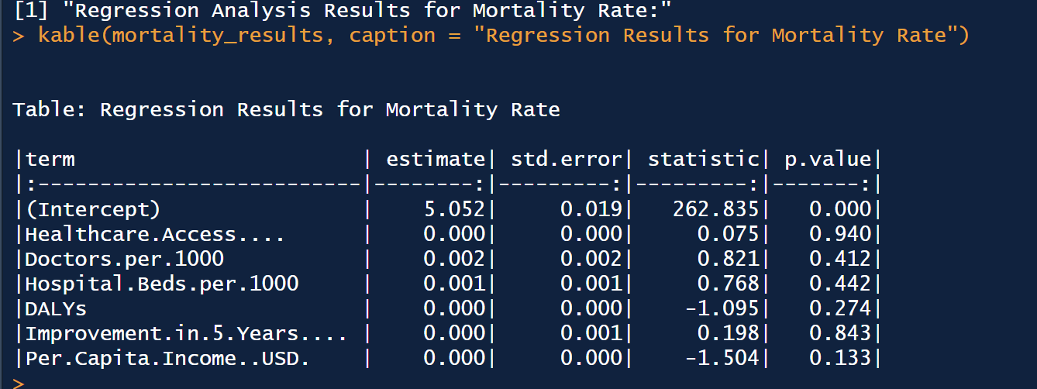
Regression Analysis (Mortality Rate)
Mortality Rate ~ Healthcare Access (%) + Doctors per 1000 + Hospital Beds per 1000 + DALYs + Improvement in 5 Years (%) + Per Capita Income (USD)
None of the variables (Healthcare Access, Doctors per 1000, Hospital Beds per 1000) significantly affect mortality rate (p-values > 0.4).
DALYs and Improvement in 5 Years show minimal impact with insignificant p-values (> 0.2).
Per Capita Income has a slight inverse relationship but is also statistically insignificant (p = 0.133).

Slide 12
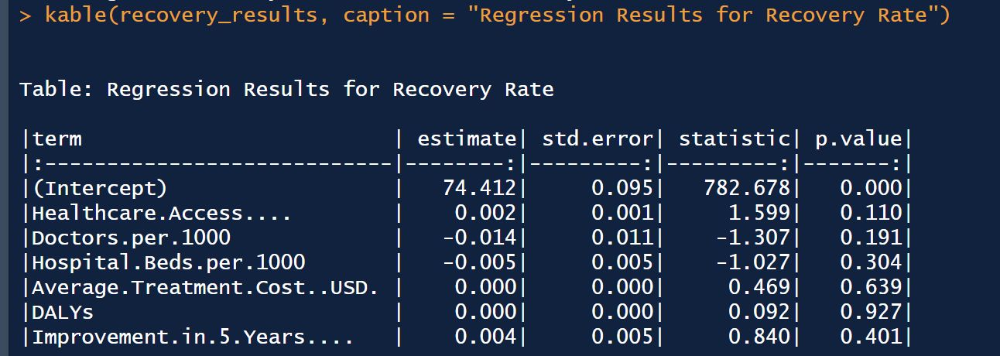
Regression Analysis (Recovery Rate)
Recovery Rate ~ Healthcare Access (%) + Doctors per 1000 + Hospital Beds per 1000 + Average Treatment Cost (USD) + DALYs + Improvement in 5 Years (%)
Healthcare Access, Doctors per 1000, and Hospital Beds per 1000 have no significant effect on Recovery Rate (p-values > 0.1).
DALYs, Average Treatment Cost, and Improvement in 5 Years show negligible and statistically insignificant impacts (p-values > 0.3).
The intercept highlights a strong baseline Recovery Rate of 74.41% (p < 0.001).

Slide 13
Strengths and Weaknesses
Strengths:
Comprehensive Analysis: Includes diverse variables (e.g., Healthcare Access, DALYs) for a broad perspective.
Clear Results: Provides detailed regression and descriptive statistics for interpretation.
Reliable Data Handling: Ensures no missing data, improving result accuracy.
Weaknesses:
Limited Significance: Most variables show negligible effects with high p-values.
Overfitting Risk: Too many insignificant variables may dilute results.

Slide 14
Conclusion
This analysis examined factors such as healthcare access, medical resources, and socioeconomic indicators, but found no significant impact on mortality or recovery rates. These findings suggest that health outcomes are influenced by more complex or unmeasured factors, needing further investigation.

Slide 15
Future
Expand on other variables such as healthcare expenditure, disease trends, policy implementation, political disruptions, etc.
Focus us on subnational regions.
Explore non-linear modeling and predictive analysis.

Slide 16
Thanks for listening!
Here is my R-Studio code as well
# here is my R-studio code:
# Load required libraries
library(dplyr)
library(tidyr)
library(knitr)
# Load dataset
data_path <- "C:/Users/sheel/Desktop/RoyFinalProjectJupyter/Global Health Statistics.csv"
health_data <- read.csv(data_path)
# Inspect dataset
print("Dataset loaded successfully.")
print("Columns in dataset:")
print(colnames(health_data))
# Check for missing values
missing_summary <- sapply(health_data, function(x) sum(is.na(x)))
print("Missing values per column:")
print(missing_summary)
# Remove rows with missing key values
required_columns <- c(
"Mortality.Rate....", "Recovery.Rate....", "Healthcare.Access....",
"Doctors.per.1000", "Hospital.Beds.per.1000", "Average.Treatment.Cost..USD.",
"DALYs", "Improvement.in.5.Years....", "Per.Capita.Income..USD.",
"Education.Index", "Urbanization.Rate...."
)
health_data <- health_data %>% drop_na(all_of(required_columns))
# Calculate descriptive statistics
descriptive_stats <- health_data %>%
select(Mortality.Rate...., Recovery.Rate...., Healthcare.Access...., Doctors.per.1000,
Hospital.Beds.per.1000, Average.Treatment.Cost..USD., DALYs, Improvement.in.5.Years....,
Per.Capita.Income..USD., Education.Index, Urbanization.Rate....) %>%
summarise_all(list(
Mean = ~round(mean(.), 3),
Median = ~round(median(.), 3),
Min = ~round(min(.), 3),
Max = ~round(max(.), 3)
)) %>%
pivot_longer(
cols = everything(),
names_to = c("Variable", ".value"),
names_sep = "_"
) %>%
mutate(
Mean = format(Mean, scientific = FALSE),
Median = format(Median, scientific = FALSE),
Min = format(Min, scientific = FALSE),
Max = format(Max, scientific = FALSE)
)
# Display descriptive statistics table
print("Restructured Descriptive Statistics Table:")
kable(descriptive_stats, caption = "Descriptive Statistics (Restructured)")
# Correlation Analysis for Expanded Variables
cor_matrix <- cor(health_data %>%
select(Mortality.Rate...., Recovery.Rate...., Healthcare.Access...., Doctors.per.1000,
Hospital.Beds.per.1000, DALYs, Improvement.in.5.Years...., Education.Index))
print("Correlation Matrix:")
kable(round(cor_matrix, 3), caption = "Correlation Matrix for Expanded Variables")
# Regression Analysis for Mortality Rate
mortality_model <- lm(Mortality.Rate.... ~ Healthcare.Access.... + Doctors.per.1000 + Hospital.Beds.per.1000 +
DALYs + Improvement.in.5.Years.... + Per.Capita.Income..USD., data = health_data)
mortality_results <- tidy(mortality_model) %>%
mutate(
estimate = round(estimate, 3),
std.error = round(std.error, 3),
statistic = round(statistic, 3),
p.value = round(p.value, 3)
)
print("Regression Analysis Results for Mortality Rate:")
kable(mortality_results, caption = "Regression Results for Mortality Rate")
# Regression Analysis for Recovery Rate
recovery_model <- lm(Recovery.Rate.... ~ Healthcare.Access.... + Doctors.per.1000 + Hospital.Beds.per.1000 +
Average.Treatment.Cost..USD. + DALYs + Improvement.in.5.Years...., data = health_data)
recovery_results <- tidy(recovery_model) %>%
mutate(
estimate = round(estimate, 3),
std.error = round(std.error, 3),
statistic = round(statistic, 3),
p.value = round(p.value, 3)
)
print("Regression Analysis Results for Recovery Rate:")
kable(recovery_results, caption = "Regression Results for Recovery Rate")
# Statistical Summary of Regression Models
mortality_summary <- summary(mortality_model)
recovery_summary <- summary(recovery_model)
cat("Model Validation for Mortality Rate:\n")
cat("R-squared:", round(mortality_summary$r.squared, 3), "\n")
cat("Adjusted R-squared:", round(mortality_summary$adj.r.squared, 3), "\n")
cat("Model Validation for Recovery Rate:\n")
cat("R-squared:", round(recovery_summary$r.squared, 3), "\n")
cat("Adjusted R-squared:", round(recovery_summary$adj.r.squared, 3), "\n")

