Slide 1
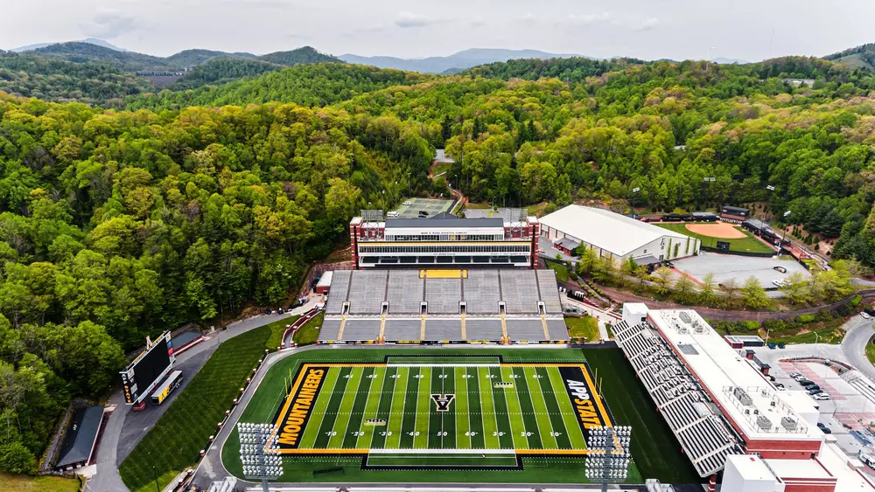
FBS Statistics
Mike Jones & Jackson Norwood
Notes:
Intro, mike jones and jackson

Slide 2
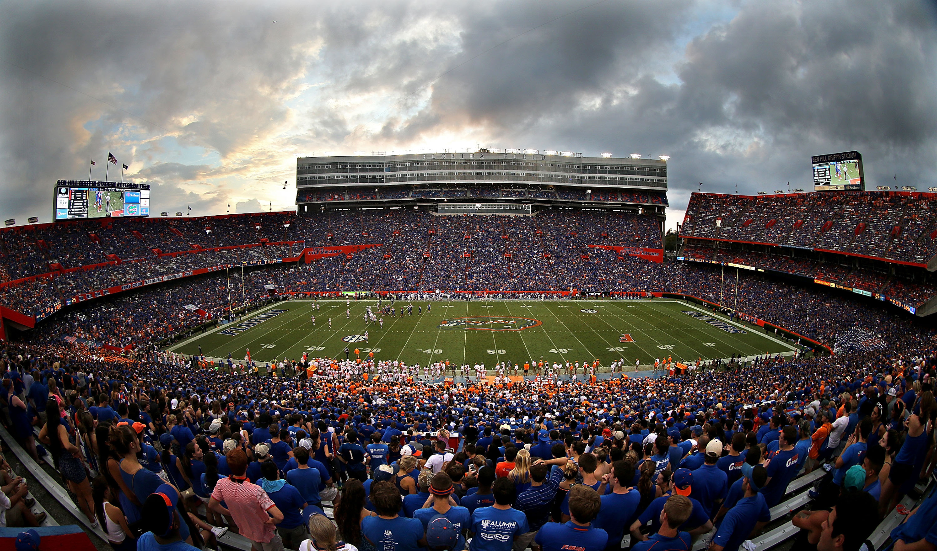
Revenues
Conference Affiliation
Win Percentage
Notes:
Why the topic is interesting . . .
Give back ground for changing landscape

Slide 3
Firearm Sales during times of Uncertainty
Questions:
How does revenue affect win PCT?
What are the various factors that influence win percentage in college football?
How do coach salaries affect?
Power 4 vs Group of 5

Slide 4
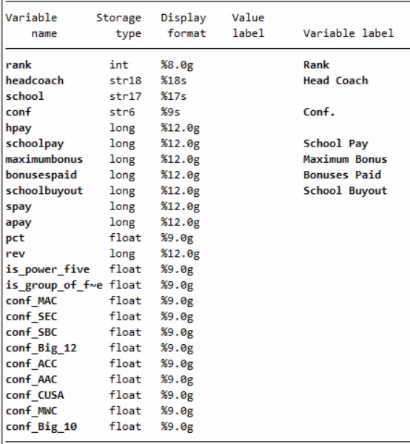
Firearm Sales during times of Uncertainty
Variables:
Dependent(s):
Win Pct
Revenue
Independents:
Coach pay
Conf affiliation
Special:
Bonuses Paid
Status
Notes:
Go in a tad more depth

Slide 5
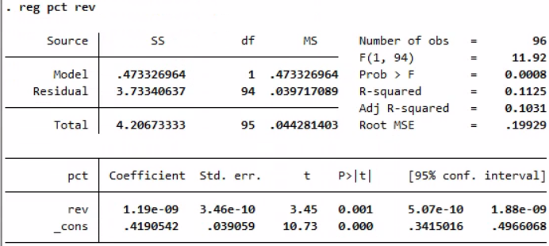
Firearm Sales during times of Uncertainty
Strategy:
First reg pct on rev
Hetero - skedasticity
Multicollinearity

Slide 6
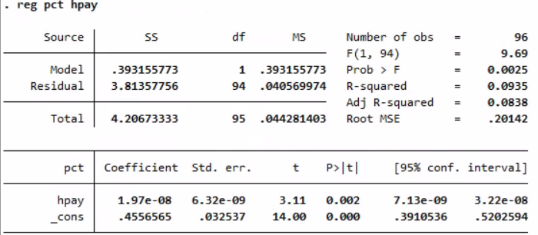
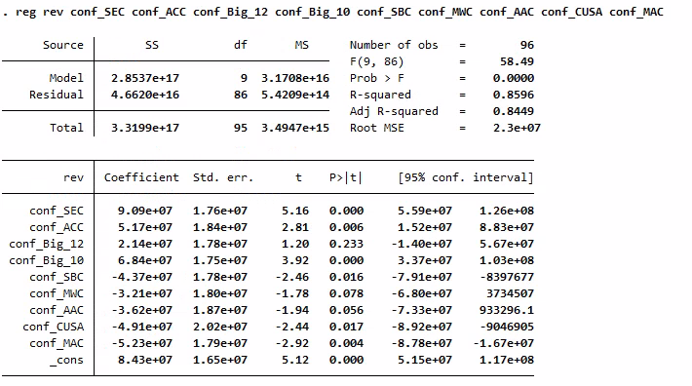
Firearm Sales during times of Uncertainty
Other Models:
Pct on Hpay
Rev on Conf
Power 4 vs Group of 5

Slide 7
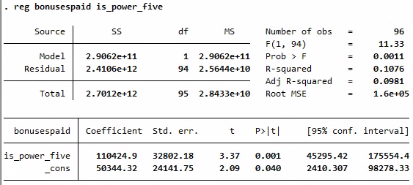
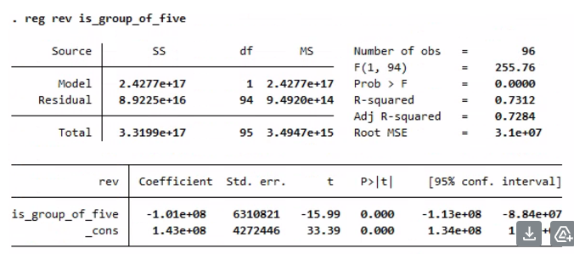
Firearm Sales during times of Uncertainty
Strengths & Weaknesses
Less meat on the bone than we thought . . .
Interesting items with conference affiliation
Multitude of unobservables
Notes:
Revenue and shit is the less meat on bone part
Conf afilliation talk about SEC being only significant binary for revenue
Restate unobservables

Slide 8
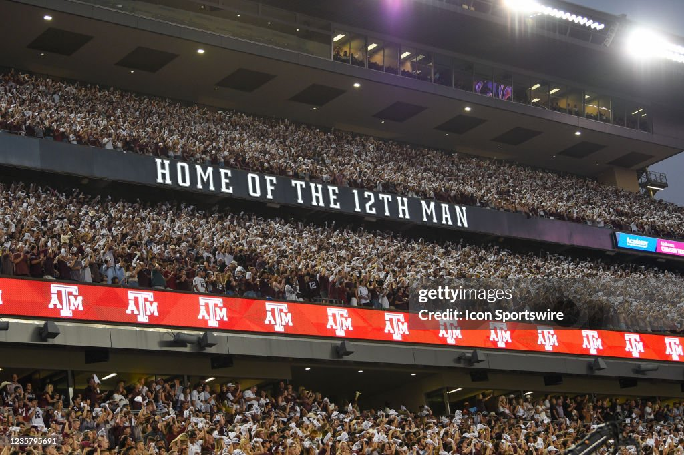
Conclusions
Revenue is a driver
Key Drivers
Gap between power and others is wide
HC Salaries are Important

Slide 9
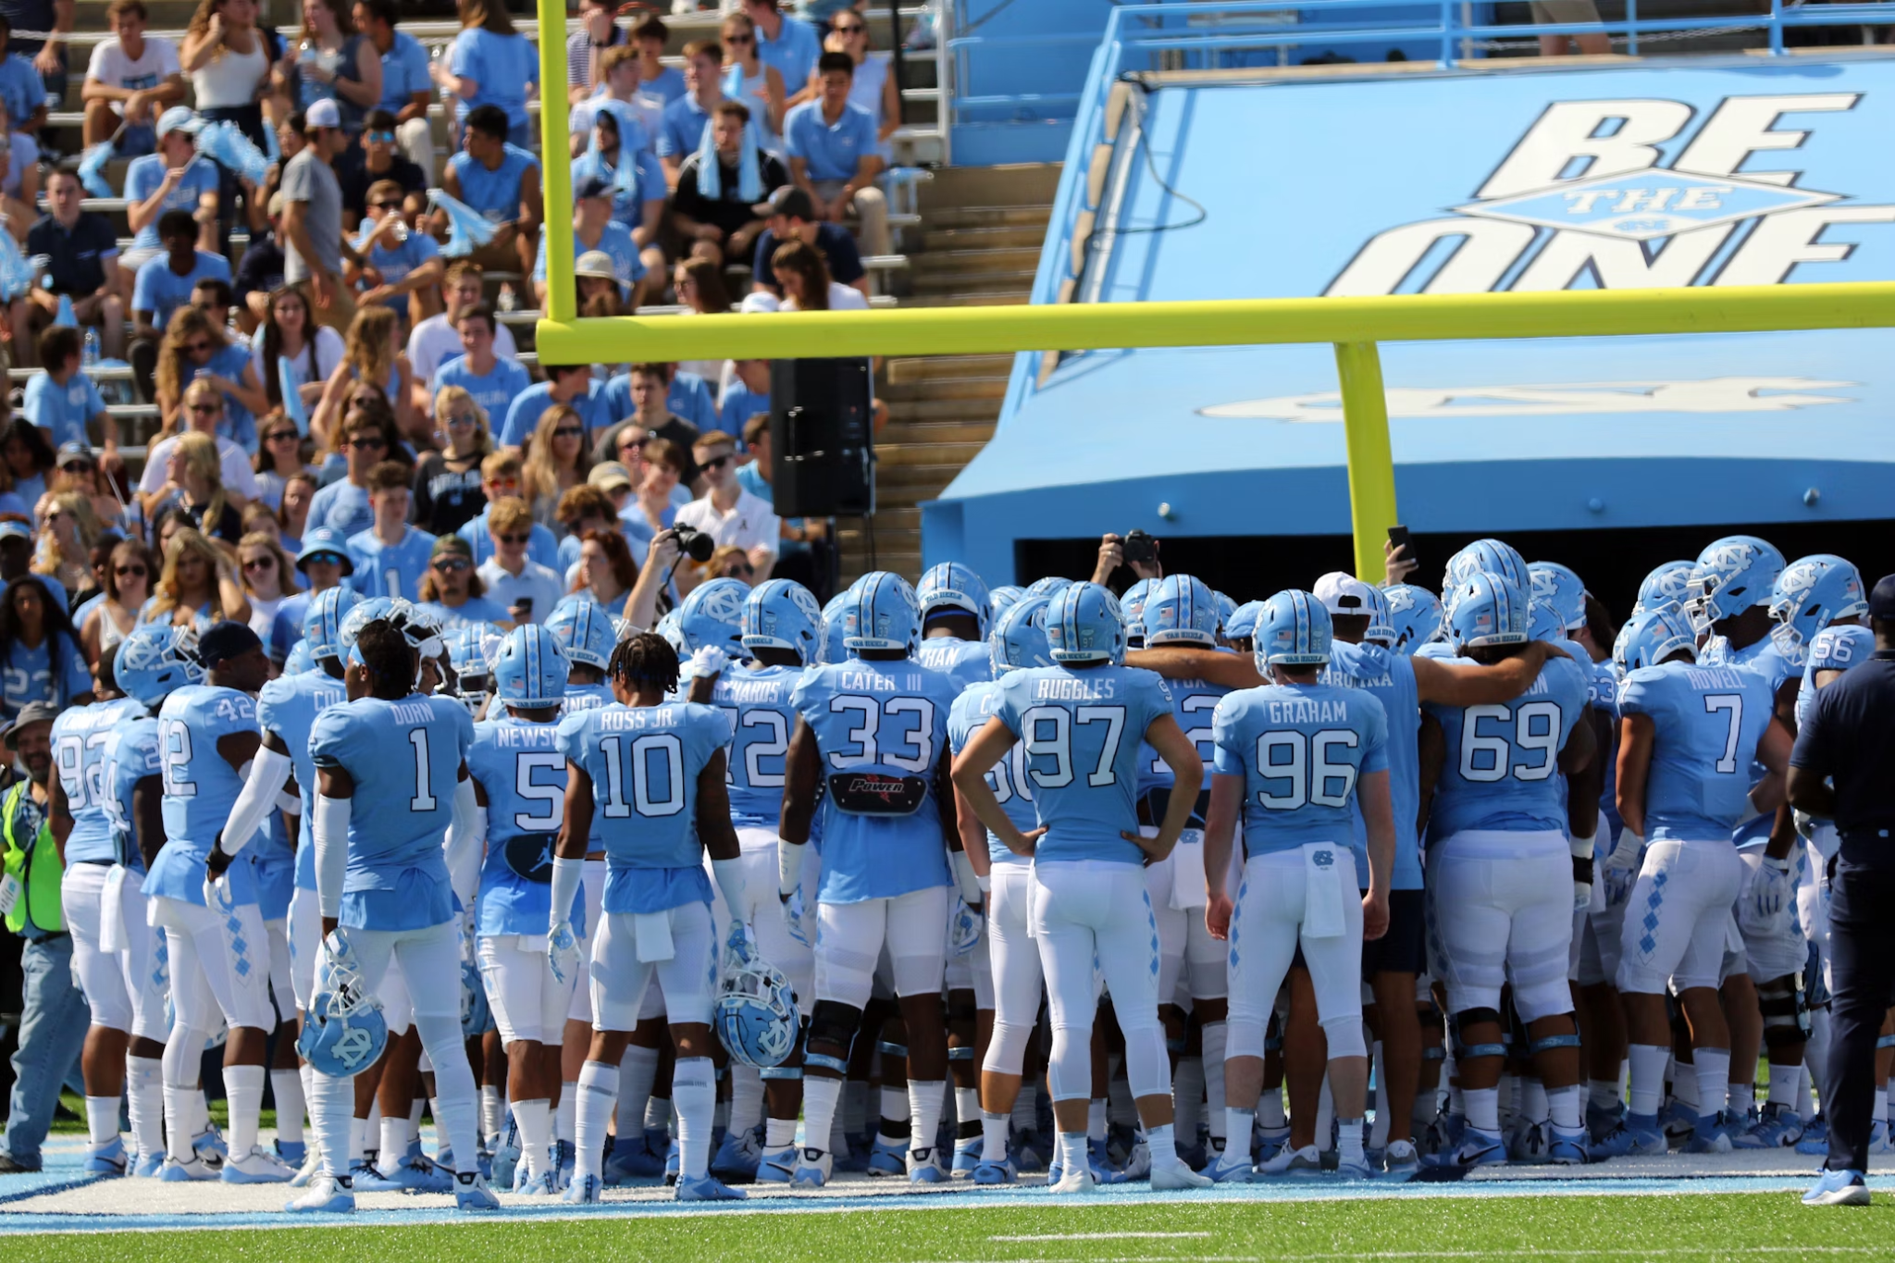
Firearm Sales during times of Uncertainty
Future Research
Time invariant?
Other unobservables
All Division 1 . .

Slide 10
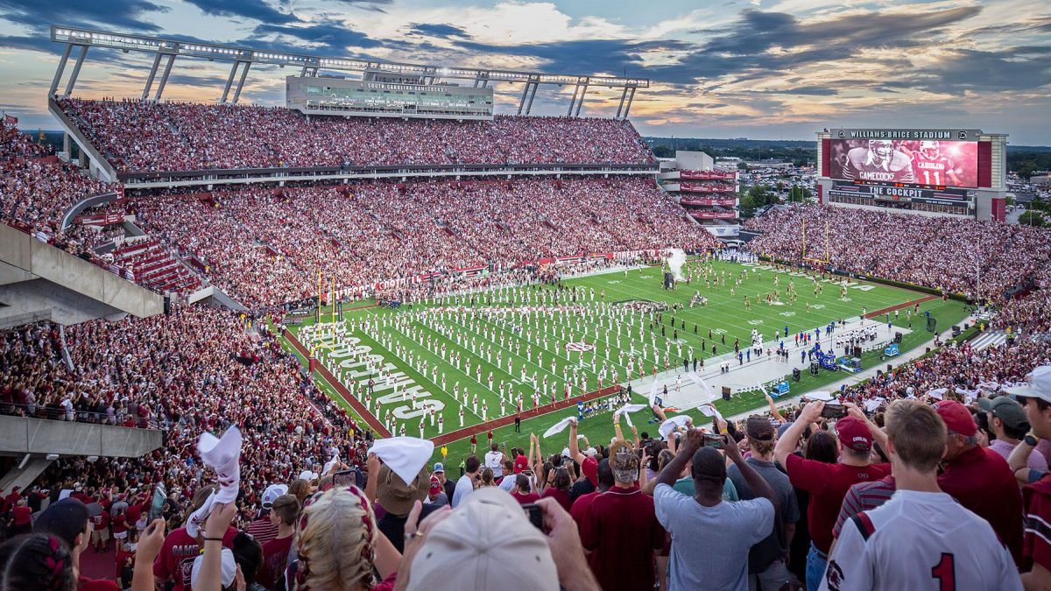
Questions?
Thank you for your time
Notes:
Fogle

