Slide 1
Analysis of Factors Influencing Cigarette Consumption
Ted Helmus and Victory Okechukwu
Econometrics Fall 2024
December 5, 2024

Slide 2
Question
Relevance
Cigarette smoking is a significant public health concern that contributes to numerous preventable diseases and places a considerable burden on healthcare systems globally.
Understanding the determinants of smoking behavior is critical for policymakers aiming to reduce smoking prevalence through targeted interventions.
How does socioeconomic, demographic, and policy-related variables affect cigarette consumption.

Slide 3
What are the Dependent and Independent Variables?
Dependent Variable
cigs: The number of cigarettes smoked per day, representing the outcome of interest.
Independent Variables
Demographic Factors:
educ: Years of schooling, indicating the level of education attained.
white: A binary variable (1 if white, 0 otherwise) representing race.
age: Age of the individual in years.
agesq: Age squared, capturing potential nonlinear effects of age.
Economic Factors:
income: Annual income in dollars.
lincome: Log-transformed income, addressing potential skewness in income distribution.
Policy Variables:
cigpric: State-level cigarette price (cents per pack).
lcigpric: Log-transformed cigarette price.
restaurn: A binary variable (1 if state restaurant smoking restrictions are in place, 0 otherwise).

Slide 4
Estimation Strategy
This study employs a multiple linear regression model to examine the significant determinants of cigarette consumption. The dependent variable, cigs, represents the daily cigarette consumption of individuals.
Robust standard errors are used to account for potential heteroscedasticity. The linear regression framework offers straightforward interpretation of coefficients.
It allows for hypothesis testing and assessment of the relative importance of variables
Multiple Regression Model
The Ordinary Least Squares (OLS) method is used for parameter estimation
Robust standard errors are used to account for potential heteroscedasticity.

Slide 5
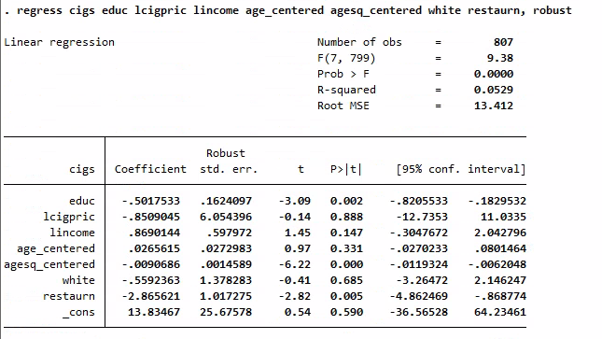
Stata Output:

Slide 6
Conclusions
Key Findings:
Education significantly reduces cigarette consumption (-0.50 cigarettes per day per additional year of schooling, p=0.002).
Restaurant smoking restrictions are associated with a reduction of 2.87 cigarettes per day (p=0.005).
Age squared centered has a significant nonlinear relationship with cigarette consumption (p=0.000).
Insignificant Variables:
In the analysis, several variables did not significantly influence daily cigarette consumption. These included cigarette price (p=0.888), income (p=0.147), race (white) (p=0.685), and the linear effect of age (p=0.331).
Model Performance:
Explains 5.3% of variability in cigarette consumption (R² = 0.0529), F-statistic (p=0.000): Model is statistically significant overall, High unexplained variance (Root MSE = 13.41).
Implications:
Public health policies like smoking bans are effective tools for reducing cigarette use.
Other important factors, such as cultural attitudes and alternative smoking habits, need further exploration.
Comprehensive models incorporating additional determinants are necessary to better explain smoking behavior.

Slide 7
Improving the Analysis
Incorporate Additional Variables:
Lifestyle factors: Include variables like physical activity, diet, and alcohol consumption that could influence smoking behavior.
Policy factors: Consider adding other smoking-related policies, such as cigarette taxes or anti-smoking advertising, which may impact consumption.
Health outcomes: Include measures of public health to see how smoking correlates with long-term health trends.
Address Data Limitations:
Longitudinal data: Use panel data or time-series data to examine changes over time and account for unobserved heterogeneity.
Contextual data: Integrate regional variations and socioeconomic factors to better understand smoking behavior patterns.
Interaction Terms:
Include interaction terms to examine how variables may jointly influence cigarette consumption (e.g., the interaction between smoking bans and education level).

Slide 8
Thank You!

