Slide 1



LIFE EXPECTANCY
Zach Hedgepath & Gabby Leach
ECONOMETRICS

Slide 2
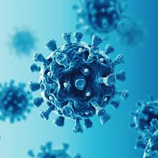
Background
Life Expectancy (2000–2019):
  Increased globally from 66.8 years to 73.1 years (WHO).
  Driven by healthcare advances and economic development.
Healthy Life Expectancy (HALE): years lived in good health
  rose from 58.1 years to 63.5 years during the same period
  individuals are living longer but spending more years managing chronic diseases and disabilities
Impact of COVID-19:
  Reversed a decade of progress in just two years
  Life expectancy: 71.4 years (similar to 2012).
  HALE: 61.9 years.

Slide 3
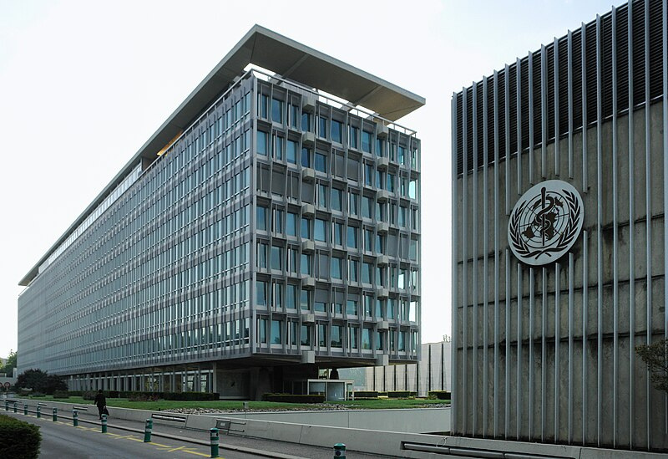
Topic & Relevance
What factors impact life expectancy the most?
Relevance:
  Indicator of Population Health
  Measures Healthcare System Effectiveness
  Reflects Social and Economic Factors
  Insight into lifestyle and other health variables

Slide 4
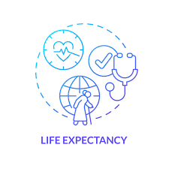

Variables Involved
WHO Data: 2,311 observations from 155 countries
Independent:
  Alcohol, BMI, GDP, & Schooling
    Alcohol: Liters of alcohol consumption above 15 years old
    BMI: Average BMI of the entire country
    GDP: reflecting economic conditions
    Schooling: Number of years that people study
Dependent:
  Life expectancy
    Average years someone is expected to live
Life_exp = 𝛽₀ + 𝛽₁alcohol+ 𝛽₂BMI+ 𝛽₃GDP+ 𝛽4School+ u

Slide 5

Estimation Strategy
  WHO data is panel data which means OLS is ineffective for this scenario
  Using a fixed effect model has a couple advantages
    Accounts for unobserved heterogeneity at the country level
      Geographical differences, cultural factors, etc
    Data is from 2000 - 2015

Slide 6
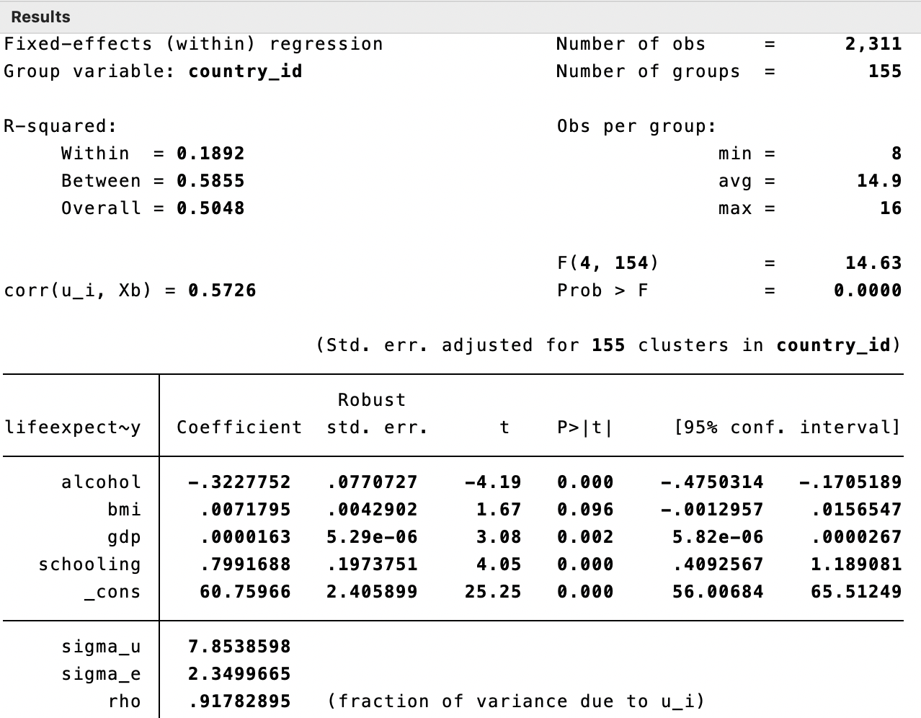

Slide 7
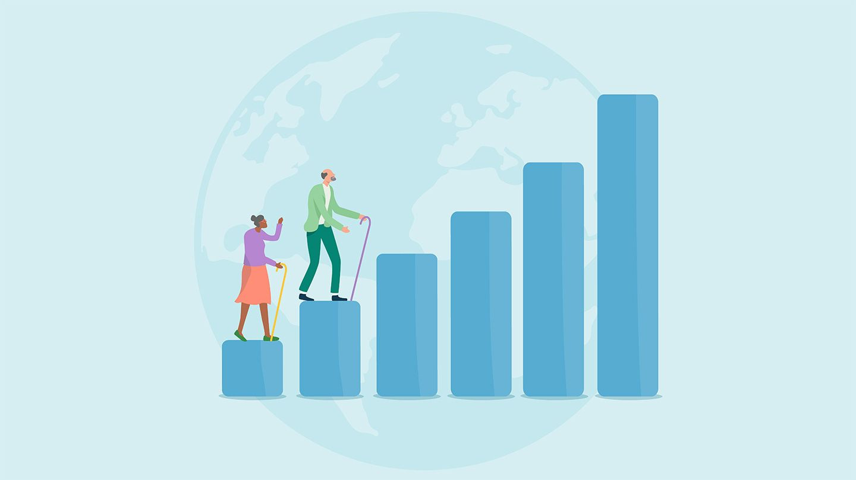
Conclusions
Our model has base life expectency as 60.76 years meaning that when all variables are 0 someone can expect to live that long.
  Positive correlation
    GDP is positively correlated
      For every one unit increase in GDP life expectancy increases by .0000163 years
    Schooling has a strong positive correlation
      For each additional year in school life expectancy increases by .80
  Negative correlation
    Alcohol consumption is negatively correlated
      For every liter of alcohol consumed life expectancy decreases by .32 years
  Weak or Ambiguous
    BMI has a weak positive correlation
      For every one unit increase in BMI life expectancy goes up by .007
Emergency Care:

Slide 8
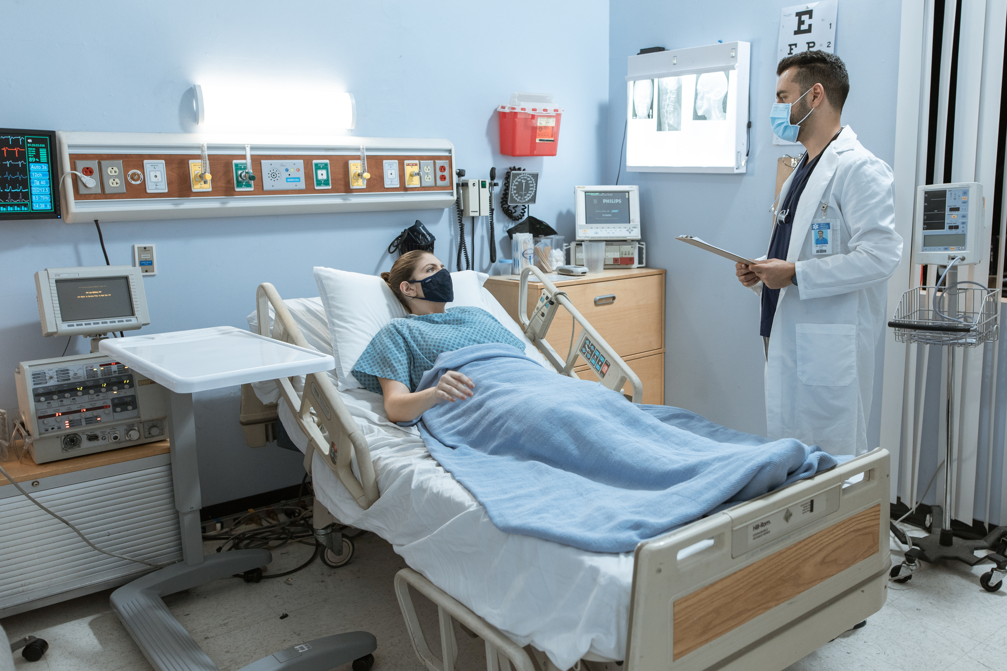

How can we improve
this analysis?
  BMI is an outdated metric
  Possibly replace with a different metric
  Data on if country is first or third world
  Possible dummy variable

Slide 9
Questions?

