Slide 1
An Estimation of depression likelihood in students through Academic Factors
Xander Brown & Jon Taylor

Slide 2
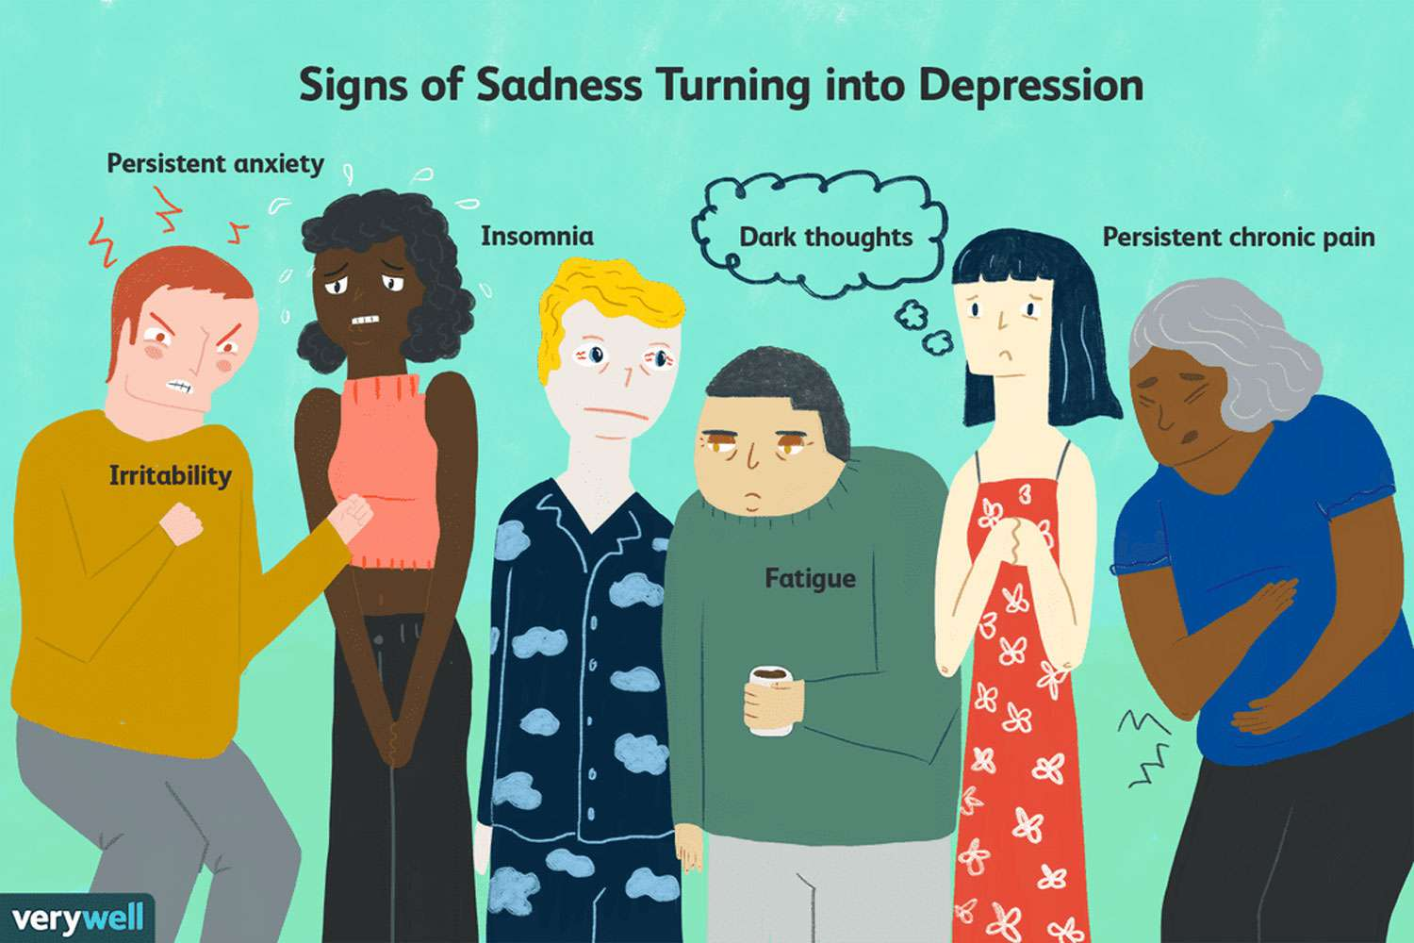
Question How do lifestyle factors affect the prevalence of depression among Students?
What should students prioritize?
What is the impact of diet and sleep?
Potential limitations of current data?

Slide 3
Variable Break Down
Data Collected from Kaggle ‘Depression Student Dataset’
Dependent Variable – Depression (0-1)
Independent Variables
Gender (Male 1, Female 0)
Age
Academic Pressure (1 -5 (high))
Study Satisfaction (1-5 (high))
Suicidal Thoughts (0-1)
Study Hours
Financial Stress (1-5 (high))
Family History (0-1)
Dummy Independent Variables
Sleep Duration
Under 5 hours
5-6 hours
7-8 hours (omitted)
8+ hours
Dietary Habits
Unhealthy
Moderate (omitted)
Healthy

Slide 4
Model Estimation
A logit model was used because the dependent variable, depression, is a binary variable representing yes and no. Logit regression allows for modeling the probability of depression as a function of multiple predictors between 0 and 1.
502 Observations
Assumptions of Logistic Regression
Binary Outcome
There was no perfect separation in the data, no combinations of independent variables perfectly predicted the outcome.
Absence of Multicollinearity
Variance Inflation Factor (VIF) was high for age (potentially with Academic years), and was excluded from the final model.
Other variables, such as Gender, Study Satisfaction, and Family History, showed acceptable VIF values, indicating low multicollinearity.

Slide 5
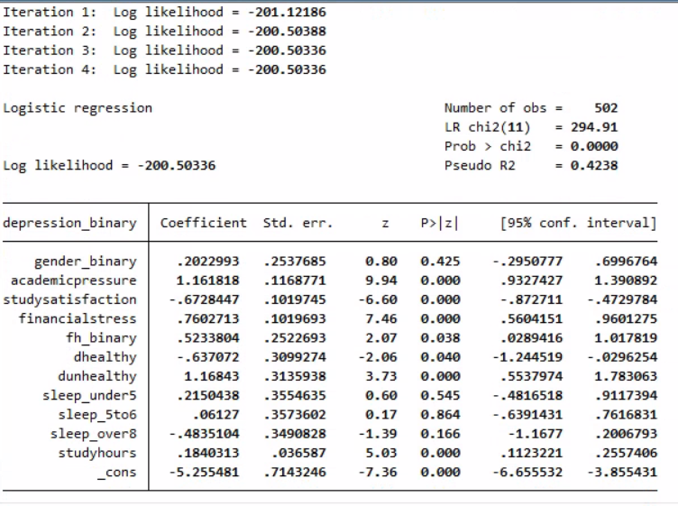
Interpretations
Likelihood ratio chi-squared of 294.91 and a p-value of 0.000 indicates the results are highly statistically significant.
Pseudo R2 shows that 42% of the variability is determined in the model.
Sleep over 8 hrs, study satisfaction, and healthy eating habits negatively affect depression likelihood.
Academic Pressure, Financial Stress, Unhealthy Eating, and Study hours are strong predictors of depression
Gender and lower levels of sleep are not statistically significant.

Slide 6
Conclusions?
The data does not include information regarding leisure activities and sunlight consumption. The inclusion of these variables could increase the predictive power of the model.
The data shows that healthy eating habits and getting enough sleep should be prioritized. The impact of study satisfaction shows that accomplishing tasks and being confident in your work can contribute to lower depression rates.
Study hours and financial stress show the effect of work and responsibilities on students’ mental health,

