Slide 1
ECONOMETRICS
Joint Tests
in Econometrics
t-test
F-test
β₁
vs.
β₁ β₂
Why F-tests matter when t-tests are not enough
one coefficient
multiple, jointly
Maria Jose Pinedo
Econometrics | September 28, 2026
Notes:
Target time: 0:20
Presenter transcript:
Today I’m going to explain joint tests in multiple regression. The easiest way to think about the topic is this: a t-test asks about one coefficient, while an F-test lets us ask about several coefficients together. I’ll show why that distinction matters, how the two tests are related, and then use the mtcars dataset in R to show a case where the individual tests and the joint test tell a very different story.
Feynman memory hook:
One player versus the whole team.

Slide 2
MOTIVATION
Why isn’t one t-test at a time enough?
The question changes when we care about variables as a group.
INDIVIDUAL QUESTION
GROUP QUESTION
t-test
F-test
H₀: βcyl = 0
H₀: βcyl = βdisp = 0
“Does cylinders matter by itself,
holding the other variables fixed?”
“Do cylinders and displacement
matter together?”
Think of a team: individual players can look ordinary, while the team can still matter a lot.
Notes:
Target time: 0:45
Presenter transcript:
Suppose I want to know whether cylinders matter. A t-test is perfect for that one question. But now suppose my real question is whether cylinders and engine displacement matter together. Running two separate t-tests does not directly answer that group question. Think of it like evaluating a team: asking whether each player looks impressive individually is not the same as asking whether the team contributes overall. That is the motivation for an F-test: one test for the group.
Feynman memory hook:
Ask: am I testing one player, or the whole team?

Slide 3
SETTING UP THE TEST
Restricted vs. unrestricted model
The restricted model is simply the world where the null hypothesis is true.
UNRESTRICTED — full model
RESTRICTED — impose H₀
mpg = β₀ + β₁cyl + β₂disp + β₃vs + u
mpg = β₀ + β₃vs + u
All coefficients are free to be estimated.
cyl and disp disappear because H₀ sets them to zero.
H₀: βcyl = βdisp = 0
q = 2 restrictions
If removing cyl and disp barely hurts the model, H₀ looks reasonable. If fit collapses, H₀ looks doubtful.
Notes:
Target time: 0:55
Presenter transcript:
To run the joint test, I compare two versions of the same regression. The unrestricted model is the full model: mpg is explained by cylinders, displacement, and vs. The restricted model is what the equation looks like if my null hypothesis is true. My null says the coefficients on cylinders and displacement are both zero, so those two variables disappear. Notice that vs stays, because I am not testing it. The F-test then asks: when I force these restrictions to be true, does the model become much worse? There are two restrictions here, so q equals 2.
Feynman memory hook:
Restricted means: pretend H₀ is true and rebuild the model.

Slide 4
THE TEST STATISTIC
What does the F-statistic actually measure?
How much fit do we lose when we force the restrictions to hold?
Restricted model
Unrestricted model
Loss from restrictions
RSS = 629.52
RSS = 269.66
359.86
more unexplained variation
fit improves
less unexplained variation
629.52 − 269.66
F = [(RSSᵣ − RSSᵤᵣ) / q] ÷ [RSSᵤᵣ / (n − k − 1)]
Large loss in fit → large F → stronger evidence against H₀
Notes:
Target time: 0:50
Presenter transcript:
The formula looks intimidating, but the idea is simple. RSS is the amount of variation the model still fails to explain. In our data, the restricted model leaves 629.52 units of unexplained variation, while the full model leaves only 269.66. So forcing cylinders and displacement out of the model causes a big loss in fit: about 359.86. The F-statistic scales that loss by the number of restrictions and by the remaining noise in the full model. The memory trick is: a large F means the restrictions did a lot of damage to the model, so the null hypothesis becomes hard to believe.
Feynman memory hook:
F measures the damage caused by forcing H₀ to be true.

Slide 5
SPECIAL CASE
With one restriction, F = t²
The familiar t-test is the one-restriction version of an F-test.
t-TEST
F-TEST
H₀: βcyl = 0
F = t²
t = −2.007
(−2.007)² = 4.026
Same hypothesis • same p-value • same decision
Notes:
Target time: 0:45
Presenter transcript:
There is one very useful connection to the t-test. If I test only one restriction, the F-statistic is exactly the square of the t-statistic. In our own regression, the t-statistic for cylinders is about negative 2.007. Squaring it gives an F-statistic of about 4.026. So when q equals 1, the t-test and F-test are mathematically equivalent: same hypothesis, same p-value, same decision. The F-test is not replacing the t-test; it extends the idea to multiple restrictions.
Feynman memory hook:
One restriction = the t-test you already know, just squared.

Slide 6
APPLIED EXAMPLE
R workflow: fit → restrict → compare
mtcars: 32 cross-sectional automobile observations
# Load the built-in data
data(mtcars)
# Unrestricted model
model_ur <- lm(mpg ~ cyl + disp + vs, data = mtcars)
# Restricted model: H0 says cyl = disp = 0
model_r <- lm(mpg ~ vs, data = mtcars)
# Individual t-tests and joint F-test
summary(model_ur)
anova(model_r, model_ur)
1 FIT
Use cyl + disp + vs
Estimate the full model.
2 RESTRICT
Drop cyl + disp
Pretend H₀ is true.
3 COMPARE
anova(model_r, model_ur)
This is the joint F-test.
Notes:
Target time: 0:55
Presenter transcript:
This is all the code I need for the main example. First I load mtcars, which has 32 cars. Then I fit the unrestricted model with cylinders, displacement, and vs. Next I fit the restricted model. Because my null hypothesis sets the cylinders and displacement coefficients to zero, I remove those two variables but keep vs. summary gives me the individual t-tests. anova compares the restricted and unrestricted models and gives me the joint F-test. The workflow is simply: fit the full model, force the null to be true, and compare the two.
Feynman memory hook:
Do not read the code line by line. Explain the three verbs: fit, restrict, compare.

Slide 7
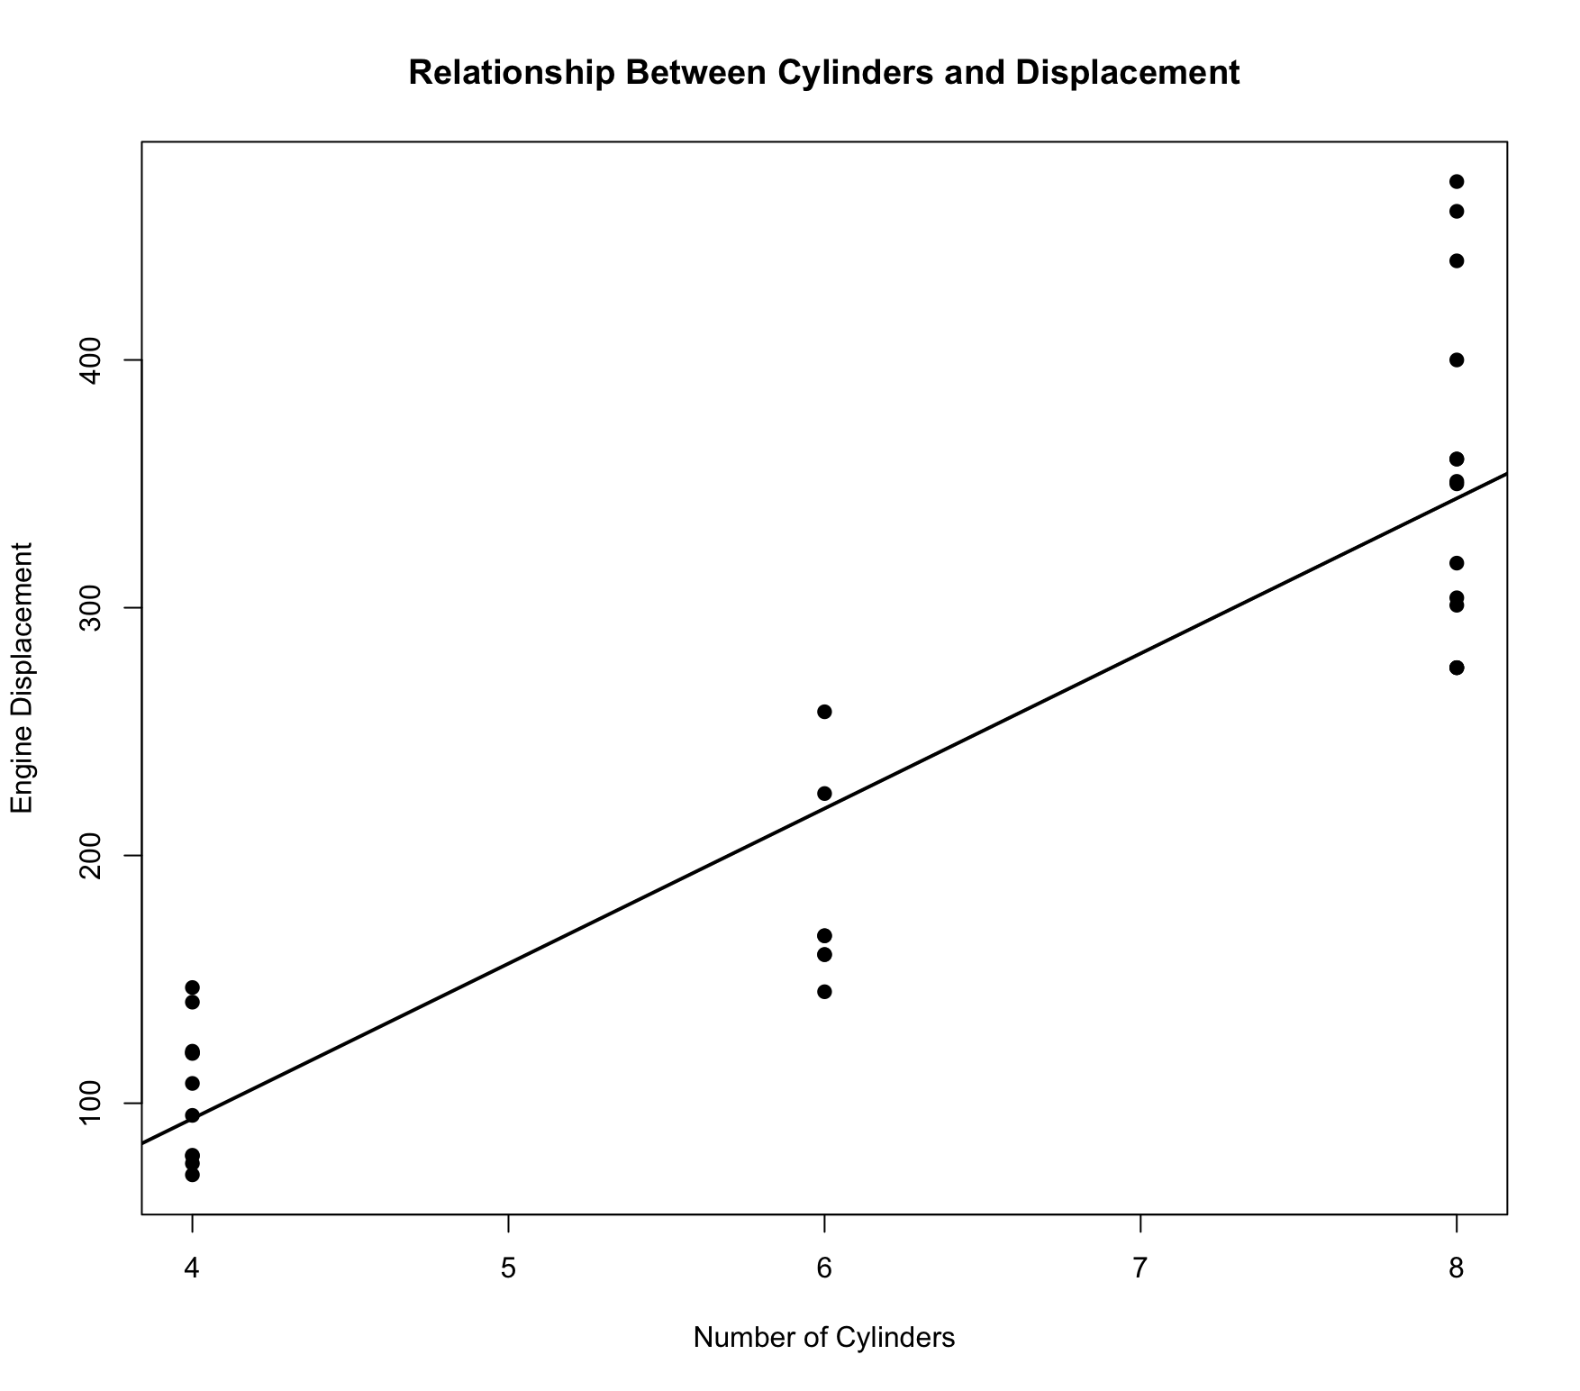
MAIN RESULT
Individually weak. Jointly strong.
This is exactly why the F-test adds information beyond separate t-tests.
Individual t-tests
cyl
p = 0.0545
Both p-values > 0.05
disp
p = 0.0624
Neither significant at the 5% level
Joint F-test
REJECT H₀
H₀: βcyl = βdisp = 0
F(2, 28) = 18.682
p = 0.000007
Correlation: 0.9
Neither variable clears 5% alone, but together they are highly significant.
Notes:
Target time: 1:15
Presenter transcript:
This is the most important result. Look first at the individual t-tests. Cylinders has a p-value of about 0.0545 and displacement about 0.0621. Both are just above 0.05, so at the 5% level I fail to reject each individual null. If I stopped there, I might say neither variable matters. But the joint F-test gives F equal to 18.682 and a p-value around 0.000007. That is far below 0.05, so I reject the joint null very strongly. In plain English: R is saying, “I may have trouble separating exactly how much of the effect belongs to cylinders and how much belongs to displacement, but I am very confident that this pair matters together.” The scatterplot helps explain why: cylinders and displacement have a correlation of about 0.90. They move together, so their separate effects are harder to isolate, even though the group contains a lot of information.
this graph shows the high correlation between the cyl (# of cilinders) and
# disp (engine displacementt)
# correlation = 0.90 => HIGH
# Similar information for two variables = difficulty in assessing actual individual effect of each variable.
# which leads to higher SErrors and lower/weak ind. t-test.
# joint tests (F test) = together more significant
Feynman memory hook:
If two teammates always move together, it is hard to credit one person—but easy to see that the pair matters.

Slide 8
THE REVERSE CASE
Can one variable be significant while the group is not? Yes.
Individual and joint tests answer different hypotheses, so they do not have to agree.
INDIVIDUAL TEST
JOINT TEST
Model:
mpg ~ hp + qsec + disp + vs
H₀: βhp = βqsec = 0
hp
p = 0.049
significant at 5%
F(2, 27) = 2.126
p = 0.139
One coefficient passes the individual test.
FAIL TO REJECT H₀
Different hypothesis → different answer. There is no contradiction.
Notes:
Target time: 0:50
Presenter transcript:
The reverse can also happen. In a second regression, horsepower has an individual p-value of about 0.049, so it just passes the 5% test. But when I jointly test horsepower and quarter-mile time together, the F-statistic is about 2.126 and the p-value is 0.139. So I fail to reject that broader joint null. This is not a contradiction. The individual test asks one question about horsepower. The joint test asks a different question about horsepower and qsec together. Different hypotheses can lead to different answers.
Feynman memory hook:
Never compare answers without first checking whether the questions are the same.

Slide 9
Questions?
Three ideas to remember
1
t-test
2
F-test
3
q = 1
Number of restrictions
One coefficient at a time
Multiple restrictions, jointly
F = t² — same decision
Joint tests answer a question individual t-tests cannot: do these variables matter together?
Maria Jose Pinedo | Econometrics
Notes:
Target time: 0:15
Presenter transcript:
So the three things to remember are: a t-test asks about one coefficient, an F-test can test several restrictions together, and when there is only one restriction, F equals t squared. Our mtcars example showed why joint testing matters: cylinders and displacement looked weak individually but were very strong together. Thank you. Any questions?
Feynman memory hook:
One variable, a group of variables, and the bridge between them: F = t².

