Slide 1
The Frisch-Waugh theorem
Alan Sonato-Ruiz

Slide 2
What does the theorem state?
Textbook definition of the theorem:
‘The general algebraic result that provides multiple regression analysis with its “partialling out” interpretation.’
The coefficient on a variable in a multiple regression is exactly what you get by first stripping out the influence of all the other regressors from that variable, then running a simple regression on what's left over
  The result of having ‘partialled out’ x2, …, xk
    Beta1^ measures x1 on y

Slide 3
Example of theorem
Problem set 2 Q4 NBASAL dataset used
Wage = 𝛽0 + 𝛽1𝑝𝑜𝑖𝑛𝑡𝑠 + 𝛽2𝑟𝑒𝑏𝑜𝑢𝑛𝑑𝑠 + 𝛽3𝑎𝑠𝑠𝑖𝑠𝑡𝑠 + u
  Estimate value of 𝛽3
Assists = 𝛿0 + 𝛿1𝑝𝑜𝑖𝑛𝑡𝑠 + 𝛿2𝑟𝑒𝑏𝑜𝑢𝑛𝑑𝑠 + 𝑣
Wage = 𝛼0 + 𝛼1𝑣 + 𝜀

Slide 4
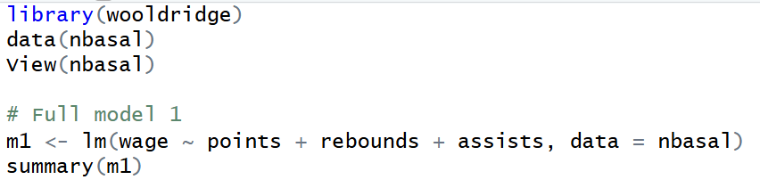
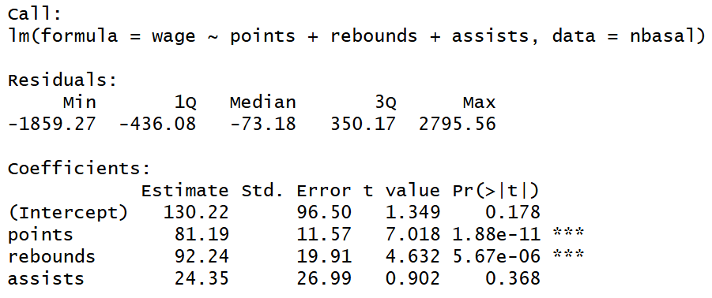
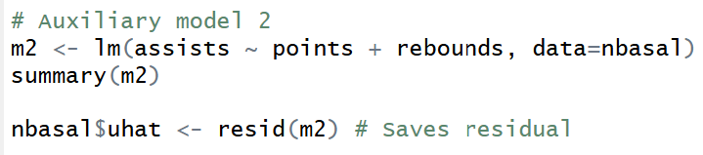
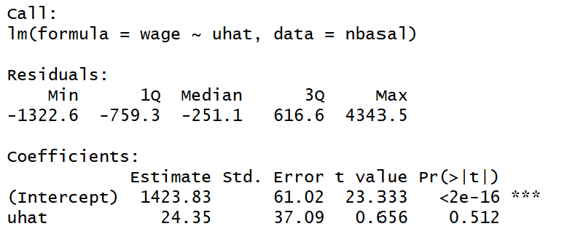
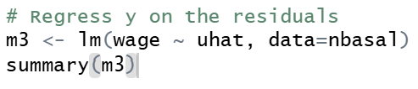
Write an R script to show this & explain what it does

Slide 5
Questions?

