Slide 1
Omitted Variable Bias
ECO 5720
Eli Caplan and Aaron Townsend
September 28, 2026

Slide 2
ECO 5720
A bias that arises when a model leaves out one or more relevant variables
How is an omitted variable bias created?
X is correlated to the omitted variable
The omitted variable is a determinant of of the dependent variable Y

Slide 3
ECO 5720
Why is Omitted Variable Bias a concern?
Distorted Results: The model will be overstated, understated, or reverse the real relationship between variables
False Causality: Creates fake connections -> Researchers think one factor causes an outcome when another variable may be responsible
Ruined Decisions: Real world decisions, policies, or business choices based on flawed models can lead to incorrect action

Slide 4
ECO 5720
Eliminating OVB- What about increasing our sample size?
Increasing the number of variables does not fix the core issue- Why?
A large sample size reduces standard errors and makes estimates more precise, but converges around the wrong number
  Our R^2 improves, but does not accurately describe relationship
Cannot control for a variable if you do not have the data for it
Adding random variables can introduce MORE bias into your sample

Slide 5
ECO 5720
Books on Your Shelf
1
2
3
4
Higher Job Pay
Studies Show…
Variables
What Else?
Academic achievement goes hand-in-hand with earning higher gross pay
Growing up in a house with lots of books on shelves is directly correlated to doing better in school
Is the number of books on our shelf the only reason why our academic performance is better?
Consider these other factors…
Parents IQ
Geographic location
Attention/Focus
Notes:
Ask classmates to answer about other possible factors with our example for classroom interaction (which is why there’s a stop in animation before “What Else”

Slide 6
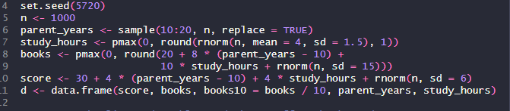
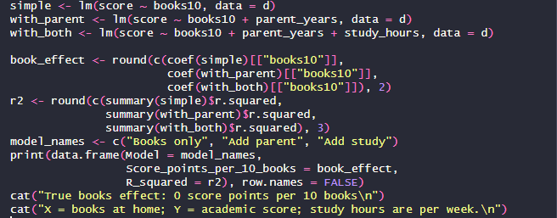
Eco 5720
R-Script
Breaking It Down:
We need to make a data set! We’ll make a random set with our variables
  parent_years
  study_hours
  books
simple: Predicts academic score using only books at home
with_parent: Repeats the comparison while accounting for parental schooling.
  with_both: Also accounts for weekly study hours. It still includes parental schooling.
Coef: Takes the books estimate from each model. Because books10 = books / 10, each estimate score points associated with 10 more books.

Slide 7
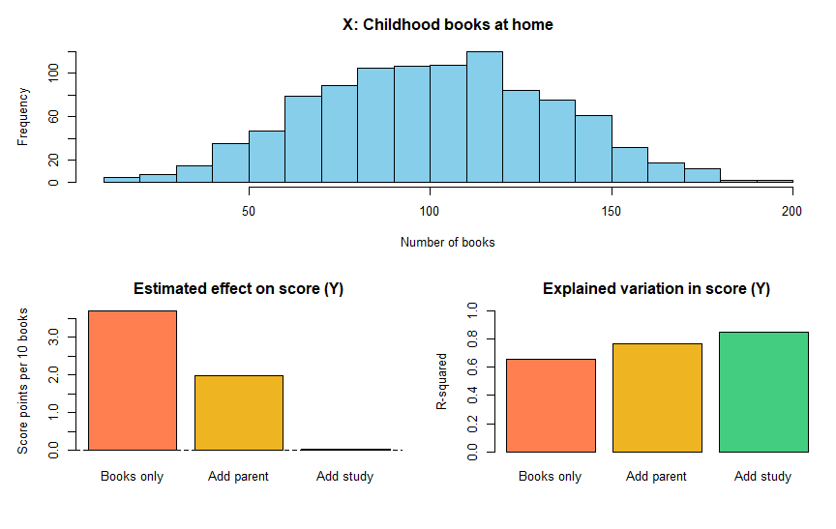
Eco 5720
Final Output
Breaking It Down:
How many students have each number of books
Estimated effect on score (Y): What each regression appears to say about 10 additional books
It rises as parent schooling and study hours are included
Notes:
Looking at everything, does that mean the books caused the higher scores?
With our 1,000 fictional students (n), our first model, used only books at home to predict their scores. It looks as though more books mean a higher score. Then we add parents’ years of schooling. The estimated books effect gets smaller. Finally, we add the hours students spend studying (add study), and the books effect moves close to zero.
Parental schooling and study hours affect scores, and both are related to how many books are at home. We gave books themselves no effect on scores. When the first model leaves those other factors out, it mistakenly gives books some of their credit. This is omitted variable bias.
The histogram shows how many books our simulated students have. The middle chart shows the changing books estimate, which is our main result. The (R^2) chart shows how much of the variation in scores each model explains. A higher (R^2) means a better fit, but it does not, by itself, prove bias.
(Point 1) Most have roughly 70–130 books; relatively few have very low or very high counts.
(Y): Using books alone suggests about 3.5 more score points. Adding parent schooling lowers that estimate to about 2; adding study hours brings it close to 0.

Slide 8
ECO 5720
Thank you!
Do you have any questions?

