Slide 1
Section 14.6
Multiple Regression Models with Qualitative Independent Variables

Slide 2
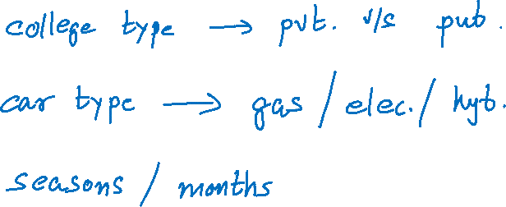
Multiple Regression Models with Qualitative Independent Variables
Qualitative variables –

Slide 3
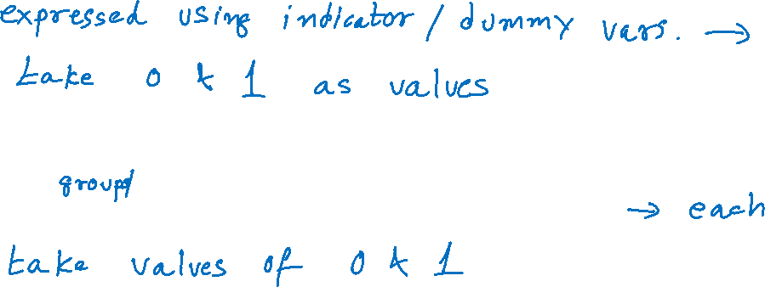
Indicator (or Dummy) Variables
Qualitative variables in regression analysis
For c classes, we use c – 1 indicator variables

Slide 4

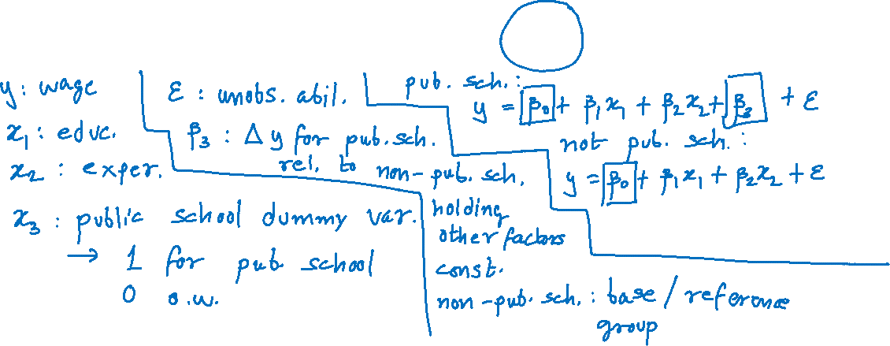
Indicator (or Dummy) Variables (cont.)
The multiple linear regression model:
$$y=β_{0}+β_{1}x_{1}+β_{2}x_{2}+β_{3}x_{3}+ε$$

Slide 5

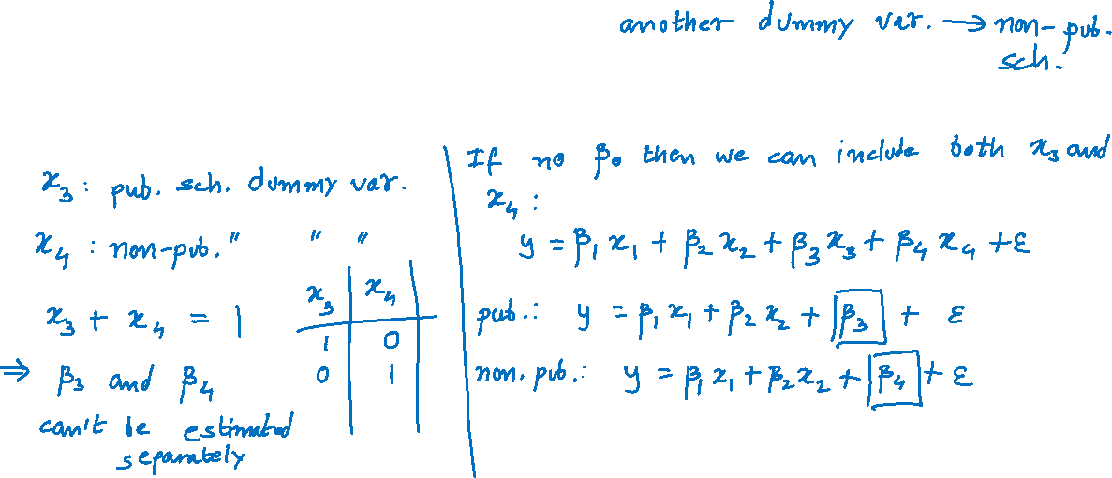
Indicator (or Dummy) Variables (cont.)
Doesn’t make sense to have
$$y=β_{0}+β_{1}x_{1}+β_{2}x_{2}+β_{3}x_{3}+β_{4}x_{4}+ε$$

Slide 6

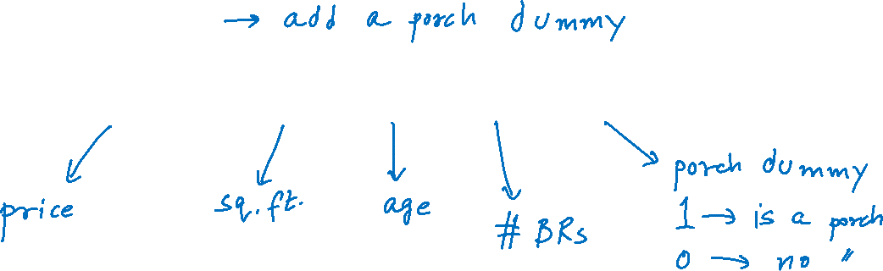
Indicator (or Dummy) Variables (cont.)
Home Prices
$$y=β_{0}+β_{1}x_{1}+β_{2}x_{2}+β_{3}x_{3}+β_{4}x_{4}+ε$$

Slide 7

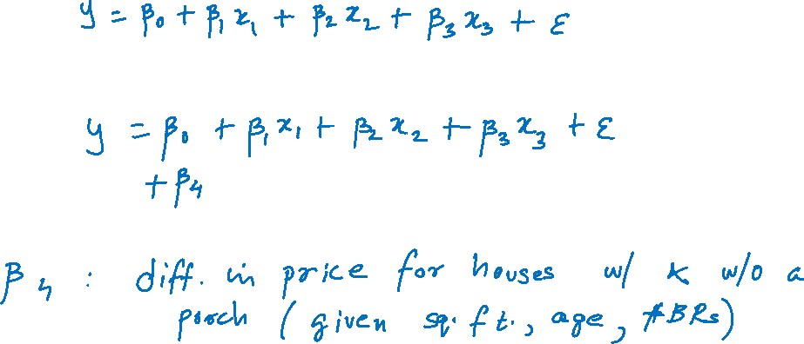
Indicator (or Dummy) Variables (cont.)
For a house without a porch ($x_{4}=0$)
For a house with a porch ($x_{4}=1$)

Slide 8
Example 14.6.1
Real estate data set with the added column of the variable porch

Slide 9
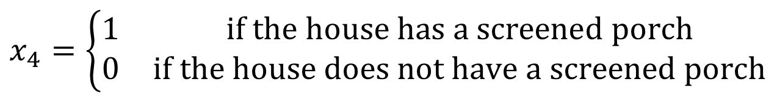
Example 14.6.1 (cont.)
Home price as a function of
x₁ = square footage
x₂ = age
x₃ = bedrooms
Estimate and statistical significance of β₄
$$x_{4}=\left\{\begin{matrix}1 & \text{if} \text{the} \text{house} \text{has} \text{a} \text{screened} \text{porch} \\ 0 & \text{if} \text{the} \text{house} \text{does} \text{not} \text{have} \text{a} \text{screened} \text{porch}\end{matrix}\right.$$

Slide 10

Example 14.6.1 (cont.)

Slide 11
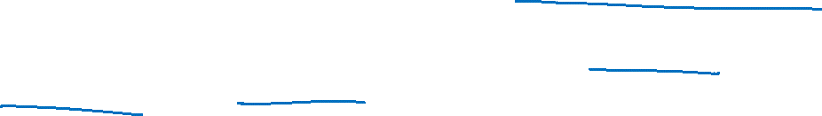
Example 14.6.2
A real estate investor wants to study the relationship between annual return on his commercial retail shops (measured in thousands of dollars) as it relates to their location and the number of homes near the shops. Specifically, the investor has collected data on the annual return of the shops, the number of households within 15 miles of the shops (measured in thousands), and the location of the shops (whether the shops are in a suburban area, near a shopping mall, or downtown). The annual return data are given in the following table.

Slide 12
Example 14.6.2 (cont.)

Slide 13
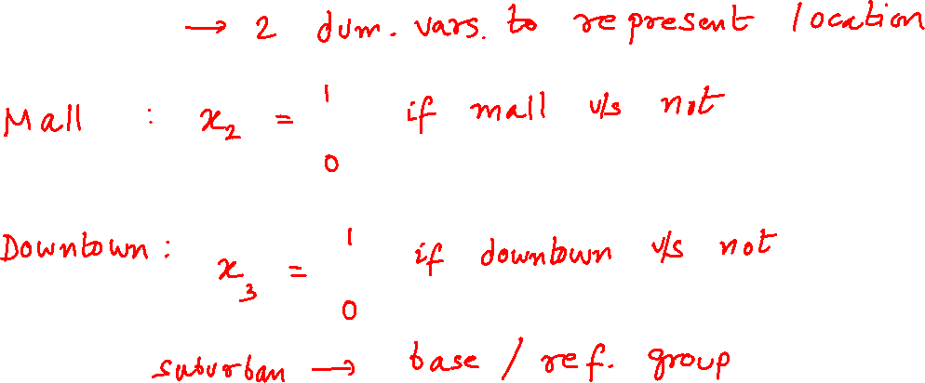
Example 14.6.2 (cont.)
x₁ = number of households
Three locations

Slide 14

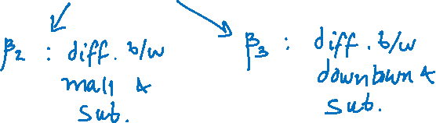
Example 14.6.2 (cont.)
Suburban location - the base group.
The coefficients estimated for the x₂ and x₃ indicator variables…
Multiple regression model
$$y=β_{0}+β_{1}x_{1}+β_{2}x_{2}+β_{3}x_{3}+ε.$$

Slide 15
Example 14.6.2 (cont.)

Slide 16
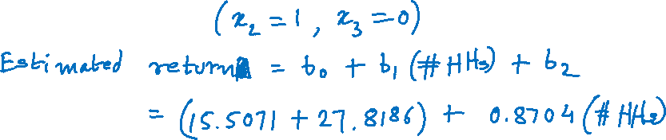
Example 14.6.2 (cont.)
Average annual return of the investments as a function of the location of the shops (i.e., whether they are near a mall, downtown, or in a suburban area).
Mall location:

Slide 17
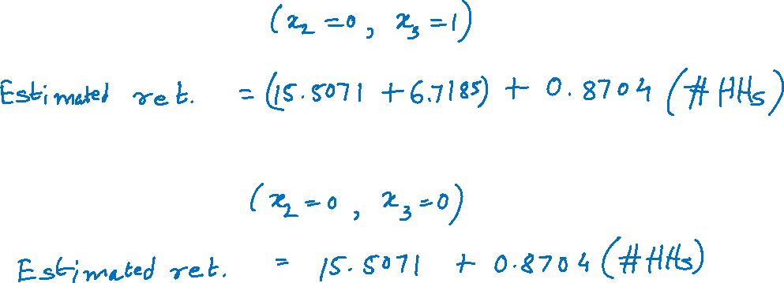
Example 14.6.2 (cont.)
Downtown location:
Suburban location:

Slide 18
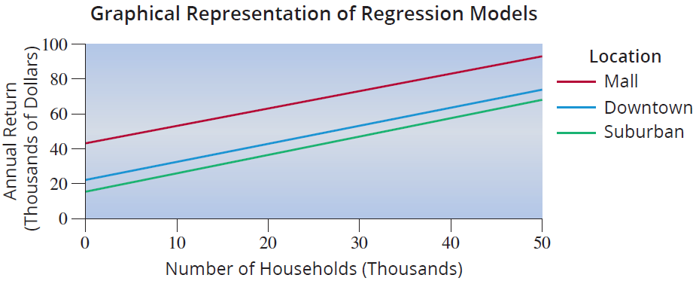
Example 14.6.2 (cont.)

Slide 19
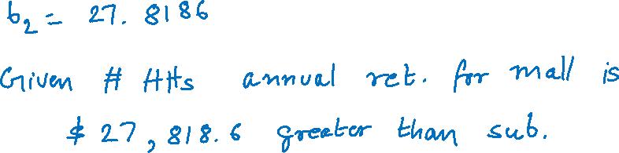
Example 14.6.2 (cont.)
To compare the mall and suburban locations

Slide 20
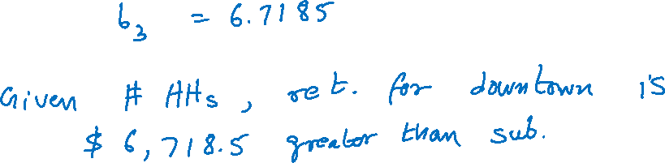
Example 14.6.2 (cont.)
To compare the downtown and suburban returns

Slide 21
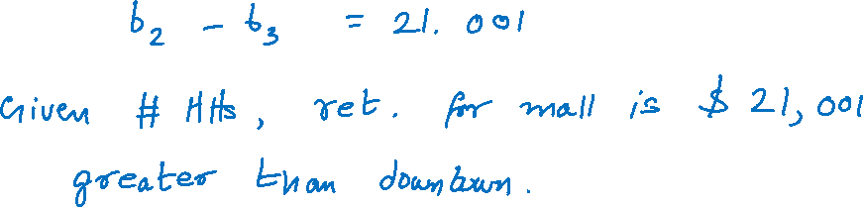
Example 14.6.2 (cont.)
To compare the mall and downtown locations

