Slide 1
Section 14.4
Inference Concerning the Multiple Regression Model and Its Coefficients

Slide 2

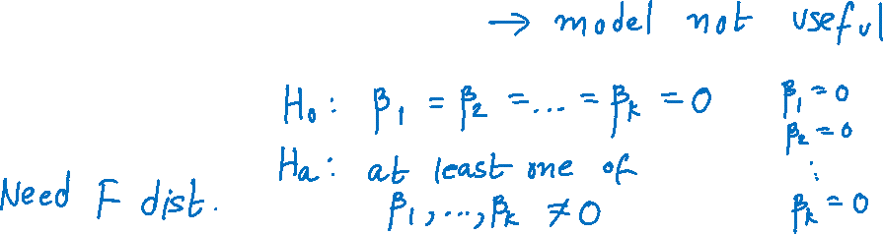
Inference Concerning the Multiple Regression Model and Its Coefficients
Multiple regression model
$y=β_{0}+β_{1}x_{1}+β_{2}x_{2}+…+β_{k}x_{k}+ε$
If $β_{1}=β_{2}=…=β_{k}=0$
Might test

Slide 3
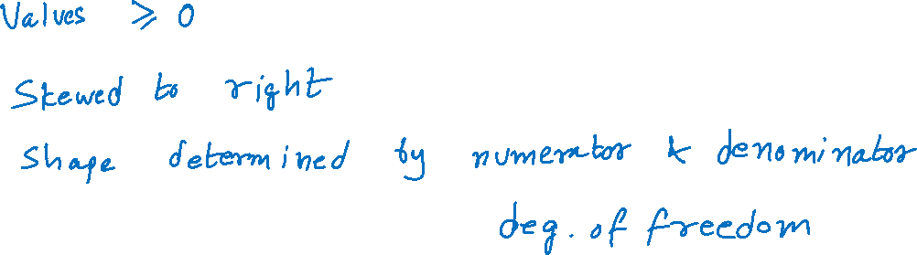
Properties of an F-Distribution

Slide 4
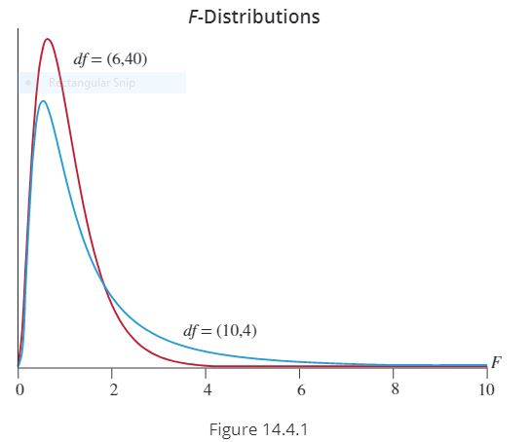
Properties of an F-Distribution (cont.)

Slide 5
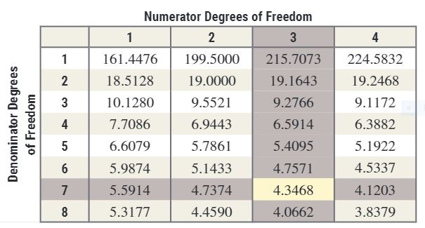
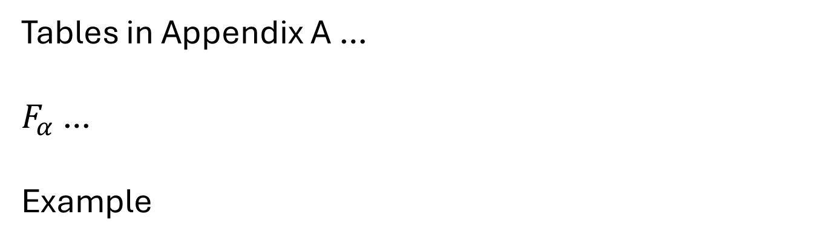
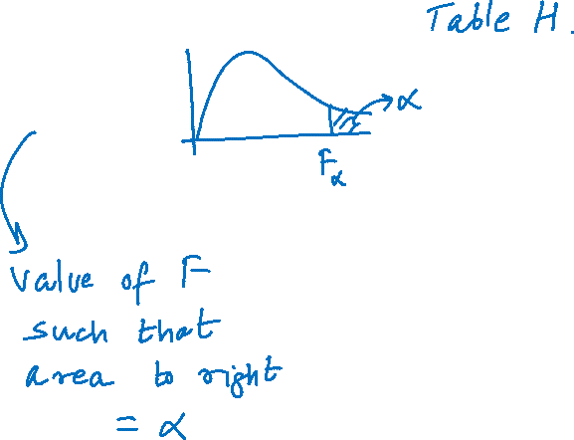
Properties of an F-Distribution (cont.)
Tables in Appendix A …
$F_{α}$ …
Example

Slide 6
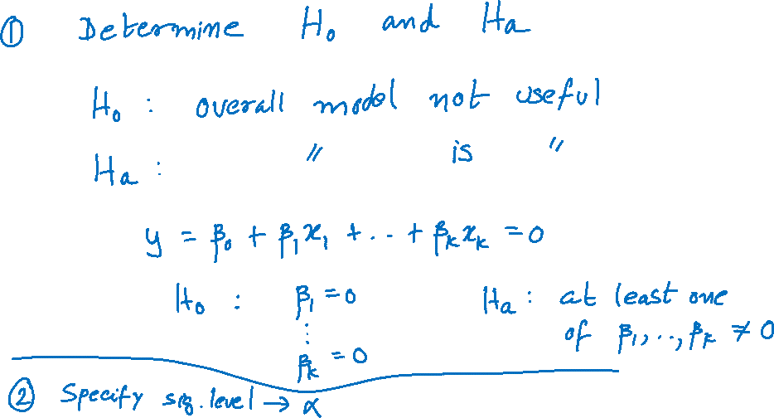
Steps in the Test of Hypothesis

Slide 7
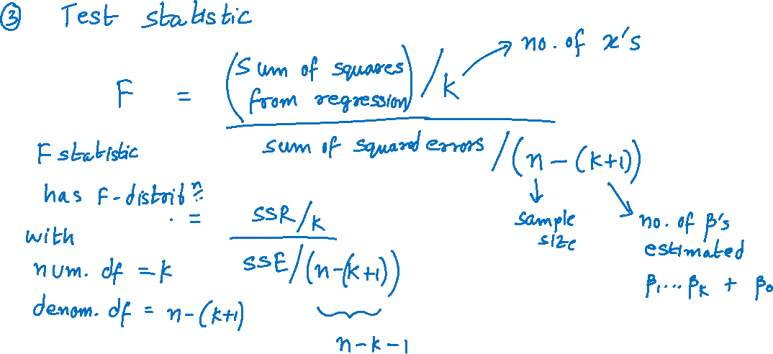
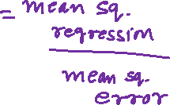
Steps in the Test of Hypotheses (cont.)

Slide 8
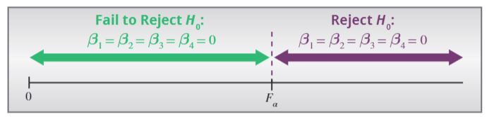
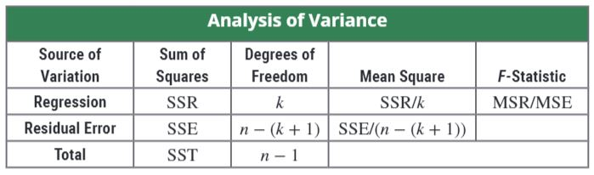
Steps in the Test of Hypotheses (cont.)

Slide 9
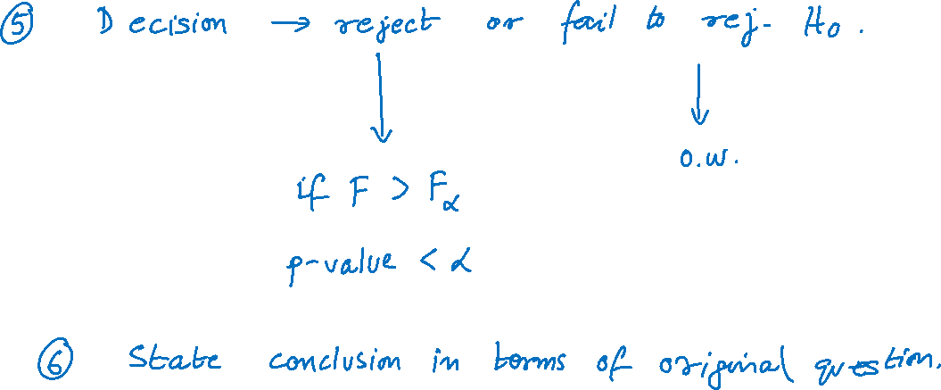
Steps in the Test of Hypotheses (cont.)

Slide 10
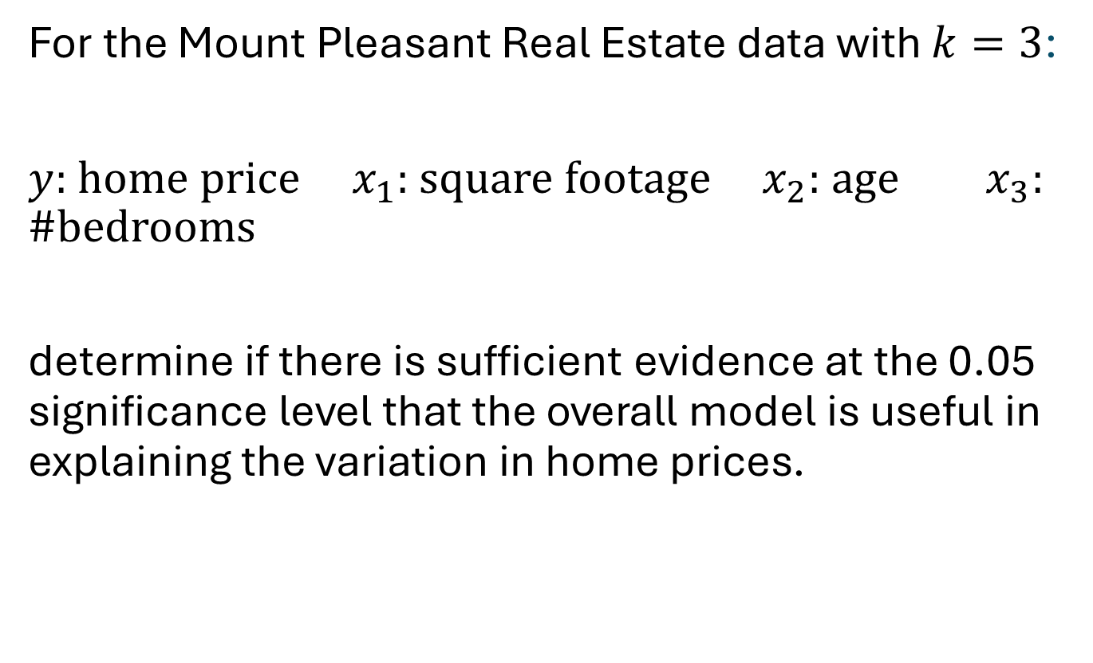
Example 14.4.1
For the Mount Pleasant Real Estate data with $k=3$:
$y$: home price $x_{1}$: square footage $x_{2}$: age $x_{3}$: #bedrooms
determine if there is sufficient evidence at the 0.05 significance level that the overall model is useful in explaining the variation in home prices.

Slide 11
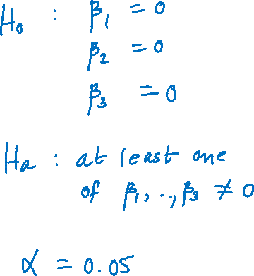
Example 14.4.1 (cont.)

Slide 12
Example 14.4.1 (cont.)

Slide 13
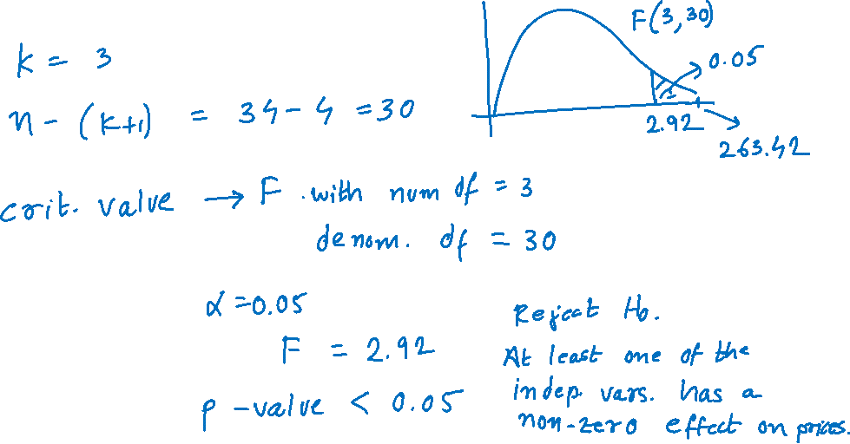
Example 14.4.1 (cont.)

Slide 14
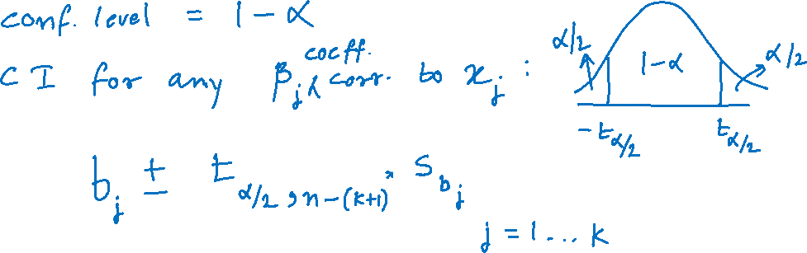
Confidence Interval for Each Coefficient

Slide 15
Example 14.4.2 (cont.)

Slide 16

Testing Hypotheses on Individual β_{i} (Example 14.4.3)
For the Mount Pleasant Real Estate model
Price of Home = β ₀ + β ₁ (Square Footage) + β ₂ (Age of Home) + β ₃ (Number of Bedrooms)
Is the independent variable number of bedrooms a useful predictor of home price? Use α = 0.05 as the level of significance.

Slide 17
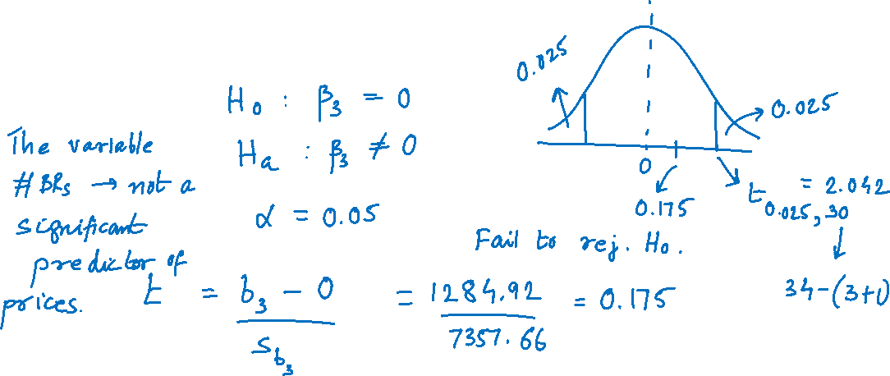
Example 14.4.3 (cont.)
Test statistic and critical value

Slide 18
Example 14.4.3 (cont.)

