Slide 1
Section 14.1
The Multiple Regression Model

Slide 2
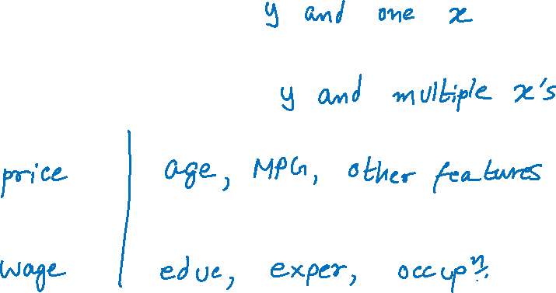
The Multiple Regression Model
Simple regression …
Multiple regression …

Slide 3
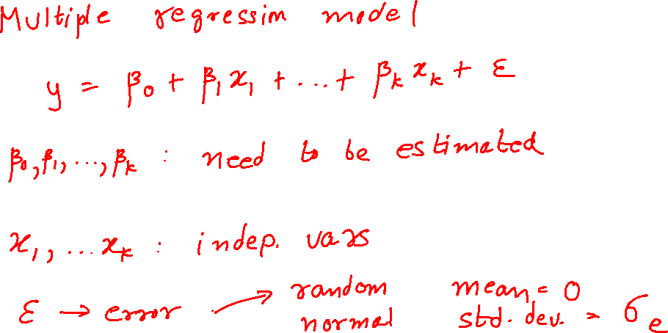
The Multiple Regression Model (cont.)

Slide 4

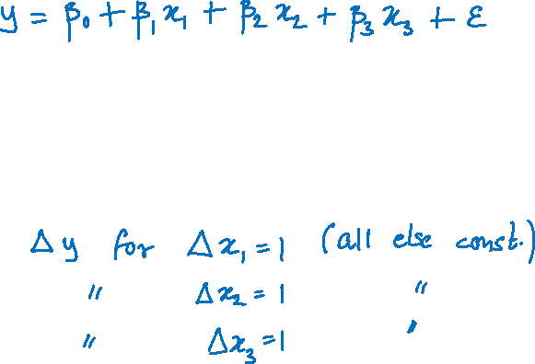
The Multiple Regression Model (cont.)
For $k=3$:
$y$: wage $x_{1}$: education $x_{2}$: experience
$x_{3}$: occupation $ε$: unobserved ability
$β_{1}$:
$β_{2}$:
$β_{3}$:

Slide 5

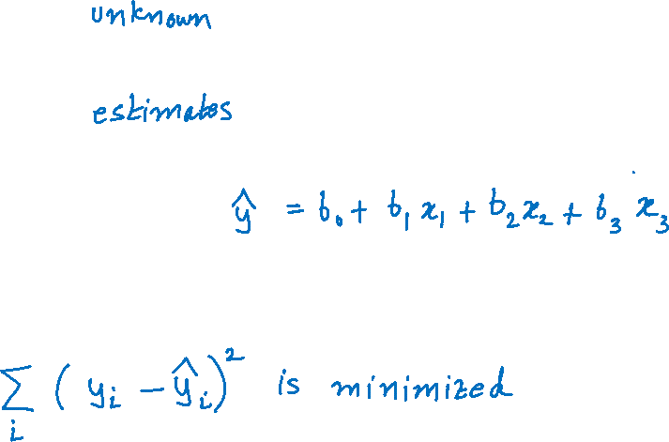
The Multiple Regression Model (cont.)
$β_{0},β_{1}, β_{2}$,$β_{3}$:
$b_{0},b_{1}, b_{2}$, $b_{3}$:
Predicted values of $y$:
$b_{0},b_{1}, b_{2}$, $b_{3}$: estimated such that …

Slide 6

The Estimated Multiple Regression Equation

Slide 7
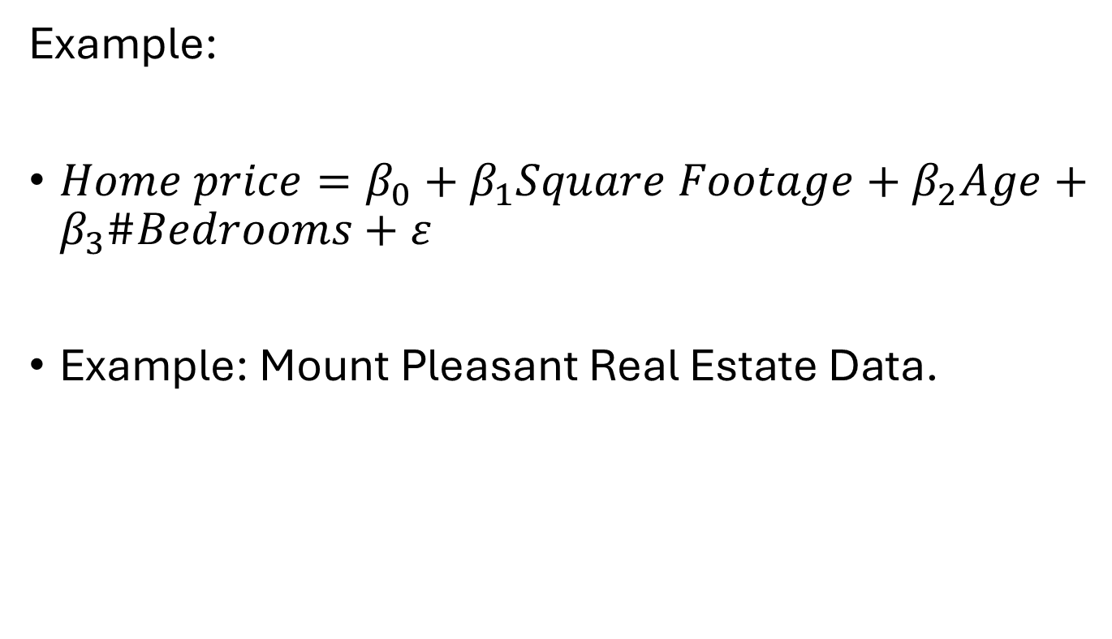
The Multiple Regression Model (cont.)
Example:
$Home price=β_{0}+β_{1}Square Footage+β_{2}Age+β_{3}\#Bedrooms+ε$
Example: Mount Pleasant Real Estate Data.

Slide 8
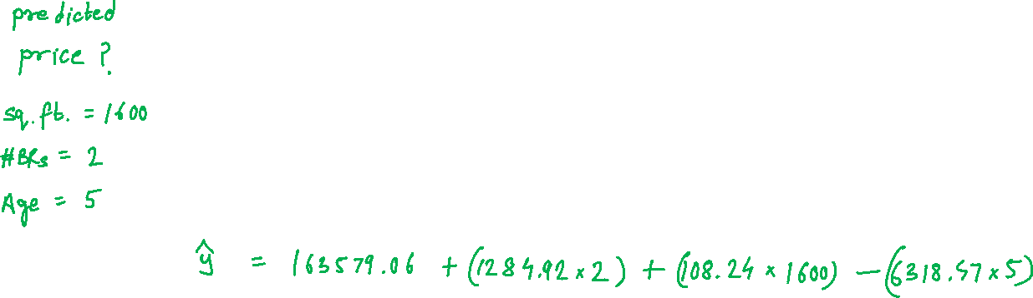
The Multiple Regression Model (cont.)

Slide 9
The Multiple Regression Model (cont.)
Some things to consider:
Explaining variation in home prices
Signs and magnitudes of the estimated coefficients
Other independent variables
Prediction

