Slide 1
Section 8.3
The Standard Normal Distribution

Slide 2
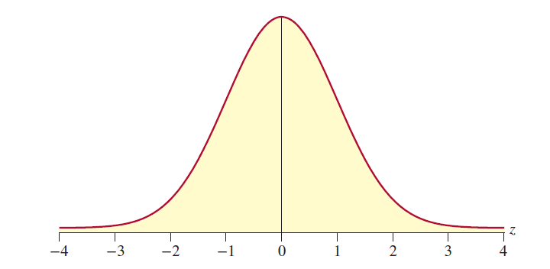
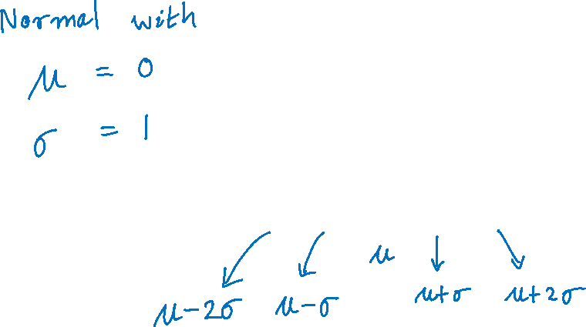
Standard Normal Distribution

Slide 3
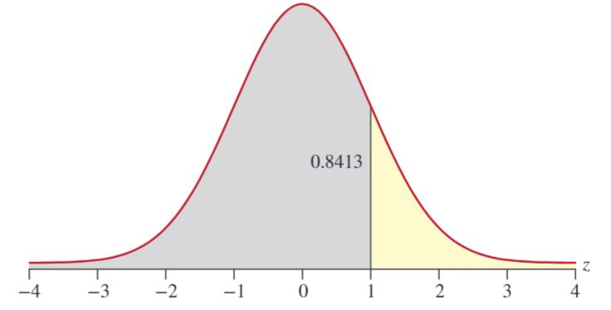
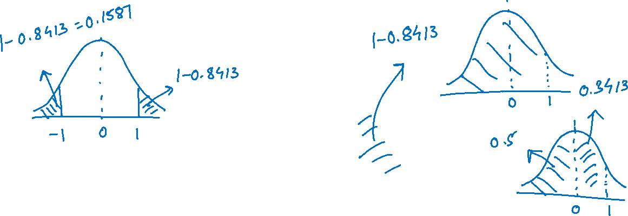
z-distribution
Tables A, B, and C in Appendix A

Slide 4
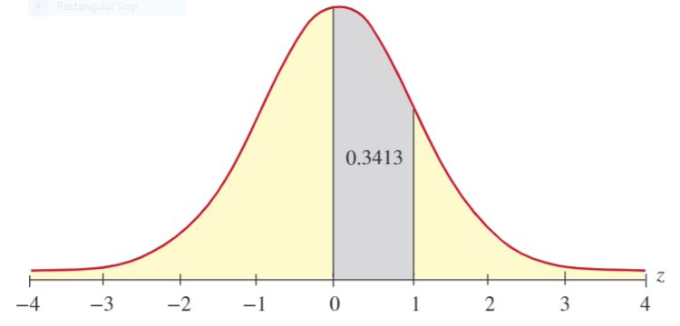
z-distribution (cont.)

Slide 5
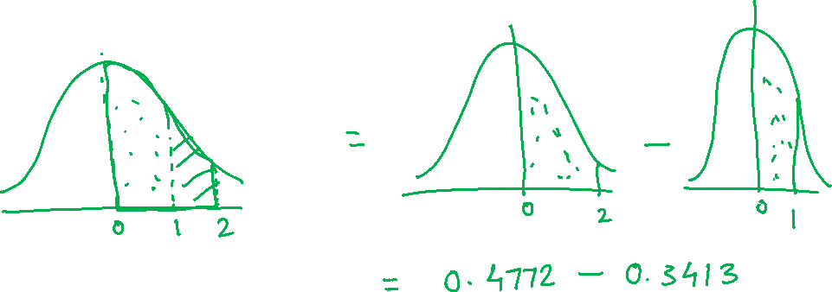
Example
What is the probability that a standard normal random variable will be between 1 and 2?

Slide 6
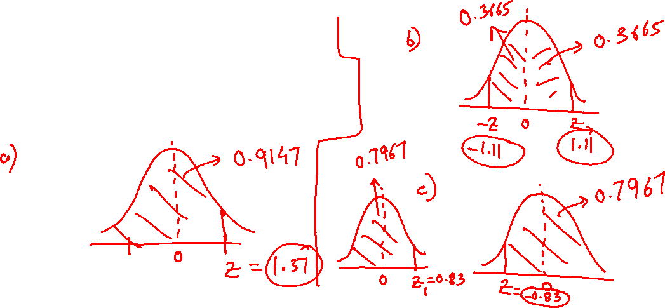
Example
Given that z is a standard normal random variable, find the value of z for each situation.
The area to the left of z is 0.9147.
The area between 0 and z is 0.3665.
The area to the right of z is 0.7967.

