Slide 1
Section 4.2
Measures of Dispersion

Slide 2
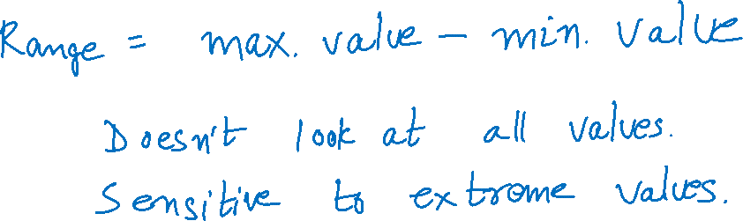
Range

Slide 3
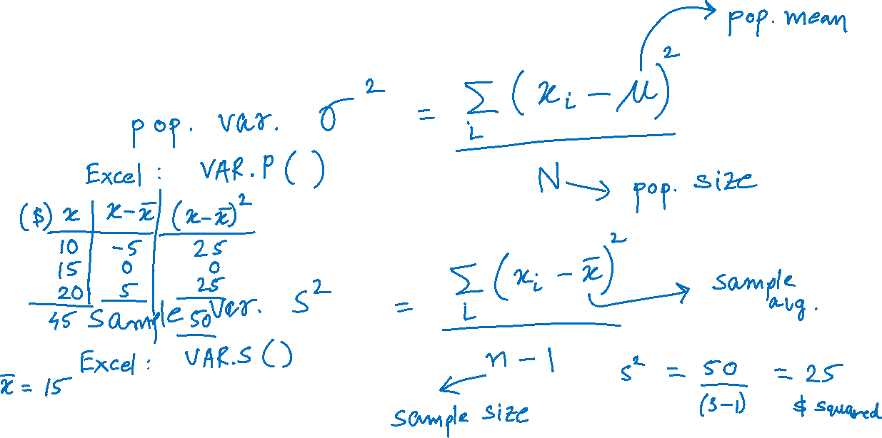
Variance

Slide 4
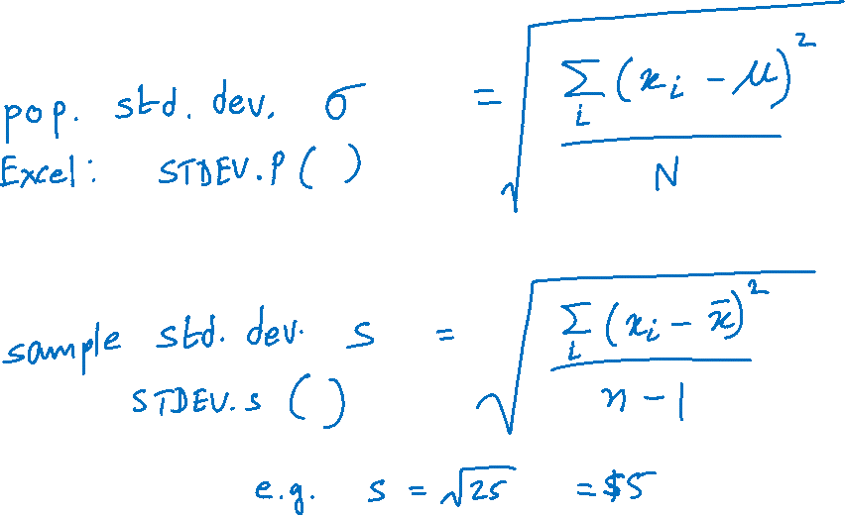
Standard Deviation

Slide 5
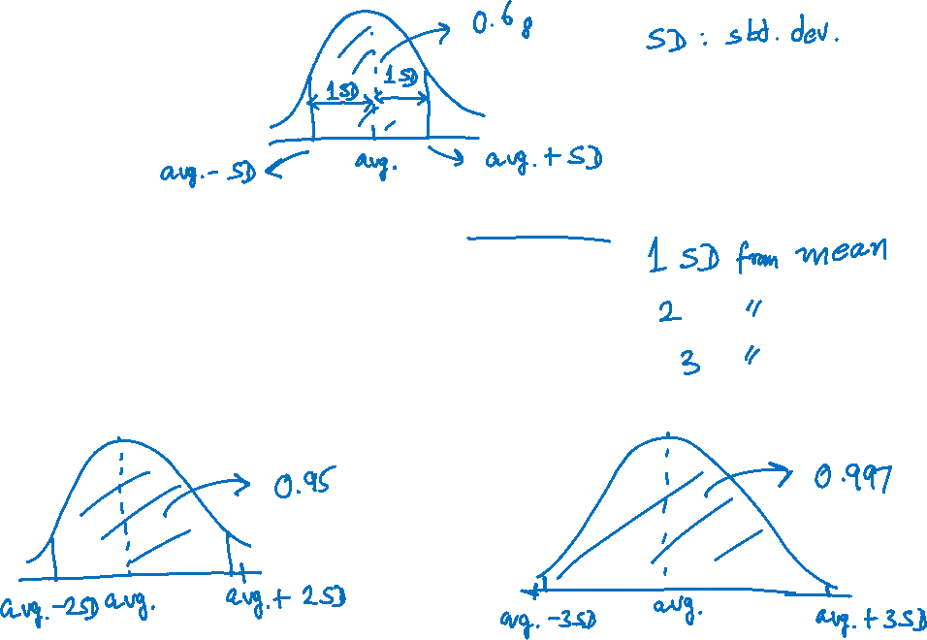
Empirical Rule
If the distribution of the data is bell-shaped, then
About 68% of the data should lie within ...
About 95% of the data should lie within ...
About 99.7% of the data should lie within ...

Slide 6
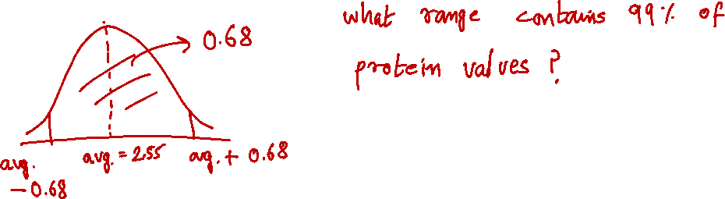
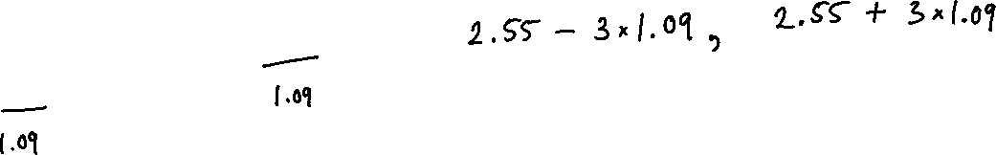
Example
Suppose a group of breakfast cereals has an average protein content of 2.55 grams, with a standard deviation of 1.09 grams. If the data possesses a bell-shaped distribution, which interval contains 68% of the protein contents?

