Slide 1
Section 9.2
Introduction to Sampling Distributions

Slide 2
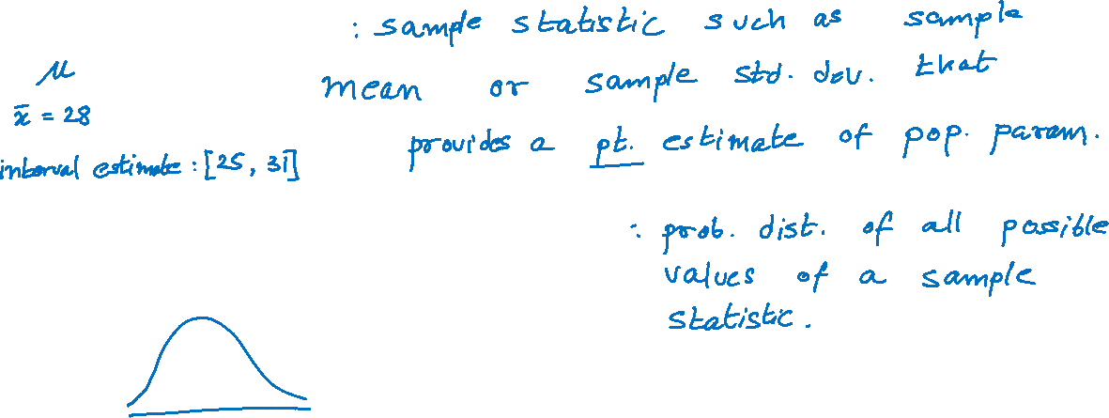
Sampling Distribution of a Statistic
Point estimator
Sampling distribution of a statistic

Slide 3
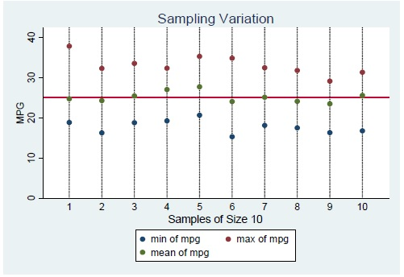
Sampling Distribution of a Statistic (cont.)

