Slide 1
Section 9.1
Random Samples

Slide 2
Random Samples
Samples representing a population
1936 United States presidential election
Poll from automobile registrations and telephones books
Indicated Landon – 57% and Roosevelt – 43%
Actual election: Roosevelt – 62% and Landon – 38% for Landon.

Slide 3
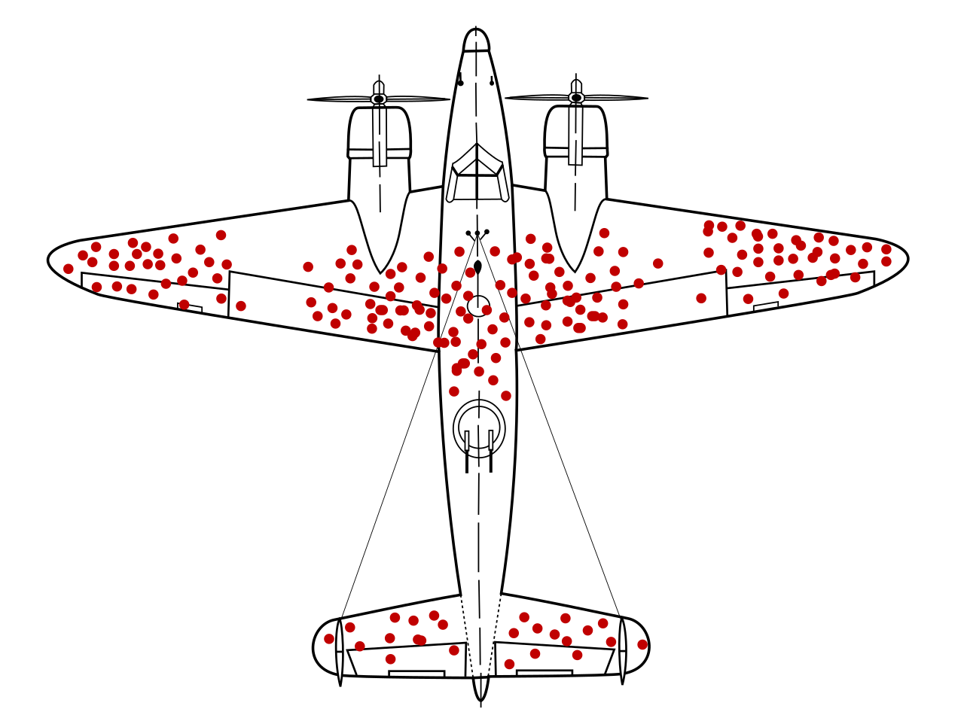
Random Samples (cont.)
https://en.wikipedia.org/wiki/Survivorship_bias

Slide 4
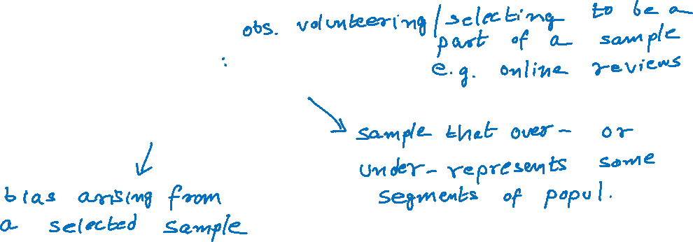
Random Samples (cont.)
Voluntary sampling
Biased or selected sample
Selection bias

Slide 5
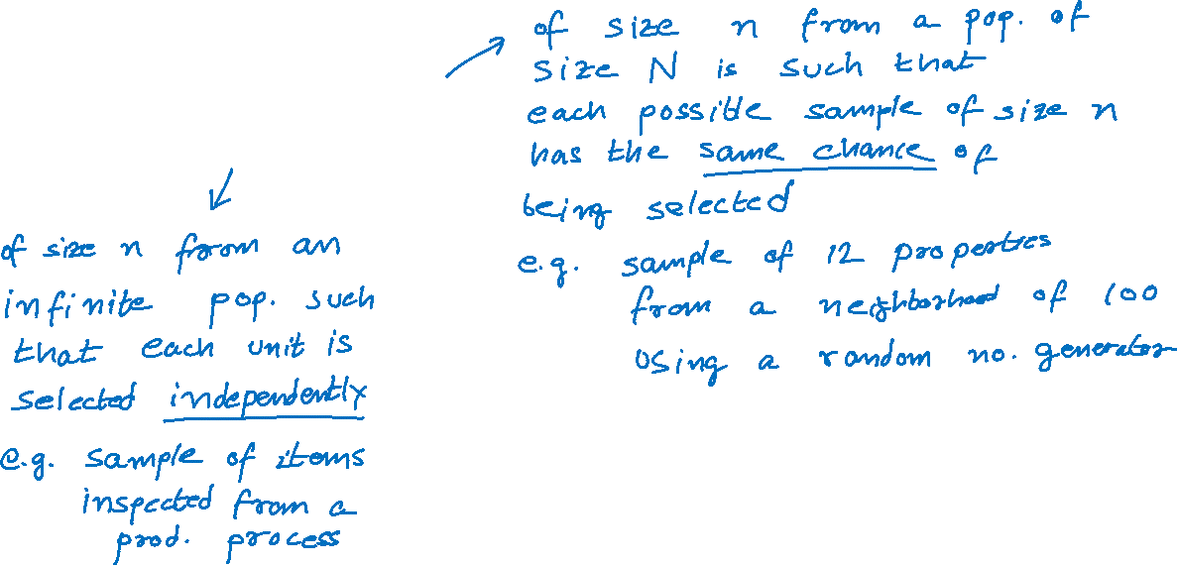
Random Samples (cont.)
Simple random sample
Random sample

