Slide 1
Section 8.4
Applications of the Normal Distribution

Slide 2
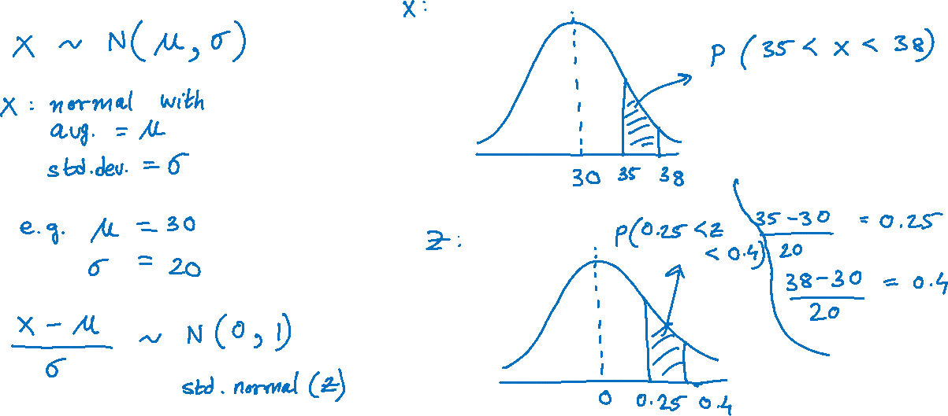
Standardizing a Normal Random Variable

Slide 3
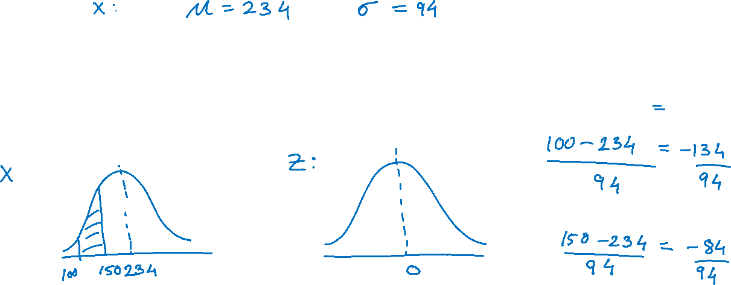
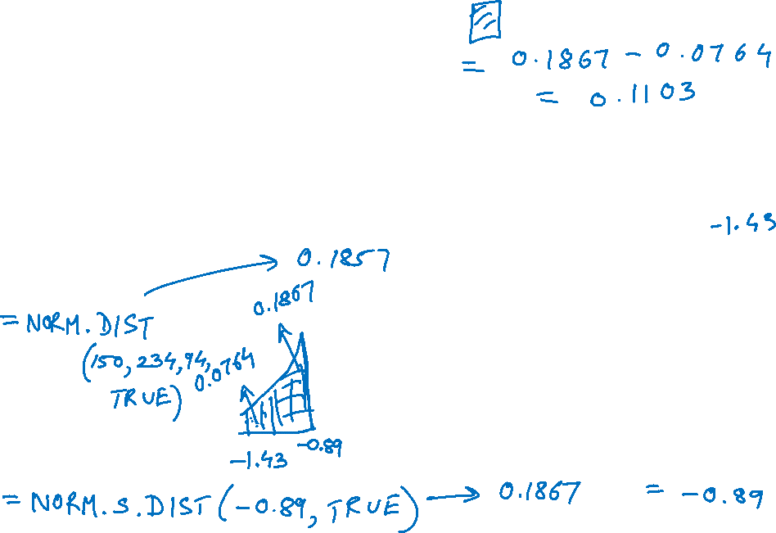
Example
Suppose that for 132 shoppers making a purchase at a clothing store, the total each shopper will spend follows a normal distribution with a mean of $234 and a standard deviation of $94. What is the probability that the next purchase total will be between $100 and $150?

Slide 4
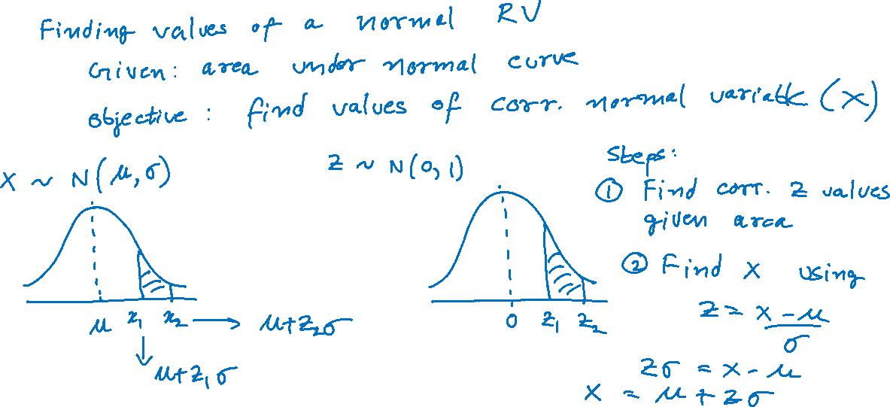
Finding Values of a Normally Distributed Random Variable

Slide 5
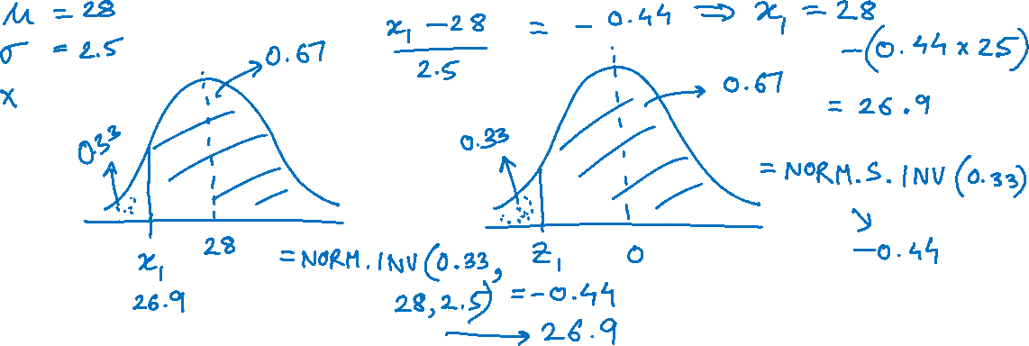
Example
If a normal distribution has a mean of 28.0 and a standard deviation of 2.5, what is the value of the random variable X that has an area to its right equal to 0.6700?

