Slide 1
Section 8.2
The Normal Distribution

Slide 2
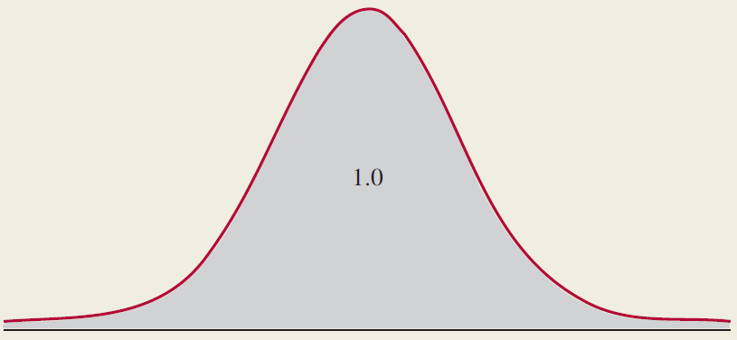
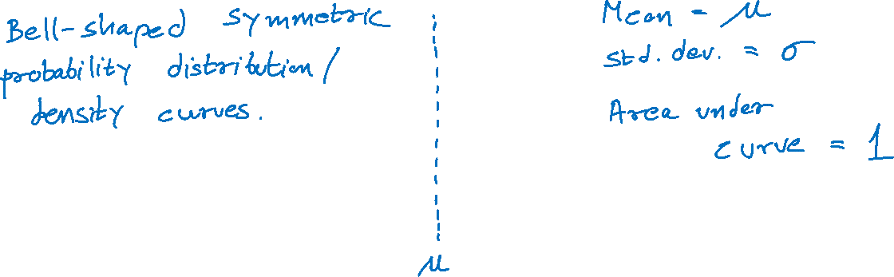
Normal Distribution
http://datacolada.org/98

Slide 3
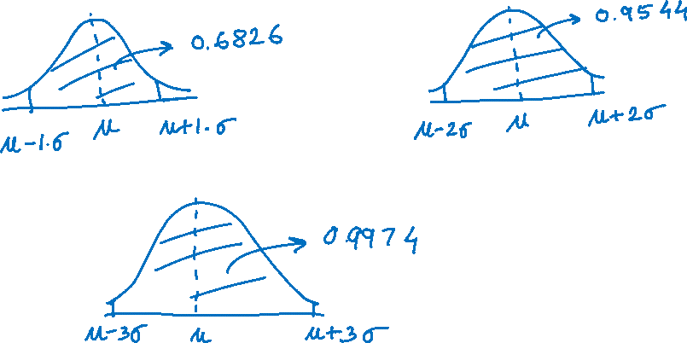
Standard Deviations Around the Mean
Probability of being within 1, 2, and 3 standard deviations of the mean.

Slide 4
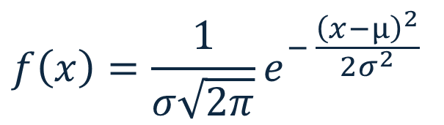
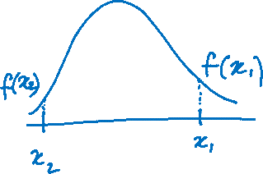
Normal Probability Density Function
Given by
$$f\left(x\right)=\frac{1}{σ\sqrt{2π}}e^{− \frac{{\left(x−μ\right)}^{2}}{2σ^{2}}}$$

Slide 5
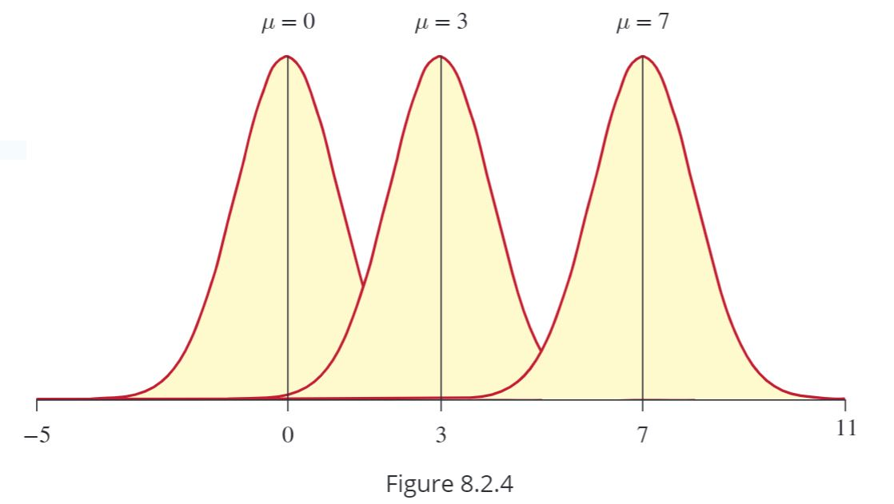
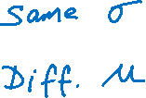
Normal Probability Density Function (cont.)

Slide 6
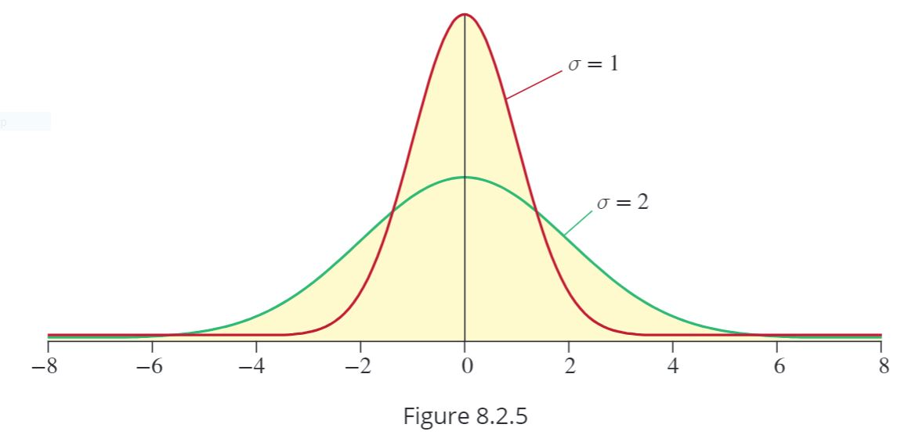
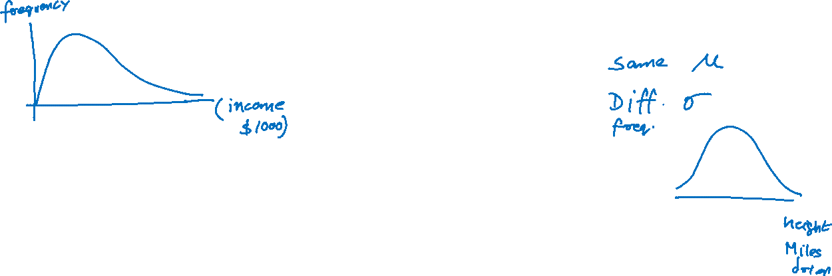
Normal Probability Density Function (cont.)

