Slide 1
Section 14.6
Multiple Regression Models with Qualitative Independent Variables

Slide 2
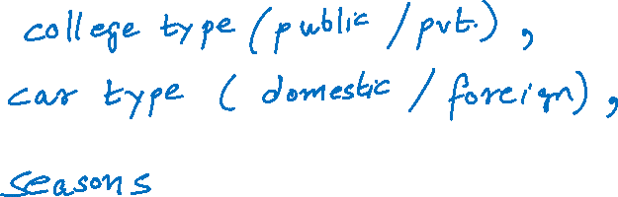
Multiple Regression Models with Qualitative Independent Variables
Qualitative variables –

Slide 3
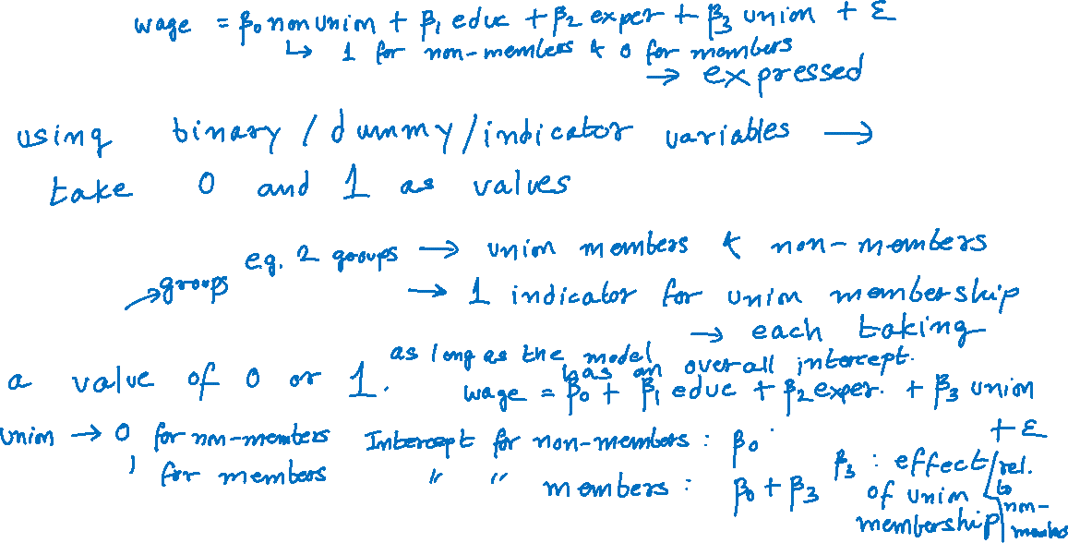
Indicator (or Dummy) Variables
Qualitative variables in regression analysis
For c classes, we use c – 1 indicator variables

Slide 4

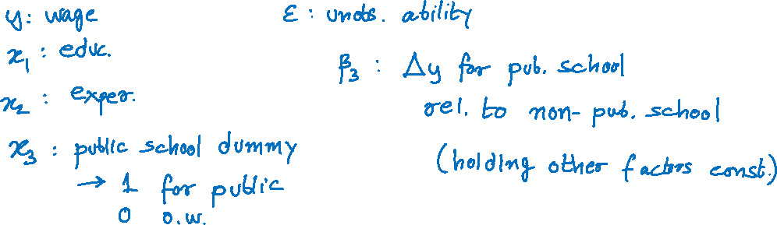
Indicator (or Dummy) Variables (cont.)
The multiple linear regression model:
$y=β_{0}+β_{1}x_{1}+β_{2}x_{2}+β_{3}x_{3}+ε$

Slide 5

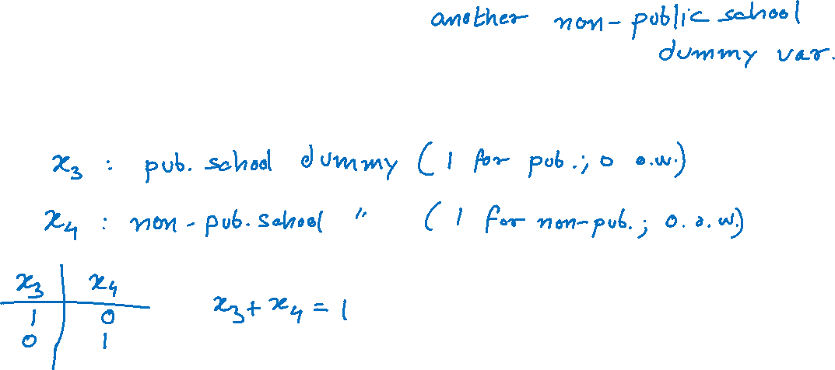
Indicator (or Dummy) Variables (cont.)
Doesn’t make sense to have
$y=β_{0}+β_{1}x_{1}+β_{2}x_{2}+β_{3}x_{3}+β_{4}x_{4}+ε$

Slide 6

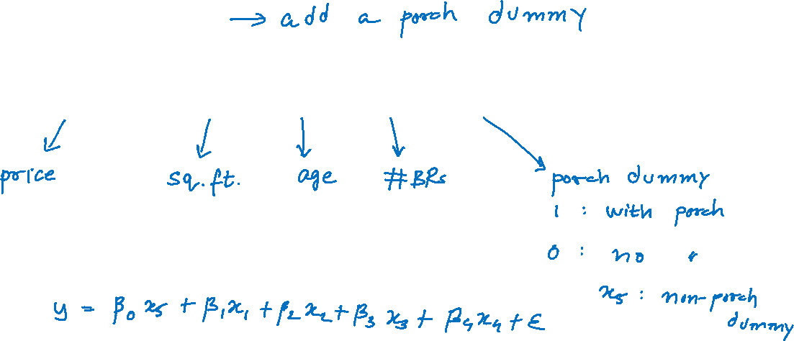
Indicator (or Dummy) Variables (cont.)
Home Prices
$y=β_{0}+β_{1}x_{1}+β_{2}x_{2}+β_{3}x_{3}+β_{4}x_{4}+ε$

Slide 7

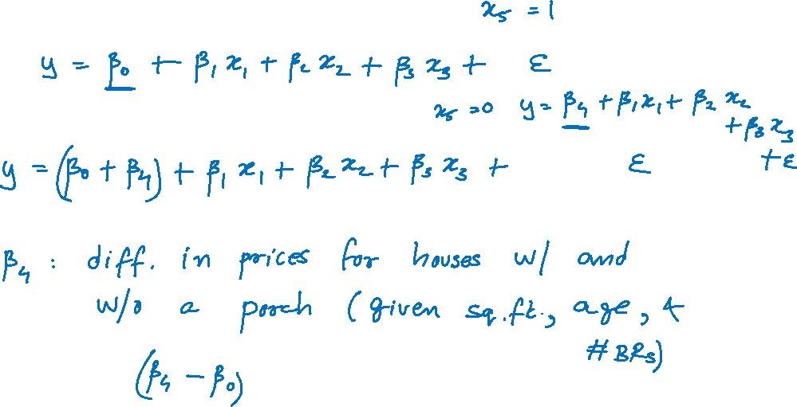
Indicator (or Dummy) Variables (cont.)
For a house without a porch ($x_{4}=0$)
For a house with a porch ($x_{4}=1$)

Slide 8
Example 14.6.1
Real estate data set with the added column of the variable porch
Mount Pleasant Real Estate Data
Price | Square Feet | Age | Number of Bedrooms | Porch | Screened Porch?
350000 | 2592 | 8 | 3 | 1 | Yes
119900 | 777 | 17 | 1 | 1 | Yes
179900 | 1137 | 17 | 2 | 0 | No
124900 | 777 | 17 | 1 | 0 | No
349999 | 2151 | 4 | 4 | 0 | No
. . .

Slide 9
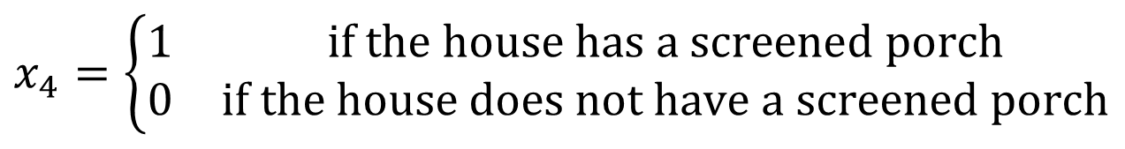
Example 14.6.1 (cont.)
Home price as a function of
x₁ = square footage
x₂ = age
x₃ = bedrooms
$$x_{4}=\left\{\begin{matrix}1 & \text{if} \text{the} \text{house} \text{has} \text{a} \text{screened} \text{porch} \\ 0 & \text{if} \text{the} \text{house} \text{does} \text{not} \text{have} \text{a} \text{screened} \text{porch}\end{matrix}\right.$$

Slide 10
Example 14.6.1 (cont.)
Fitted model:
SUMMARY OUTPUT
Regression Statistics
Multiple R | 0.983153945
R Square | 0.96659168
Adjusted R Square | 0.961983636
Standard Error | 21275.07421
Observations | 34

Slide 11
Example 14.6.1 (cont.)
ANOVA
 | df | SS | MS | F | Signiﬁcance F
Regression | 4 | 3.79777E+11 | 94944231937 | 209.7618082 | 5.92154E-21
Residual | 29 | 13126234702 | 452628782.8
Total | 33 | 3.92903E+11
 | Coeﬃcients | Standard Error | t Stat | P-value | Lower 95% | Upper 95%
Intercept | 163626.7916 | 20421.30079 | 8.012554798 | 7.76213E-09 | 121860.5419 | 205393.0413
Square Feet | 114.9454965 | 9.88474698 | 11.62857246 | 1.93724E-12 | 94.72891896 | 135.162074
Age | −6152.363638 | 750.6484437 | −8.196065268 | 4.89101E-09 | −7687.612086 | −4617.11519
Number of Bedrooms | −1358.306077 | 7327.914624 | −0.185360522 | 0.854236625 | −16345.57428 | 13628.96213
Porch | −13506.63879 | 8148.538447 | −1.657553545 | 0.108188125 | −30172.27116 | 3158.993583

Slide 12
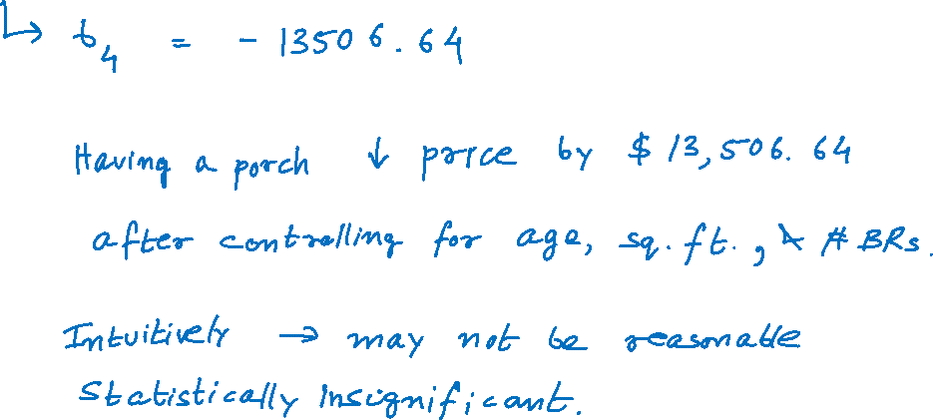
Example 14.6.1 (cont.)
Estimate and statistical significance of β₄

Slide 13
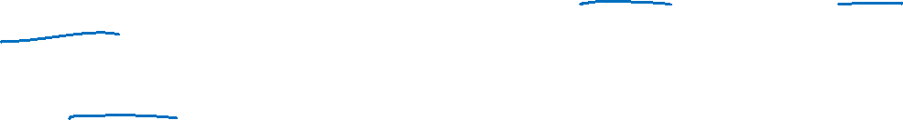
Example 14.6.2
A real estate investor wants to study the relationship between annual return on his commercial retail shops (measured in thousands of dollars) as it relates to their location and the number of homes near the shops. Specifically, the investor has collected data on the annual return of the shops, the number of households within 15 miles of the shops (measured in thousands), and the location of the shops (whether the shops are in a suburban area, near a shopping mall, or downtown). The annual return data are given in the following table.

Slide 14
Example 14.6.2 (cont.)
x₁ = number of households
Shop Data
Shop | Location | Annual Return (Thousands of Dollars) | Number of Households (Thousands)
1 | Mall | 185.69 | 163
2 | Suburban | 203.00 | 215
3 | Mall | 245.81 | 232
4 | Mall | 137.07 | 108
5 | Suburban | 207.36 | 220
. . .

Slide 15
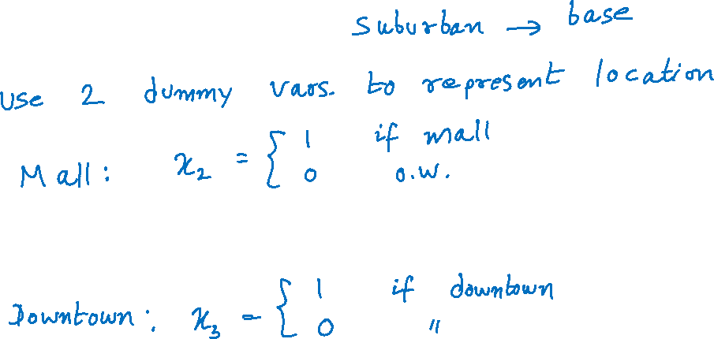
Example 14.6.2 (cont.)
Three locations

Slide 16

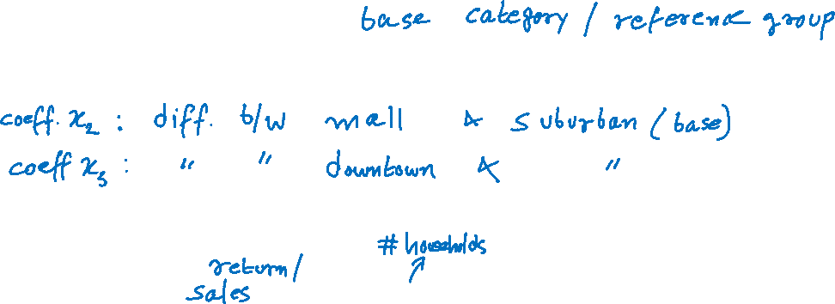
Example 14.6.2 (cont.)
Suburban location - the base level variable.
The coefficients estimated for the x₂ and x₃ indicator variables…
Multiple regression model
$$y=β_{0}+β_{1}x_{1}+β_{2}x_{2}+β_{3}x_{3}+ε.$$

Slide 17
Example 14.6.2 (cont.)
Fitted model
Estimated Annual Return = 15.5071 + 0.8704 (number of households) + 27.8186 (mall) + 6.7185 (downtown).

Slide 18
Example 14.6.2 (cont.)
SUMMARY OUTPUT
Regression Statistics
Multiple R | 0.999974838
R Square | 0.999949677
Adjusted R Square | 0.999943871
Standard Error | 0.288707033
Observations | 30
ANOVA
 | df | SS | MS | F | Signiﬁcance F
Regression | 3 | 43062.89567 | 14354.29856 | 172213.5214 | 5.5533E-56
Residual | 26 | 2.167145526 | 0.083351751
Total | 29 | 43065.06282

Slide 19
Example 14.6.2 (cont.)
 | Coeﬃcients | Standard Error | t Stat | P-value | Lower 95% | Upper 95%
Intercept | 15.50707387 | 0.261037514 | 59.40553771 | 2.6636E-29 | 14.97050357 | 16.04364416
# of Households | 0.870441943 | 0.001225001 | 710.5645401 | 2.77306E-57 | 0.867923919 | 0.872959968
Mall | 27.81856958 | 0.138873816 | 200.3154397 | 5.45545E-44 | 27.53311037 | 28.1040288
Downtown | 6.718542409 | 0.13223228 | 50.80864057 | 1.49967E-27 | 6.446735064 | 6.990349754

Slide 20
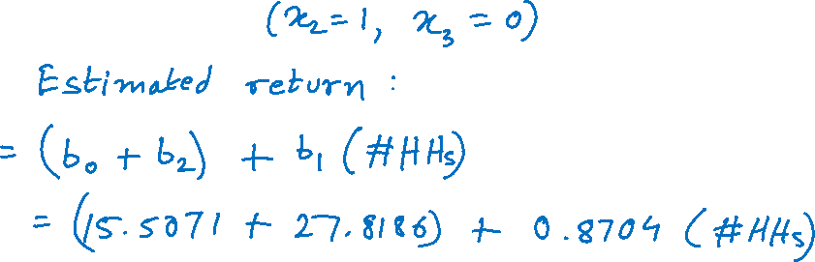
Example 14.6.2 (cont.)
Average annual return of the investments as a function of the location of the shops (i.e., whether they are near a mall, downtown, or in a suburban area).
Mall location:

Slide 21
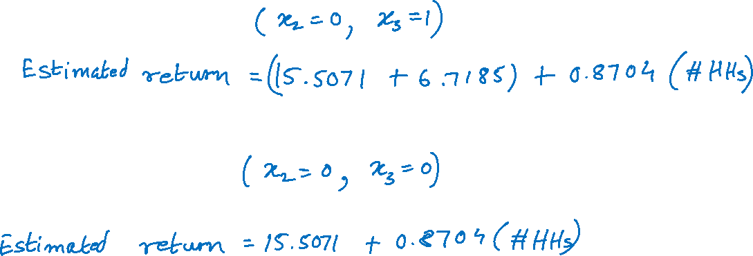
Example 14.6.2 (cont.)
Downtown location:
Suburban location:

Slide 22
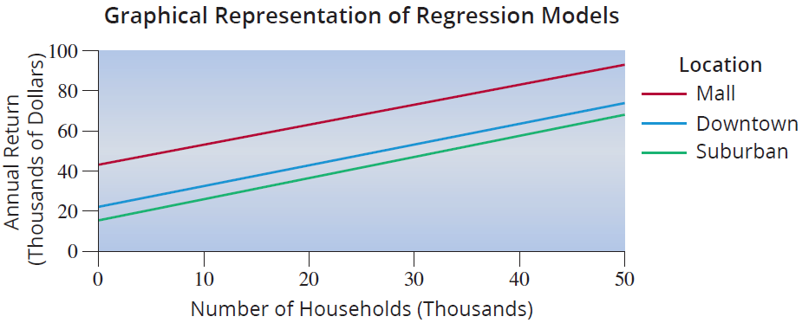
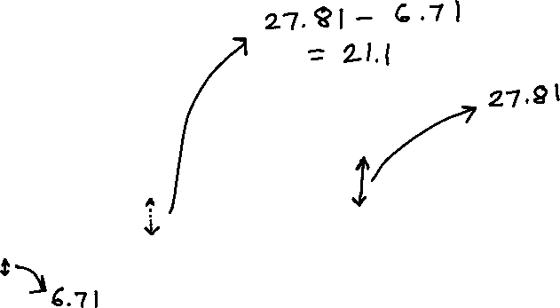
Example 14.6.2 (cont.)

Slide 23
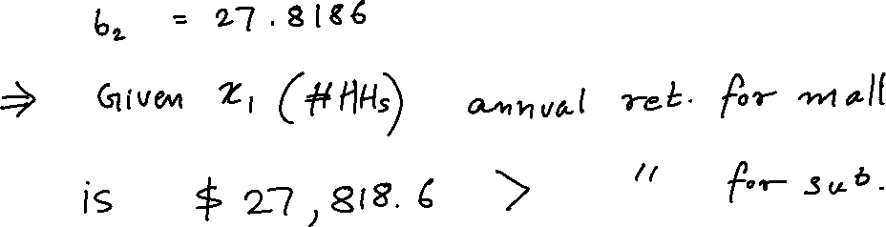
Example 14.6.2 (cont.)
To compare the mall and suburban locations

Slide 24
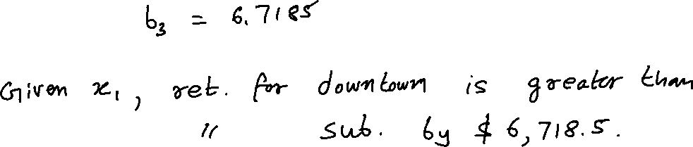
Example 14.6.2 (cont.)
Similarly, to compare downtown and suburban returns

Slide 25
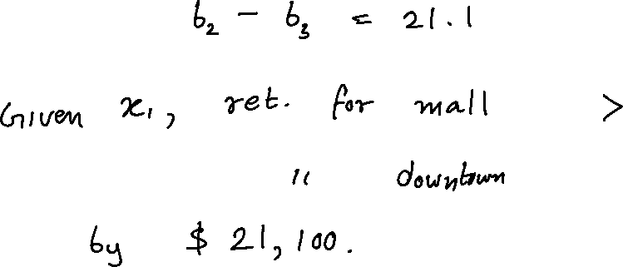
Example 14.6.2 (cont.)
Lastly, to compare mall and downtown locations

