Slide 1
Section 13.1
Assumptions of the Simple Linear Model

Slide 2
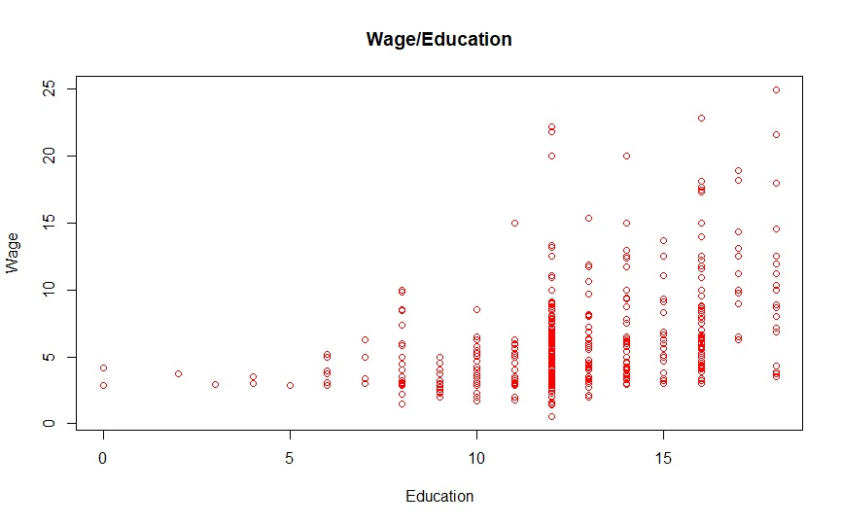
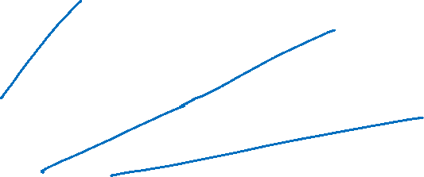
Linear Regression Model

Slide 3
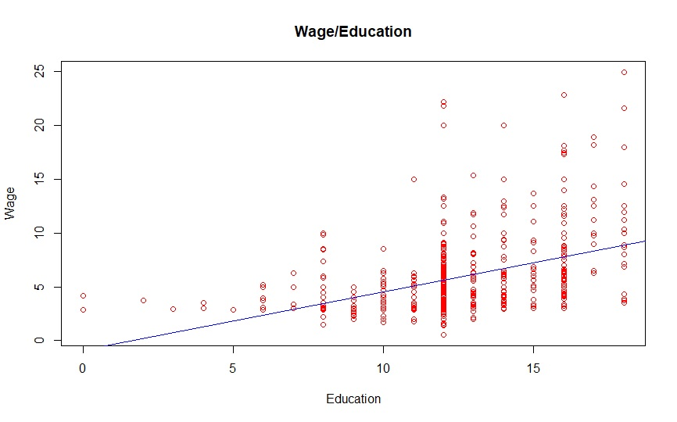
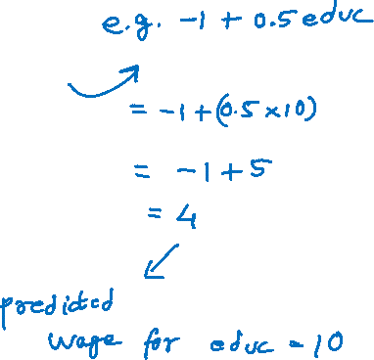
Linear Regression Model (cont.)

Slide 4
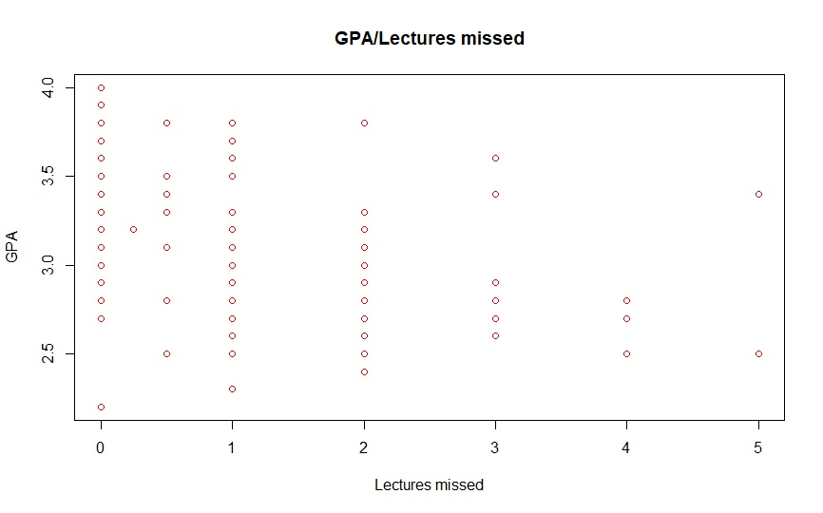
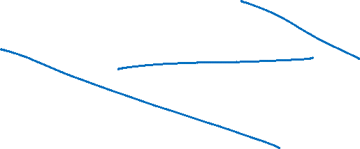
Linear Regression Model (cont.)

Slide 5
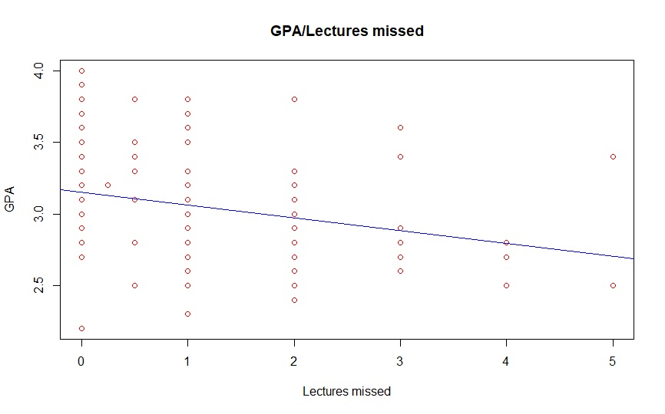
Linear Regression Model (cont.)

Slide 6

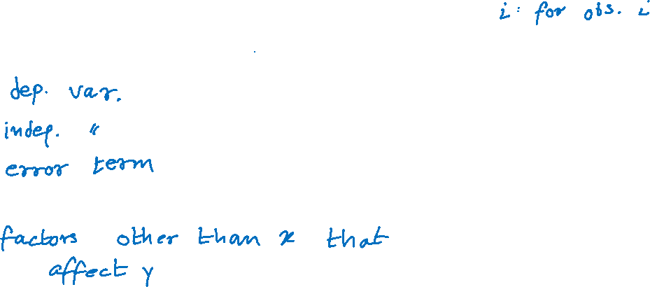
Linear Regression Model (cont.)
The simple linear regression model:
$$y_{i}=β_{0}+β_{1}x_{i}+ε_{i}$$
$y_{i}$:
$x_{i}$:
$ε_{i}$:
$ε$:

Slide 7
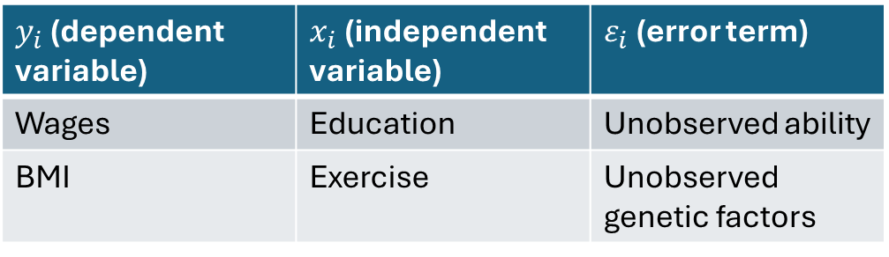

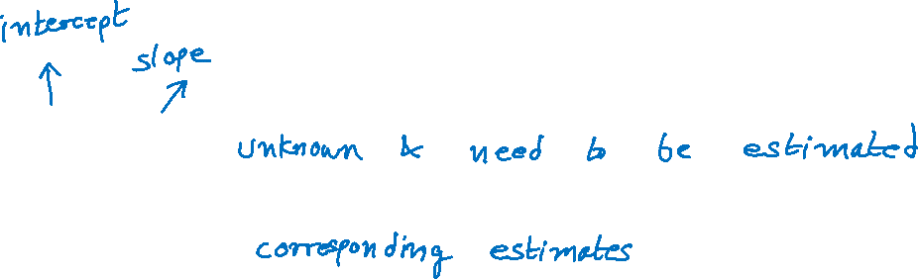
Linear Regression Model (cont.)
Examples:
$β_{0}$ and $β_{1}$:
$b_{0}$ and $b_{1}$:
$y_{i}$ (dependent variable) | $x_{i}$ (independent variable) | $ε_{i}$ (error term)
Wages | Education | Unobserved ability
BMI | Exercise | Unobserved genetic factors

Slide 8

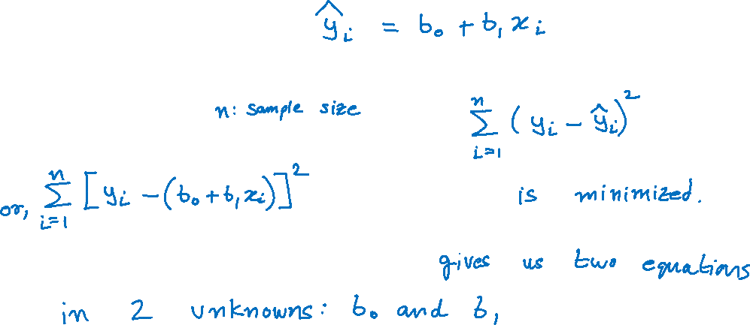
Linear Regression Model (cont.)
Predicted values of $y$:
$b_{0}$and $b_{1}$are estimated such that
Minimizing the above expression

Slide 9
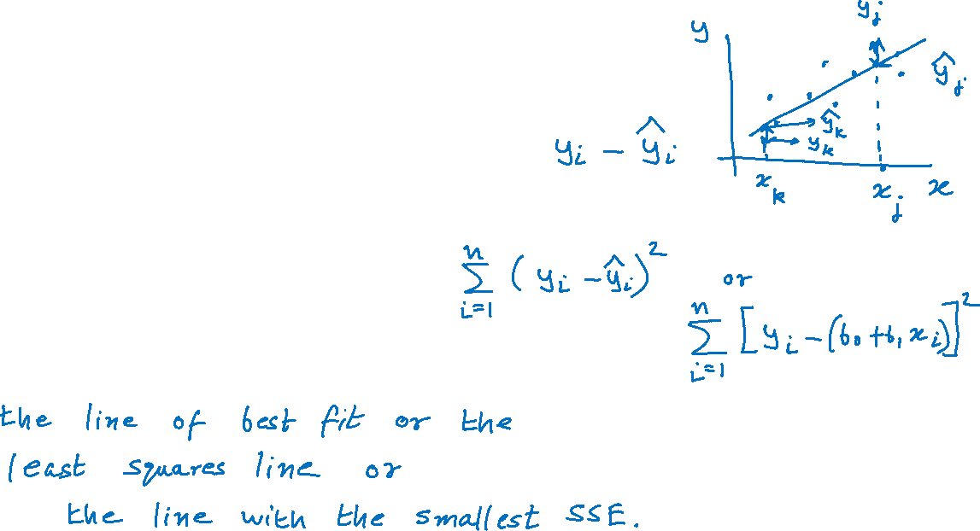
Linear Regression Model (cont.)
For each observation, the model’s error:
The sum of squared errors (SSE):
We estimate the regression line as

Slide 10




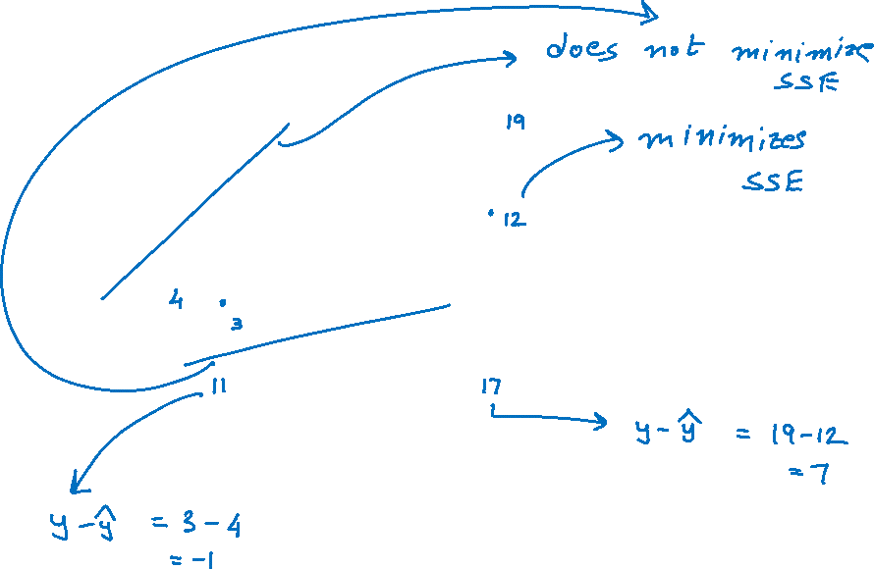



Linear Regression Model (cont.)
$$y_{k}$$
$$\hat{y_{i}}=b_{0}+b_{1}x_{i}$$
$$\hat{y_{k}}$$
$$b_{0}:\hat{y} when x is 0$$
$$\hat{y_{j}}$$
$$b_{1}: Δ\hat{y} when Δx is 1$$
$$y_{j}$$

Slide 11
Linear Regression Model (cont.)

Slide 12
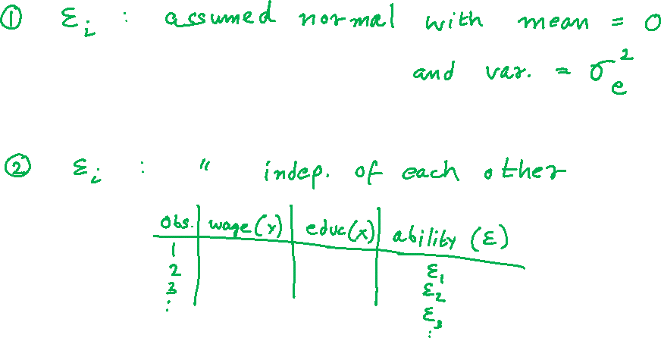
Assumptions about the Error Term in the Linear Model

Slide 13
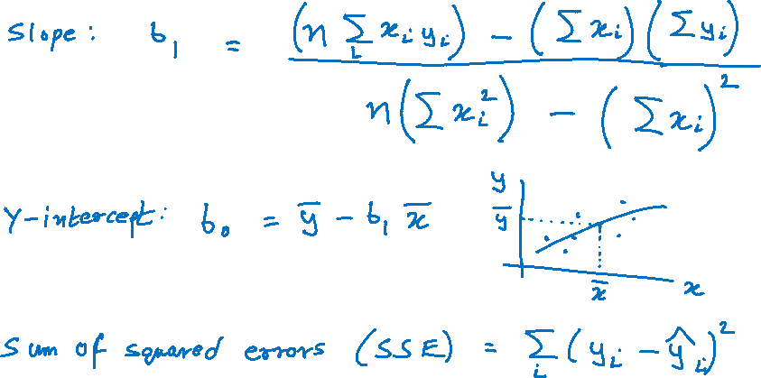
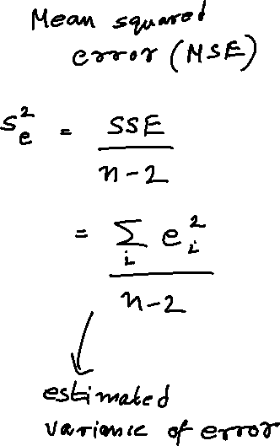
Estimates of the Regression Model Parameters

Slide 14
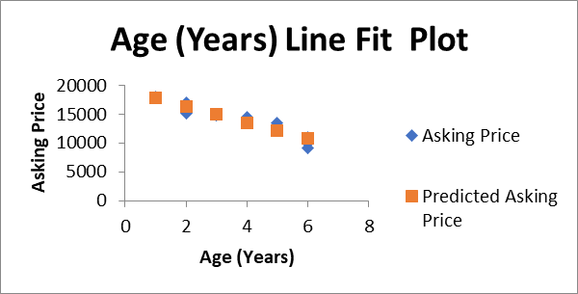
Using Excel to estimate a Simple Linear Regression Model
Age (Years) | Asking Price
1 | 17850
1 | 18000
2 | 15195
2 | 16995
2 | 15625
3 | 14935
3 | 14879
4 | 14460
4 | 13586
5 | 13050
5 | 13495
6 | 9150
6 | 9950
6 | 10995

Slide 15
Using Excel to estimate a Simple Linear Regression Model (cont.)
Regression Statistics
Multiple R | 0.951498605
R Square | 0.905349596
Adjusted R Square | 0.897462062
Standard Error | 868.6718405
Observations | 14
ANOVA
 | df | SS | MS | F | Significance F
Regression | 1 | 86613696.02 | 86613696.02 | 114.7823428 | 1.69218E-07
Residual | 12 | 9055089.197 | 754590.7664
Total | 13 | 95668785.21
 | Coefficients | Standard Error | t Stat | P-value | Lower 95% | Upper 95% | Lower 95.0% | Upper 95.0%
Intercept | 19198.32237 | 524.9046752 | 36.57487402 | 1.1184E-13 | 18054.65333 | 20341.99141 | 18054.65333 | 20341.99141
Age (Years) | -1412.230263 | 131.8159523 | -10.71365217 | 1.69218E-07 | -1699.432551 | -1125.027975 | -1699.432551 | -1125.027975

Slide 16
Using Excel to estimate a Simple Linear Regression Model (cont.)
Age (Years) | Asking Price | Predicted Asking Price | Residuals or Error | Squared Errors
 |  | 19198.32 -1412.23(Age) | (Price - Predicted Price)
1 | 17850 | 17786.09211 | 63.90789474 | 4084.21901
1 | 18000 | 17786.09211 | 213.9078947 | 45756.58743
2 | 15195 | 16373.86184 | -1178.861842 | 1389715.243
2 | 16995 | 16373.86184 | 621.1381579 | 385812.6112
2 | 15625 | 16373.86184 | -748.8618421 | 560794.0586
3 | 14935 | 14961.63158 | -26.63157895 | 709.2409972
3 | 14879 | 14961.63158 | -82.63157895 | 6827.977839
4 | 14460 | 13549.40132 | 910.5986842 | 829189.9637
4 | 13586 | 13549.40132 | 36.59868421 | 1339.463686
5 | 13050 | 12137.17105 | 912.8289474 | 833256.6872
5 | 13495 | 12137.17105 | 1357.828947 | 1843699.45
6 | 9150 | 10724.94079 | -1574.940789 | 2480438.49
6 | 9950 | 10724.94079 | -774.9407895 | 600533.2272
6 | 10995 | 10724.94079 | 270.0592105 | 72931.97719
 |  |  |  | 9055089.197 | SSE
 |  |  |  | 754590.7664 | MSE

Slide 17
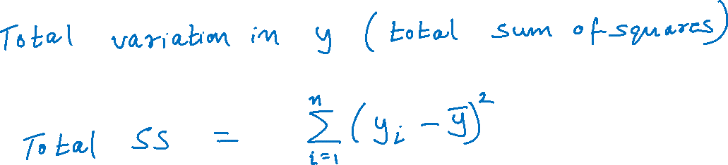
Evaluating the Fit of a Linear Model

Slide 18
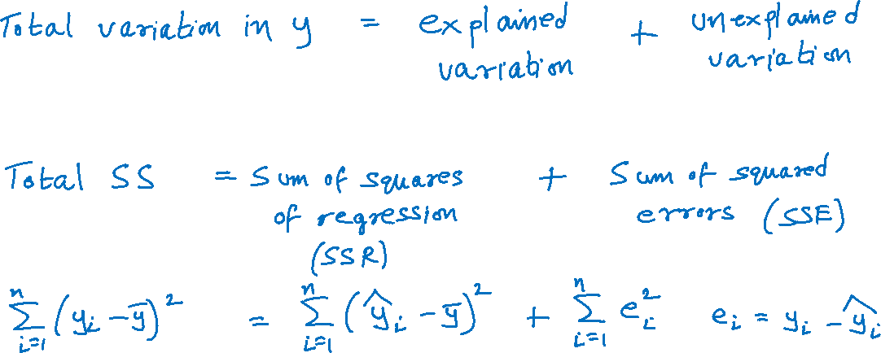
Evaluating the Fit of a Linear Model (cont.)

Slide 19
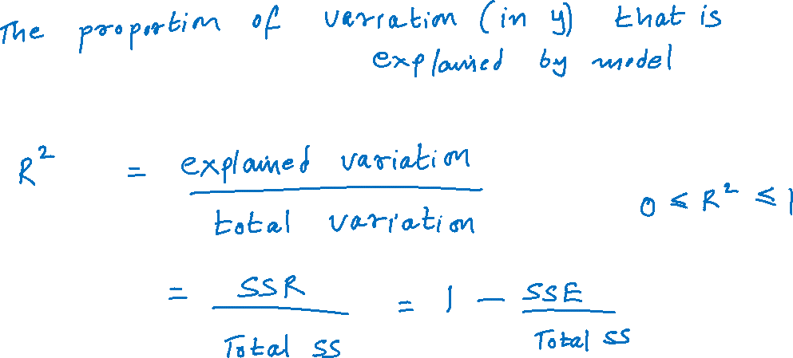
Coefficient of Determination

Slide 20
Coefficient of Determination (cont.)
Regression Statistics
Multiple R | 0.951498605
R Square | 0.905349596
Adjusted R Square | 0.897462062
Standard Error | 868.6718405
Observations | 14
ANOVA
 | df | SS | MS | F | Significance F
Regression | 1 | 86613696.02 | 86613696.02 | 114.7823428 | 1.69218E-07
Residual | 12 | 9055089.197 | 754590.7664
Total | 13 | 95668785.21
 | Coefficients | Standard Error | t Stat | P-value | Lower 95% | Upper 95% | Lower 95.0% | Upper 95.0%
Intercept | 19198.32237 | 524.9046752 | 36.57487402 | 1.1184E-13 | 18054.65333 | 20341.99141 | 18054.65333 | 20341.99141
Age (Years) | -1412.230263 | 131.8159523 | -10.71365217 | 1.69218E-07 | -1699.432551 | -1125.027975 | -1699.432551 | -1125.027975

Slide 21
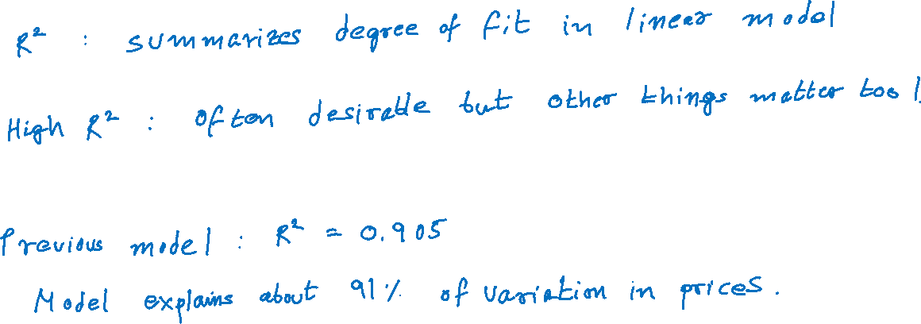
Coefficient of Determination (cont.)

Slide 22
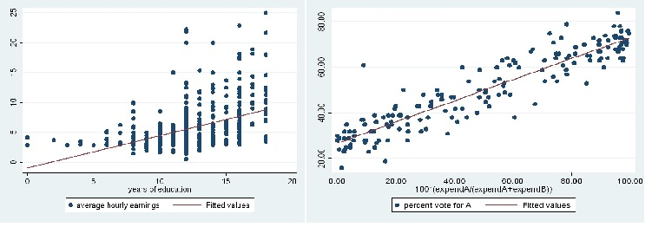
Coefficient of Determination (cont.)
Low R²
High R²

