Slide 1
Section 12.1
Inference about Two Means: Independent Samples

Slide 2
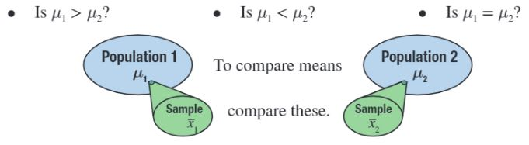
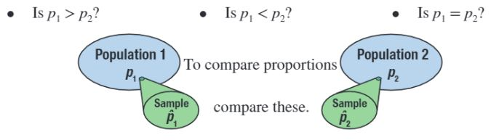
Inferences About Two Samples

Slide 3
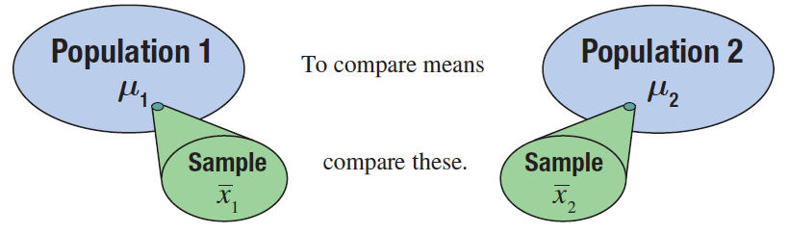
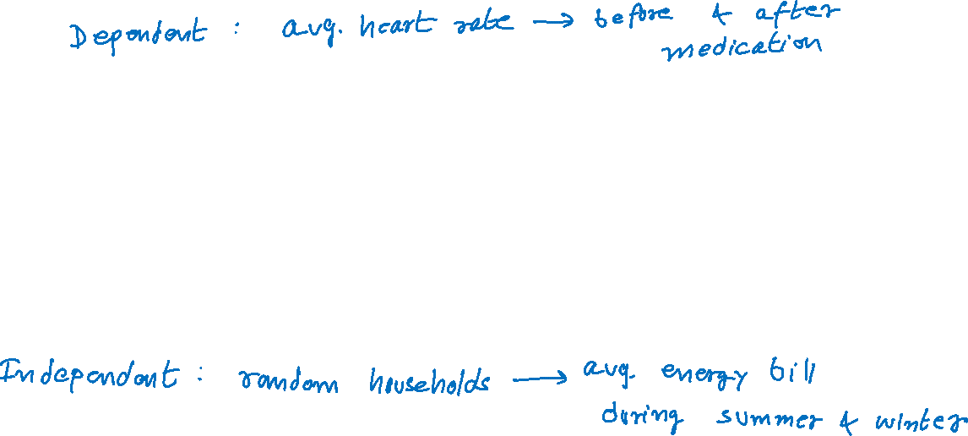
Inferences about the Means of Two Independent Populations, σ₁ and σ₂ Known

Slide 4
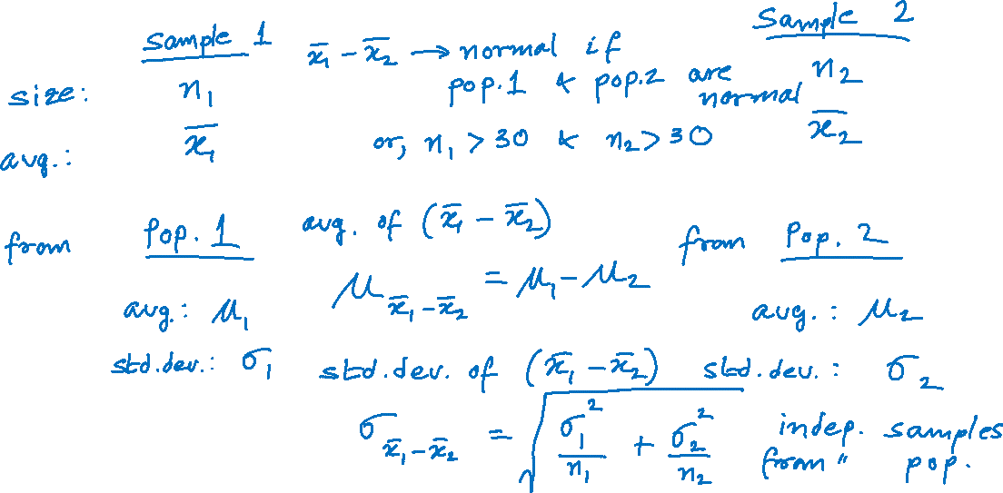
Properties of the Sampling Distribution of

Slide 5
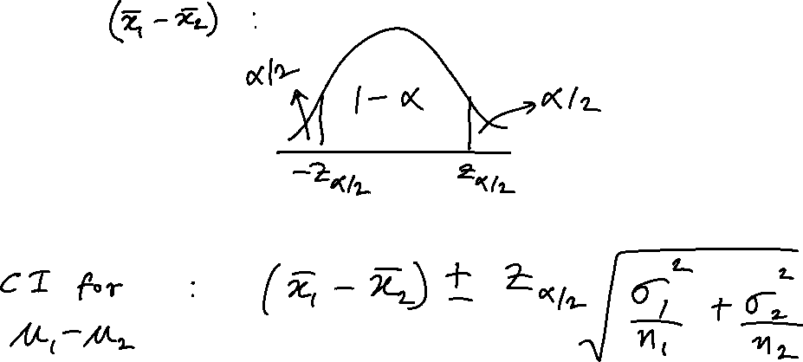
100(1 − α)% Confidence Interval for μ₁ − μ₂

Slide 6
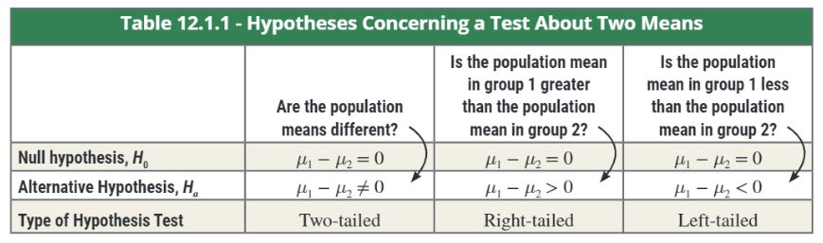
Hypothesis Testing

Slide 7
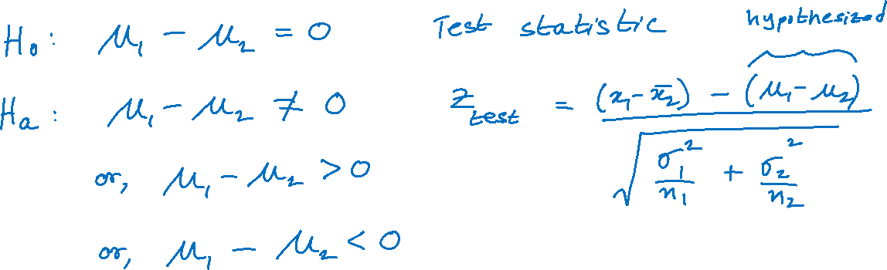
Testing a Hypothesis about Two Independent Population Means, σ₁ and σ₂ Known

Slide 8
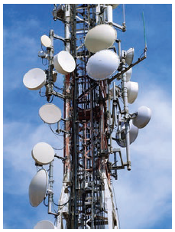

Example
A telecommunications analyst is interested in knowing if there is a significant difference in the average service outage times between cable television subscribers and satellite television subscribers. She randomly selects 50 cable subscribers and 50 satellite subscribers for the study.
She gives each subscriber a survey and asks them to record the length of time of each service outage for a month. She summarizes the results of the survey and calculates the mean outage for each television service. The results of the study are shown in the following table.

Slide 9
Example (cont.)
Service Outage Time (in minutes)
 | n |  | σ
Cable | 50 | 8.8 | 3
Satellite | 50 | 9.5 | 2
Calculate a 95% confidence interval for the mean difference in average service outage time between cable and satellite subscribers.
Is there persuasive evidence for the analyst to conclude at α = 0.05 that there is a difference in mean service outage time between cable and satellite subscribers?

Slide 10
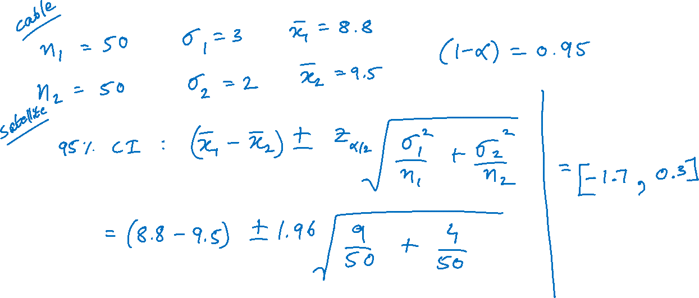
Example (cont.)

Slide 11
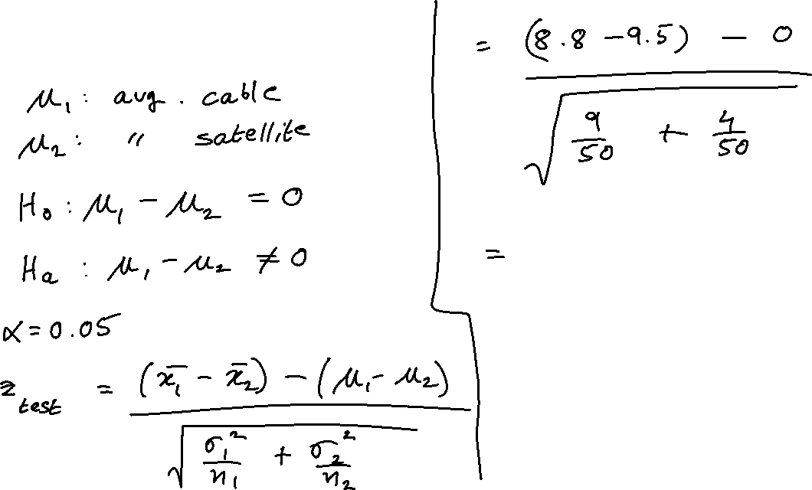
Example (cont.)

Slide 12
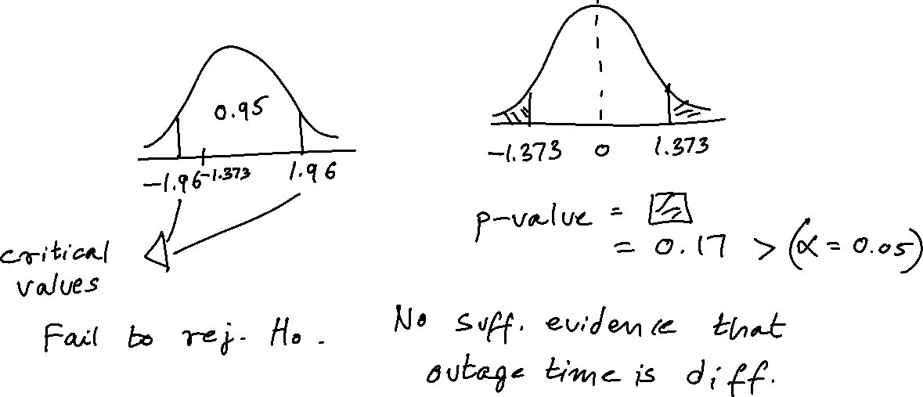
Example (cont.)

Slide 13
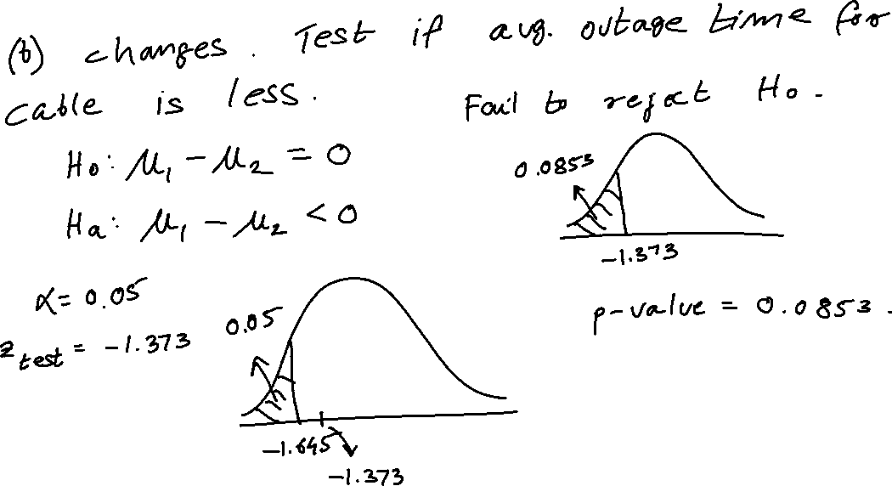
Example (cont.)

Slide 14
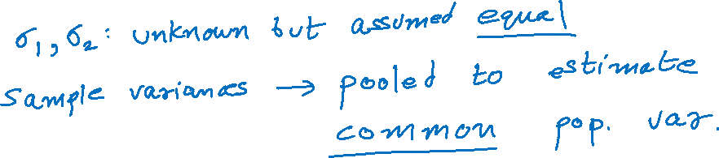
Inferences about the Mean of Two Independent Populations, σ₁ and σ₂ Unknown and Assumed Equal

Slide 15
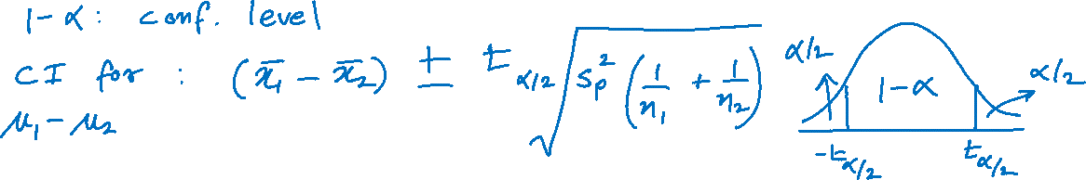
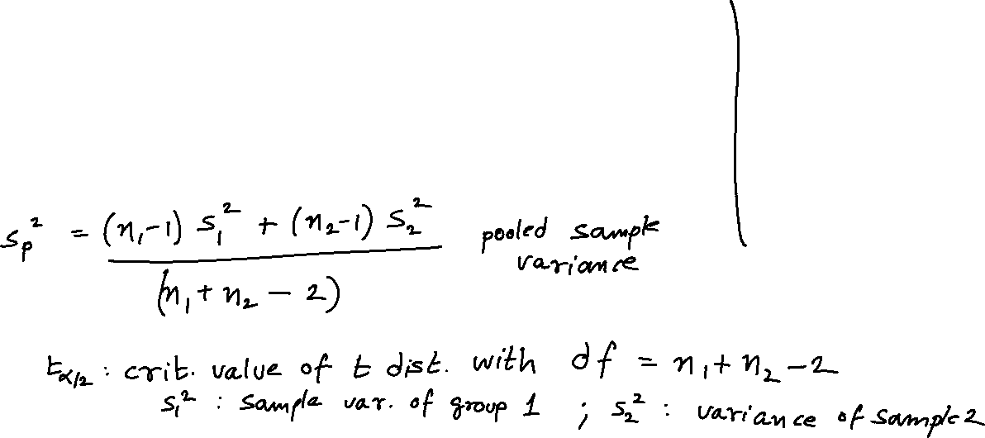
100(1 − α)% Confidence Interval for μ₁ − μ₂ Assuming σ₁ and σ₂ are Unknown but Equal

Slide 16
Example
For a consumer product, the mean dollar sales per retail outlet last year in a random sample of 15 stores was $3425 with a standard deviation of $200. For a second product, the mean dollar sales per outlet in a random sample of 16 stores was $3250 with a standard deviation of $175. The sales amounts per outlet are assumed to be approximately normally distributed for both products. Assume that the population variances are equal.

Slide 17
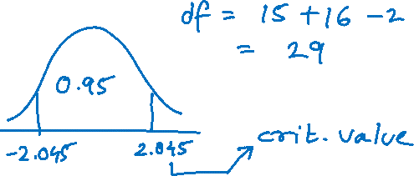
Example (cont.)
Retail Sales (Dollars)
 | n |  | S
Product 1 | 15 | $3425 | 200
Product 2 | 16 | $3250 | 175
Calculate a 95% confidence interval for the difference in average dollar sales between the two products.

Slide 18
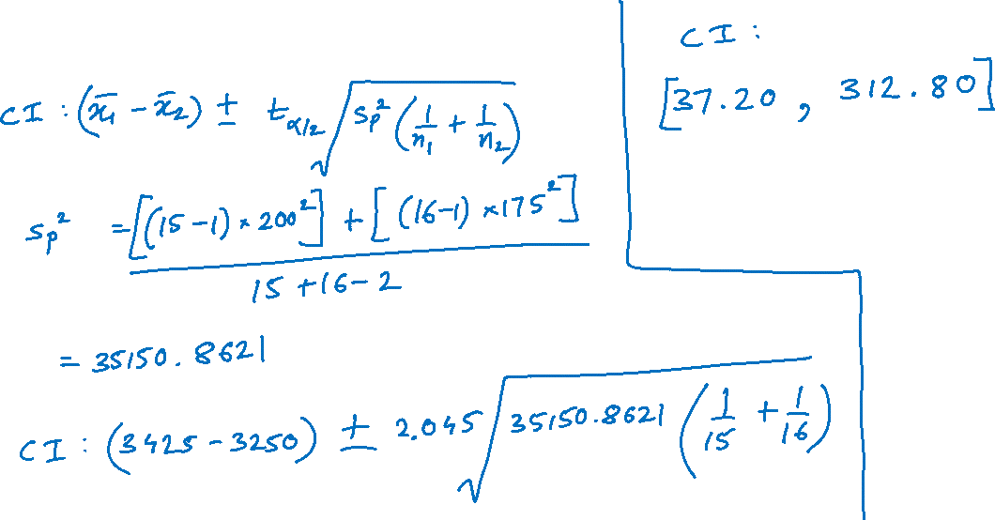
Example (cont.)

Slide 19
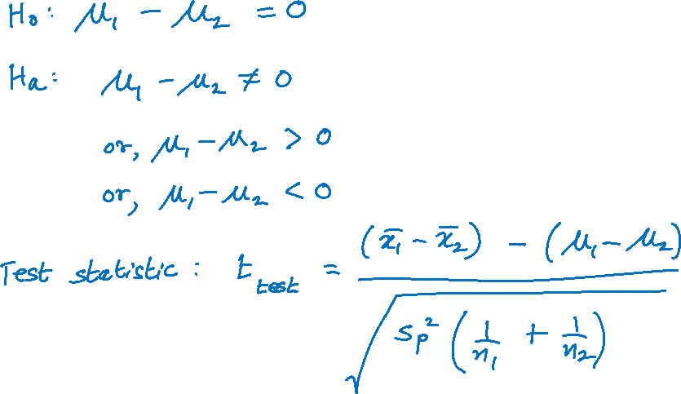
Testing a Hypothesis about Two Independent Population Means, σ₁ and σ₂ Unknown but Equal

Slide 20
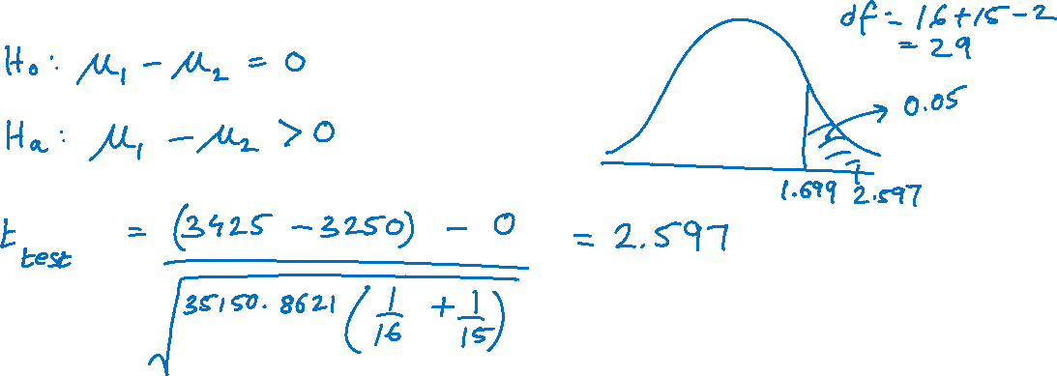
Previous Example
Is there persuasive evidence to conclude at α = 0.05 that the average sales for Product 1 is significantly greater than that for Product 2?

Slide 21
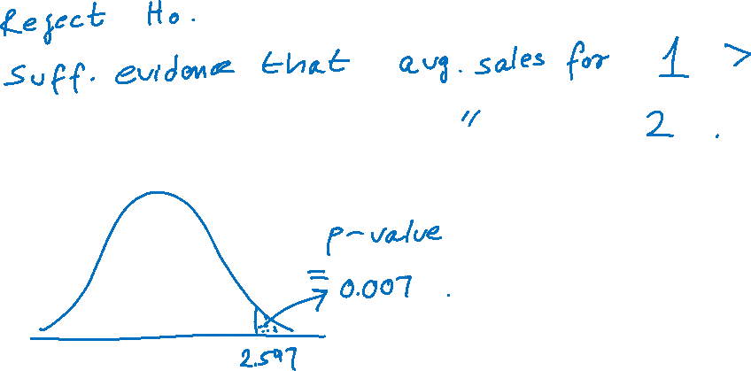
Previous Example (cont.)

Slide 22
Inferences about the Means of Two Independent Populations, σ₁ and σ₂ Unknown and Assumed Unequal

Slide 23
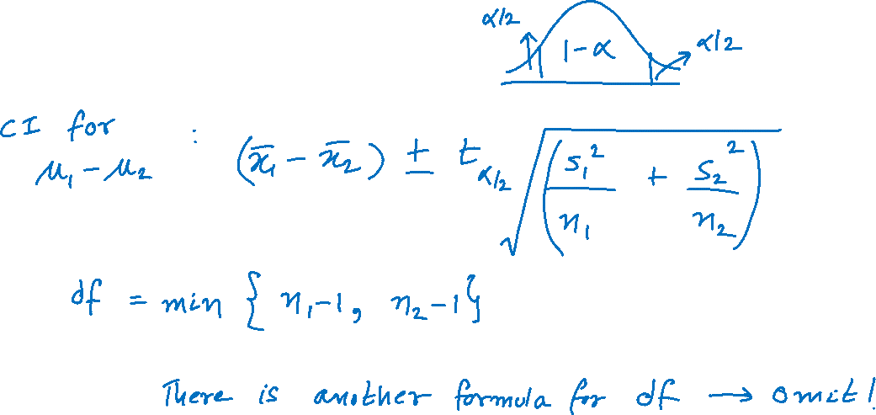
100(1 − α)% Confidence Interval for μ₁ − μ₂ Assuming σ₁ and σ₂ are Unknown and Unequal

Slide 24

Example
A statistics instructor wants to know if using the courseware that accompanied her statistics textbook will improve students' test scores. Since she is teaching two sections of a statistics course this term, she decides to use the courseware in one class and not the other. The courseware contained premade homework assignments for each section of the book, so she had the students in one of her classes do the online homework. For the other class she gave them a similar homework assignment from the textbook.

Slide 25
Example (cont.)
The instructor believes that the immediate feedback from the online courseware on homework assignments will likely improve students’ performance on tests. For the first test she gave the students in both classes the same test. She took a simple random sample of 16 students’ test scores on the first test from each class. One student subsequently dropped the class, so that student’s test score was omitted from the data. The results were as follows.

Slide 26
Example (cont.)
Test Scores Using Courseware
73 | 75 | 76 | 78 | 78 | 80 | 82 | 83
84 | 85 | 87 | 88 | 88 | 92 | 93
Calculate a 95% confidence interval for the mean difference between the test scores for the two statistics classes.
Test Scores Not Using Courseware
60 | 62 | 65 | 67 | 72 | 74 | 74 | 75
77 | 79 | 79 | 80 | 81 | 85 | 88 | 93

Slide 27
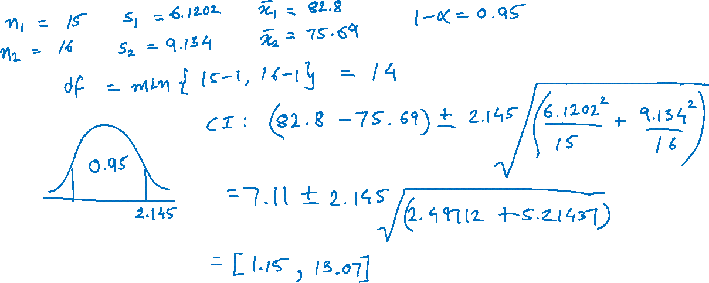
Example (cont.)

Slide 28
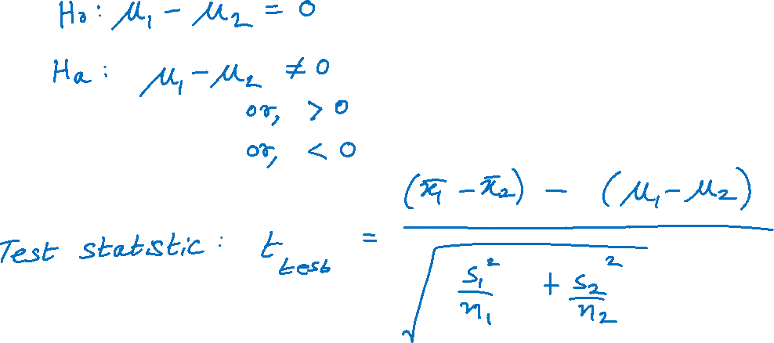
Hypothesis Testing of μ₁ − μ₂ with σ₁ and σ₂ Unknown and Unequal

Slide 29
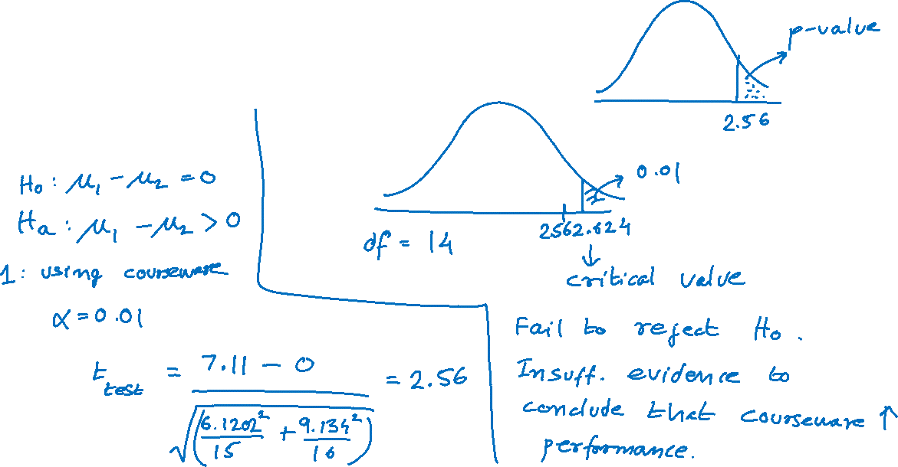
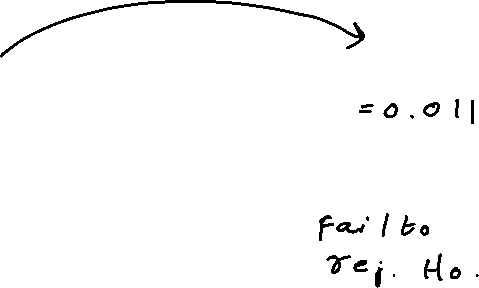
Previous Example
=T.DIST.RT(2.56,14)
Is there persuasive evidence at α = 0.01 that using the courseware improves students' test scores?

