Slide 1
Section 11.6
Practical Significance vs. Statistical Significance

Slide 2
Example
Suppose a dog food manufacturer wants to know if the proper amount of dog food is being placed in the 25 pound bags. Hypotheses:
A sample of 2000 bags was selected with the following results:

Slide 3
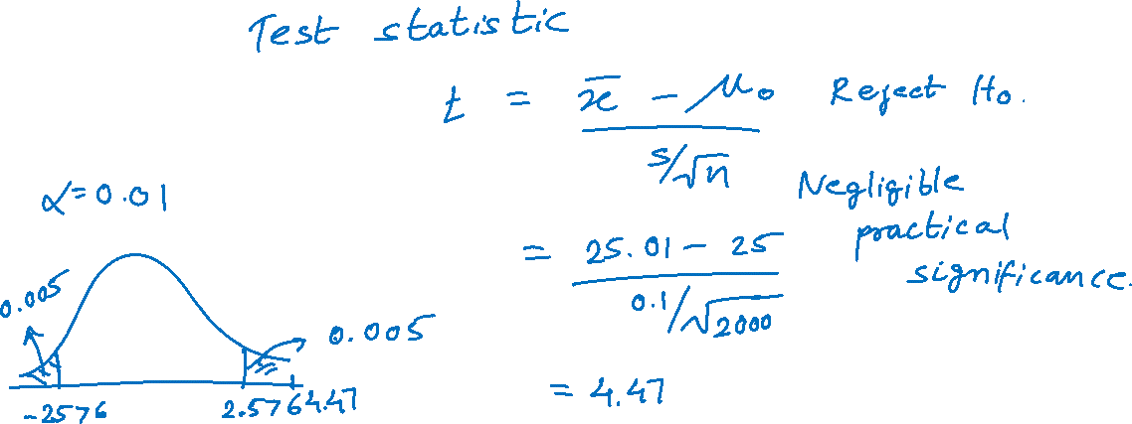
Example (cont.)

