Slide 1
Section 11.1
Introduction to Hypothesis Testing

Slide 2
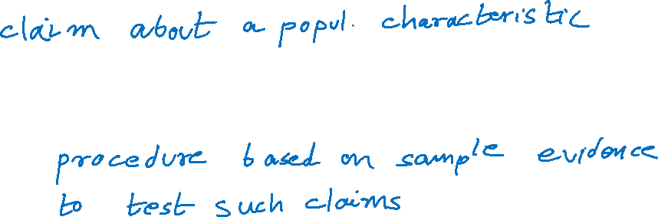
Hypothesis Testing
Hypothesis:
Hypothesis test:

Slide 3
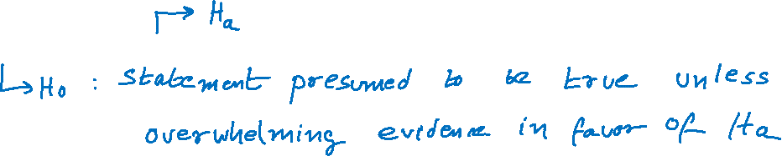
Introduction to Hypothesis Testing
Null and alternative hypotheses.
Example:
H₀: Defendant not guilty
H_{a}: Defendant guilty

Slide 4
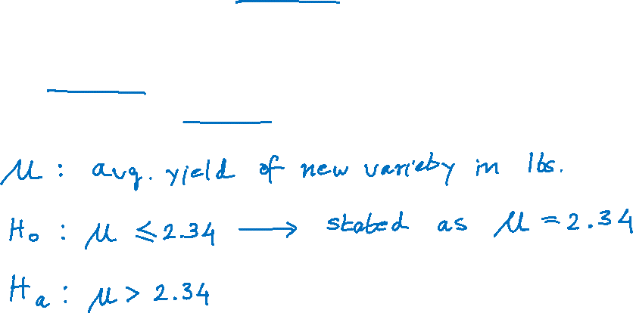
A molecular biologist has been investigating several species of wild potato plants and believes she has discovered genetic properties that will increase the yield of the standard species. She has genetically engineered these new properties into the standard variety and produced a new variety. The standard species yields an average of 2.34 pounds per plant. She would like to know if her new plant has superior yield.

Slide 5
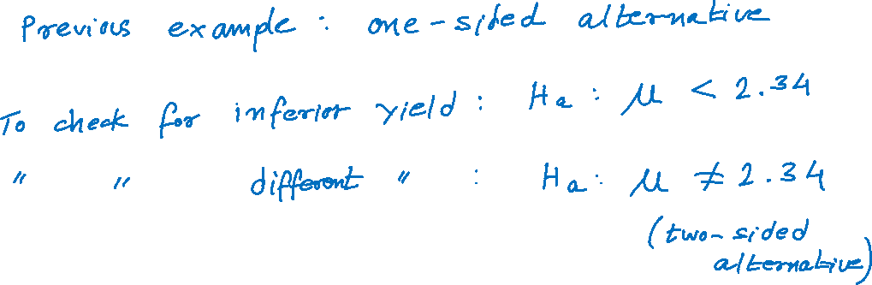
One-sided and Two-sided H_{a}

Slide 6
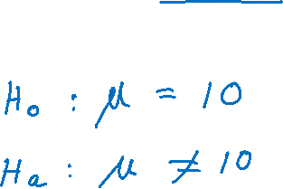
Suppose a potato chip manufacturer is concerned that the bagging equipment is not functioning properly when filling 10-ounce bags. He wants to test a hypothesis that will help determine if there is a problem with the bagging equipment. What is the correct hypothesis?

Slide 7
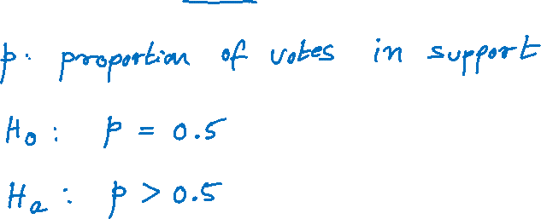
Martha Brandon wants to assess her candidacy in a forthcoming race for the state senate. She is an incumbent and wants to raise sufficient support to retain her seat. How should she formulate an appropriate hypothesis to determine if there is overwhelming evidence that she will retain her seat?

Slide 8
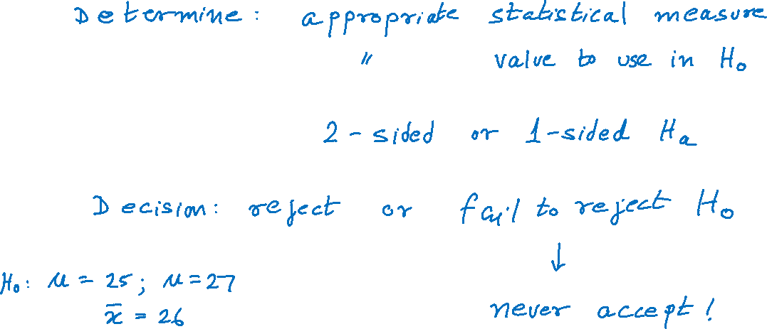
Formulating Hypothesis Testing Problems

Slide 9
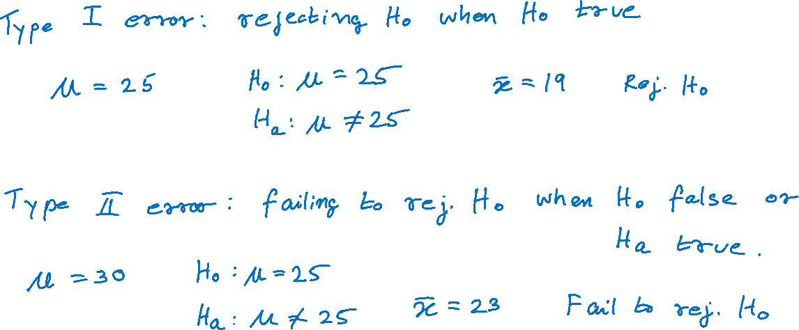
Errors in Hypothesis Testing

Slide 10
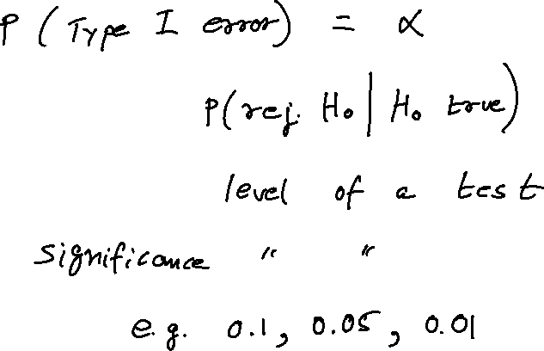
α, Type I Error

Slide 11
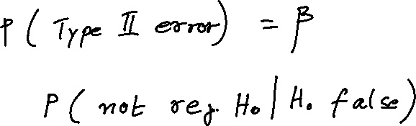
β, Type II Error

Slide 12
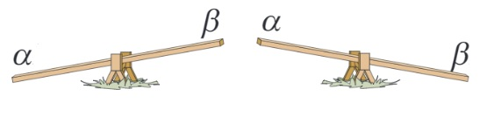
Why Not Make Both α and β as Small as Possible?
Tradeoff between α and β.

