Slide 1
Section 10.1
Point Estimation of the Population Mean

Slide 2
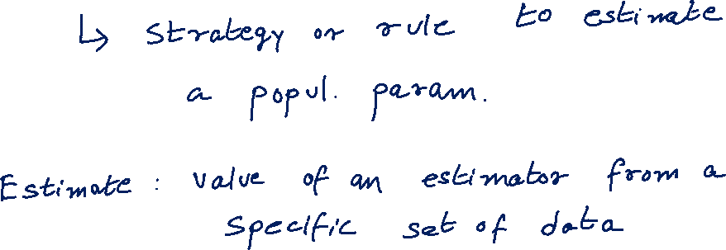
Estimator

Slide 3
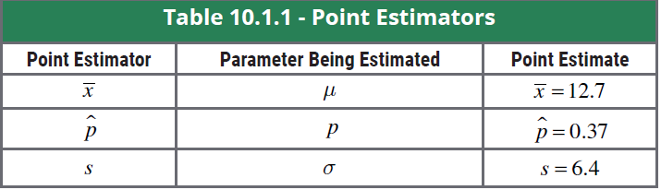
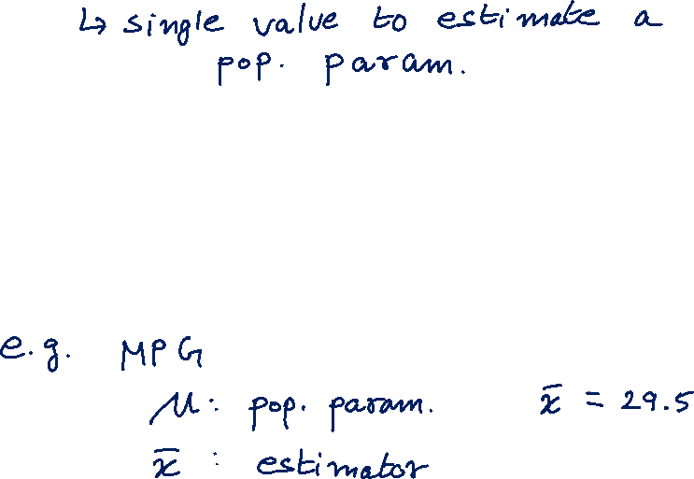
Point Estimator

Slide 4
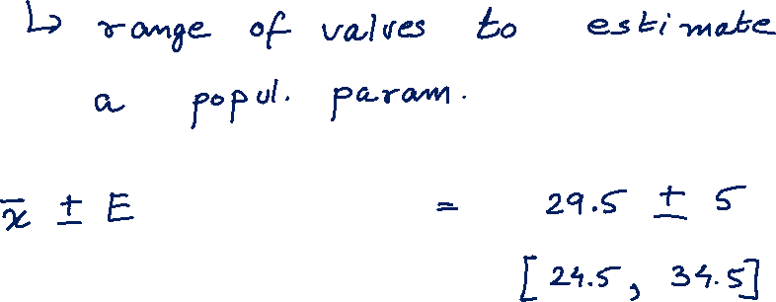
Interval Estimator

