Slide 1
Section 5.1
Scatterplots and Correlation

Slide 2
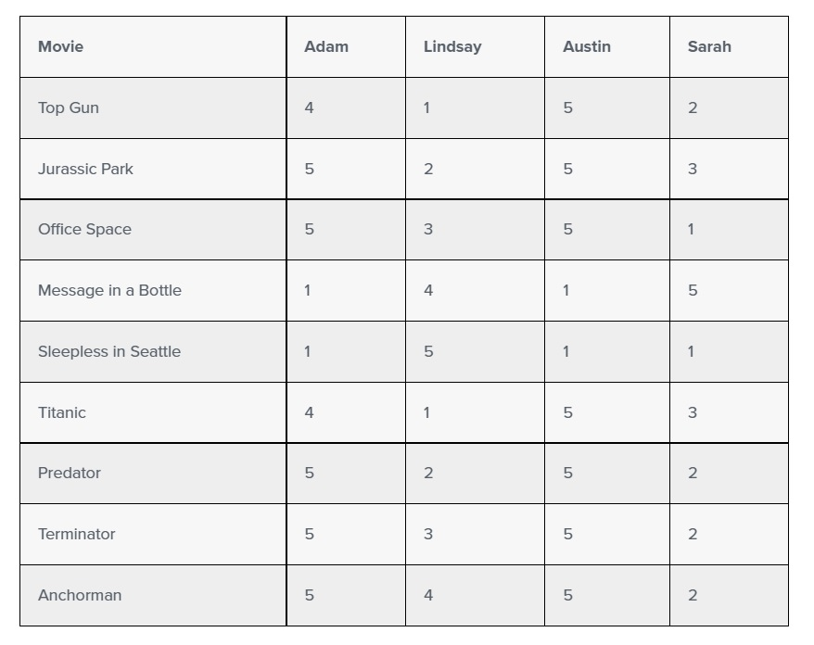
Correlation
https://teamairship.com/how-netflix-uses-correlations/

Slide 3
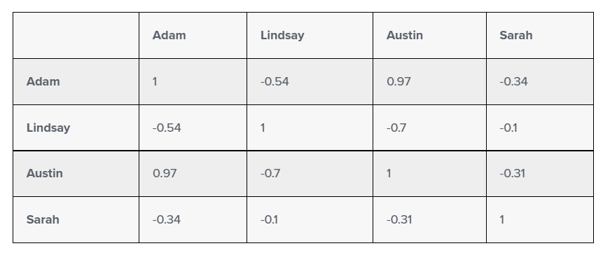
Correlation (cont.)

Slide 4
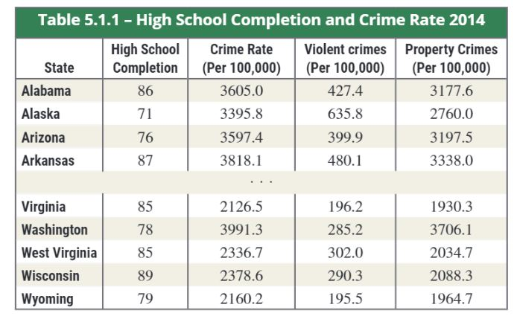
Scatterplots

Slide 5
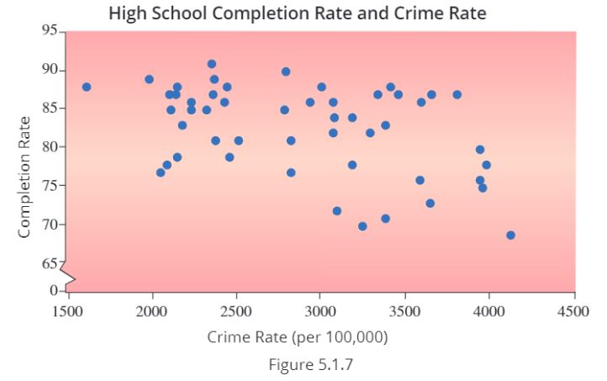
Scatterplots (cont.)

Slide 6
Correlation Coefficient
Formula
Measures the degree of linear relationship between two variables.
n:
$$\bar{x}:$$
$\bar{y}:$
S_{x}:
S_{y}:

Slide 7
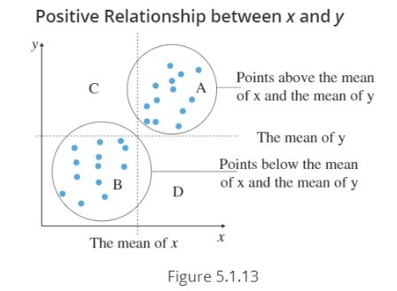
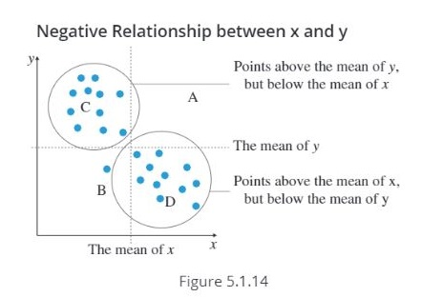
Correlation Coefficient (cont.)

Slide 8
Correlation Coefficient
Obs. No. | x (age ) | y (time) | $$\left(x−\overline{x}\right)$$ | $$\left(y−\overline{y}\right)$$ | $${\left(x−\overline{x}\right)}^{2}$$ | $${\left(y−\overline{y}\right)}^{2}$$
1 | 23 | 8
2 | 27 | 10
3 | 48 | 12
4 | 52 | 14
5 | 60 | 16
Total: | $$\sum_{i=1}^{5}{x_{i}}$$ | $$\sum_{i=1}^{5}{y_{i}}$$ | $$\sum_{i=1}^{5}{(x_{i}−\overline{x})}$$ | $$\sum_{i=1}^{5}{(y_{i}−\overline{y})}$$ | $$\sum_{i=1}^{5}{{\left(x_{i}−\overline{x}\right)}^{2}}$$ | $$\sum_{i=1}^{5}{{\left(y_{i}−\overline{y}\right)}^{2}}$$
The data contains information on time taken to run 1 mile by 5 individuals (in minutes). x denotes age and y denotes time.
r =
 | $$\left(\frac{x−\overline{x}}{s_{x}}\right)$$ | $$\left(\frac{y−\overline{y}}{s_{y}}\right)$$ | $$\left(\frac{x−\overline{x}}{s_{x}}\right)\left(\frac{y−\overline{y}}{s_{y}}\right)$$
 | $$\sum_{i=1}^{5}{\left(\frac{x_{i}−\overline{x}}{s_{x}}\right)}$$ | $$\sum_{i=1}^{5}{\left(\frac{y_{i}−\overline{y}}{s_{y}}\right)}$$ | $$\sum_{i=1}^{5}{\left(\frac{x−\overline{x}}{s_{x}}\right)\left(\frac{y−\overline{y}}{s_{y}}\right)}$$

Slide 9
Properties of the Correlation Coefficient

Slide 10
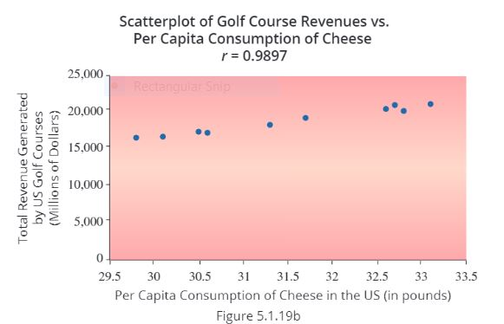
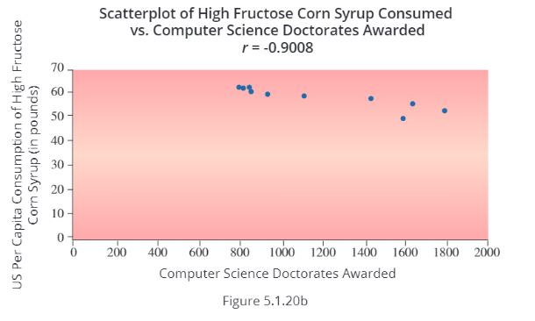
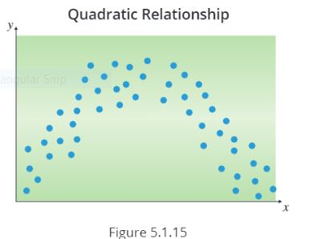
Avoiding Some Correlation Pitfalls

