Slide 1
Section 4.3
Measures of Relative Position

Slide 2
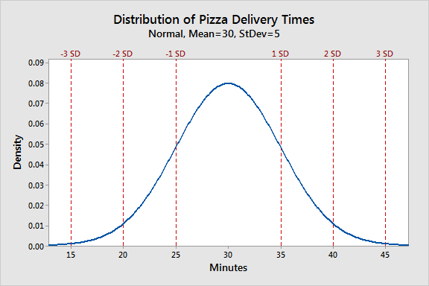
z-Score
Transforms a data value into the number of standard deviations that value is from the mean.
https://statisticsbyjim.com/basics/normal-distribution/

Slide 3
Example 4.3.4
Suppose you scored an 86 on your biology test and a 94 on your psychology test. The mean and standard deviations of the two tests are given in the following table.
What are the z-scores for your two tests? On which of the tests did you perform relatively better?
Test Scores
Course | Mean | Standard Deviation
Biology | 74 | 10
Psychology | 82 | 11

Slide 4
Example 4.3.4 (cont.)
Solution

Slide 5
Properties of a z-Score
Properties
If z-score < 0
If z-score > 0
Unit-free measure

