Slide 1
Section 4.2
Measures of Dispersion

Slide 2
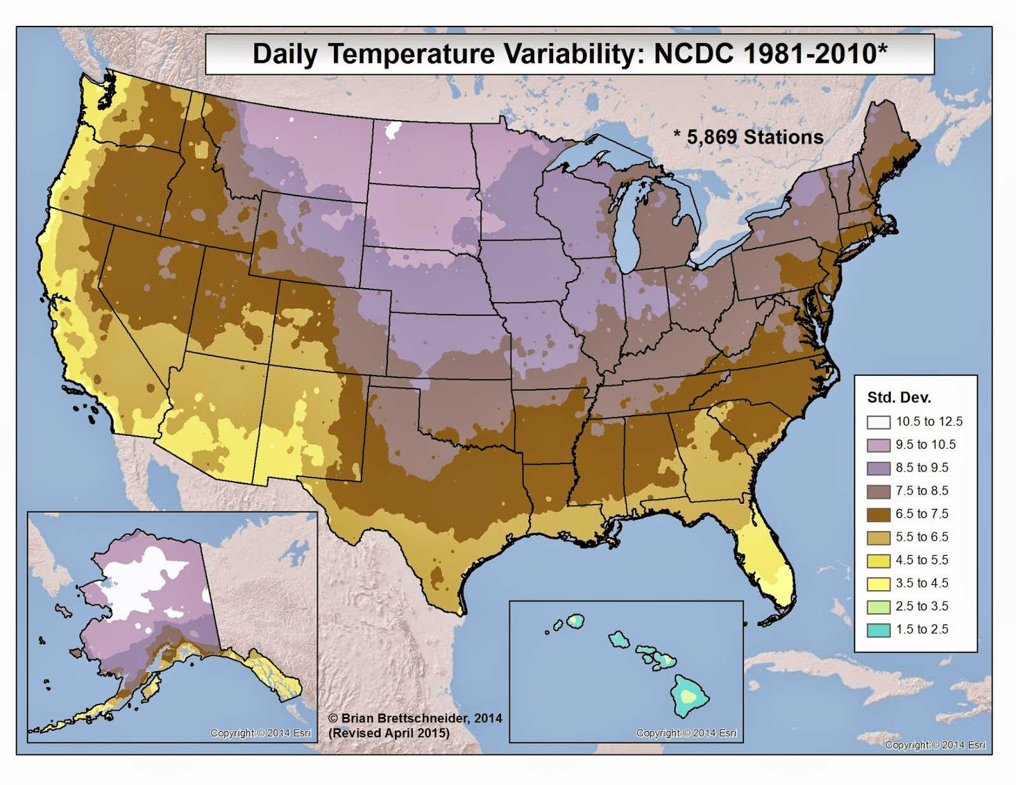
Measures of Dispersion
http://us-climate.blogspot.com/2014/12/intra-annual-climate-variability.html

Slide 3
Range

Slide 4
Example 4.2.1
Calculate the range of the following data set consisting of the number of times the television channel was changed in a 1-hour time span.
Solution
4 | 6 | 16 | 9 | 24 | 8 | 12 | 1

Slide 5
Variance
Population variance

Slide 6
Variance (cont.)
Sample variance

Slide 7
Example 4.2.4
Given the following times in minutes of 6 persons running a 1000-meter course, compute the sample variance.
Solution
5 | 10 | 9 | 11 | 9 | 7

Slide 8
Standard Deviation

Slide 9
Empirical Rule
Properties
If the distribution of the data is bell-shaped, then
About 68% of the data should lie within ...
About 95% of the data should lie within ...
About 99.7% of the data should lie within ...

Slide 10
Example 4.2.5
Suppose a group of high technology stocks has an average earnings per share of $6.26, with a standard deviation of $1.37. If the data possesses a bell-shaped distribution, which interval contains 68% of the earnings? Which interval contains 95% of the earnings?

