Slide 1
Section 4.1
Measures of Location (Central Tendency)

Slide 2
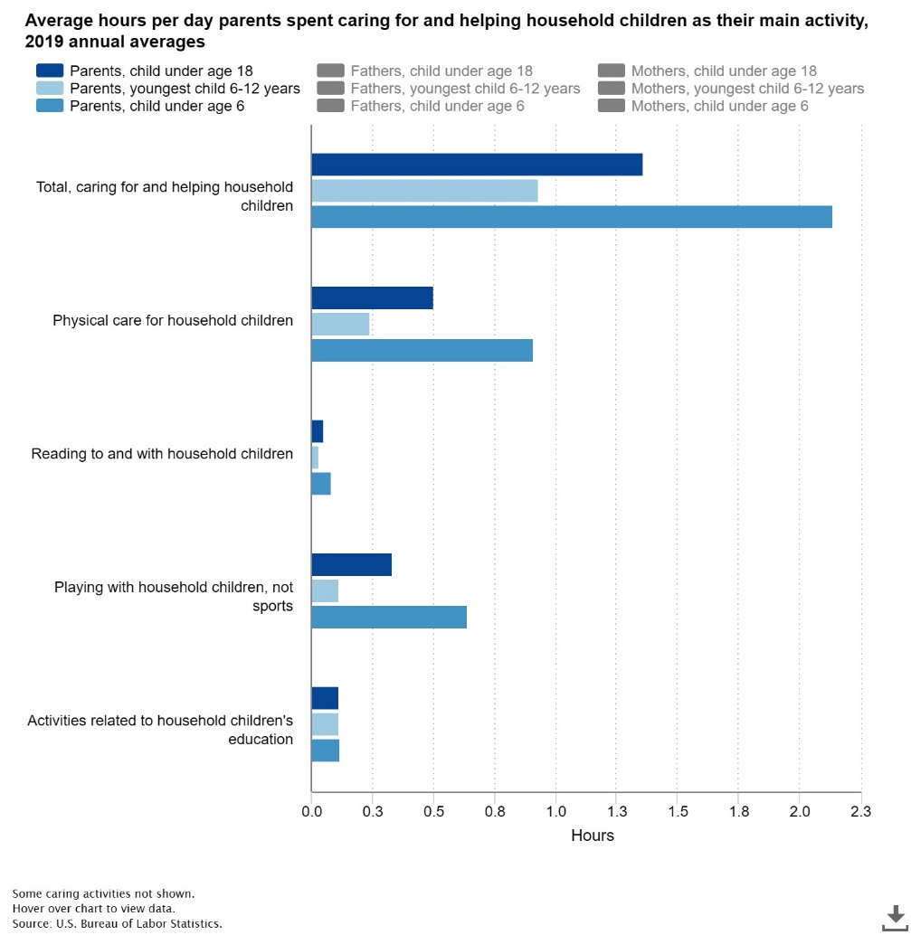
Describing and Summarizing Data from One Variable
https://www.bls.gov/charts/american-time-use/activity-by-parent.htm

Slide 3
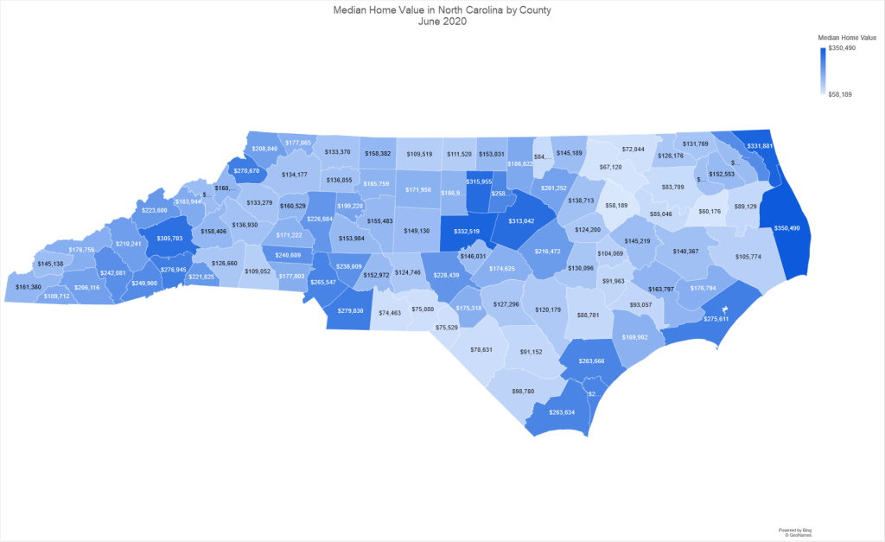
Describing and Summarizing Data from One Variable (cont.)
https://richardkeroack.com/median-home-values-by-state/median-home-value-in-north-carolina/

Slide 4
Describing and Summarizing Data from One Variable (cont.)
Top 10 Baby Names of 2020
Rank Male name Female name
1 Liam Olivia
2 Noah Emma
3 Oliver Ava
4 Elijah Charlotte
5 William Sophia
6 James Amelia
7 Benjamin Isabella
8 Lucas Mia
9 Henry Evelyn
10 Alexander Harper
https://www.ssa.gov/oact/babynames/index.html

Slide 5

Arithmetic Mean
Sample mean
$\overline{x} =$
Population mean
μ =

Slide 6

Example 4.1.1
Calculate the sample mean of the following sample data values: 4, 10, 7, 15.
Solution
$$\overline{x}=\frac{\sum{xi}}{n}$$

Slide 7
Arithmetic Mean (cont.)
Sum of mean deviations =
Sensitive to extreme values

Slide 8
Median

Slide 9
Example 4.1.5
Consider the following goal tallies from eleven games played by a soccer team.
Find the median.
2 | 3 | 5 | 4 | 1 | 7 | 3 | 3 | 1 | 2 | 6

Slide 10
Example 4.1.6
Consider the following ten test scores from a student taking a high school calculus class.
Find the median.
65 | 98 | 76 | 83 | 94 | 79 | 88 | 72 | 90 | 85

Slide 11
Mode

Slide 12
Example 4.1.7
Find the mode of the following data regarding the number of power outages reported over a period of eleven days.
0 | 1 | 4 | 3 | 9 | 8 | 10 | 0 | 1 | 3 | 0

Slide 13
Mode (cont.)
Data with two modes …
Data with more than two modes …
Also possible for data to have no mode.

Slide 14
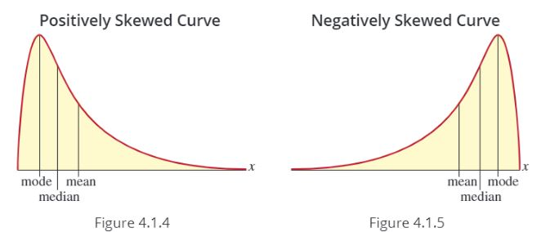
The Relationship between the Mean, Median, and Mode

Slide 15
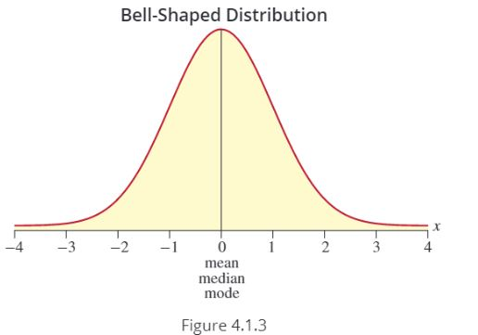
The Relationship between the Mean, Median, and Mode (cont.)

