Slide 1
Section 14.4
Inference Concerning the Multiple Regression Model and Its Coefficients

Slide 2

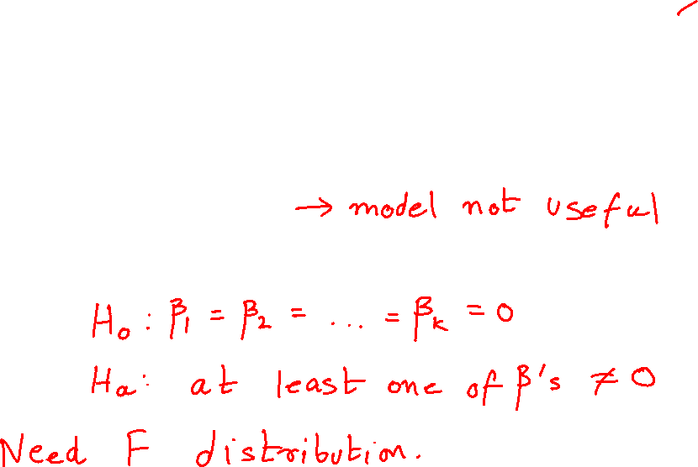
Inference Concerning the Multiple Regression Model and Its Coefficients
Multiple regression model
$$y=β_{0}+β_{1}x_{1}+β_{2}x_{2}+…+β_{k}x_{k}+ε$$
If $β_{1}=β_{2}=…=β_{k}=0$
Might test

Slide 3
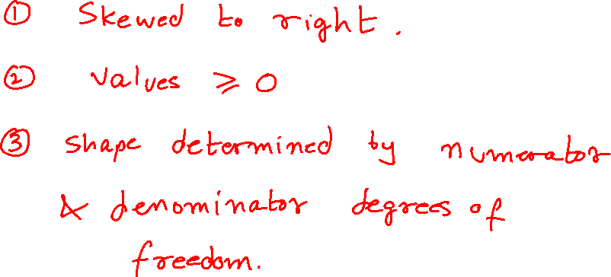
Properties of an F-Distribution

Slide 4
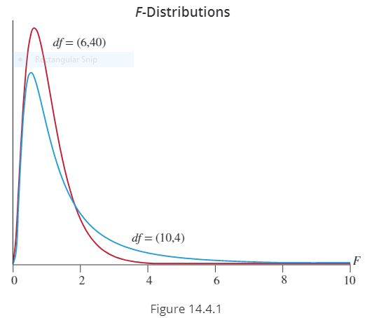
Properties of an F-Distribution (cont.)

Slide 5
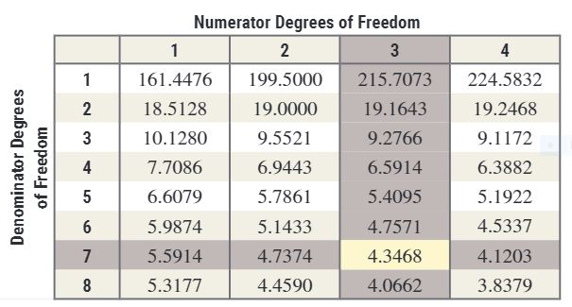
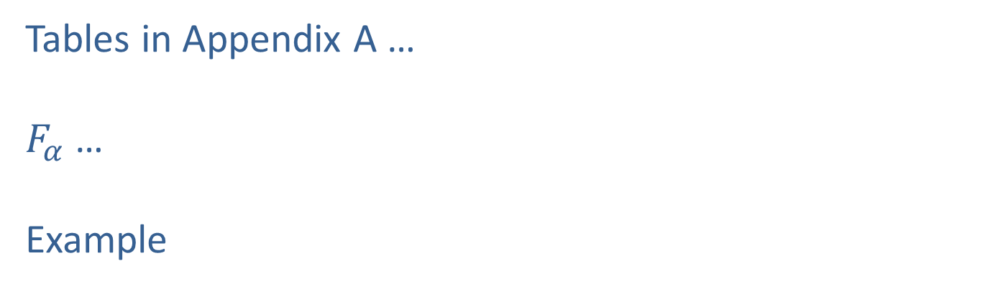
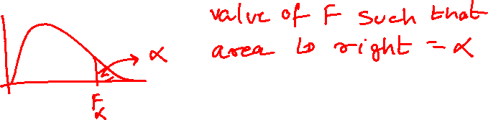
Properties of an F-Distribution (cont.)
Tables in Appendix A …
$F_{α}$ …
Example

Slide 6
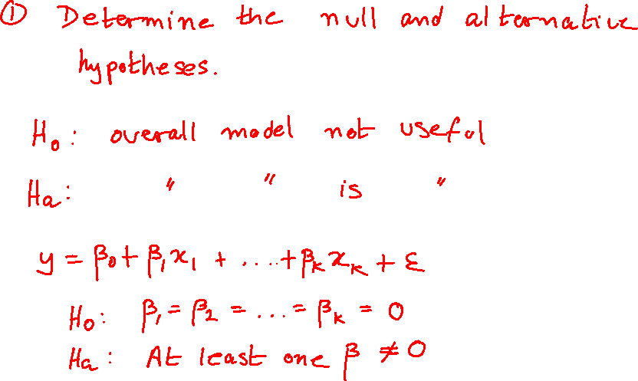
Steps in the Test of Hypothesis

Slide 7
Steps in the Test of Hypothesis (cont.)

Slide 8
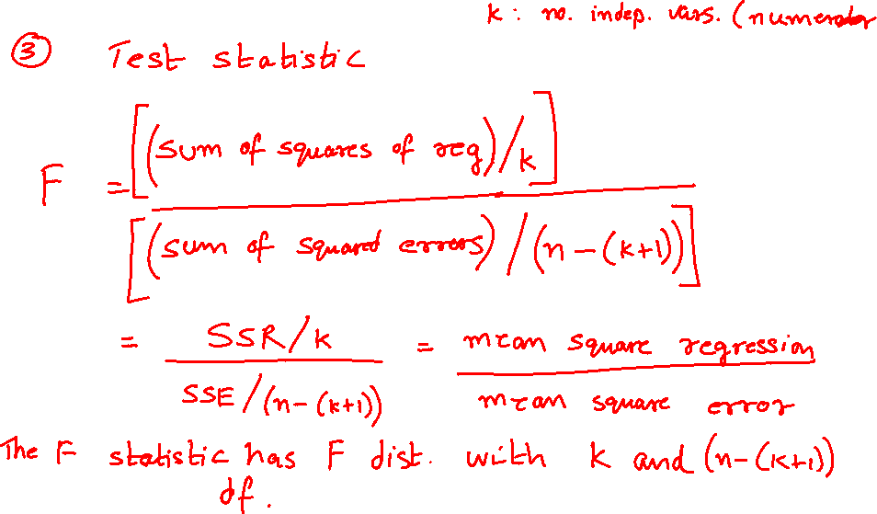
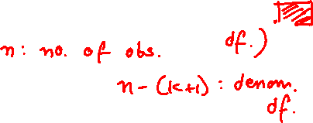
Testing the Multiple Regression Model (cont.)

Slide 9
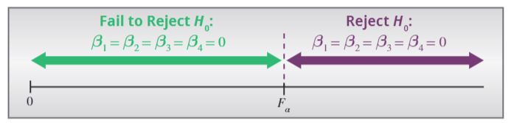
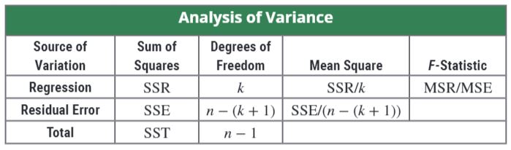
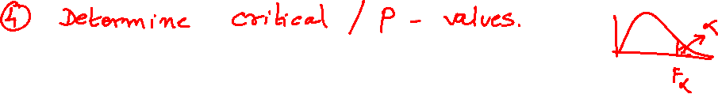
Testing the Multiple Regression Model (cont.)

Slide 10
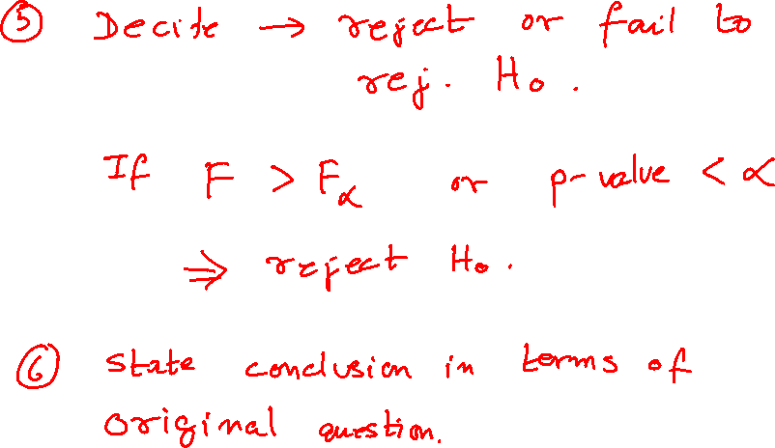
Testing the Multiple Regression Model (cont.)

Slide 11
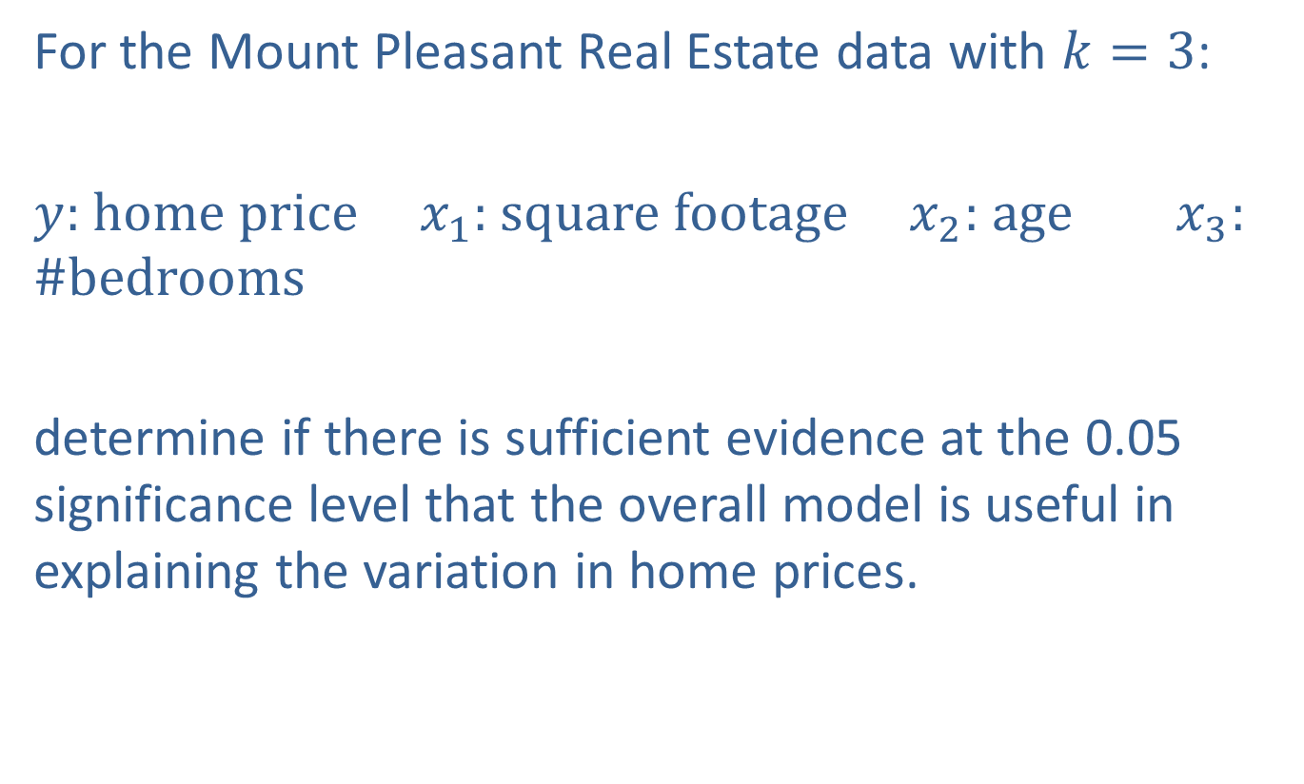
Example 14.4.1
For the Mount Pleasant Real Estate data with $k=3$:
$y$: home price $x_{1}$: square footage $x_{2}$: age $x_{3}$: #bedrooms
determine if there is sufficient evidence at the 0.05 significance level that the overall model is useful in explaining the variation in home prices.

Slide 12
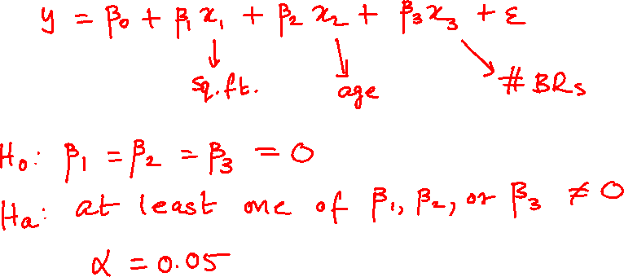
Example 14.4.1 (cont.)

Slide 13

Example 14.4.1 (cont.)

Slide 14
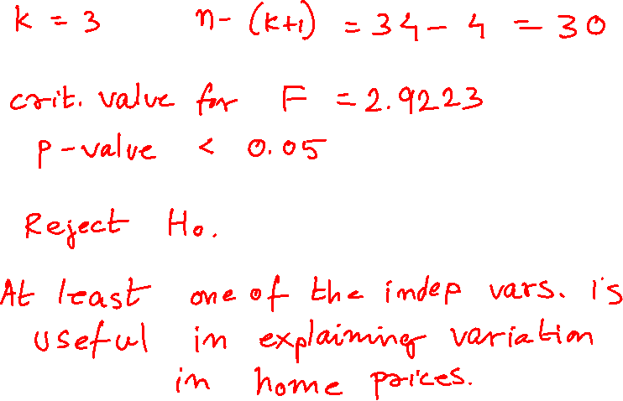
Example 14.4.1 (cont.)

Slide 15
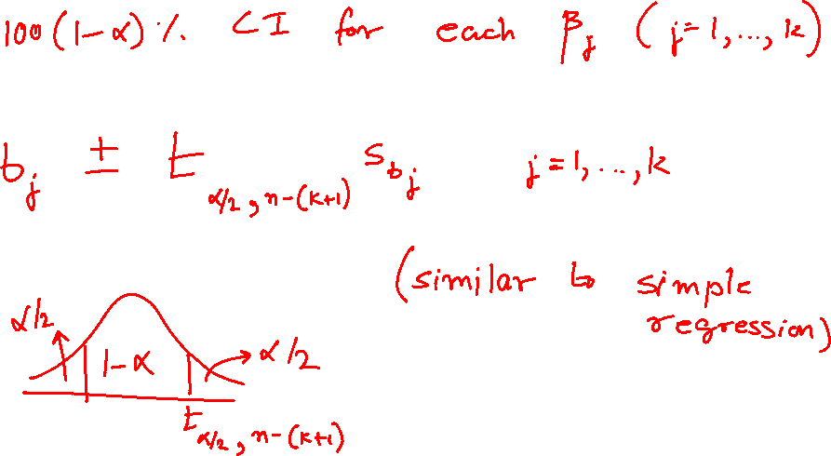
Confidence Interval for Each Coefficient

Slide 16
Example 14.4.2 (cont.)

Slide 17
Testing Hypotheses on Individual β_{i} (Example 14.4.3)
For the Mount Pleasant Real Estate model,
Price of Home = β ₀ + β ₁ (Square Footage) + β ₂ (Age of Home) + β ₃ (Number of Bedrooms).
Is the independent variable number of bedrooms a useful predictor of home price? Use α = 0.05 as the level of significance.

Slide 18
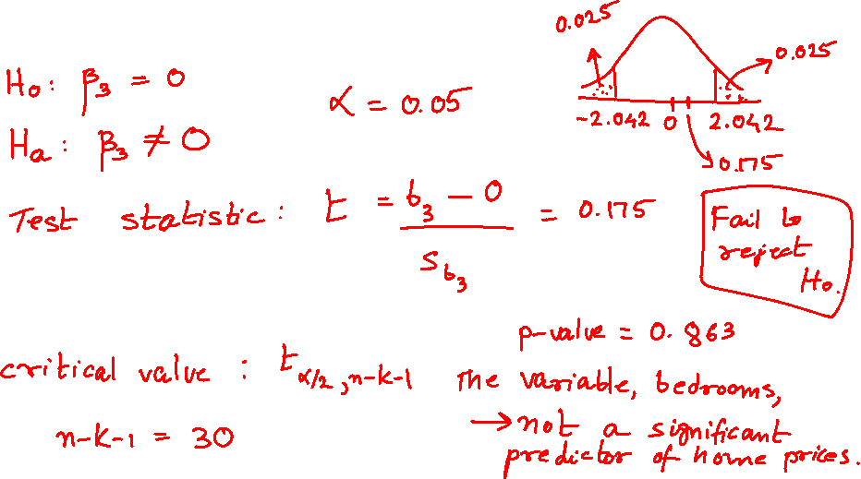
Example 14.4.3 (cont.)
Test statistic and critical value

Slide 19
Example 14.4.3 (cont.)

