Slide 1
Section 12.2
Inference about Two Means: Dependent Samples (Paired Difference)

Slide 2
Inference about Two Means: Dependent Samples (Paired Difference)

Slide 3
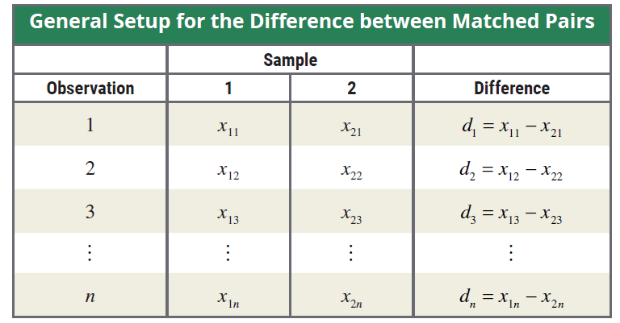
Difference between Matched Pairs

Slide 4
100(1 − α)% Confidence Interval for μ_{d}

Slide 5
Testing a Hypothesis about Two Dependent Population Means

Slide 6
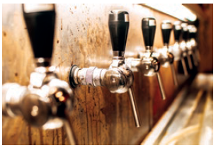
Example 12.2.1
Bull & Bones Brewhaus is a microbrewery that has two restaurants located within 15 miles of each other. The owner of the microbrewery wants to compare the average daily food sales of the two restaurants. To do so, the owner randomly selects 10 days over a five-month period (college football season) and records the daily food sales. The results are given in the following table.

Slide 7
Example 12.2.1 (cont.)
Calculate a 95% confidence interval for the mean difference in restaurant sales.
The owner wants to know if there is evidence of a difference between the average daily food sales of the two restaurants. Test using α = 0.01.
Daily Food Sales for Two Restaurants ($)
Day | Restaurant 1 | Restaurant 2 | Difference = Restaurant 1 – Restaurant 2
1 | 5828 | 7894 | −2066
2 | 9836 | 11,573 | −1737
3 | 3984 | 5319 | −1335
4 | 5845 | 6389 | −544

Slide 8
Example 12.2.1 (cont.)
Solution
Daily Food Sales for Two Restaurants ($)
Day | Restaurant 1 | Restaurant 2 | Difference = Restaurant 1 – Restaurant 2
5 | 5210 | 6055 | −845
6 | 9668 | 10,631 | −963
7 | 6768 | 7866 | −1098
8 | 6726 | 7976 | −1250
9 | 4399 | 5652 | −1253
10 | 6692 | 8083 | −1391

Slide 9
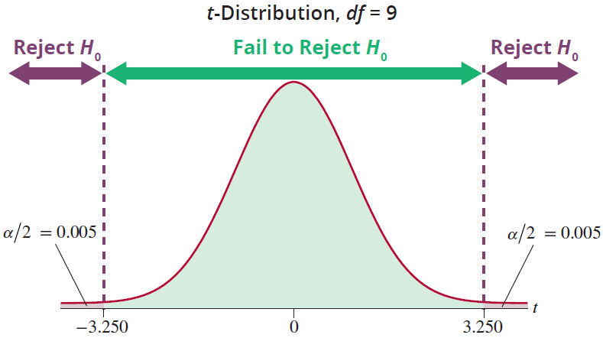
Example 12.2.1 (cont.)

Slide 10
Example 12.2.2
A researcher is interested in knowing the effect which one ounce of 100-proof alcohol has on his subjects. To study this effect the researcher randomly selects 10 subjects and records their reaction times (in seconds) both before and after drinking one ounce of 100-proof alcohol. The results of the study are displayed in the following table.
Can the researcher conclude at α = 0.01 that the average reaction time is longer after consuming one ounce of 100-proof alcohol?

Slide 11
Example 12.2.2 (cont.)
Reaction Times (in seconds)
Subject | Before | After | Difference
1 | 0.4 | 0.5 | −0.1
2 | 0.5 | 0.5 | 0.0
3 | 0.6 | 0.7 | −0.1
4 | 0.4 | 0.6 | −0.2
5 | 0.5 | 0.6 | −0.1
6 | 0.4 | 0.4 | 0.0
7 | 0.4 | 0.5 | −0.1
8 | 0.5 | 0.7 | −0.2
9 | 0.6 | 0.8 | −0.2
10 | 0.4 | 0.5 | −0.1

Slide 12
Example 12.2.2 (cont.)
Solution

Slide 13
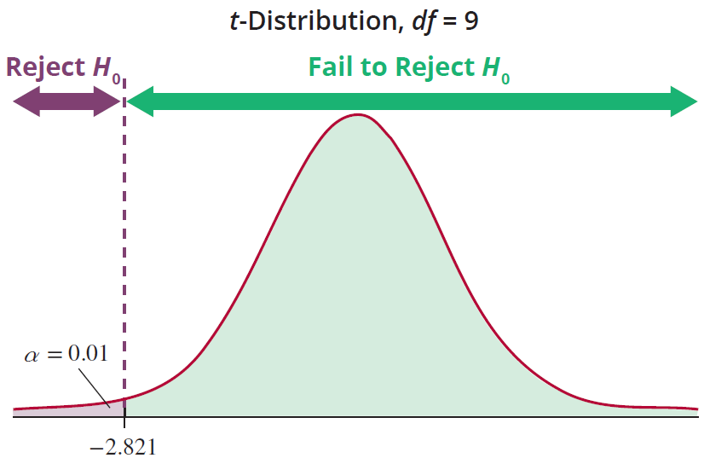
Example 12.2.2 (cont.)

