Slide 1
Section 4.6
Proportions and Percentages

Slide 2
Proportions
A proportion is one of the more common summary measures especially for qualitative data. A proportion can be expressed as a fraction or a percentage.

Slide 3
Definition: Proportion
A proportion measures the fraction of a group that possesses some characteristic.

Slide 4
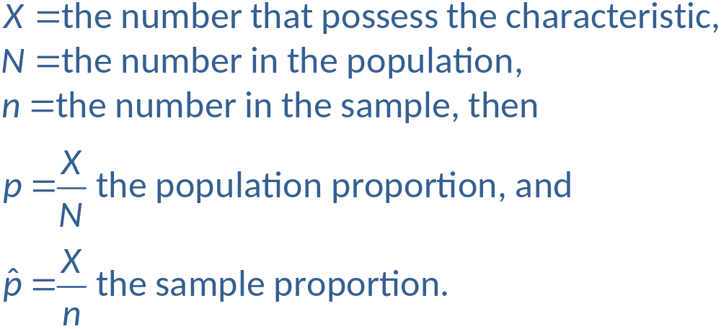
Proportions (cont.)
To calculate a proportion, simply count the number in the group that possess the characteristic of interest and divide the count by the number in the group. Let

Slide 5

Example 4.6.1: Determining the Proportion of
Left-Handed Students
Suppose your statistics class is composed of 48 students of which 4 are left-handed. What proportion of the class is left-handed?
There are 48 pieces of data in the class. Think of the data as composed of 0s and 1s. Any left-handed person will be a 1, and any right-handed person will be a 0. In our data set, there are four 1s and forty-four 0s.

Slide 6
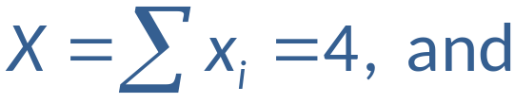
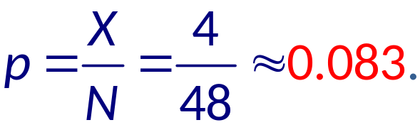
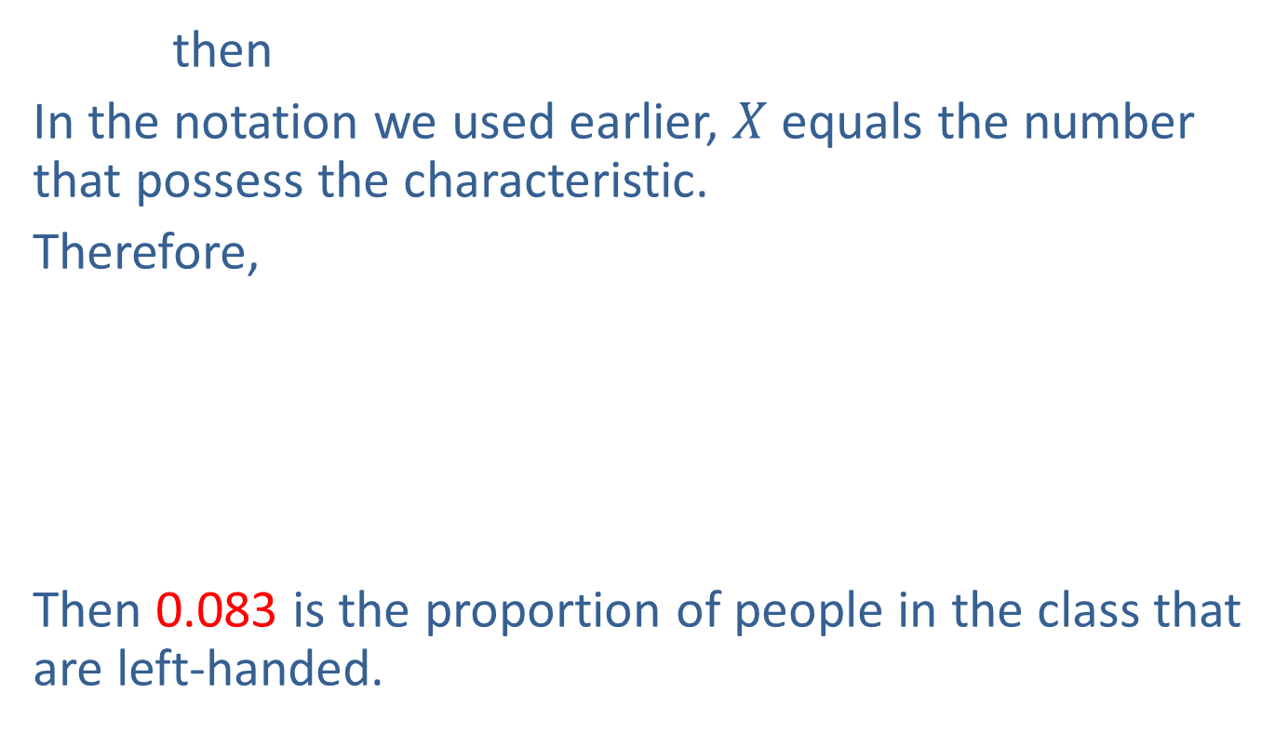
Example 4.6.1: Determining the Proportion of
Left-Handed Students (cont.)
then
In the notation we used earlier, $X$ equals the number that possess the characteristic.
Therefore,
Then 0.083 is the proportion of people in the class that are left-handed.

Slide 7
Proportions (cont.)
In the previous example, the proportion of people in the class who are left-handed could have been reported as a percentage. Instead of saying that 0.083 is the proportion of people in the class that are left-handed, it could be stated that 8.3% of people in the class are left-handed.

