Slide 1
Section 4.2
Measures of Dispersion

Slide 2
The Range
The range is a primitive measure of spread that does not use the deviation concept. It is highly sensitive to outliers and consequently, not a resistant measure.

Slide 3
Definition: Range
The range is the difference between the largest and smallest data values.

Slide 4
Example 4.2.1: Determining the Range of Sodium Content of Breakfast Cereals
Determine the range of the data on the sodium content of ten popular breakfast cereals from Example 4.1.6.
Sodium Content of Breakfast Cereals
Cereal Brand | Sodium (mg)
Apple Jacks | 125
Captain Crunch | 220
Corn Flakes | 290
Golden Grahams | 280
Crispix | 220
Froot Loops | 125
Frosted Flakes | 200

Slide 5
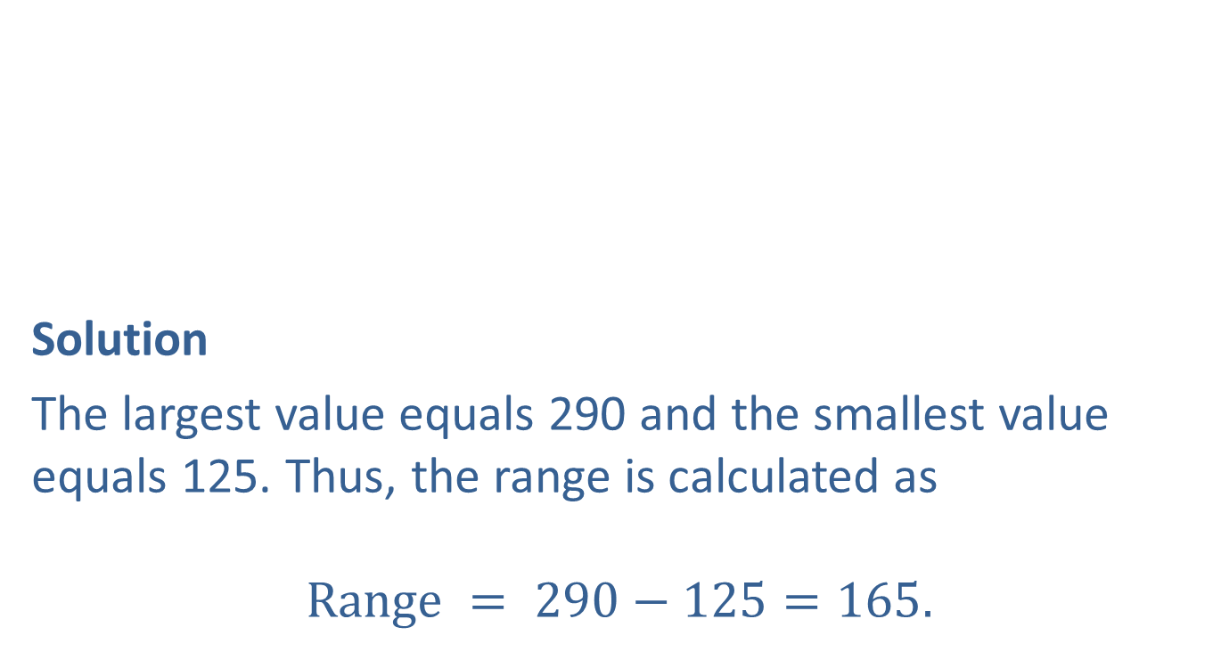
Example 4.2.1: Determining the Range of Sodium Content of Breakfast Cereals (cont.)
Solution
The largest value equals 290 and the smallest value equals 125. Thus, the range is calculated as
$$Range = 290−125=165.$$
Sodium Content of Breakfast Cereals (cont.)
Cereal Brand | Sodium (mg)
Fruity Pebbles | 135
Honey Nut Cheerios | 250
Life | 150

Slide 6
Variance and Standard Deviation
The variance and standard deviation are the most common measures of variability.
If the data is tightly packed around the mean, the variance and standard deviation will be relatively small.
On the other hand, if the data is widely dispersed about the mean, the variance and standard deviation will be relatively large.

Slide 7
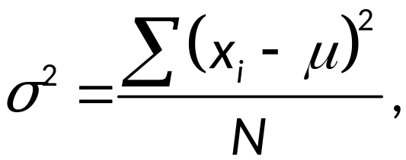
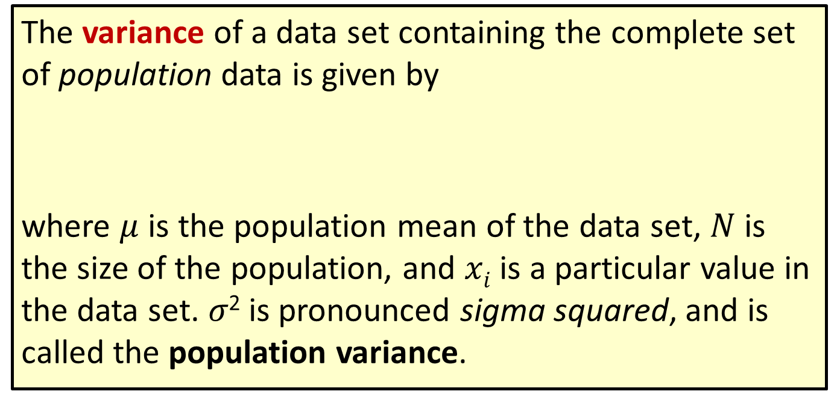
Formula: Variance
The variance of a data set containing the complete set of population data is given by
where $μ$ is the population mean of the data set, $N$ is the size of the population, and $xi$ is a particular value in the data set. 𝜎² is pronounced sigma squared, and is called the population variance.

Slide 8
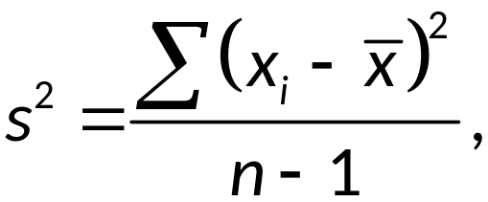
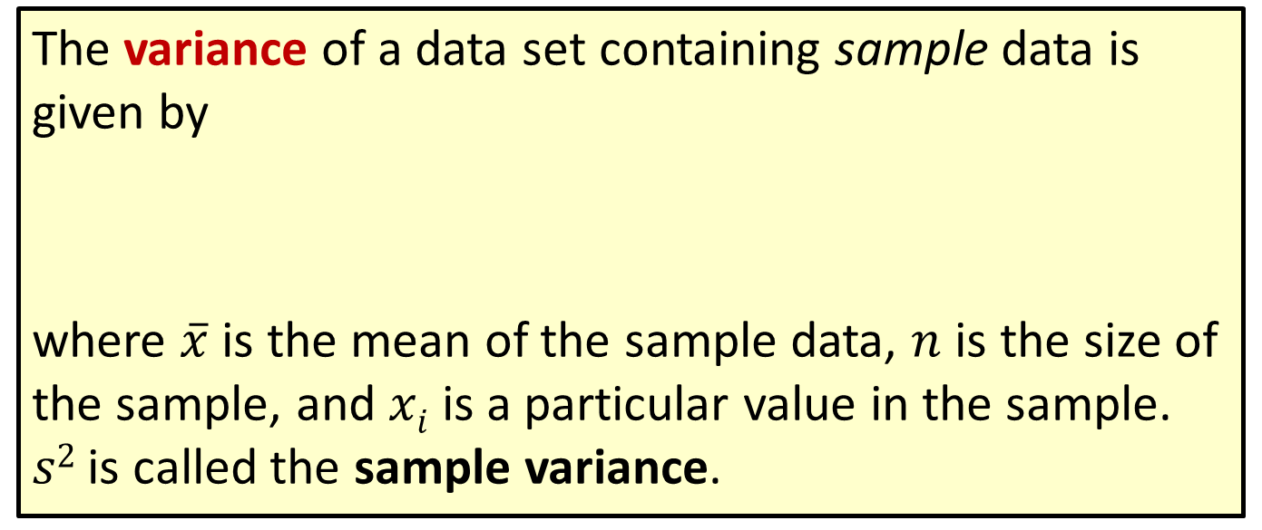
Formula: Variance (cont.)
The variance of a data set containing sample data is given by
where $\overline{x}$ is the mean of the sample data, $n$ is the size of the sample, and $xi$ is a particular value in the sample. $s2$ is called the sample variance.

Slide 9
Example 4.2.4: Determining the Sample Variance of Sodium Content
Using the cereal data in Example 4.1.6, determine the sample variance of sodium content.
Solution
We previously computed the mean of this sample as 199.5. In the table below we do the basic calculations needed to compute the sample variance. Note the only difference from the table for calculating mean absolute deviation (Example 4.2.2) is that we are squaring the deviations instead of taking the absolute value.

Slide 10
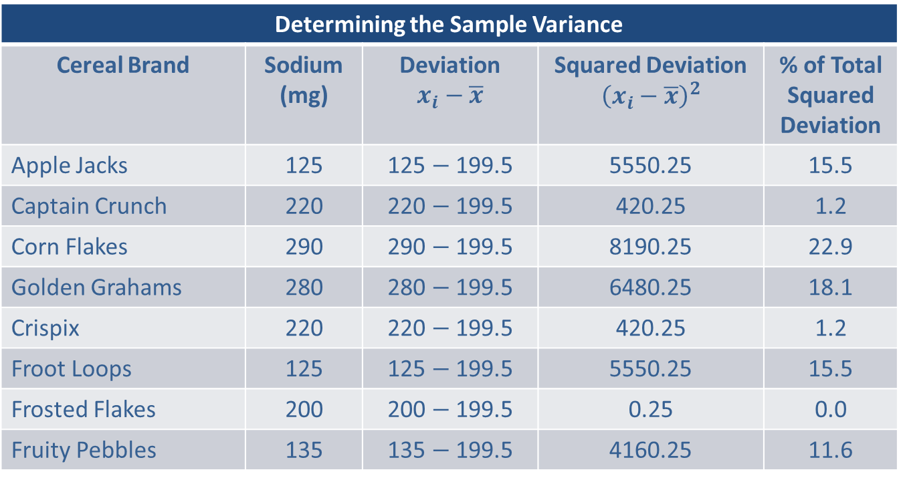
Example 4.2.4: Determining the Sample Variance of Sodium Content (cont.)
Determining the Sample Variance
Cereal Brand | Sodium (mg) | Deviation $$x_{i}−\overline{x}$$ | Squared Deviation $${\left(x_{i}−\overline{x}\right)}^{2}$$ | % of Total Squared Deviation
Apple Jacks | 125 | 125 $−$ 199.5 | 5550.25 | 15.5
Captain Crunch | 220 | 220 $−$ 199.5 | 420.25 | 1.2
Corn Flakes | 290 | 290 $−$ 199.5 | 8190.25 | 22.9
Golden Grahams | 280 | 280 $−$ 199.5 | 6480.25 | 18.1
Crispix | 220 | 220 $−$ 199.5 | 420.25 | 1.2
Froot Loops | 125 | 125 $−$ 199.5 | 5550.25 | 15.5
Frosted Flakes | 200 | 200 $−$ 199.5 | 0.25 | 0.0
Fruity Pebbles | 135 | 135 $−$ 199.5 | 4160.25 | 11.6

Slide 11
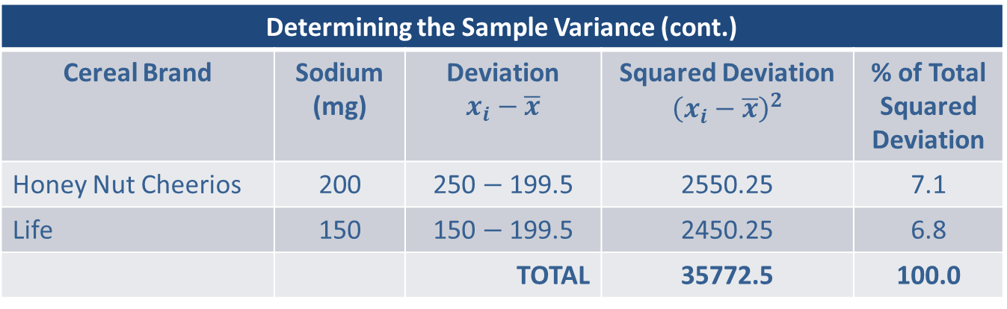
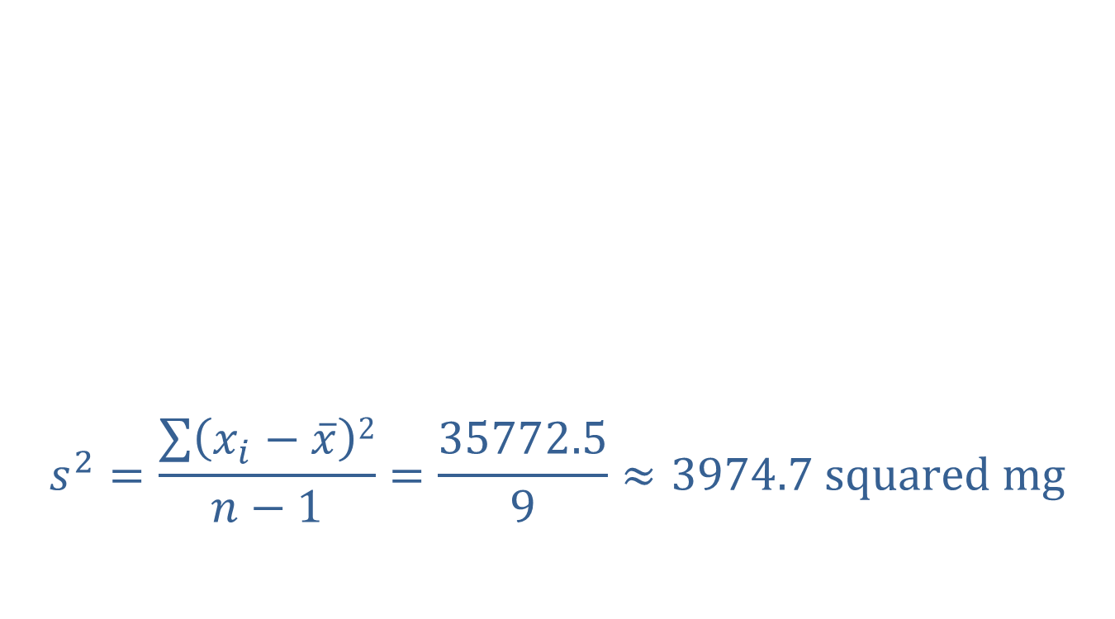
Example 4.2.4: Determining the Sample Variance of Sodium Content (cont.)
$$s^{2}=\frac{\sum{\left(x_{i}−\overline{x}\right)2}}{n−1}=\frac{35772.5}{9}≈3974.7 squared mg$$
Determining the Sample Variance (cont.)
Cereal Brand | Sodium (mg) | Deviation $$x_{i}−\overline{x}$$ | Squared Deviation $${\left(x_{i}−\overline{x}\right)}^{2}$$ | % of Total Squared Deviation
Honey Nut Cheerios | 200 | 250 $−$ 199.5 | 2550.25 | 7.1
Life | 150 | 150 $−$ 199.5 | 2450.25 | 6.8
 |  | TOTAL | 35772.5 | 100.0

Slide 12
Definition: Standard Deviation
The standard deviation is also a measure of how much the data varies around the mean. It is found by taking the square root of the variance.

Slide 13
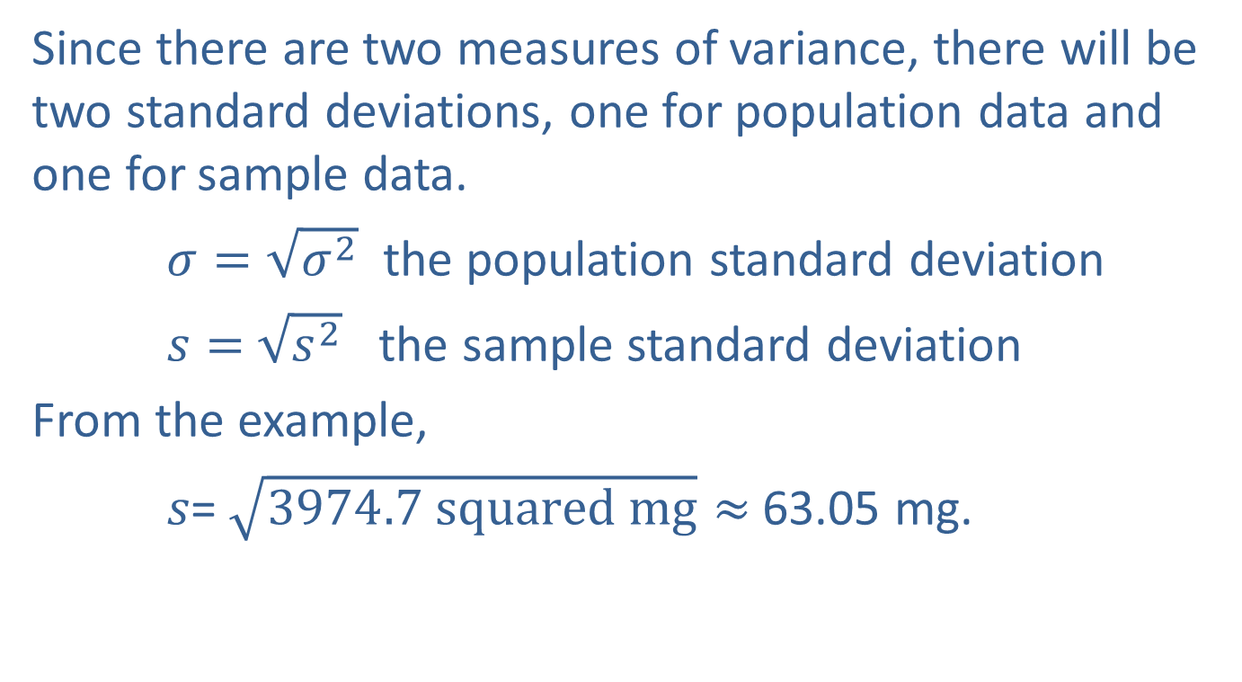
Example 4.2.4: Determining the Sample Variance of Sodium Content (cont.)
Since there are two measures of variance, there will be two standard deviations, one for population data and one for sample data.
$σ=\sqrt{σ^{2}}$ the population standard deviation
$s=$ $\sqrt{s^{2}}$ the sample standard deviation
From the example,
𝑠= $\sqrt{3974.7 squared mg}≈$63.05 mg.

Slide 14
Properties: Properties of the Standard Deviation
The standard deviation is always nonnegative. It is zero only if all the data values are exactly the same.
The standard deviation can increase dramatically if there are one or more outliers in the data.
The standard deviation is expressed in the same units as the original data values.

Slide 15
Using the Standard Deviation
Empirical Rule
The histogram of large data sets from many natural phenomena as well as psychological, sociological, and business data frequently appear to have bell-shaped histograms.

Slide 16
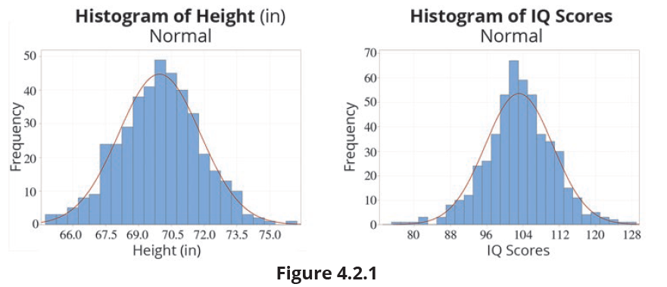
Using the Standard Deviation (cont.)

Slide 17
Using the Standard Deviation (cont.)
The histogram peaks at the median and decreases symmetrically on both sides in the shape of a bell. This bell-shaped histogram phenomenon is observed so frequently that it is called the empirical rule. If the mean and variance are known, the empirical rule allows a data analyst the ability to create accurate probability statements about the concentration of measurements around the mean. This rule doesn’t apply to all distributions, only those that are bell-shaped.

Slide 18
Properties: Empirical Rule
If the distribution of the data is bell-shaped, then
About 68% of the data should lie within 1 standard deviation of the mean.
About 95% of the data should lie within 2 standard deviations of the mean.
About 99.7% of the data should lie within 3 standard deviations of the mean.

Slide 19
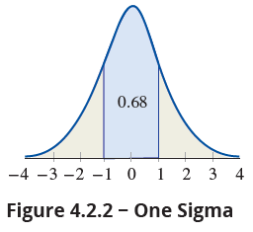
Using the Standard Deviation (cont.)
One sigma rule: If the distribution of the data is bell-shaped, about 68% of the data should lie within one standard deviation of the mean.
A deviation of more than one sigma from the mean is to be expected about once in every three observations.

Slide 20
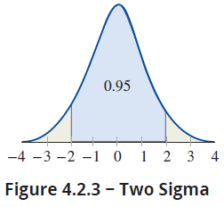
Using the Standard Deviation (cont.)
Two sigma rule: If the distribution of the data is bell-shaped, about 95% of the data should lie within two standard deviations of the mean.
A deviation of more than two sigma from the mean is to be expected about once in every twenty observations.

Slide 21
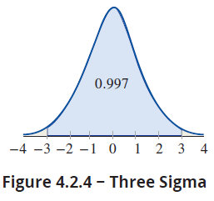
Using the Standard Deviation (cont.)
Three sigma rule: If the distribution of the data is bell-shaped, about 99.7% of the observations should lie within three standard deviations of the mean.
A deviation of more than three sigma from the mean is to be expected about once in every 370 observations, slightly less than 0.3% of the time.

Slide 22
Example 4.2.5: Applying the Empirical Rule to Stock Earnings
Suppose a group of high technology stocks has an average earnings per share during the fourth quarter of $6.26, with a standard deviation of $1.37 at the close of trading on December 31st. If the data possesses a bell-shaped distribution, which interval is known to contains 68% of the earnings? Which interval contains 95% of the earnings?
Solution
Using the one sigma rule, we will capture 68% of the observations.

Slide 23
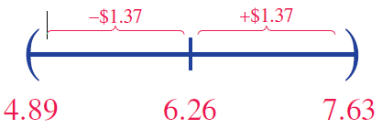
Example 4.2.5: Applying the Empirical Rule to Stock Earnings (cont.)
$6.26 ± $1.37
Using the one sigma rule results in an interval from $6.26 − $1.37 to $6.26 + $1.37. Doing the arithmetic produces an interval from $4.89 to $7.63.

Slide 24
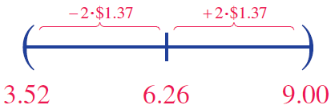
Example 4.2.5: Applying the Empirical Rule to Stock Earnings (cont.)
To capture 95% of the earnings, use the two sigma rule, $6.26 ± 2 ⋅ $1.37. Doing the arithmetic results in an interval from $3.52 to $9.00.
Note that to increase the percentage of data captured from 68% to 95% requires an interval that is twice as large.

