Slide 1
Section 4.1
Measures of Location

Slide 2
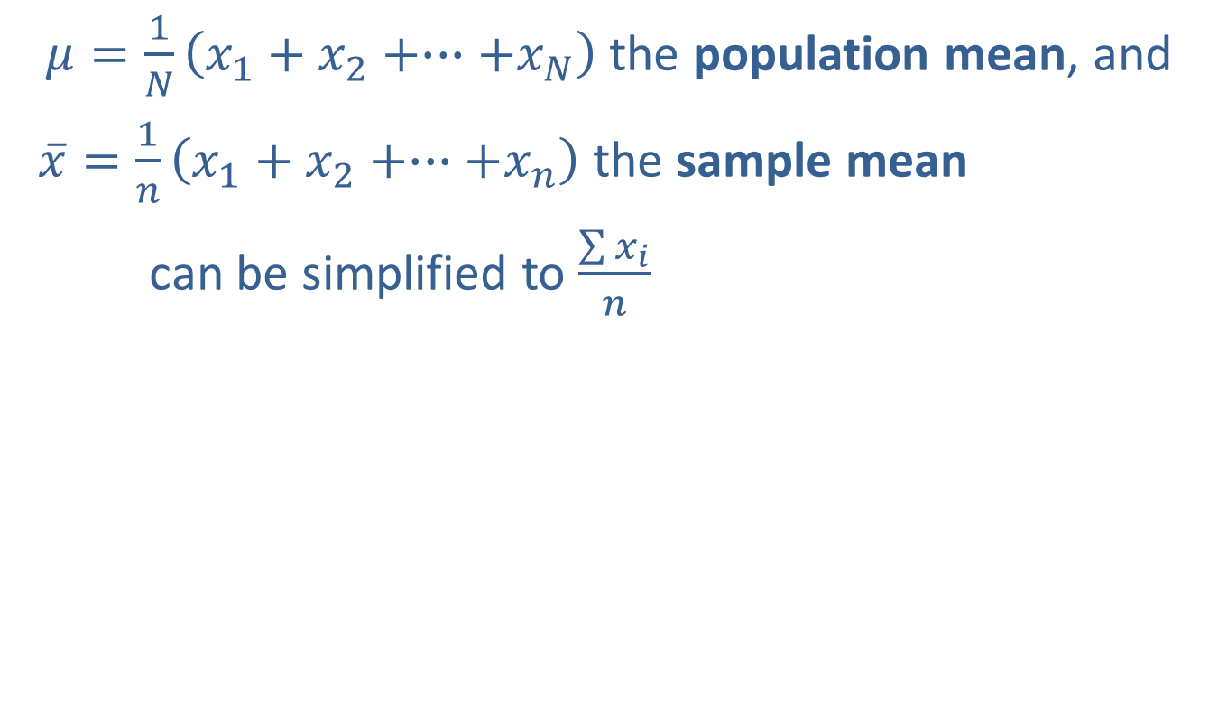
The Arithmetic Mean
$μ=\frac{1}{N}\left(x_{1}+x_{2}+∙∙∙+x_{N}\right)$ the population mean, and
$\overline{x}=\frac{1}{n}\left(x_{1}+x_{2}+∙∙∙+x_{n}\right)$ the sample mean
can be simplified to $\frac{\sum{x_{i}}}{n}$

Slide 3
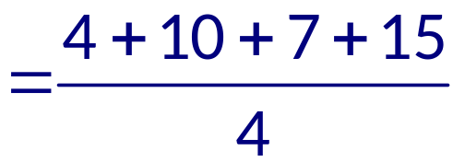
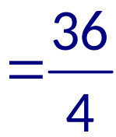


Example 4.1.1: Determining the Sample Mean
Determine the sample mean of the following sample data values: 4, 10, 7, 15.
Solution
Note that

Slide 4
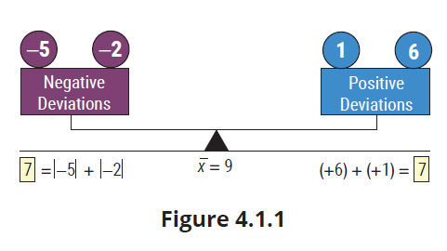
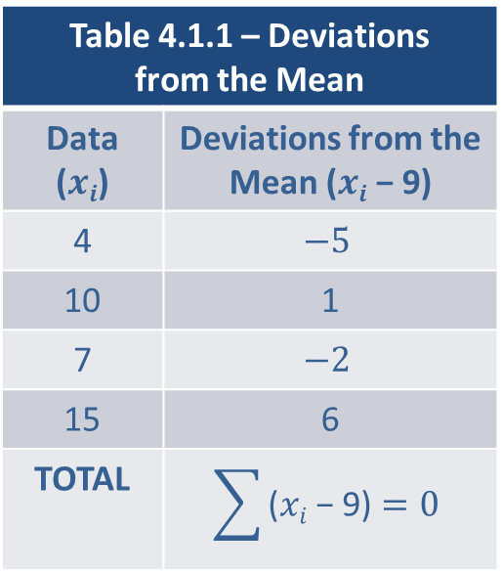
The Arithmetic Mean (cont.)
Table 4.1.1 – Deviations from the Mean
Data ($xi$) | Deviations from the Mean ($xi$ − 9)
4 | $$−5$$
10 | 1
7 | $$−2$$
15 | 6
TOTAL | $$\sum{\text{(}xi\text{ − 9)}=0}$$

Slide 5
Definition: Outliers and Resistant Measures
An outlier is a data value that is extremely different from other measurements in the data set. Statistical measures which are not affected by outliers are said to be resistant.

Slide 6
The Arithmetic Mean (cont.)
The mean is not a resistant measure.

Slide 7
Definition: Median
The median of a set of observations is the measure of center that is the middle value of the data when it is arranged in ascending order. The same number of data values lie on either side of the median.

Slide 8
The Median (cont.)
To determine the median of a set of data, we use the following steps.

Slide 9
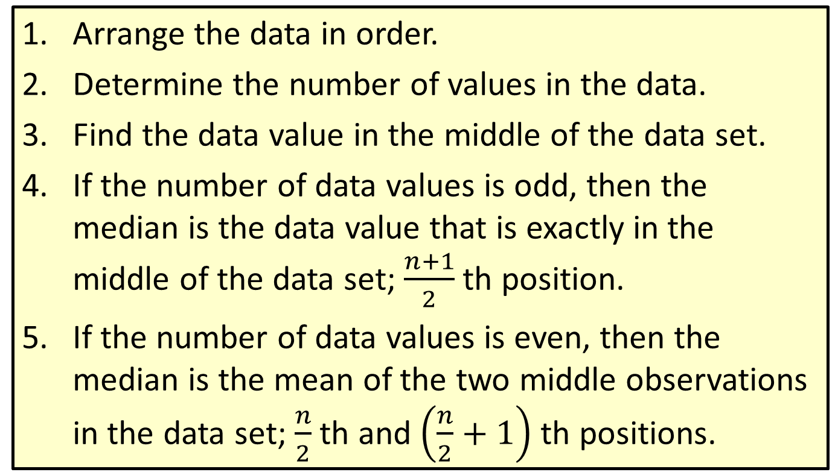
Procedure: Finding the Median of a Data Set
Arrange the data in order.
Determine the number of values in the data.
Find the data value in the middle of the data set.
If the number of data values is odd, then the median is the data value that is exactly in the middle of the data set; $\frac{n+1}{2}$ th position.
If the number of data values is even, then the median is the mean of the two middle observations in the data set; $\frac{n}{2}$ th and $\left(\frac{n}{2}+1\right)$ th positions.

Slide 10
Example 4.1.6: Determining the Median Sodium Level
Approximately 30% of Americans have high blood pressure. Consuming excess sodium, which is especially prevalent in processed foods, is a contributing factor to an increase in blood pressure. The following data represent the sodium content per serving (in milligrams) of ten popular breakfast cereals.

Slide 11
Example 4.1.6: Determining the Median Sodium Level (cont.)
Sodium Content of Breakfast Cereals
Cereal Brand | Sodium (mg)
Apple Jacks | 125
Captain Crunch | 220
Corn Flakes | 290
Golden Grahams | 280
Crispix | 220
Froot Loops | 125
Frosted Flakes | 200
Fruity Pebbles | 135
Honey Nut Cheerios | 250
Life | 150

Slide 12
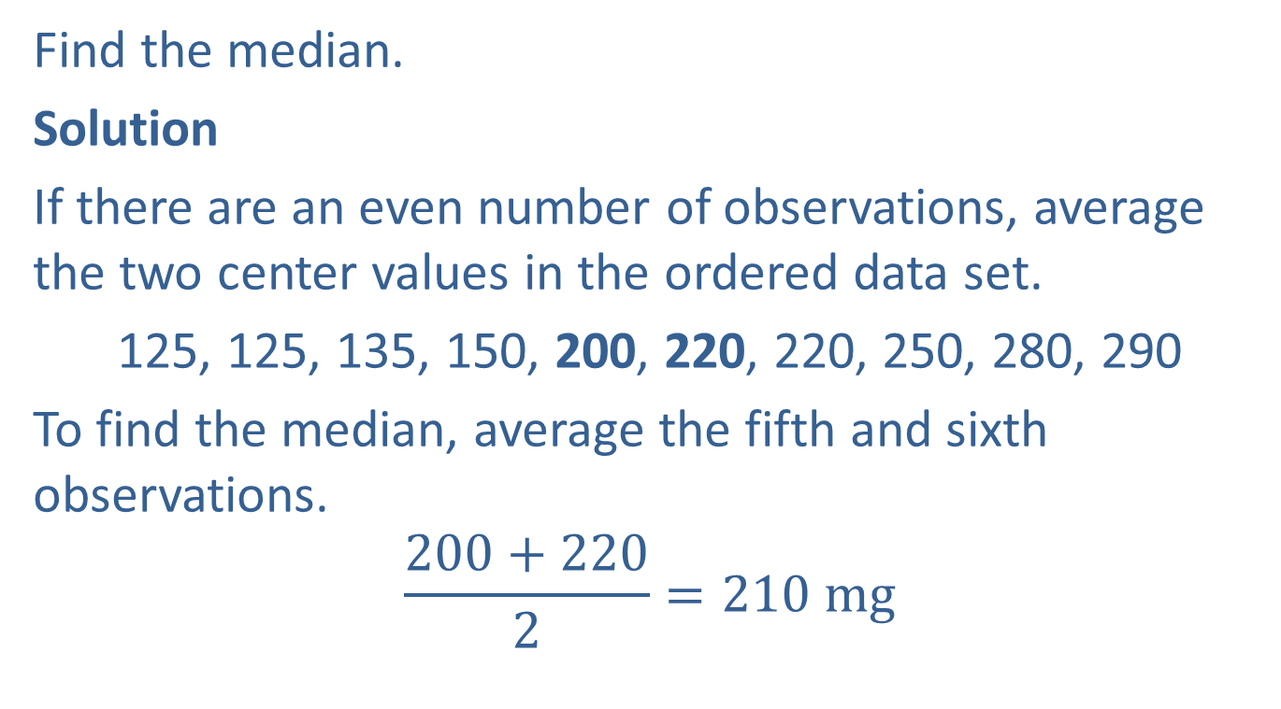
Example 4.1.6: Determining the Median Sodium Level (cont.)
Find the median.
Solution
If there are an even number of observations, average the two center values in the ordered data set.
125, 125, 135, 150, 200, 220, 220, 250, 280, 290
To find the median, average the fifth and sixth observations.
$$\frac{200+220}{2}=210 mg$$

Slide 13
The Mode
The mode is another measure of location. It is not used as frequently as the mean or the median, and its relation to the “central tendency” concept and the values of the mean and median are not predictable. The mode is the only measure of location that can be used for nominal data. Of the three measures of location, the mode is used the least due to the limited information it provides. Sometimes sorting the data (in ascending or descending order) makes it easier to find the mode.

Slide 14
Definition: Mode
The mode of a data set is the most frequently occurring value.

Slide 15

Example 4.1.7: Determining the Mode of Apgar Scores
An Apgar score is a quick way for doctors to evaluate the health of a newborn a few minutes after birth. Scores range from 0 to 10 with a score of 10 being the best possible outcome. Find the mode of the following data representing the Apgar scores of eleven newborns born at a local hospital.

Slide 16
Example 4.1.7: Determining the Mode of Apgar Scores (cont.)
Solution
Since the value of 9 occurs more than any other value, it is the mode. In this instance, as a measure of location, the modal value is not a particularly appealing choice. However, as noted previously, the mode does possess one very favorable property—it is the only measure of location that can be applied to nominal data. Therefore, for nominal measurements like color preferences, it would be perfectly reasonable to discuss the modal color.

Slide 17
The Mode (cont.)
Suppose we added one more value to the data set in Example 4.1.7. If this value were a 7, then both 9 and 7 would be repeated three times and there would be two modes. When this occurs, the data is said to be bimodal. Any time a data set has more than two modes, it is said to be multimodal. If all observations in a data set occur with the same frequency, the data set has no mode.

Slide 18
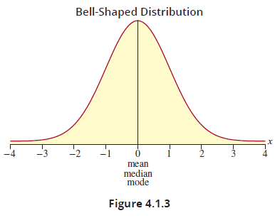
The Relationship between the Mean, Median, and Mode
For a bell-shaped distribution, the mean, median, and mode are identical.

Slide 19
The Relationship between the Mean, Median, and Mode (cont.)
If the distribution of the data has a long tail on the right, it is said to be skewed to the right, or positively skewed.
If the distribution has a long tail on the left, it is said to be skewed to the left, or negatively skewed.

Slide 20
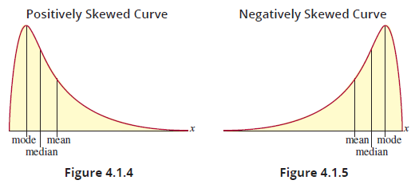
The Relationship between the Mean, Median, and Mode (cont.)

