Slide 1
Section 9.3
The Distribution of the Sample Mean and the Central Limit Theorem

Slide 2
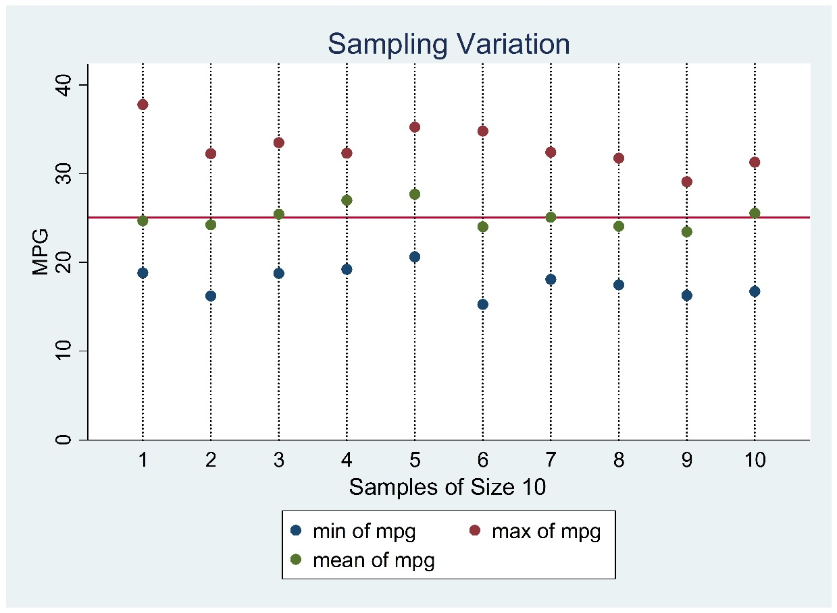
The Distribution of the Sample Mean and the Central Limit Theorem

Slide 3
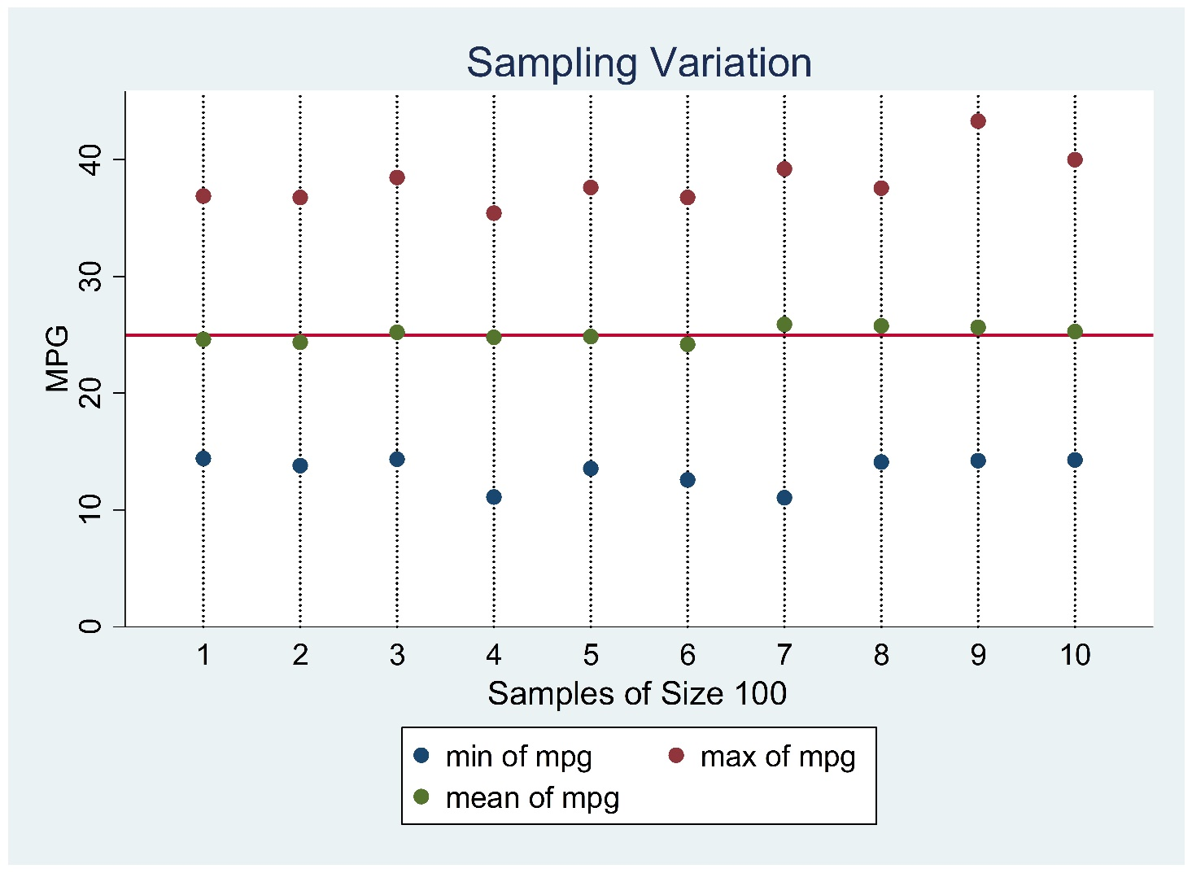
The Distribution of the Sample Mean and the Central Limit Theorem (cont.)

Slide 4
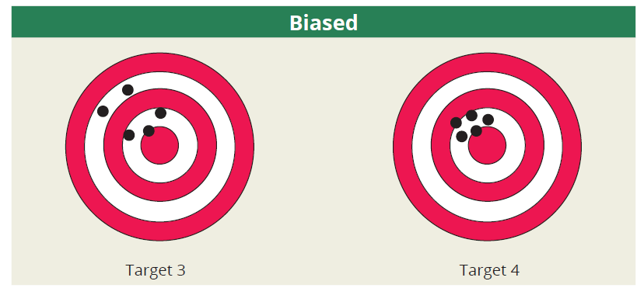
Unbiased vs. Biased Estimators

Slide 5
Unbiased Estimators

Slide 6
Average Value of

Slide 7
Variability of
Variability of an estimator
We refer to as

Slide 8
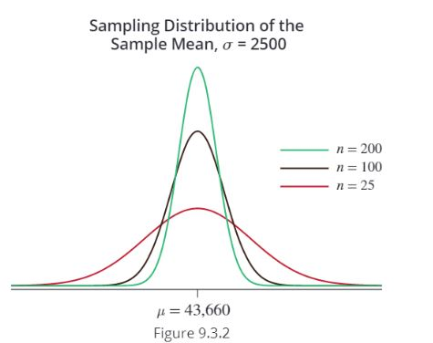
Variability of (cont.)

Slide 9
The Central Limit Theorem
The distribution of the sample mean becomes closer to a normal distribution as the sample size becomes larger, regardless of the shape of the population from which the sample is drawn.

Slide 10
The Central Limit Theorem (cont.)
http://onlinestatbook.com/stat_sim/sampling_dist/index.html

Slide 11
The Central Limit Theorem (cont.)

Slide 12
The Central Limit Theorem (cont.)

Slide 13
Using the z-transformation to Apply the Central Limit Theorem
Under the theorem, we can use the z-transformation to calculate probabilities about the random variable .

Slide 14
$$\overline{X}\sim N(μ, \frac{σ}{\sqrt{n}})$$
0.95
0.025
0.025
$$\overline{x_{1}}$$
μ
$$\overline{x_{2}}$$
$$\frac{\overline{X}−μ}{\frac{σ}{\sqrt{n}}}≡Z\sim N(0, 1)$$
0.95
0.025
0.025
-1.96
0
1.96
$$\frac{\overline{x_{1}}−μ}{\frac{σ}{\sqrt{n}}}=−1.96$$
$$\overline{x_{1}}=μ−1.96\frac{σ}{\sqrt{n}}$$
$$\frac{\overline{x_{2}}−μ}{\frac{σ}{\sqrt{n}}}=1.96$$
$$\overline{x_{2}}=μ+1.96\frac{σ}{\sqrt{n}}$$

Slide 15
Example 9.3.1
Suppose a population has a mean of 30 and a variance of 25. If a sample size of 100 is drawn from the population, what is the probability that the sample mean will be larger than 31?
Solution

Slide 16
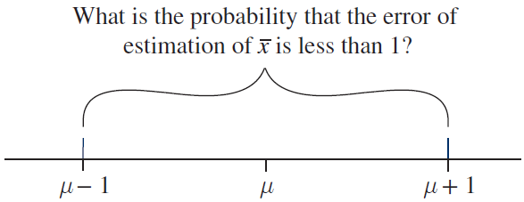
Example 9.3.2
Consider the same scenario as in Example 9.3.1 except that the sample mean is unknown. What is the probability that the sample mean will be in error by at most one unit from the true mean?
Solution: Condition that must be satisfied |μ - $\overline{x}$|<1.

