Slide 1
Section 8.3
The Standard Normal Distribution

Slide 2
Standard Normal Distribution

Slide 3
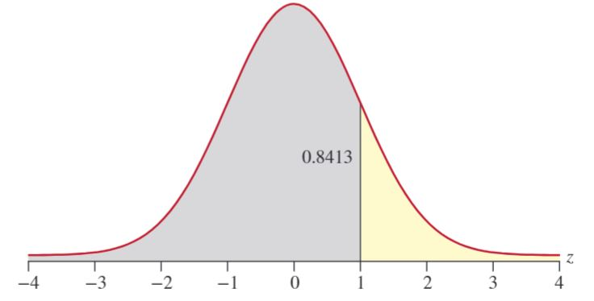
z-distribution
Tables A, B, and C in Appendix A

Slide 4
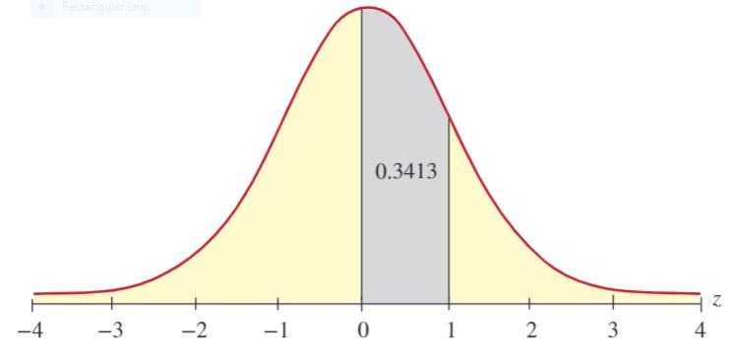
z-distribution (cont.)

Slide 5
Example 8.3.1
Compute the probability that a standard normal random variable is less than 1.27.
Solution

Slide 6
Example 8.3.3
Determine the probability that a standard normal random variable is greater than 1.37.
Solution

Slide 7
Example 8.3.6
Given that z is a standard normal random variable, find the value of z for each situation.
The area to the left of z is 0.1469.
The area to the right of z is 0.7967.

