Slide 1
Section 8.2
The Normal Distribution

Slide 2
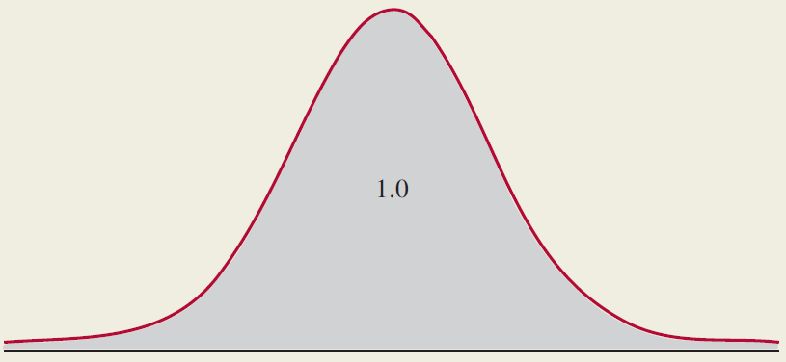
Normal Distribution

Slide 3
Standard Deviations Around the Mean
Probability of being within 1, 2, and 3 standard deviations of the mean.

Slide 4
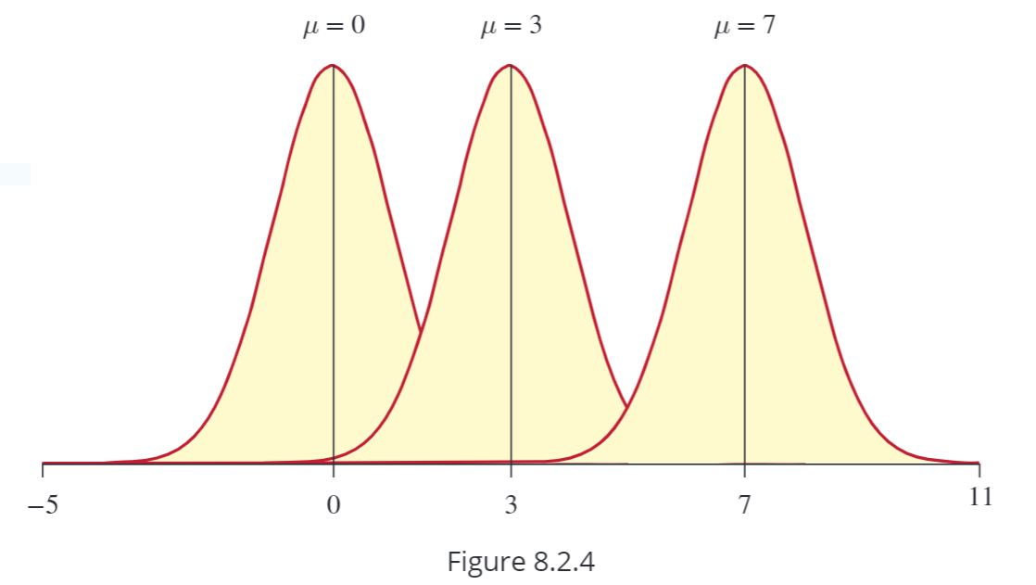
Normal Probability Density Function

Slide 5
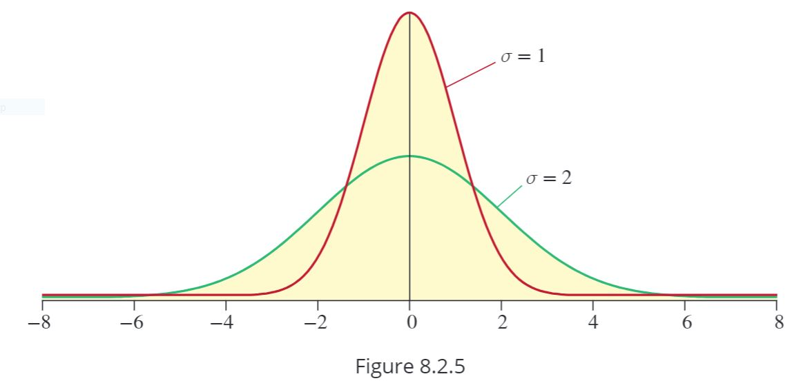
Normal Probability Density Function (cont.)

