Slide 1
Section 13.2
Inference Concerning β₁

Slide 2
Inference Concerning β₁
Simple linear regression model:
Estimated from the sample:
$β_{1}$:
$b_{1}$:

Slide 3
Confidence Interval for β₁
Confidence interval for $β_{1}$:
Variance of $b_{1}: σ_{b_{1}}^{2}=$

Slide 4
Confidence Interval for β₁ (cont.)
Sample estimate of the variance of $b_{1}$:
$$s_{b_{1}}^{2}=$$
where $s_{e}^{2}=$
Standard deviation (standard error) of $b_{1}$:
$$s_{b_{1}}=$$

Slide 5
100(1 − 𝛼)% Confidence Interval for β₁

Slide 6
Example 13.2.1
A model relating the age of a Honda Civic LX sedan to the asking price of the automobile was constructed.
Asking Price = β₀ + β₁ ⋅ (Age).
If the data given below is considered a random sample of Honda Civics, then a relationship can be constructed from the sample data.

Slide 7
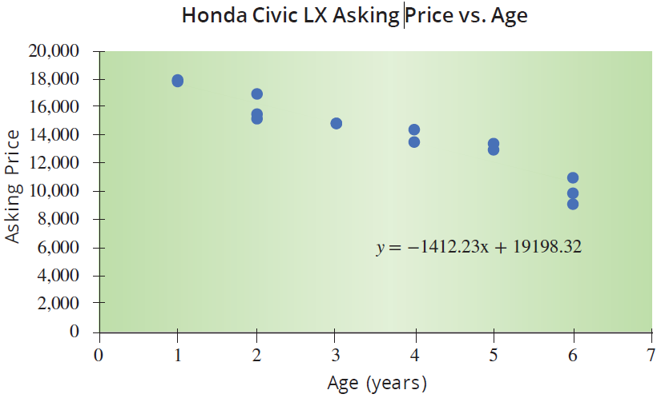
Example 13.2.1 (cont.)
Price of a Honda Civic LX Sedan
Age (Years) | Asking Price
1 | 17,850
1 | 18,000
2 | 15,195
2 | 16,995
2 | 15,625
3 | 14,935
3 | 14,879
4 | 14,460
4 | 13,586
5 | 13,050
5 | 13,495
6 | 9,150
6 | 9,950
6 | 10,995

Slide 8
Example 13.2.1 (cont.)
Least squares regression line:

Slide 9
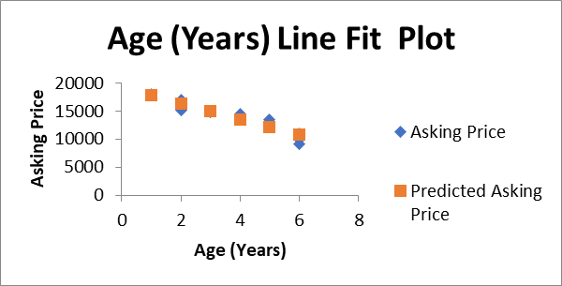
Example 13.2.1 (cont.)
Age (Years) | Asking Price
1 | 17850
1 | 18000
2 | 15195
2 | 16995
2 | 15625
3 | 14935
3 | 14879
4 | 14460
4 | 13586
5 | 13050
5 | 13495
6 | 9150
6 | 9950
6 | 10995

Slide 10
Example 13.2.1 (cont.)
Regression Statistics
Multiple R | 0.951498605
R Square | 0.905349596
Adjusted R Square | 0.897462062
Standard Error | 868.6718405
Observations | 14
ANOVA
 | df | SS | MS | F | Significance F
Regression | 1 | 86613696.02 | 86613696.02 | 114.7823428 | 1.69218E-07
Residual | 12 | 9055089.197 | 754590.7664
Total | 13 | 95668785.21
 | Coefficients | Standard Error | t Stat | P-value | Lower 95% | Upper 95% | Lower 95.0% | Upper 95.0%
Intercept | 19198.32237 | 524.9046752 | 36.57487402 | 1.1184E-13 | 18054.65333 | 20341.99141 | 18054.65333 | 20341.99141
Age (Years) | -1412.230263 | 131.8159523 | -10.71365217 | 1.69218E-07 | -1699.432551 | -1125.027975 | -1699.432551 | -1125.027975

Slide 11
Example 13.2.1 (cont.)
95% confidence interval for β₁

Slide 12
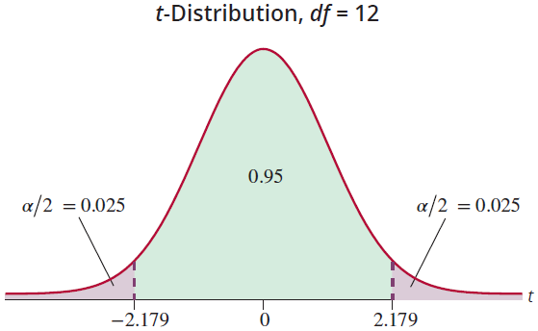
Example 13.2.1 (cont.)

Slide 13
Example 13.2.1 (cont.)
Standard deviation of b₁

Slide 14
Example 13.2.1 (cont.)
Age (Years) x | Sum of Squared Deviations | Age (Years) x | Sum of Squared Deviations
1 | (1 − 3.57)² | 4 | (4 − 3.57)²
1 | (1 − 3.57)² | 4 | (4 − 3.57)²
2 | (2 − 3.57)² | 5 | (5 − 3.57)²
2 | (2 − 3.57)² | 5 | (5 − 3.57)²
2 | (2 − 3.57)² | 6 | (6 − 3.57)²
3 | (3 − 3.57)² | 6 | (6 − 3.57)²
3 | (3 − 3.57)² | 6 | (6 − 3.57)²
Total

Slide 15
Example 13.2.1 (cont.)
Age (Years) | Asking Price | Predicted Asking Price | Residuals or Error | Squared Errors
 |  | 19198.32 -1412.23(Age) | (Price - Predicted Price)
1 | 17850 | 17786.09211 | 63.90789474 | 4084.21901
1 | 18000 | 17786.09211 | 213.9078947 | 45756.58743
2 | 15195 | 16373.86184 | -1178.861842 | 1389715.243
2 | 16995 | 16373.86184 | 621.1381579 | 385812.6112
2 | 15625 | 16373.86184 | -748.8618421 | 560794.0586
3 | 14935 | 14961.63158 | -26.63157895 | 709.2409972
3 | 14879 | 14961.63158 | -82.63157895 | 6827.977839
4 | 14460 | 13549.40132 | 910.5986842 | 829189.9637
4 | 13586 | 13549.40132 | 36.59868421 | 1339.463686
5 | 13050 | 12137.17105 | 912.8289474 | 833256.6872
5 | 13495 | 12137.17105 | 1357.828947 | 1843699.45
6 | 9150 | 10724.94079 | -1574.940789 | 2480438.49
6 | 9950 | 10724.94079 | -774.9407895 | 600533.2272
6 | 10995 | 10724.94079 | 270.0592105 | 72931.97719
 |  |  |  | 9055089.197 | SSE
 |  |  |  | 754590.7664 | MSE

Slide 16
Example 13.2.1 (cont.)

Slide 17
Example 13.2.1 (cont.)
ANOVA
 | df | SS | MS | F | Signiﬁcance F
Regression | 1 | 86613696.0169 | 86613696.0169 | 114.7823 | 1.69218E-07
Residual | 12 | 9055089.1974 | 754590.77
Total | 13 | 95668785.2143
 | Coeﬃcients | Standard Error | t Stat | P-value | Lower 95% | Upper 95%
Intercept | 19198.3224 | 524.9047 | 36.5749 | 1.12E-13 | 18054.65333 | 20341.99141
Age (Years) |  |  | −10.7137 | 1.69E-07 | −1699.432551 | −1125.027975

Slide 18
Example 13.2.1 (cont.)
Regression Statistics
Multiple R | 0.951498605
R Square | 0.905349596
Adjusted R Square | 0.897462062
Standard Error | 868.6718405
Observations | 14
ANOVA
 | df | SS | MS | F | Significance F
Regression | 1 | 86613696.02 | 86613696.02 | 114.7823428 | 1.69218E-07
Residual | 12 | 9055089.197 | 754590.7664
Total | 13 | 95668785.21
 | Coefficients | Standard Error | t Stat | P-value | Lower 95% | Upper 95% | Lower 95.0% | Upper 95.0%
Intercept | 19198.32237 | 524.9046752 | 36.57487402 | 1.1184E-13 | 18054.65333 | 20341.99141 | 18054.65333 | 20341.99141
Age (Years) | -1412.230263 | 131.8159523 | -10.71365217 | 1.69218E-07 | -1699.432551 | -1125.027975 | -1699.432551 | -1125.027975

Slide 19
Example 13.2.2
99% confidence interval for β₁ using the model described in Example 13.2.1.

Slide 20
Example 13.2.2 (cont.)
Regression Statistics
Multiple R | 0.951498605
R Square | 0.905349596
Adjusted R Square | 0.897462062
Standard Error | 868.6718405
Observations | 14
ANOVA
 | df | SS | MS | F | Significance F
Regression | 1 | 86613696.02 | 86613696.02 | 114.7823428 | 1.69218E-07
Residual | 12 | 9055089.197 | 754590.7664
Total | 13 | 95668785.21
 | Coefficients | Standard Error | t Stat | P-value | Lower 95% | Upper 95% | Lower 99.0% | Upper 99.0%
Intercept | 19198.32237 | 524.9046752 | 36.57487402 | 1.1184E-13 | 18054.65333 | 20341.99141 | 17594.98026 | 20801.66448
Age (Years) | -1412.230263 | 131.8159523 | -10.71365217 | 1.69218E-07 | -1699.432551 | -1125.027975 | -1814.867308 | -1009.593218

Slide 21
Example 13.2.3
We examined a model relating SAT score to graduating GPA. A portion of the data is repeated here.
SAT Scores and Graduating GPA
Student | SAT Verbal | SAT Math | SAT Total | College GPA
1 | 680 | 554 | 1234 | 3.42
2 | 486 | 562 | 1048 | 2.37
3 | 500 | 564 | 1064 | 2.52
4 | 501 | 564 | 1065 | 2.25
5 | 503 | 583 | 1086 | 2.9
. . .

Slide 22
Example 13.2.3 (cont.)
The population regression model to be estimated is
Graduating GPA = β₀ + β₁ ⋅ (SAT Score).
95% confidence interval for β₁.

Slide 23
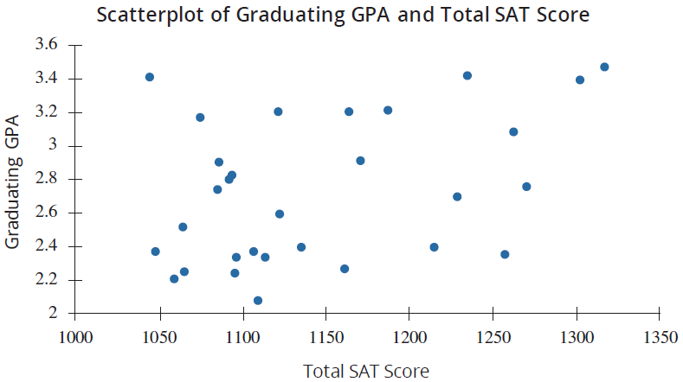
Example 13.2.3 (cont.)

Slide 24
Example 13.2.3 (cont.)
Solution
ANOVA
 | df | SS | MS | F | Signiﬁcance F
Regression | 1 | 0.854832198 | 0.854832198 | 5.321848064 | 0.028670474
Residual | 28 | 4.497554469 | 0.160626945
Total | 29 | 5.352386667
 | Coeﬃcients | Standard Error | t Stat | P-value | Lower 95% | Upper 95%
Intercept | 0.273342604 | 1.067710391 | 0.256008189 | 0.799816021 | −1.913762987 | 2.460448195
SAT Score | 0.002144823 | 0.000929737 | 2.306913103 | 0.028670474 | 0.000240343 | 0.004049304

Slide 25
Example 13.2.3 (cont.)
Regression Statistics
Multiple R | 0.399637925
R Square | 0.159710471
Adjusted R Square | 0.129700131
Standard Error | 0.400782915
Observations | 30
ANOVA
 | df | SS | MS | F | Significance F
Regression | 1 | 0.854832198 | 0.854832198 | 5.321848064 | 0.028670474
Residual | 28 | 4.497554469 | 0.160626945
Total | 29 | 5.352386667
 | Coefficients | Standard Error | t Stat | P-value | Lower 95% | Upper 95% | Lower 95.0% | Upper 95.0%
Intercept | 0.273342604 | 1.067710391 | 0.256008189 | 0.799816021 | -1.913762987 | 2.460448195 | -1.913762987 | 2.460448195
SAT | 0.002144823 | 0.000929737 | 2.306913103 | 0.028670474 | 0.000240343 | 0.004049304 | 0.000240343 | 0.004049304

Slide 26
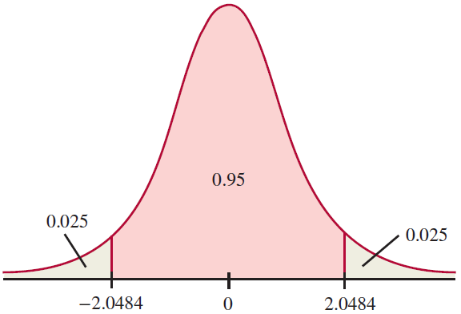
Example 13.2.3 (cont.)

Slide 27
Testing a Hypothesis Concerning β₁
Simple linear regression model:
$$y_{i}=β_{0}+β_{1}x_{i}+ε_{i}$$
$$β_{1}=0$$

Slide 28
Example 13.2.4
Using the data in Example 13.2.1, determine if there is overwhelming evidence at the α = 0.05 level of a relationship between the price of a Honda Civic and its age.

Slide 29
Example 13.2.4 (cont.)
SUMMARY OUTPUT
Regression Statistics
Multiple R | 0.951498605
R Square | 0.905349596
Adjusted R Square | 0.897462062
Standard Error | 868.6718405
Observations | 14
ANOVA
 | df | SS | MS | F | Signiﬁcance F
Regression | 1 | 86613696.0169 | 86613696.0169 | 114.7823 | 1.69218E-07
Residual | 12 | 9055089.1974 | 754590.8
Total | 13 | 95668785.2143

Slide 30
Example 13.2.4 (cont.)
 | Coeﬃcients | Standard Error | t Stat | P-value | Lower 95% | Upper 95%
Intercept | 19198.3224 | 524.9047 | 36.5749 | 1.12E-13 | 18054.65333 | 20341.99141
Age (Years) | −1412.2303 | 131.8160 | −10.7137 | 1.69E-07 | −1699.432551 | −1125.027975

Slide 31
Example 13.2.4 (cont.)
Regression Statistics
Multiple R | 0.951498605
R Square | 0.905349596
Adjusted R Square | 0.897462062
Standard Error | 868.6718405
Observations | 14
ANOVA
 | df | SS | MS | F | Significance F
Regression | 1 | 86613696.02 | 86613696.02 | 114.7823428 | 1.69218E-07
Residual | 12 | 9055089.197 | 754590.7664
Total | 13 | 95668785.21
 | Coefficients | Standard Error | t Stat | P-value | Lower 95% | Upper 95% | Lower 99.0% | Upper 99.0%
Intercept | 19198.32237 | 524.9046752 | 36.57487402 | 1.1184E-13 | 18054.65333 | 20341.99141 | 17594.98026 | 20801.66448
Age (Years) | -1412.230263 | 131.8159523 | -10.71365217 | 1.69218E-07 | -1699.432551 | -1125.027975 | -1814.867308 | -1009.593218

Slide 32
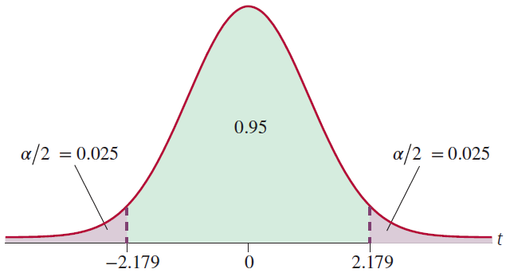
Example 13.2.4 (cont.)

