Slide 1
Section 11.4
Testing a Hypothesis about a Population Proportion

Slide 2
Testing a Hypothesis about a Population Proportion
Use $\hat{p}$ to test hypotheses about $p$

Slide 3
Hypotheses for a Test about a Single Proportion

Slide 4
Example 11.4.1
A college is trying a new student registration system and wants to know if there is sufficient evidence to conclude that more than 60% of the students favor it. In a random sample of 520 students, 352 said that the new registration system is superior. Say α = 0.05.

Slide 5
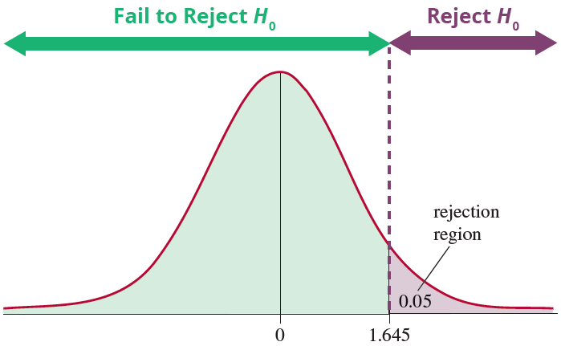
Example 11.4.1 (cont.)

Slide 6
Calculating P-Values for a Hypothesis Test for a Proportion

Slide 7
Example 11.4.1 (cont.)

