Slide 1
Section 9.4
The Distribution of the Sample Proportion

Slide 2
Sample Proportion
Population proportion:
Sample proportion:

Slide 3
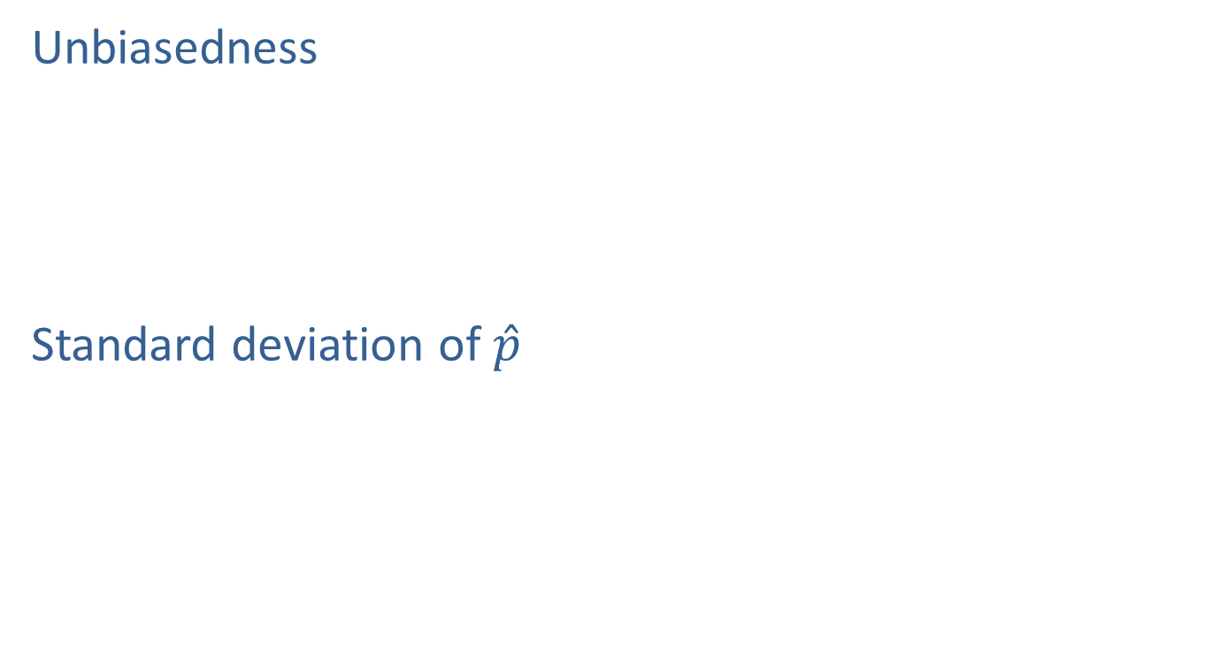
Expected Value and Standard Deviation of the Sample Proportion
Unbiasedness
Standard deviation of $\hat{p}$

Slide 4
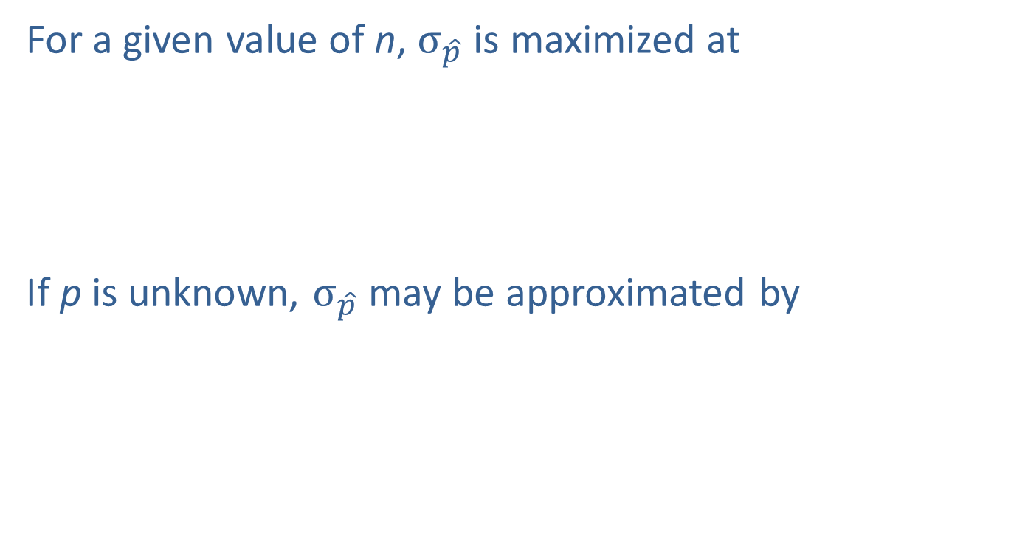
Expected Value and Standard Deviation of the Sample Proportion (cont.)
For a given value of n, $σ_{\hat{p}}$ is maximized at
If p is unknown, $σ_{\hat{p}}$ may be approximated by

Slide 5
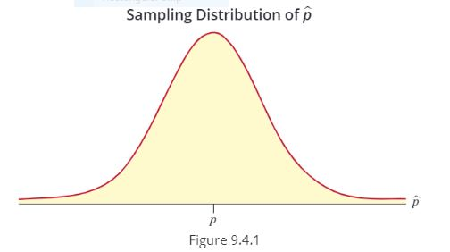

Sampling Distribution of the Sample Proportion
Sampling distribution of $\hat{p}$ approaches normality as $n$ becomes sufficiently large and
http://digitalfirst.bfwpub.com/stats_applet/generic_stats_applet_24_sampdistprop.html

Slide 6
Example
Suppose a sample of 400 persons is used to perform a taste test between Pepsi and other colas. If the true fraction in the population that prefers Pepsi is 0.5, what is the probability that less than 0.44 of the persons in the sample will prefer Pepsi?

