Slide 1
Section 9.3
The Distribution of the Sample Mean and the Central Limit Theorem

Slide 2
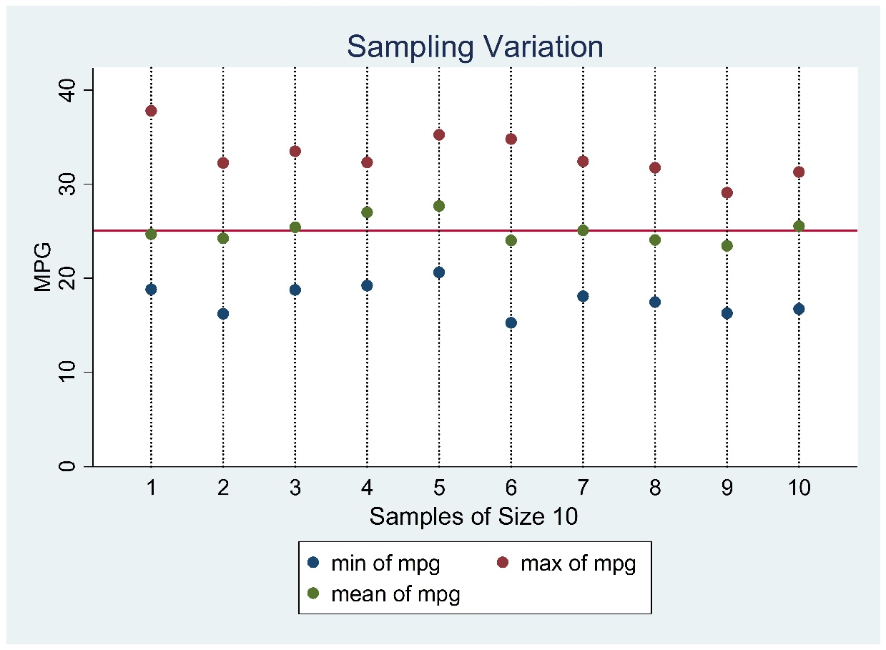
The Distribution of the Sample Mean and the Central Limit Theorem

Slide 3
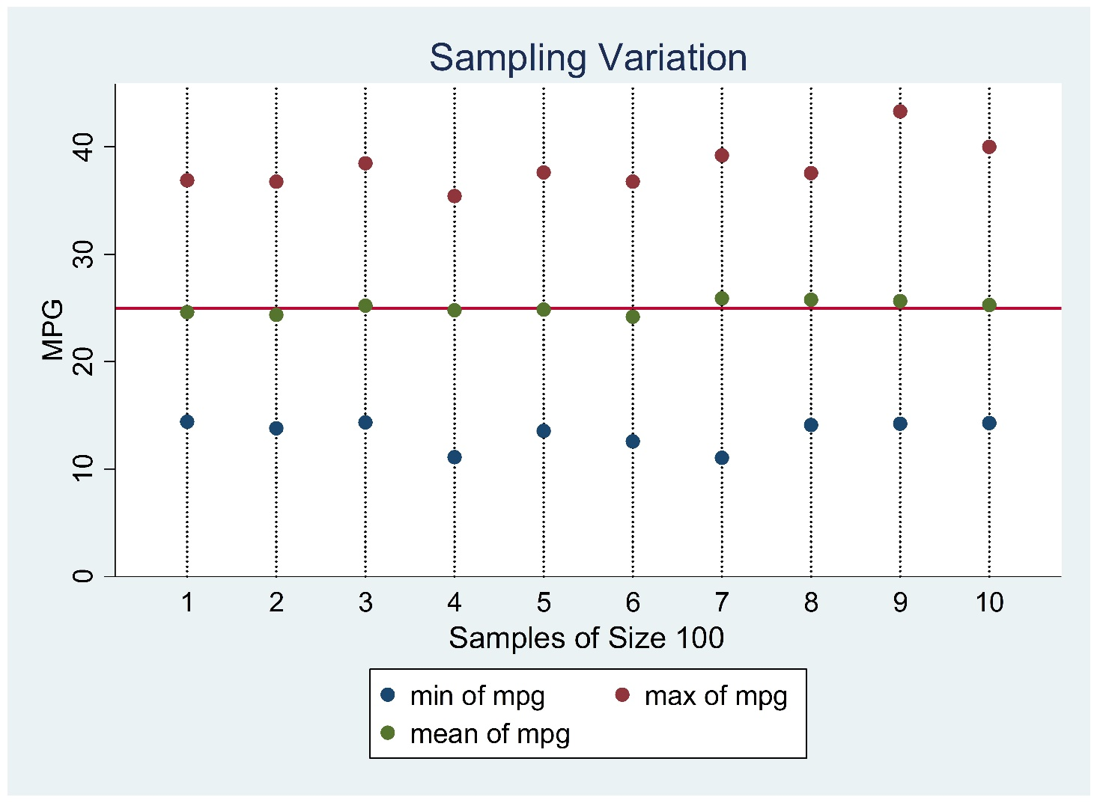
The Distribution of the Sample Mean and the Central Limit Theorem (cont.)

Slide 4
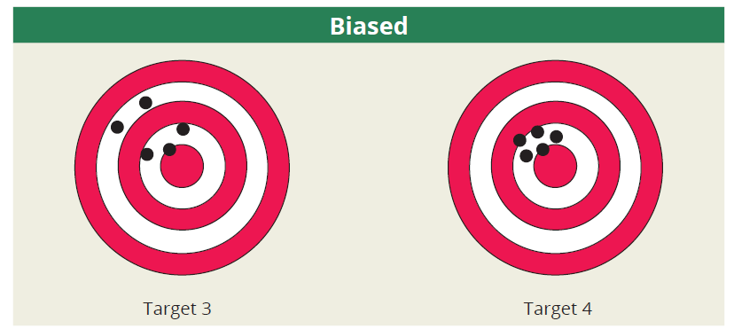
Unbiased vs. Biased Estimators

Slide 5
Unbiased Estimators

Slide 6
Average Value of

Slide 7
Variability of
Variance

Slide 8
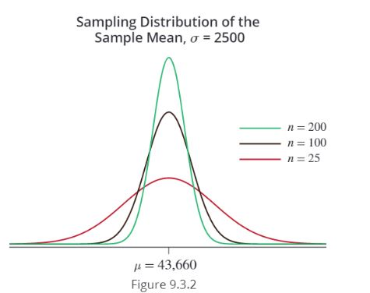
Variability of (cont.)

Slide 9
The Central Limit Theorem
The distribution of the sample mean becomes closer to a normal distribution as the sample size becomes larger, regardless of the shape of the population from which the sample is drawn.

Slide 10
The Central Limit Theorem (cont.)
http://onlinestatbook.com/stat_sim/sampling_dist/index.html

Slide 11
The Central Limit Theorem (cont.)

Slide 12
The Central Limit Theorem (cont.)

Slide 13
Using the z-transformation to Apply the Central Limit Theorem
Probabilities about the random variable

Slide 14
$$\overline{X}\sim N(μ, \frac{σ}{\sqrt{n}})$$
0.95
0.025
0.025
$$\overline{x_{1}}$$
μ
$$\overline{x_{2}}$$
$$\frac{\overline{X}−μ}{\frac{σ}{\sqrt{n}}}≡Z\sim N(0, 1)$$
0.95
0.025
0.025
-1.96
0
1.96
$$\frac{\overline{x_{1}}−μ}{\frac{σ}{\sqrt{n}}}=−1.96$$
$$\overline{x_{1}}=μ−1.96\frac{σ}{\sqrt{n}}$$
$$\frac{\overline{x_{2}}−μ}{\frac{σ}{\sqrt{n}}}=1.96$$
$$\overline{x_{2}}=μ+1.96\frac{σ}{\sqrt{n}}$$

Slide 15
Example
Suppose a population has a mean of 30 and a variance of 25. If a sample size of 100 is drawn from the population, what is the probability that the sample mean will be larger than 31?

