Slide 1
Section 5.1
Scatterplots and Correlation

Slide 2
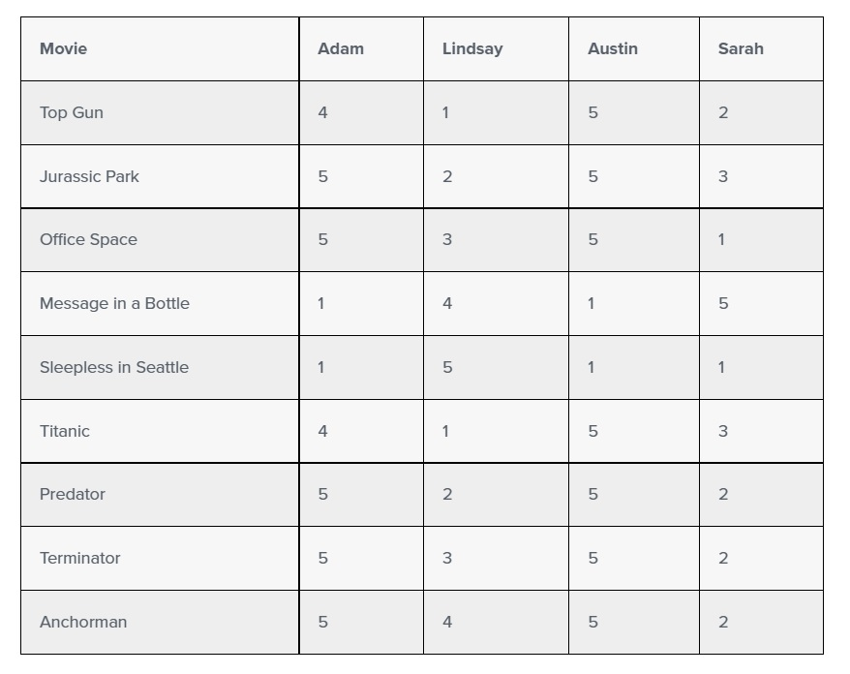
Correlation
https://teamairship.com/how-netflix-uses-correlations/

Slide 3
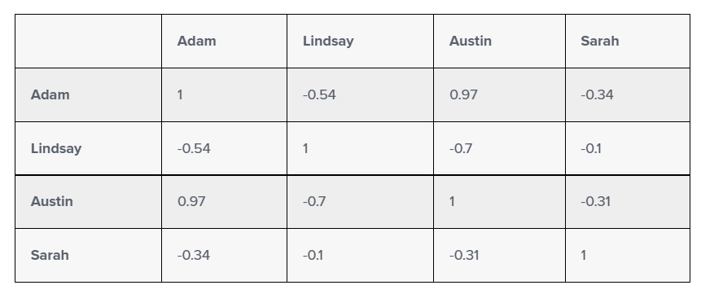
Correlation (cont.)

Slide 4
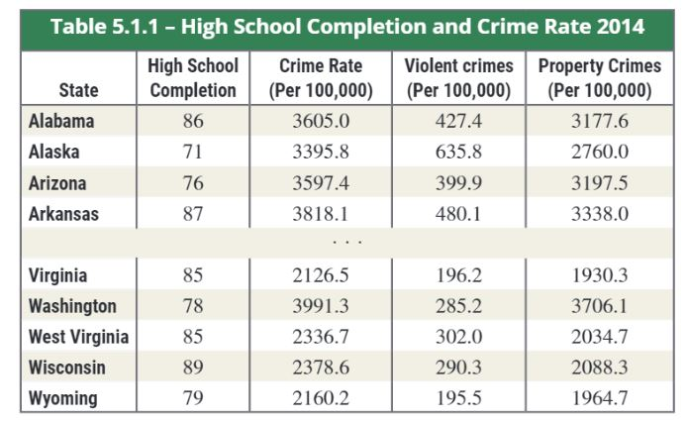
Scatterplots

Slide 5
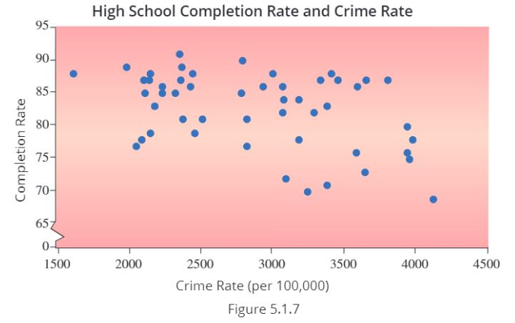
Scatterplots (cont.)

Slide 6
(Sample) Correlation Coefficient

Slide 7
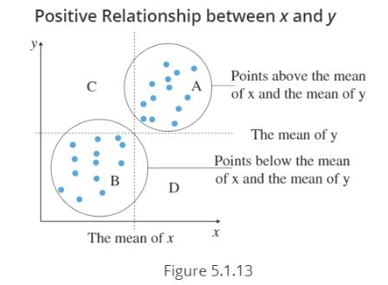
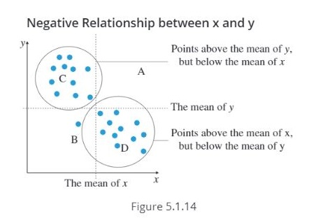
Correlation Coefficient (cont.)

Slide 8
Correlation Coefficient (cont.)

Slide 9
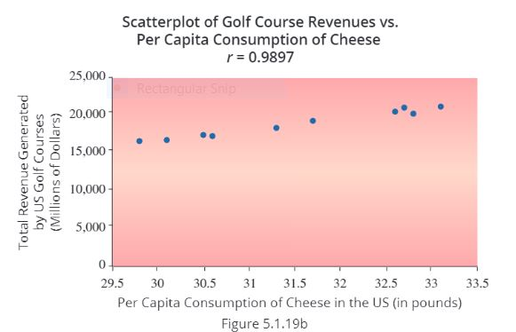
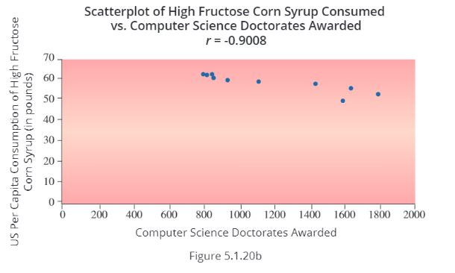
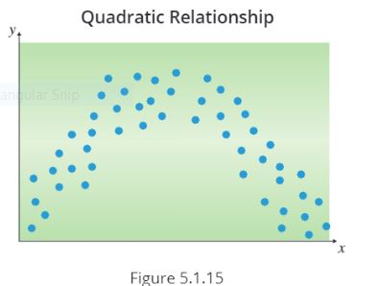
Avoiding Some Correlation Pitfalls

