Slide 1
Section 4.6
Proportions and Percentages

Slide 2
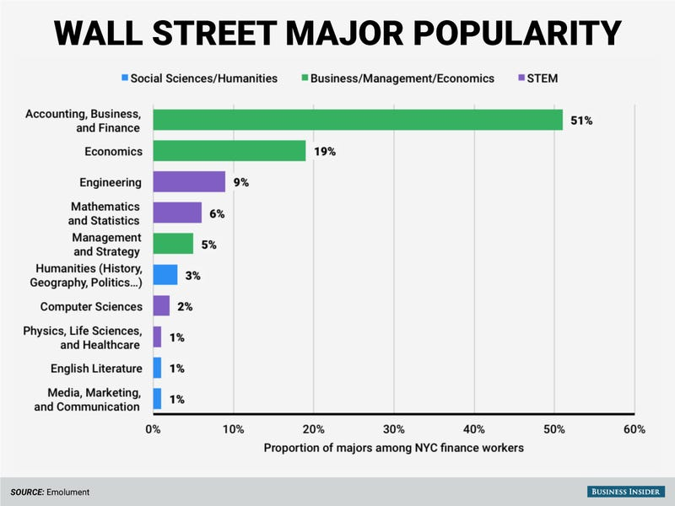
Proportion
Measures the fraction of a group that possesses some characteristic.
https://www.businessinsider.com/the-most-common-college-major-on-wall-street-2015-11#an-overall-look-at-a-handful-of-majors-across-all-levels-shows-a-similar-result-51-of-total-wall-street-respondents-are-accounting-business-and-finance-majors-followed-by-economics-and-then-engineering-5

