Slide 1
Section 4.3
Measures of Relative Position

Slide 2
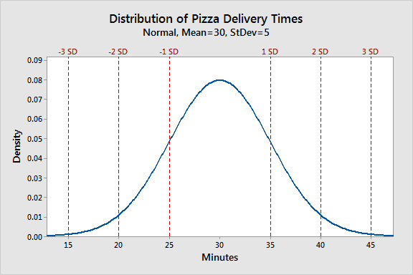
z-Score
https://statisticsbyjim.com/basics/normal-distribution/

Slide 3
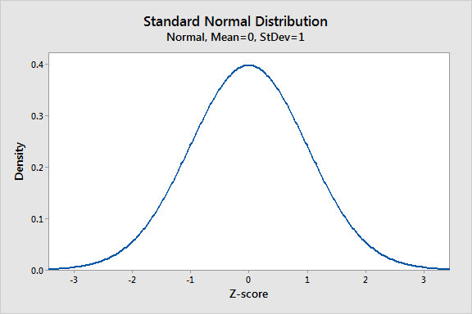
z-Score (cont.)
https://statisticsbyjim.com/basics/normal-distribution/

Slide 4
Example
Test Scores
Course | Mean | Standard Deviation
Biology | 74 | 10
Psychology | 82 | 11
What are the z-scores for your two tests? On which of the tests did you perform relatively better?

Slide 5
Properties of a z-Score
Properties
If z-score < 0
If z-score > 0
Unit-free measure

