Slide 1
Section 4.1
Measures of Central Tendency

Slide 2

Arithmetic Mean
Sample mean
$\overline{x} =$
Population mean
μ =

Slide 3
Median

Slide 4
Mode

Slide 5
Mode (cont.)
Data with two modes …
Data with more than two modes …
Also possible for data to have no mode.

Slide 6
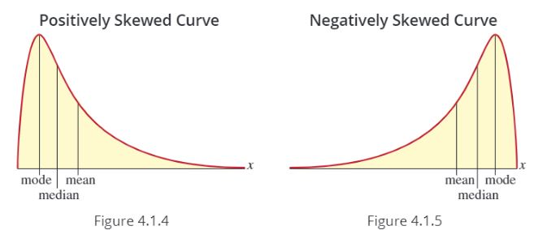
The Relationship between the Mean, Median, and Mode

Slide 7
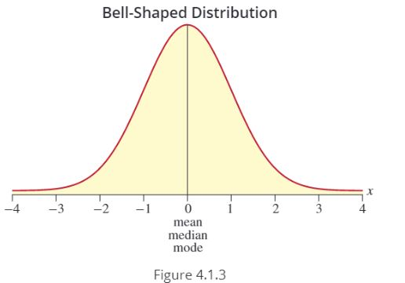
The Relationship between the Mean, Median, and Mode (cont.)

