Slide 1
Section 12.3
Inference about Two Population Proportions

Slide 2
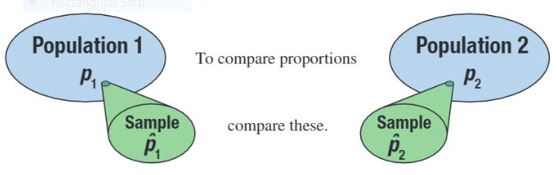
Inference about Two Population Proportions

Slide 3
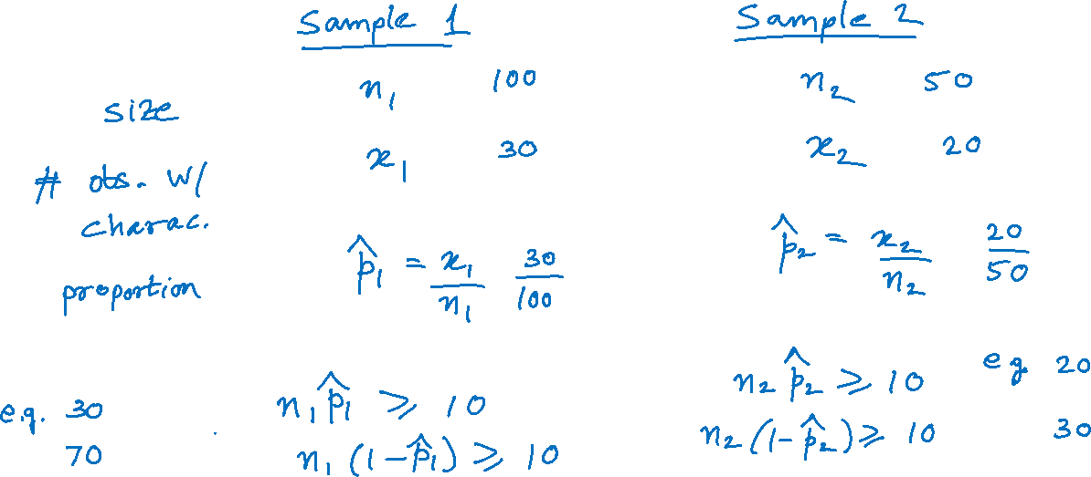
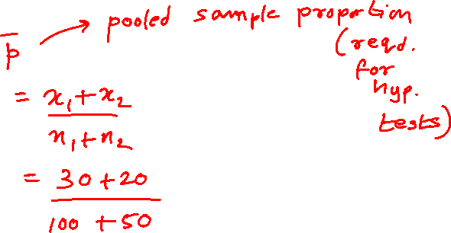
Assumptions for Comparing Two Population Proportions

Slide 4
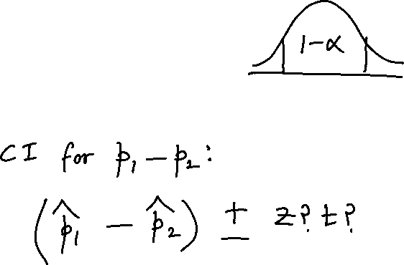
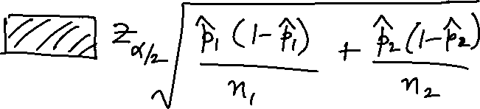
100(1 −α)% Confidence Interval for p₁ − p₂

Slide 5
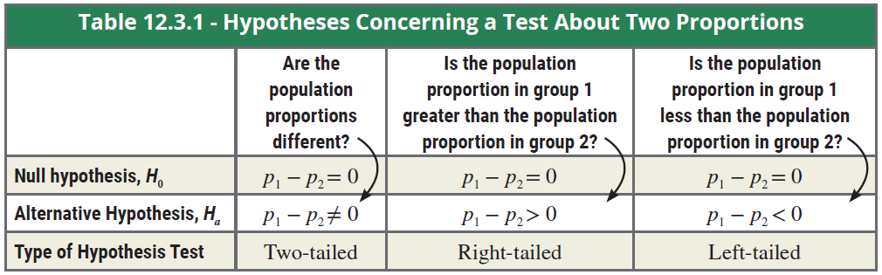
Hypothesis Testing about p₁-p₂

Slide 6
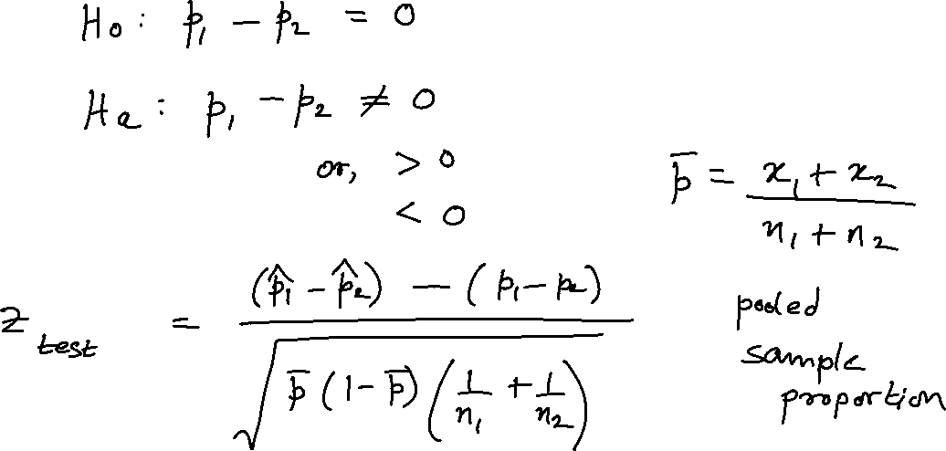
Testing a Hypothesis about Two Population Proportions

Slide 7

Example
A cell phone executive has recently been bombarded with complaints from his customers about defective cell phones. He has two plants which produce the cell phones, and he is not sure where the defective phones are coming from. In the past,
the plants have had good control over the number of defective phones produced. Because of the recent flurry of complaints, he thinks that one of the plants may have lost control over its production process.

Slide 8
Example (cont.)
To test this theory, he randomly selects 200 phones from each of the plants and counts the number of defective phones. The results of the survey are displayed in the table.
Cell Phone Survey Data
 | Number Sampled | Number of Defectives
Plant A | 200 | 12
Plant B | 200 | 10

Slide 9

Example (cont.)
Are the sample sizes large enough to assume that the sample proportions are approximately normally distributed?
Calculate a 95% confidence interval for the difference between the proportions of defective phones from Plant A and Plant B.
Is there sufficient evidence for the cell phone executive to conclude that there is a difference in the proportion of defective cell phones produced by the two plants at α = 0.10?

Slide 10
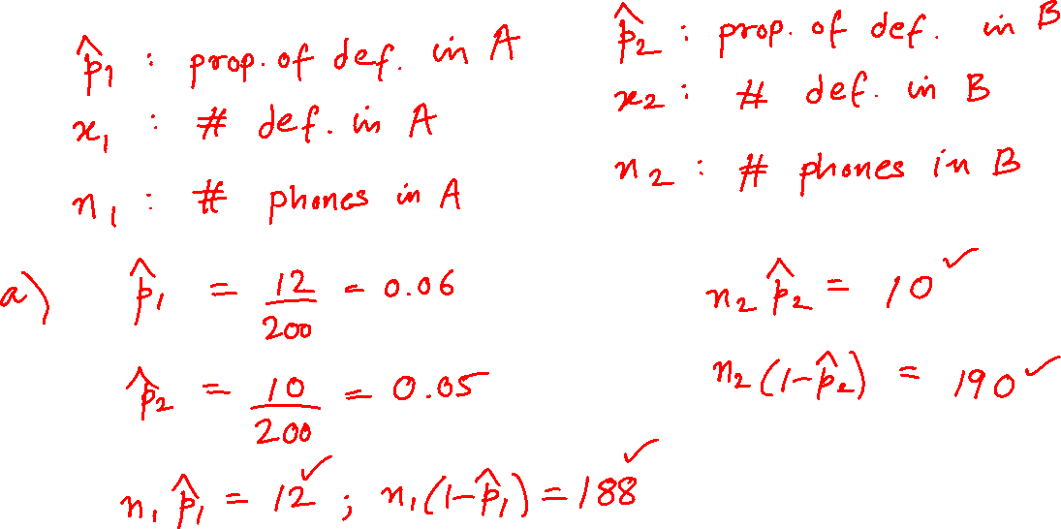
Example (cont.)

Slide 11
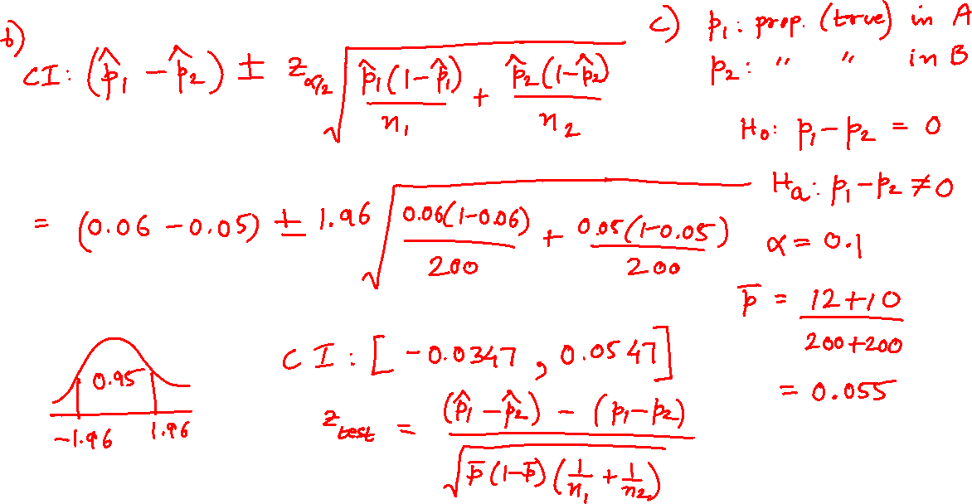
Example (cont.)

Slide 12
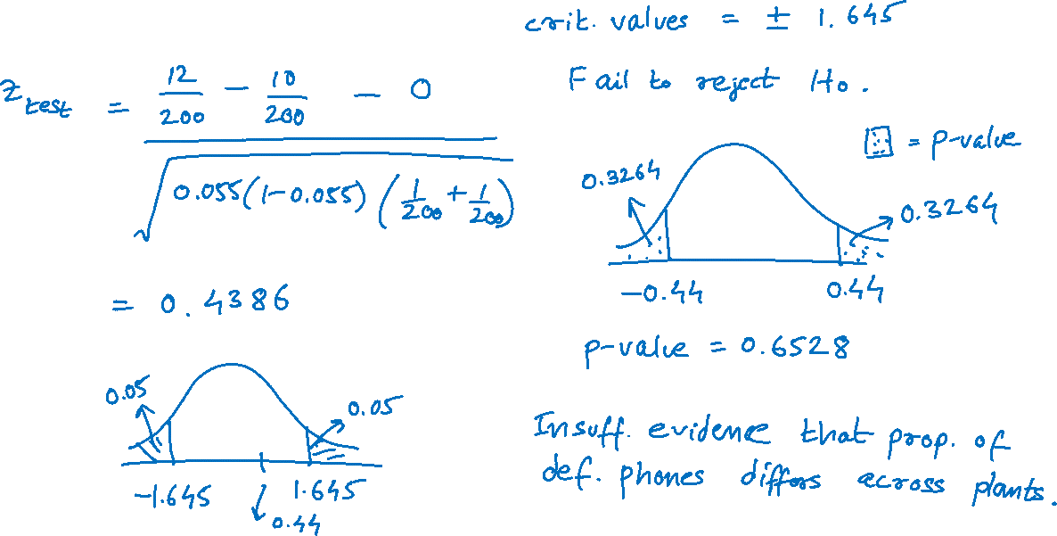
Example (cont.)

Slide 13
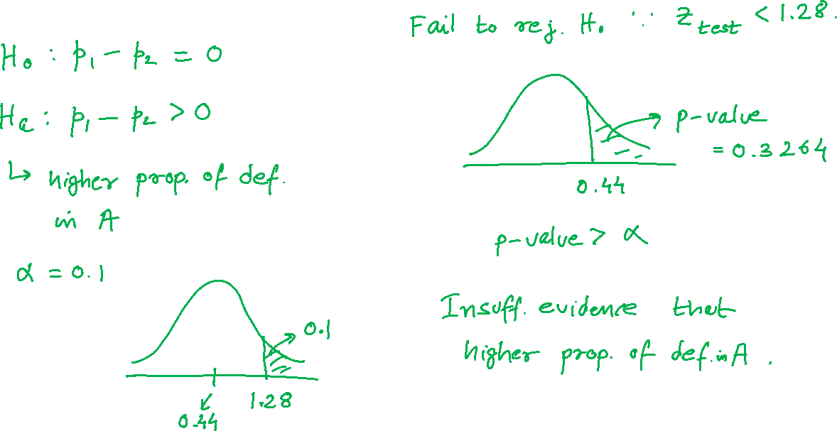
Example (cont.)

