Slide 1



Section 11.4
Testing a Hypothesis about a Population Proportion

Slide 2
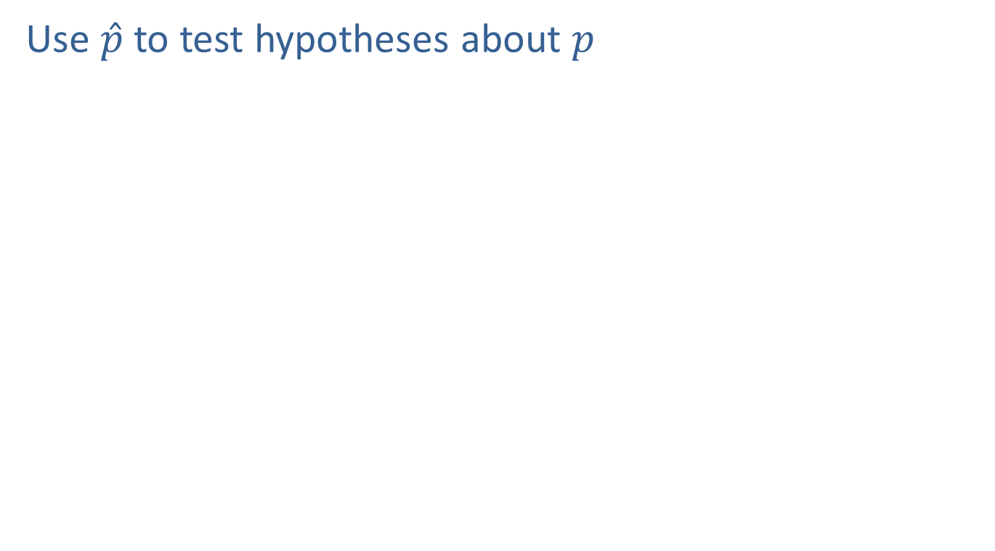
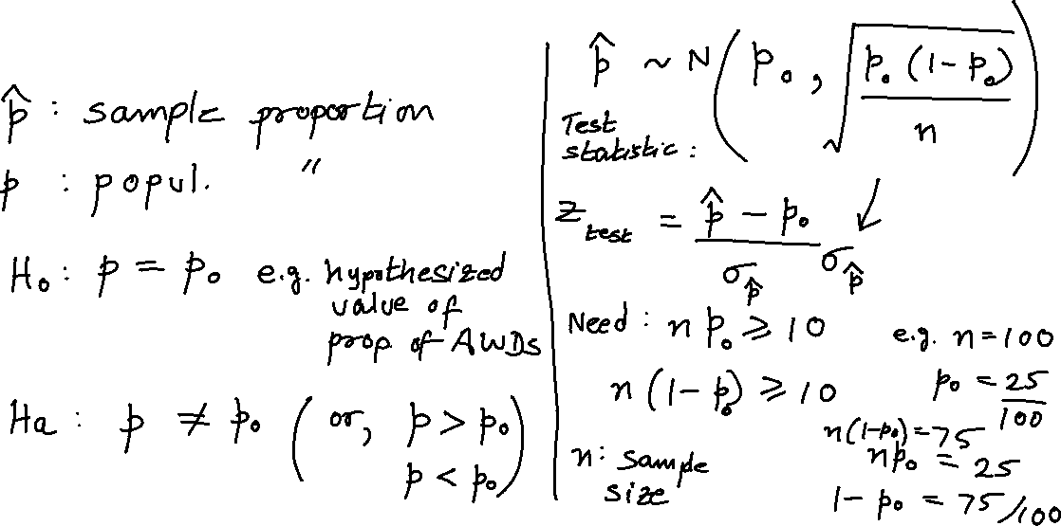
Testing a Hypothesis about a Population Proportion
Use $\hat{p}$ to test hypotheses about $p$

Slide 3
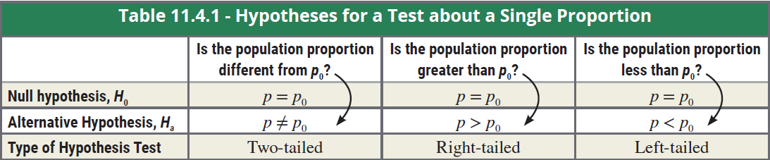

Hypotheses for a Test about a Single Proportion

Slide 4
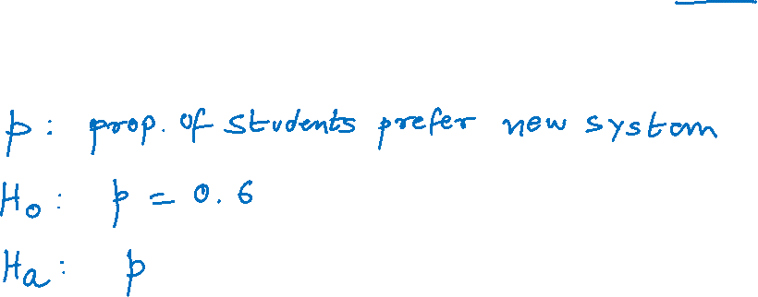

Example
A college is trying a new student registration system and wants to know if there is sufficient evidence to conclude that more than 60% of the students favor it. In a random sample of 520 students, 352 said that the new registration system is superior. Say α = 0.05.

Slide 5
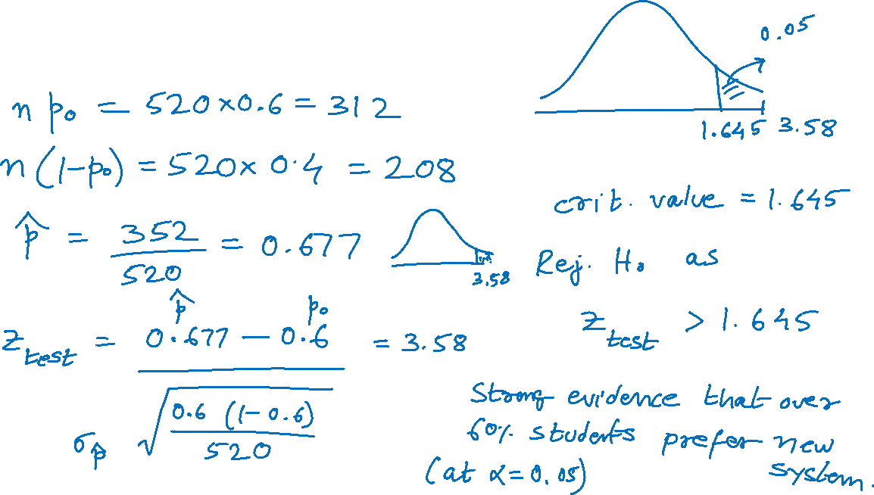
Example (cont.)

Slide 6
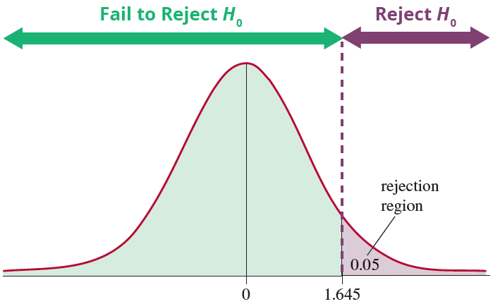
Example (cont.)

Slide 7
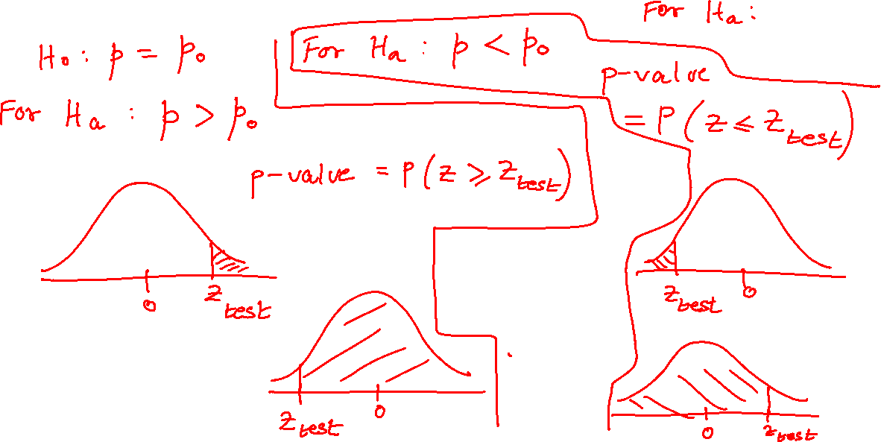
Calculating P-Values for a Hypothesis Test for a Proportion

Slide 8
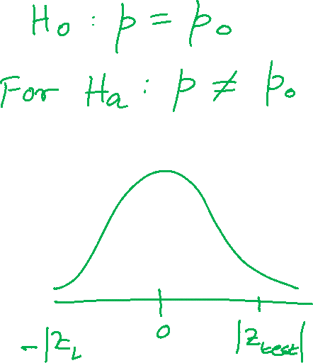
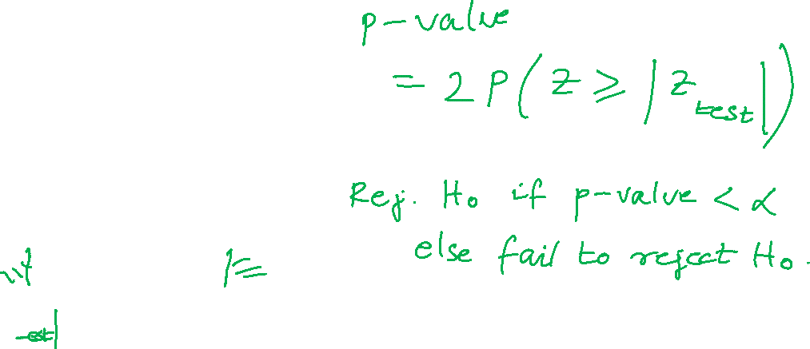
Calculating P-Values for a Hypothesis Test for a Proportion (cont.)

Slide 9
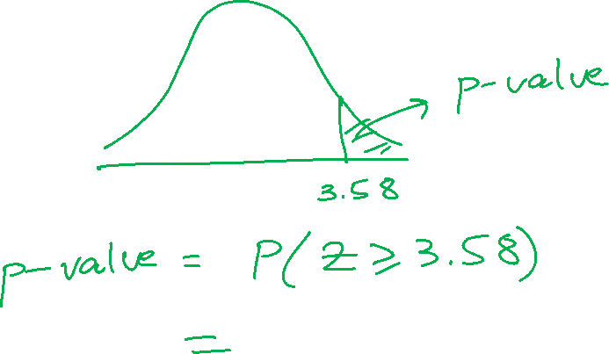
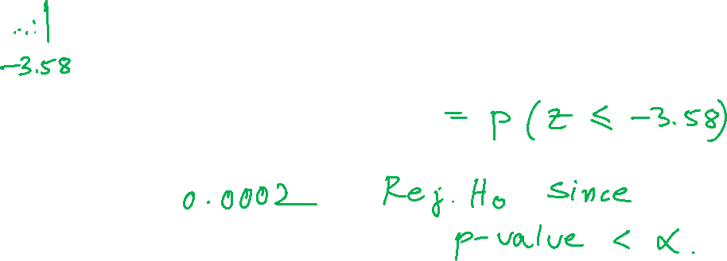
Example (cont.)

