Slide 1
Section 11.2
Testing a Hypothesis about a Population Mean with σ Known and Unknown

Slide 2
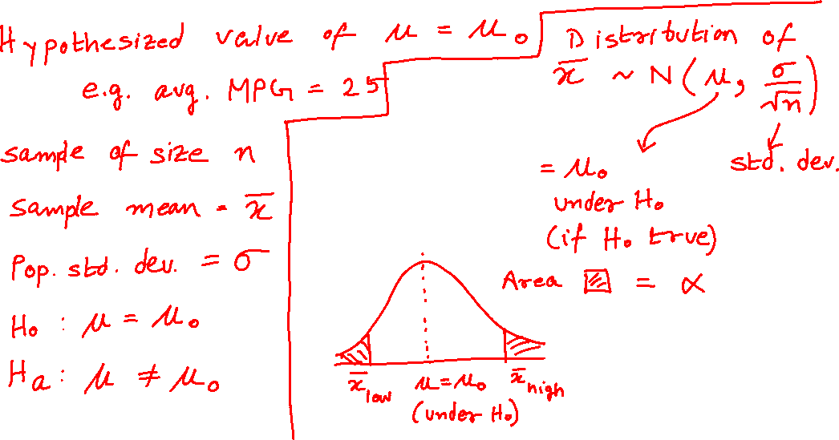
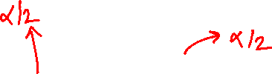
Testing a Hypothesis About a Mean, σ Known

Slide 3
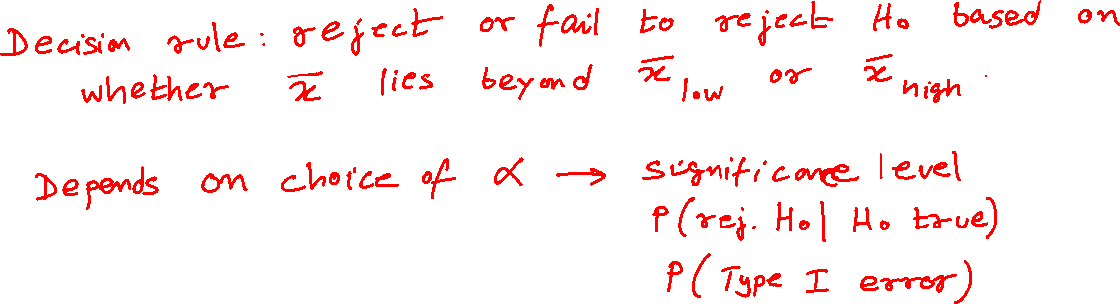
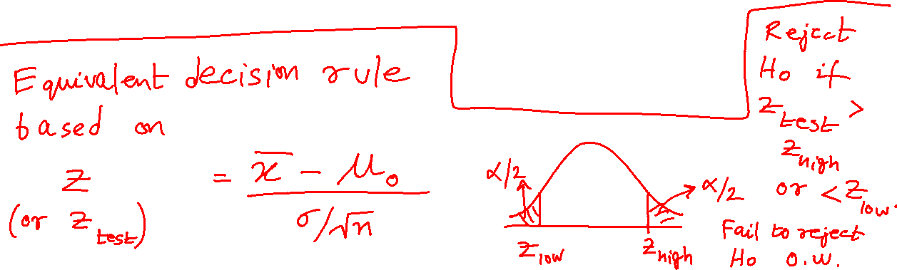
Testing a Hypothesis About a Mean, σ Known (cont.)

Slide 4





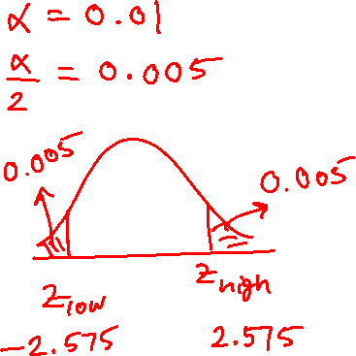

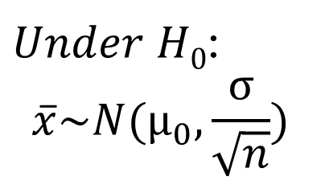
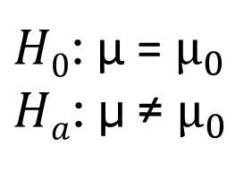
$Under H0$:
$$\overline{x}\sim N(μ_{0}, \frac{σ}{\sqrt{n}})$$
$H0$: μ = $μ_{0}$
$Ha$: μ ≠ $μ_{0}$
α/2
α/2
$$\overline{x_{low}}$$
$${\text{μ}}_{0}$$
$$\overline{x_{high}}$$
$$\frac{\overline{x}−μ_{0}}{\frac{σ}{\sqrt{n}}}≡z\sim N(0, 1)$$
α/2
α/2
$$z_{low}$$
0
$$z_{high}$$

Slide 5
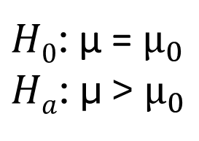
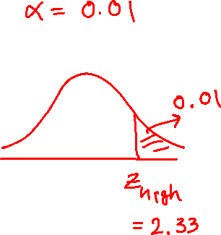
$Under H0$:
$$\overline{x}\sim N(μ_{0}, \frac{σ}{\sqrt{n}})$$
$H0$: μ = $μ_{0}$
$Ha$: μ > $μ_{0}$
α
$${\text{μ}}_{0}$$
$$\overline{x_{high}}$$
$$\frac{\overline{x}−μ_{0}}{\frac{σ}{\sqrt{n}}}≡z\sim N(0, 1)$$
α
0
$$z_{high}$$

Slide 6
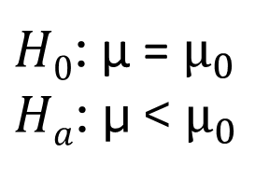
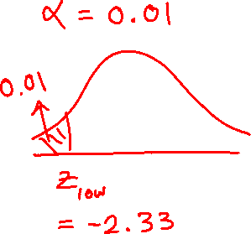
$Under H0$:
$$\overline{x}\sim N(μ_{0}, \frac{σ}{\sqrt{n}})$$
$H0$: μ = $μ_{0}$
$Ha$: μ < $μ_{0}$
α
$$\overline{x_{low}}$$
$${\text{μ}}_{0}$$
$$\frac{\overline{x}−μ_{0}}{\frac{σ}{\sqrt{n}}}≡z\sim N(0, 1)$$
α
$$z_{low}$$
0

Slide 7
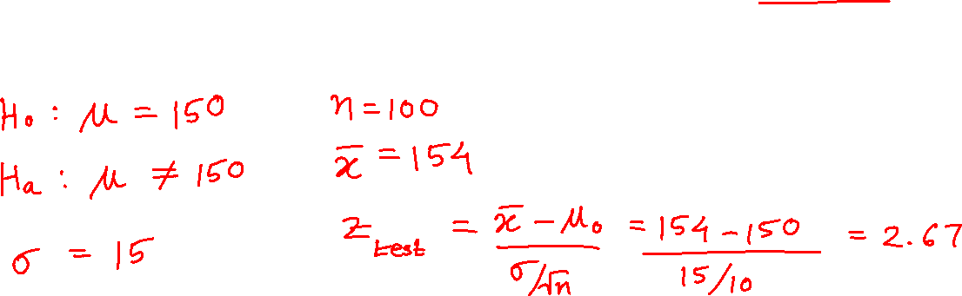
Example
Average national reading level for high school sophomores is 150 words per minute with a standard deviation of 15. Want to know if sophomore students at Lincoln High School read at a different level. The level of the test is 0.05. A random sample size of 100 students yields an average of 154 words per minute.

Slide 8
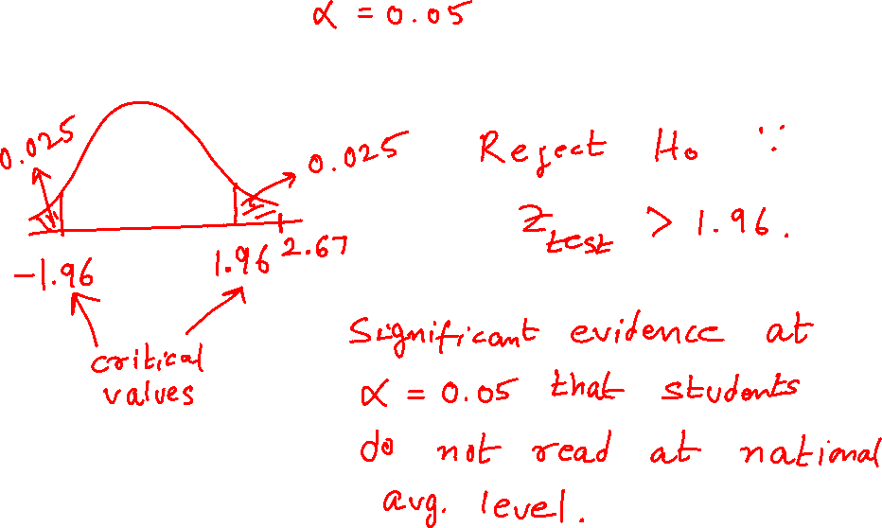
Example (cont.)

Slide 9
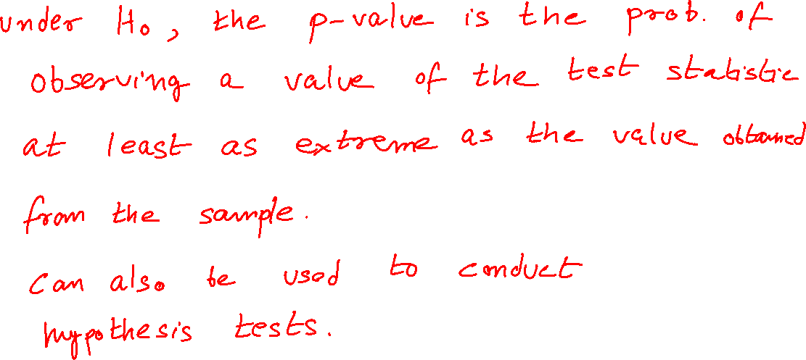
P-Value

Slide 10

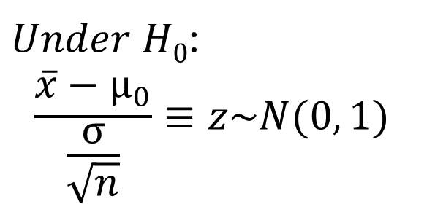
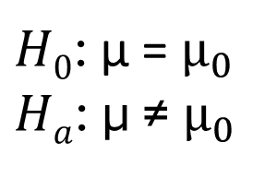

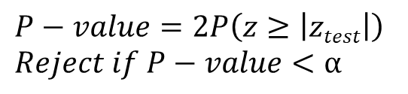
$Under H0$:
$$\frac{\overline{x}−μ_{0}}{\frac{σ}{\sqrt{n}}}≡z\sim N(0, 1)$$
$H0$: μ = $μ_{0}$
$Ha$: μ ≠ $μ_{0}$
$${−|z}_{test}|$$
0
$${|z}_{test}|$$
$$P−value=2P\left(z≥\left|ztest\right|\right)$$
$Reject if P−value<α$
$$\frac{\overline{x}−μ_{0}}{\frac{σ}{\sqrt{n}}}≡z\sim N(0, 1)$$
α/2
α/2
$$z_{low}$$
0
$$z_{high}$$

Slide 11
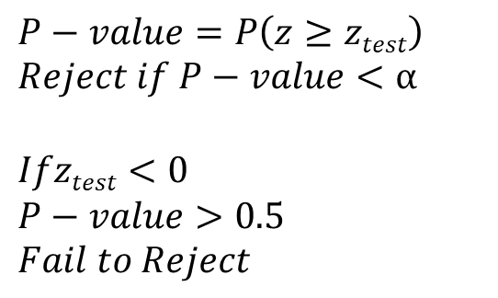
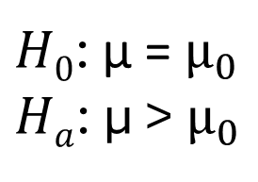

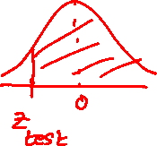
$Under H0$:
$$\frac{\overline{x}−μ_{0}}{\frac{σ}{\sqrt{n}}}≡z\sim N(0, 1)$$
$H0$: μ = $μ_{0}$
$Ha$: μ > $μ_{0}$
0
$$z_{test}$$
$$P−value=P\left(z≥ztest\right)$$
$Reject if P−value<α$
$$Ifztest<0$$
$$P−value>0.5$$
$$Fail to Reject$$
$$\frac{\overline{x}−μ_{0}}{\frac{σ}{\sqrt{n}}}≡z\sim N(0, 1)$$
α
0
$$z_{high}$$

Slide 12
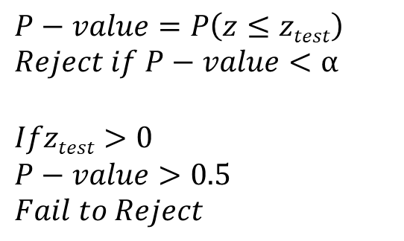

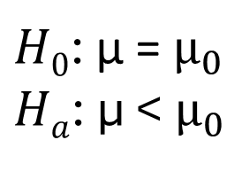
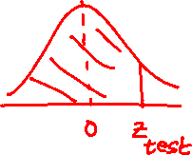
$Under H0$:
$$\frac{\overline{x}−μ_{0}}{\frac{σ}{\sqrt{n}}}≡z\sim N(0, 1)$$
$H0$: μ = $μ_{0}$
$Ha$: μ < $μ_{0}$
$$z_{test}$$
0
$$P−value=P\left(z≤ztest\right)$$
$Reject if P−value<α$
$$Ifztest>0$$
$$P−value>0.5$$
$$Fail to Reject$$
$$\frac{\overline{x}−μ_{0}}{\frac{σ}{\sqrt{n}}}≡z\sim N(0, 1)$$
α
$$z_{low}$$
0

Slide 13
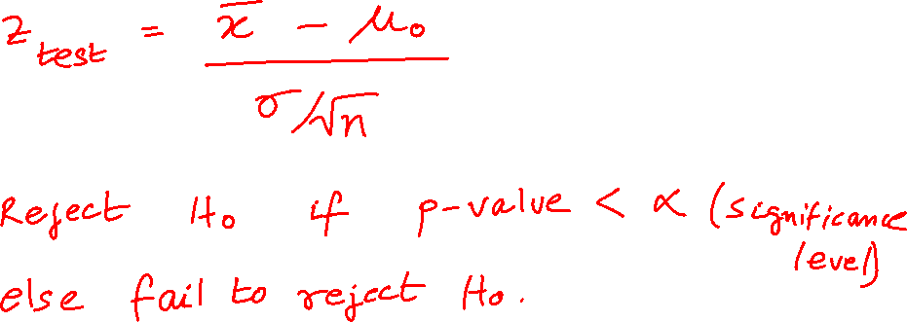
Performing a Hypothesis Test Using P-Values

Slide 14
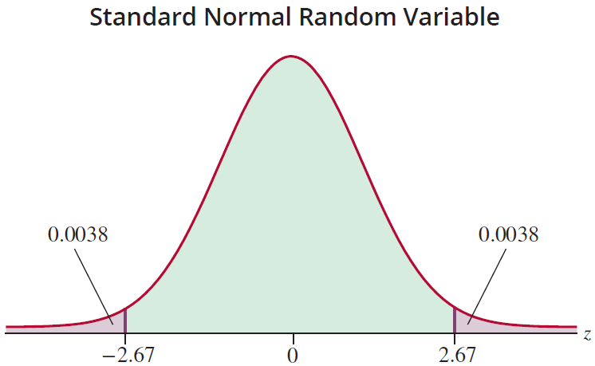
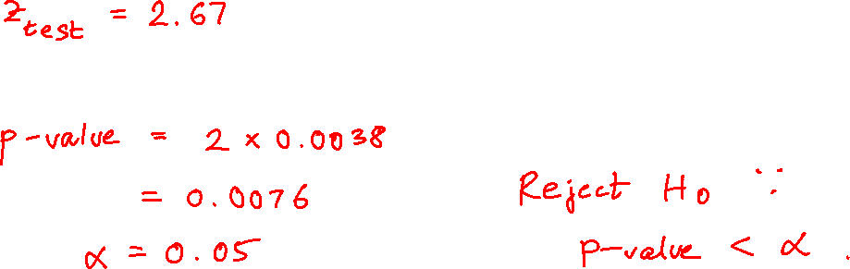
Previous Example (cont.)

Slide 15
Example
A microprocessor designer has developed a new fabrication process which he believes will increase the usable life of a chip. Currently the usable life is 16,000 hours with a standard deviation of 2500 hours. Test the hypothesis that the process increases the usable life of a chip, at the 0.01 level. A random sample of 1000 microprocessors is tested and has a mean life of 16,200 hours. Assume the standard deviation of the life of the new chips is equal to the standard deviation of the current chips.

Slide 16
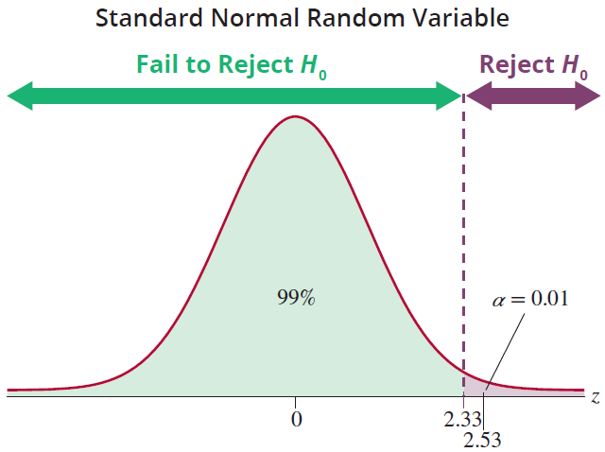
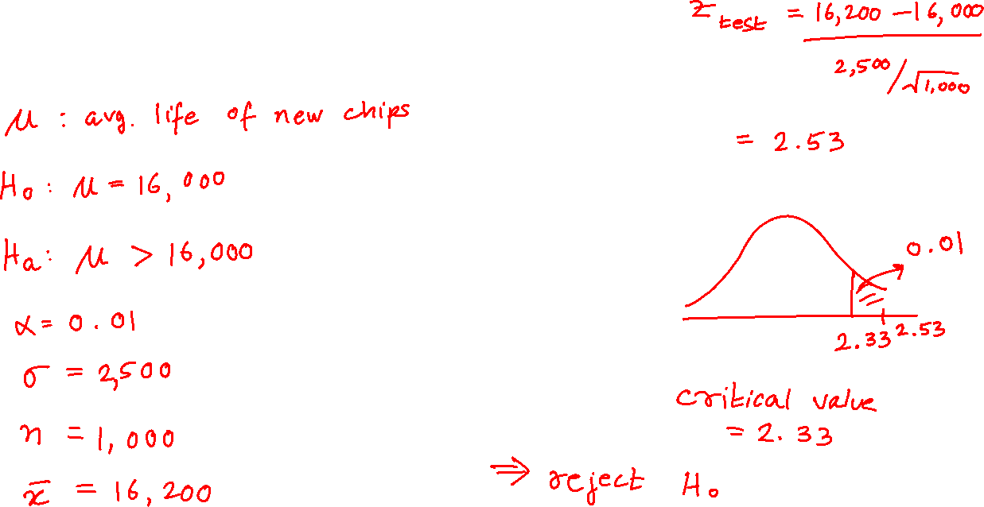
Example (cont.)

Slide 17
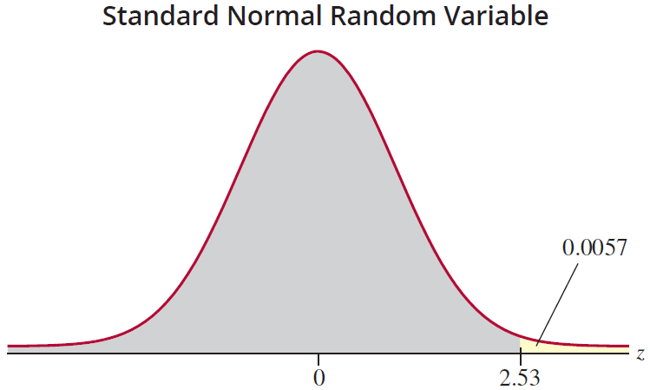
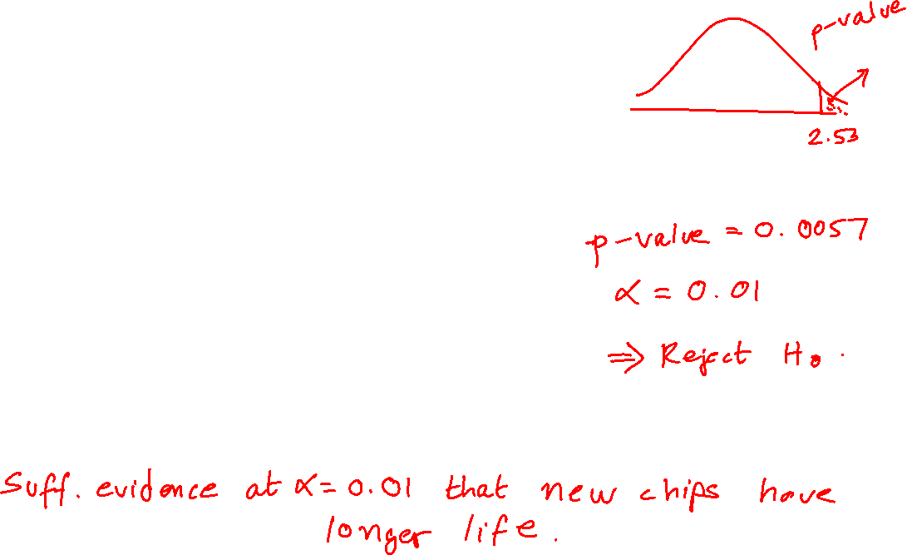
Example (cont.)

Slide 18
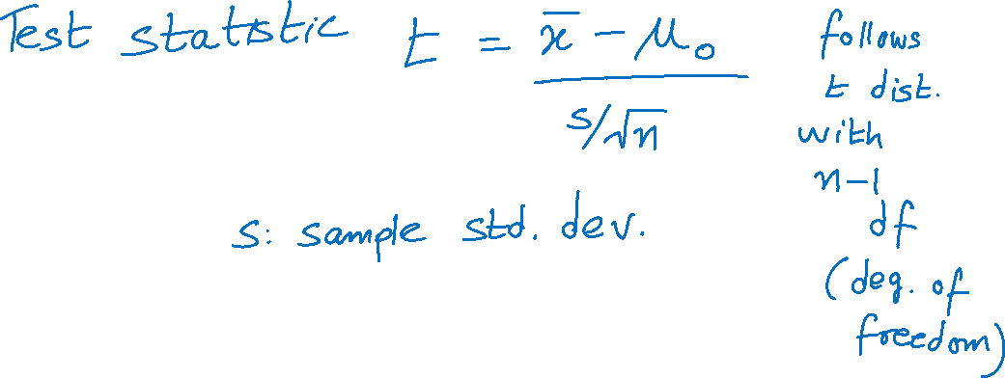
Testing a Hypothesis About a Mean, σ Unknown

Slide 19

Example
A personnel researcher has designed a questionnaire she believes will take an average time of 35 minutes to complete. Suppose she randomly samples 20 employees and finds that the mean time to take the test is 29 minutes with a standard deviation of s = 8 minutes. Determine if there is sufficient evidence to conclude that the completion time of the newly designed test differs from its intended duration. Conduct the test at the 0.05 level. Assume the sample comes from a normally distributed population.

Slide 20
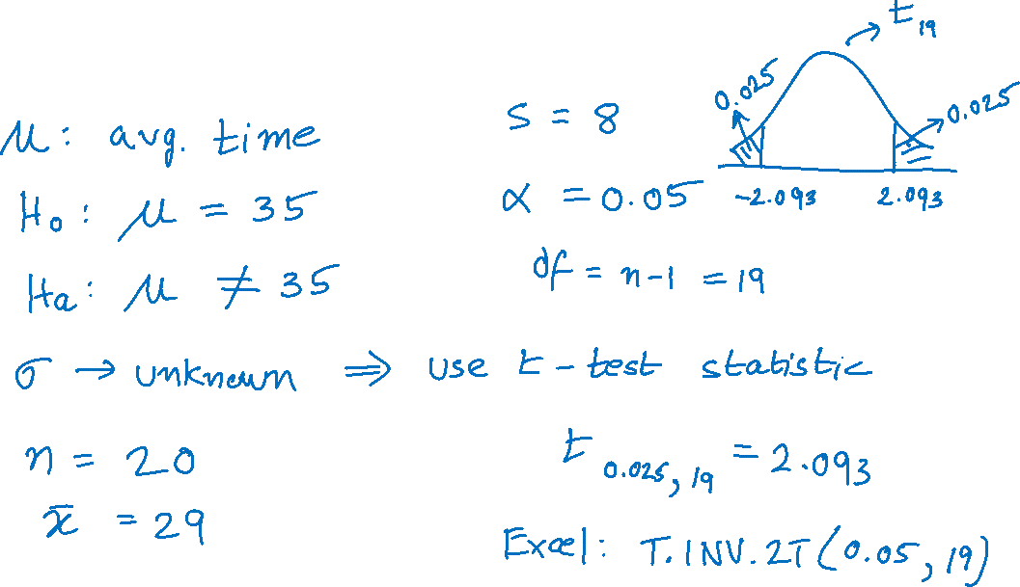
Example (cont.)

Slide 21
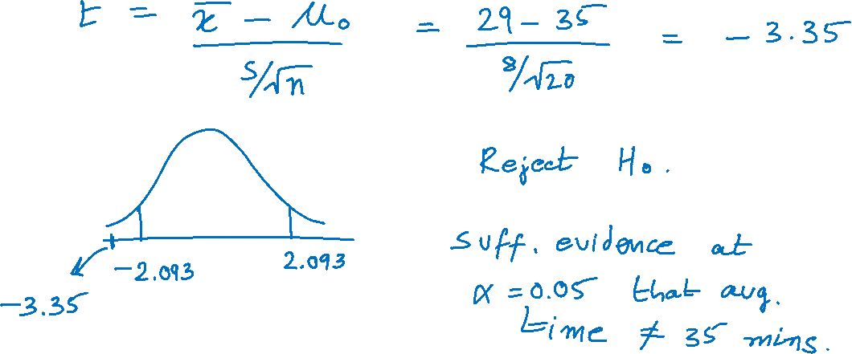
Example (cont.)

Slide 22
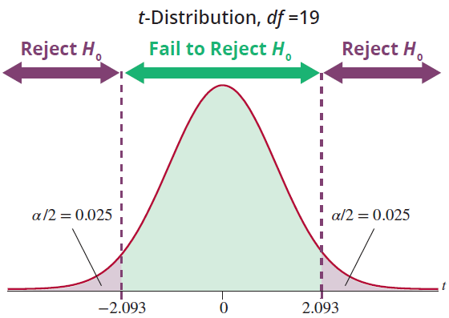
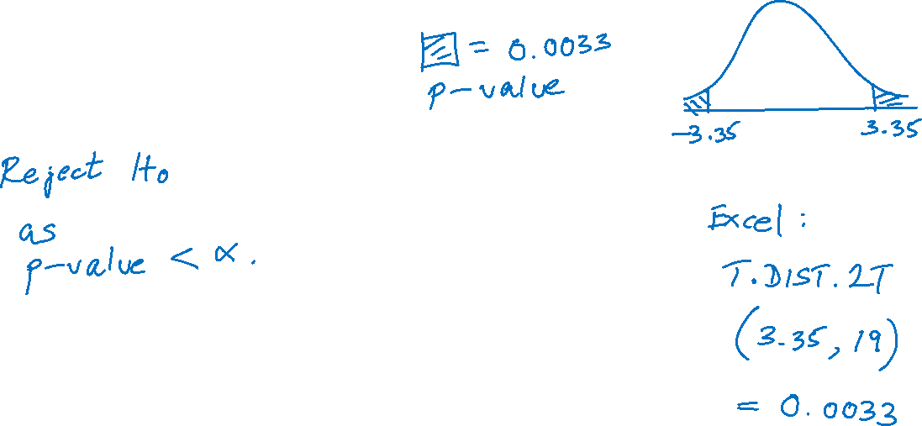

Slide 23
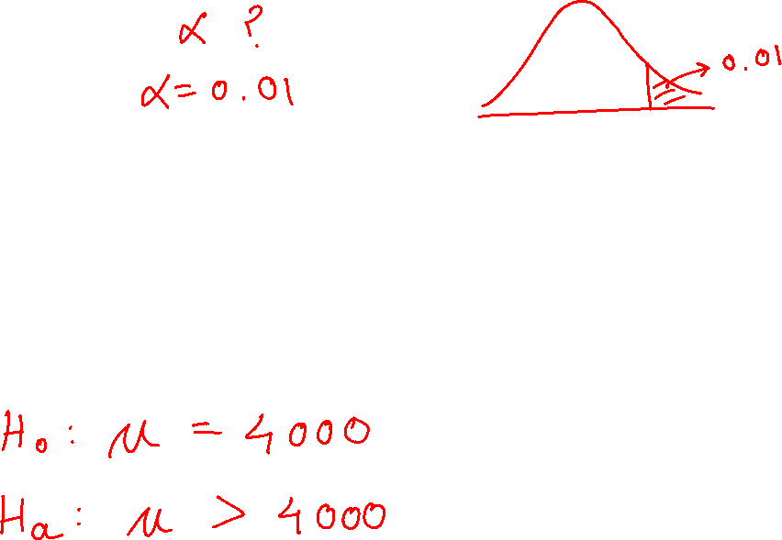
Example
The Alexander Bolt Company produces half-inch A-class stainless steel bolts that have a mean tensile strength of more than 4000 pounds per square inch (psi), the specified quality standard. The company wants to be sure that its A-class product is above the quality standard. A sample of 25 bolts is to be randomly selected from stock and tested for tensile strength.

Slide 24
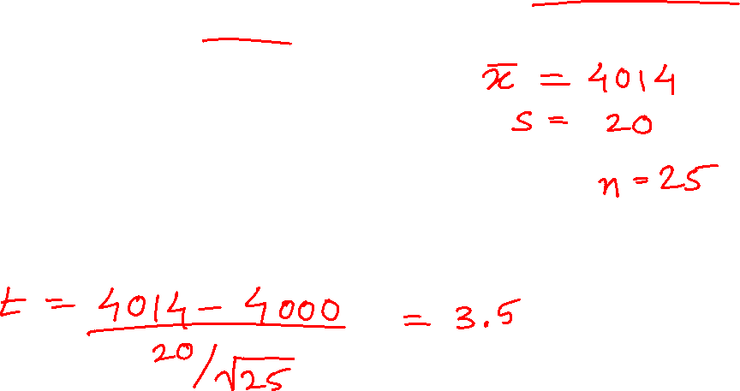
Example (cont.)
Design a test of hypothesis to determine if there is overwhelming evidence that the bolts are better than the specified quality standard.
Sample values:
4023 3993 4009 4006 4039 3984 4003 4007
4007 4055 4004 4049 4000 3995 4019 4003 4029
4009 4041 4021 4012 3984 4040 4025 3986

Slide 25
Example (cont.)

Slide 26
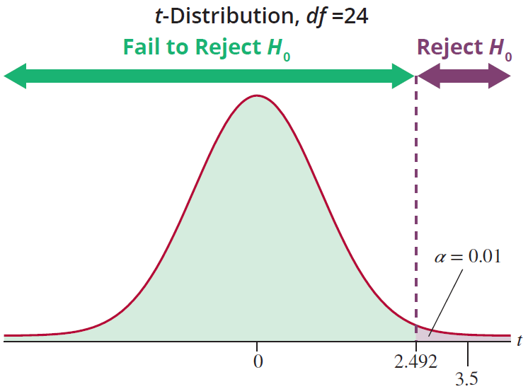
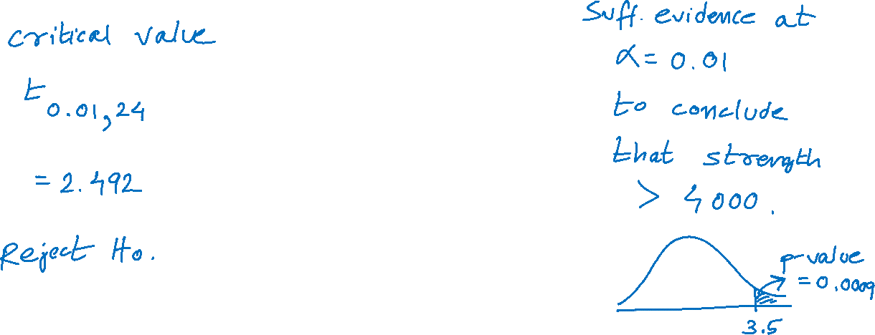
Example (cont.)

Slide 27
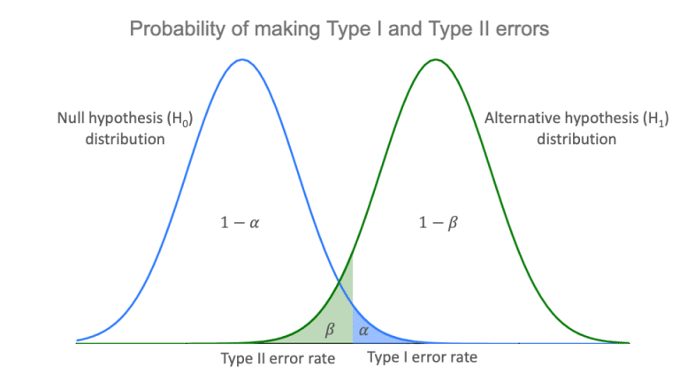

Why Not Make Both α and β as Small as Possible?
https://www.scribbr.com/statistics/type-i-and-type-ii-errors/

