Slide 1
Section 10.2
Interval Estimation of the Population Mean

Slide 2

Interval Estimator and Confidence Interval
An interval estimator ...
Example: $\overline{x}−E, \overline{x}+E$
https://www.npr.org/sections/health-shots/2018/05/29/615120123/study-puts-puerto-rico-death-toll-at-5-000-from-hurricane-maria-in-2017

Slide 3
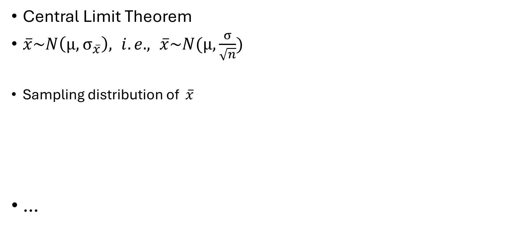

Interval Estimator and Confidence Interval (cont.)
Central Limit Theorem
$\overline{x}\sim N\left(μ, σ_{\overline{x}}\right), i.e., \overline{x}\sim N(μ, \frac{σ}{\sqrt{n}})$
Sampling distribution of $\overline{x}$
…
$$\overline{x}$$
μ

Slide 4

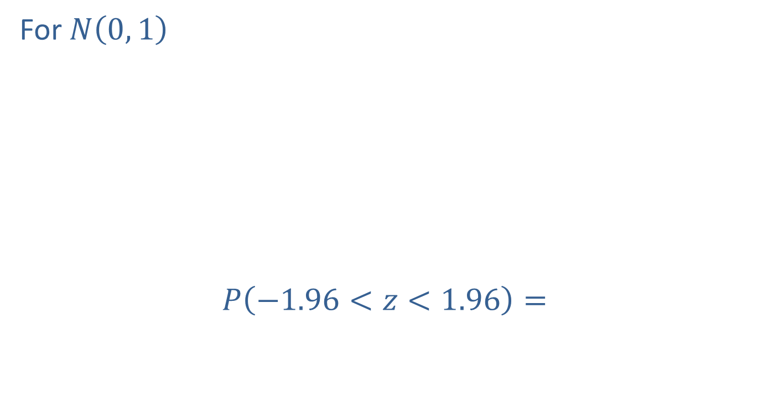
Interval Estimator and Confidence Interval (cont.)
For $N\left(0, 1\right)$
$P\left(−1.96<z<1.96\right)=$
0.95
$$z$$
0.025
0.025
-1.96
0
1.96

Slide 5




Interval Estimator and Confidence Interval (cont.)
From $P\left(−1.96<\frac{\overline{x}−μ}{σ_{\overline{x}}}<1.96\right)=$
Sampling distribution of $\overline{x}$
0.95
$$\overline{x}$$
0.025
0.025
μ
$$μ+1.96σ_{\overline{x}}$$
$$μ−1.96σ_{\overline{x}}$$

Slide 6
Interval Estimator and Confidence Interval (cont.)
0.95
$$\overline{x}$$
0.025
0.025
μ
$$μ+1.96σ_{\overline{x}}$$
$$μ−1.96σ_{\overline{x}}$$

Slide 7


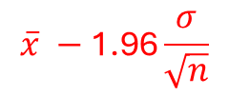
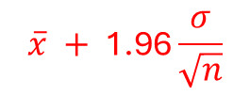

Interval Estimator and Confidence Interval (cont.)
$$\overline{x} −\text{1.96}\frac{σ}{\sqrt{n}}$$
$$\overline{x} + \text{1.96}\frac{σ}{\sqrt{n}}$$
$$\overline{x}$$
μ - 1.96$\frac{σ}{\sqrt{n}}$
μ
μ + 1.96$\frac{σ}{\sqrt{n}}$

Slide 8

Interval Estimator and Confidence Interval (cont.)
$P\left(μ−1.96σ_{\overline{x}}<\overline{x}<μ+1.96σ_{\overline{x}}\right)=$
$P\left(\overline{x}−1.96σ_{\overline{x}}<μ<\overline{x}+1.96σ_{\overline{x}}\right)=$
$P\left(\overline{x}−1.96\frac{σ}{\sqrt{n}}<μ<\overline{x}+1.96\frac{σ}{\sqrt{n}}\right)=$

Slide 9
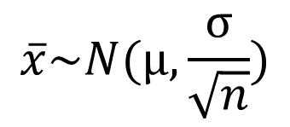
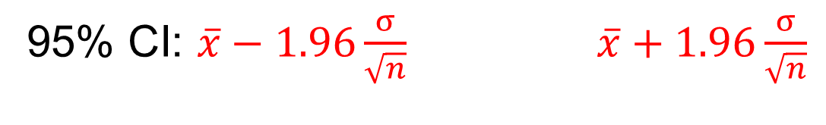


$$\overline{x}\sim N(μ, \frac{σ}{\sqrt{n}})$$
0.95
0.025
0.025
$$\overline{x_{1}}$$
$$\overline{x_{2}}$$
95% CI: $\overline{x}−1.96\frac{σ}{\sqrt{n}}$ $\overline{x}+1.96\frac{σ}{\sqrt{n}}$

Slide 10
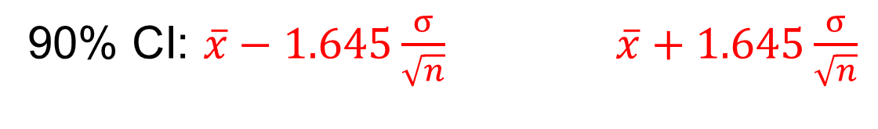
$$\overline{x}\sim N(μ, \frac{σ}{\sqrt{n}})$$
0.90
0.05
0.05
$$\overline{x_{1}}$$
$$\overline{x_{2}}$$
90% CI: $\overline{x}−1.645\frac{σ}{\sqrt{n}}$ $\overline{x}+1.645\frac{σ}{\sqrt{n}}$

Slide 11
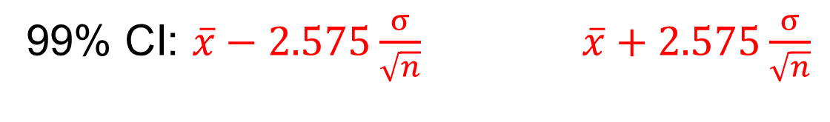
$$\overline{x}\sim N(μ, \frac{σ}{\sqrt{n}})$$
0.99
0.005
0.005
$$\overline{x_{1}}$$
$$\overline{x_{2}}$$
99% CI: $\overline{x}−2.575\frac{σ}{\sqrt{n}}$ $\overline{x}+2.575\frac{σ}{\sqrt{n}}$

Slide 12
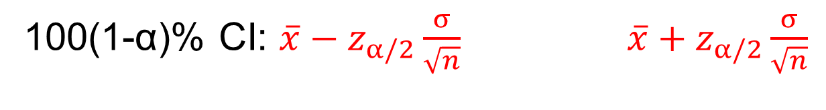
$$\overline{x}\sim N(μ, \frac{σ}{\sqrt{n}})$$
1-α
α/2
α/2
$$\overline{x_{1}}$$
$$\overline{x_{2}}$$
100(1-α)% CI: $\overline{x}−z_{α/2}\frac{σ}{\sqrt{n}}$ $\overline{x}+z_{α/2}\frac{σ}{\sqrt{n}}$

Slide 13
100(1 − α)% Confidence Interval for the Population Mean, σ Known

Slide 14
Example
A random sample of 100 car engines has a mean weight of 425 pounds. Construct the 80% confidence interval for the population mean if the standard deviation of the population is 900.

Slide 15
Example (cont.)

Slide 16

Maximum Error and Margin of Error, E
$z_{α/2}\frac{σ}{\sqrt{n}}$
Confidence Interval: $\overline{x}−E, \overline{x}+E$

Slide 17
Interval Estimation of the Population Mean for a Normal Population with σ Unknown

Slide 18



Student’s t-Distribution
t-distribution: like normal distribution with slightly thicker tails; approaches normal as …
$$z$$
$$t (df=12)$$
$$t (df=6)$$
0

Slide 19


$$z$$
0.025
0.025
-1.96
0
1.96
$$t (df=6)$$
0.025
0.025
-2.45
0
2.45
https://priceonomics.com/the-guinness-brewer-who-revolutionized-statistics/

Slide 20
100(1 − α)% Confidence Interval for the Population Mean, σ Unknown

Slide 21
Example
A random sample of hours worked in a week by student interns is drawn from a normal population with unknown mean and variance. The seven data values sampled are as follows.
25, 19, 37, 29, 40, 28, 31
Construct a 95% confidence interval for the population mean.

Slide 22
Example (cont.)

Slide 23
Example
A manufacturing company is interested in the amount of time it takes to complete a certain stage of the production process. The project manager randomly samples 10 products as they come from the production line and notes the time of completion. The average completion time is 23.45 minutes with a sample standard deviation of 4.32 minutes. Based on this sample, construct a 95% confidence interval for the average completion time for that stage in the production process.

Slide 24
Example (cont.)
Assume that the population distribution of the completion times is approximately normal.

Slide 25
Example (cont.)

Slide 26
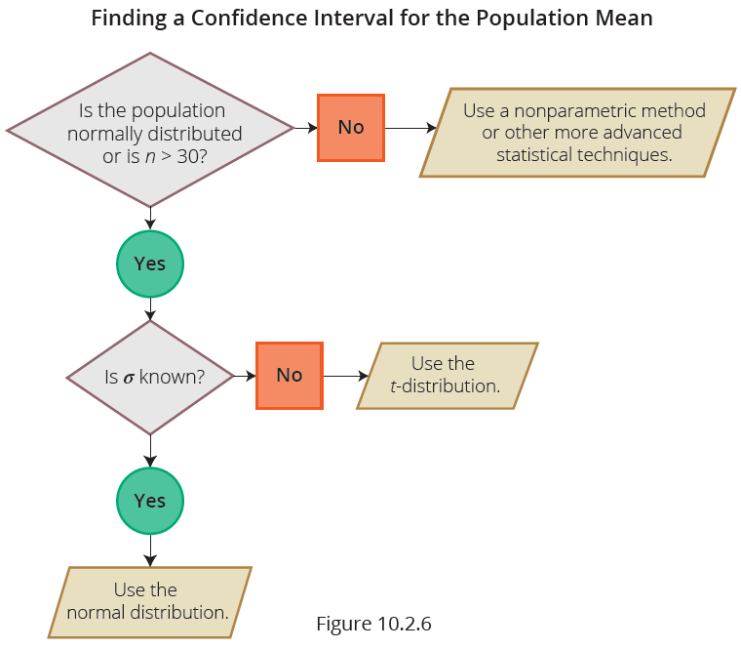
Interval Estimation of the Population Mean: A Summary

Slide 27

Sample Size Determination for Estimating a Population Mean for σ Known
Width of the confidence interval:
$z_{α/2}$: …
σ: …
n: …
n can be selected for a maximum E or $z_{α/2}\frac{σ}{\sqrt{n}}$.

Slide 28
Sample Size Determination for Estimating a Population Mean for σ Known (cont.)

Slide 29
Example
Consider a population having a standard deviation of 15. We want to estimate the mean of the population. How large of a sample is needed to construct a 95% confidence interval for the mean of this population if the margin of error is equal to 1.5?

Slide 30
Example (cont.)

Slide 31
Sample Size Determination for Estimating a Population Mean for σ Unknown

Slide 32
Example
An airline’s maintenance manager desires to estimate the average time (in hours) required to replace a jet engine in a Boeing 767. How large a sample would be necessary if the manager wishes to be 95% confident of estimating the mean to within one-quarter of an hour (E = 0.25). Assume a preliminary sample of size n = 31 has an average replacement time of 16.7 hours with a standard deviation of 4.3 hours.

Slide 33
Example (cont.)

