Slide 1
Section 14.3
Interpreting the Coefficients of the Multiple Regression Model

Slide 2


Interpretation of Multiple Regression Coefficients
Multiple regression model with $k=3$:
$y$: home price $x_{1}$: square footage $x_{2}$: age
$x_{3}$: #bedrooms $ε$: e.g., unobserved quality

Slide 3
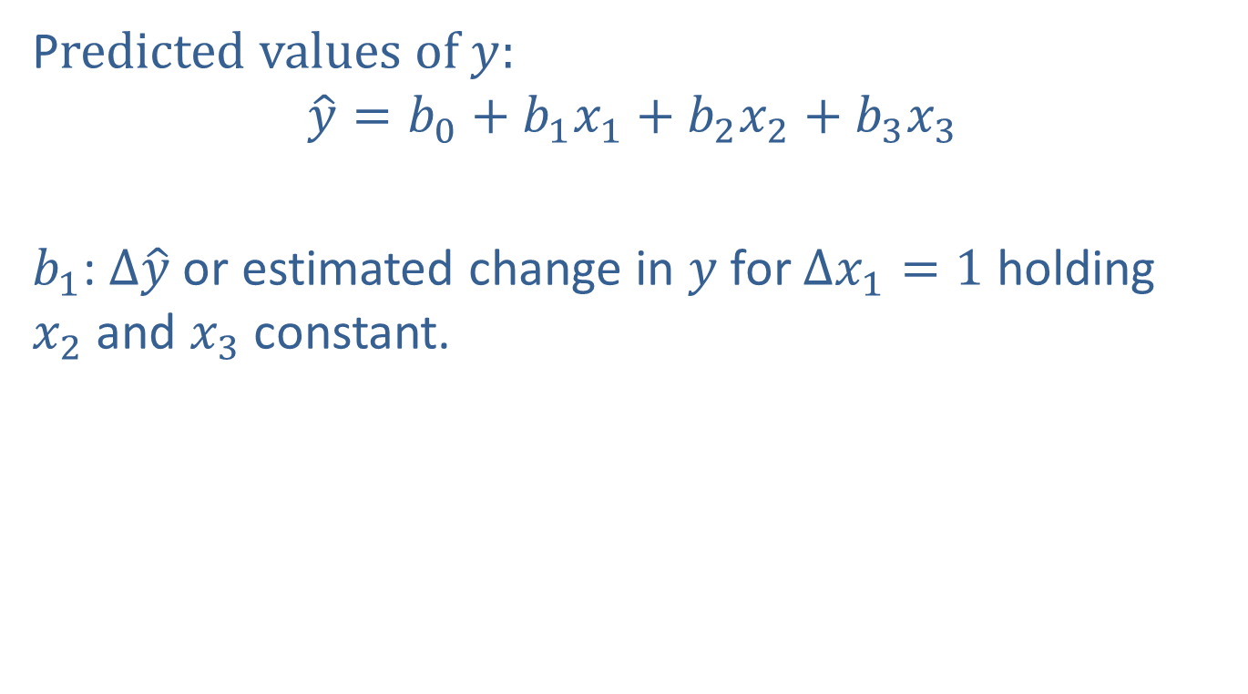
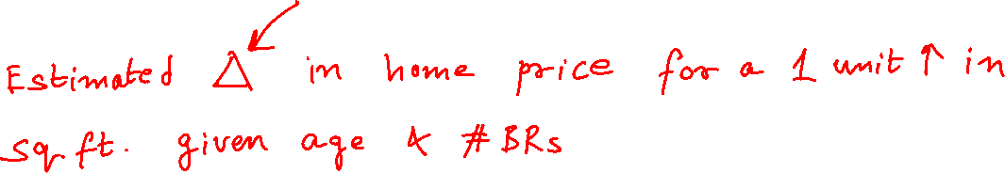
Interpretation of Multiple Regression Coefficients (cont.)
Predicted values of $y$:
$\hat{y}=b_{0}+b_{1}x_{1}+b_{2}x_{2}+b_{3}x_{3}$
$b_{1}$: $∆\hat{y}$ or estimated change in $y$for $∆x_{1}=1$ holding $x_{2}$and $x_{3}$constant.

Slide 4

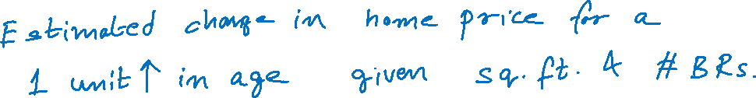
Interpretation of Multiple Regression Coefficients (cont.)
Predicted values of $y$:
$\hat{y}=b_{0}+b_{1}x_{1}+b_{2}x_{2}+b_{3}x_{3}$
$b_{2}$: $∆\hat{y}$ or estimated change in $y$for $∆x_{2}=1$ holding $x_{1}$and $x_{3}$constant.

Slide 5

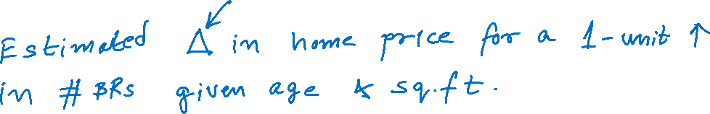
Interpretation of Multiple Regression Coefficients (cont.)
Predicted values of $y$:
$\hat{y}=b_{0}+b_{1}x_{1}+b_{2}x_{2}+b_{3}x_{3}$
$b_{3}$: $∆\hat{y}$ or estimated change in $y$for $∆x_{3}=1$ holding $x_{1}$and $x_{2}$constant.

Slide 6
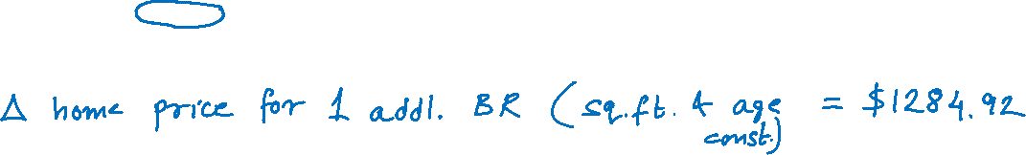
Interpretation of Multiple Regression Coefficients (cont.)

Slide 7
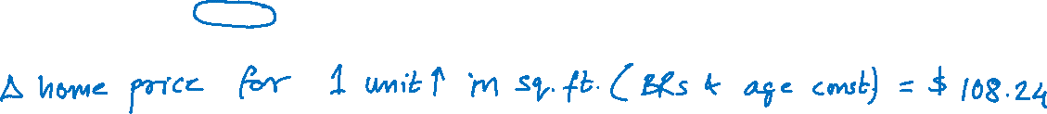
Interpretation of Multiple Regression Coefficients (cont.)

Slide 8
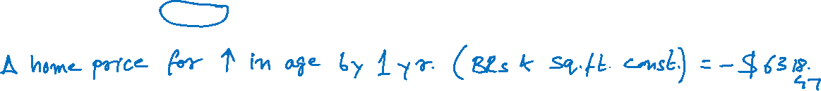
Interpretation of Multiple Regression Coefficients (cont.)

