Slide 1
Section 14.2
The Coefficient of Determination and Adjusted R²

Slide 2
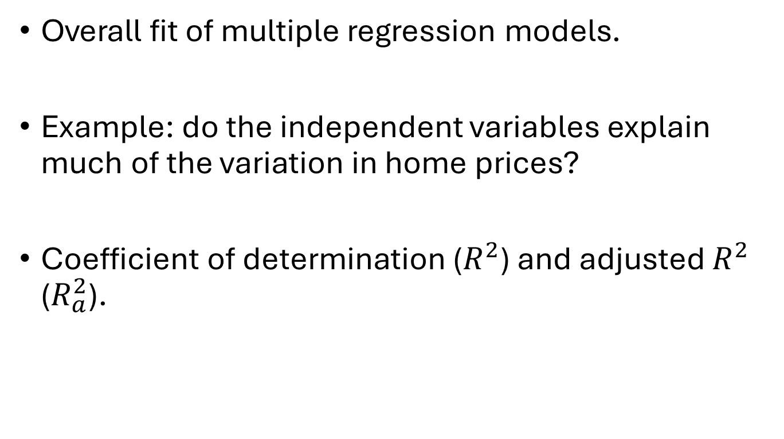
Coefficient of Determination
Overall fit of multiple regression models.
Example: do the independent variables explain much of the variation in home prices?
Coefficient of determination ($R^{2}$) and adjusted $R^{2}$ ($R_{a}^{2}$).

Slide 3

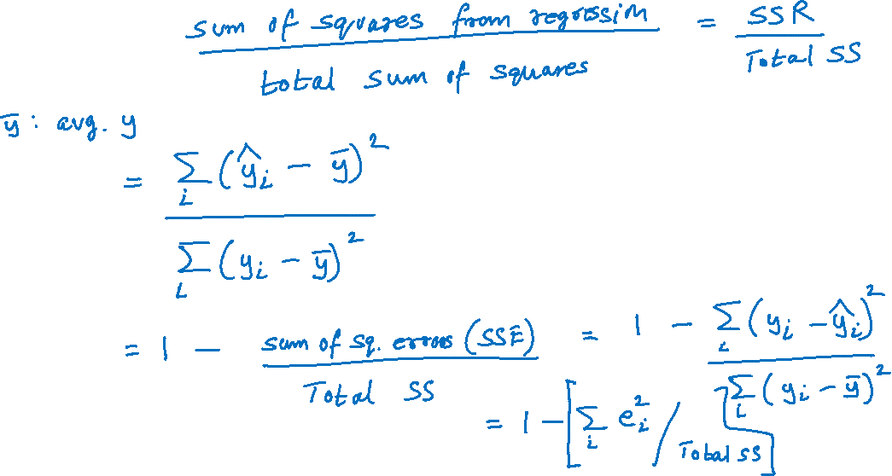
Coefficient of Determination (cont.)
$R^{2}=$

Slide 4

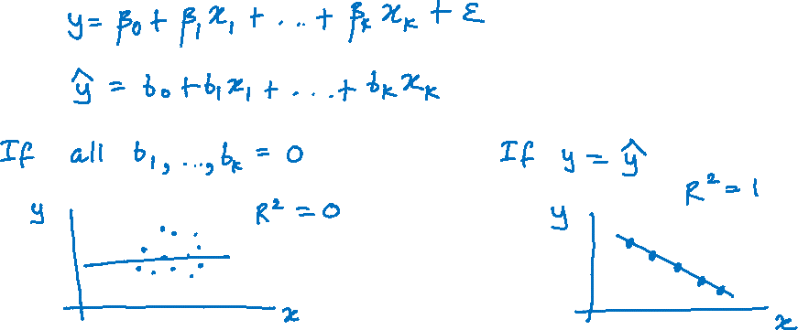
Coefficient of Determination (cont.)
We always have:
$0≤R^{2}$ $≤1$

Slide 5
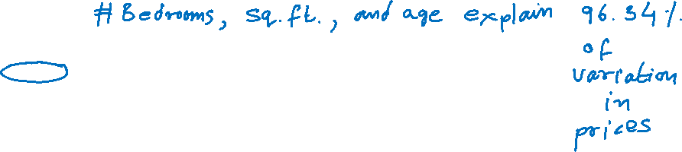
Coefficient of Determination (cont.)

Slide 6
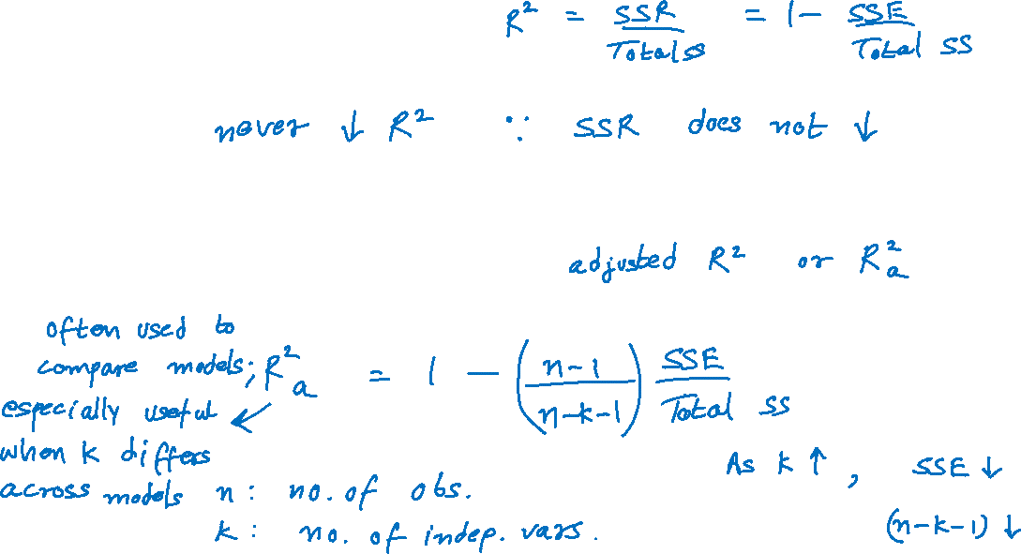
Adjusted R²
Adding more independent variables to a regression …
Modified measure that adjusts for the number of independent variables …

Slide 7
Adjusted R² (cont.)

